Slide 1
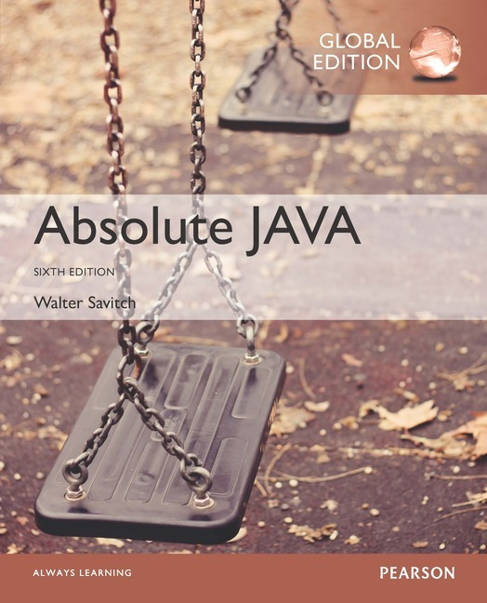
Chapter 1
Getting Started
Slides prepared by Rose Williams, Binghamton University
Kenrick Mock, University of Alaska Anchorage
Copyright © 2017 Pearson Ltd. All rights reserved.

Slide 2
Introduction To Java
Most people are familiar with Java as a language for Internet applications
We will study Java as a general purpose programming language
The syntax of expressions and assignments will be similar to that of other high-level languages
Details concerning the handling of strings and console output will probably be new

Slide 3
Origins of the Java Language
Created by Sun Microsystems team led by James Gosling in 1991 (now owned by Oracle)
Originally designed for programming home appliances
Difficult task because appliances are controlled by a wide variety of computer processors
Team developed a two-step translation process to simplify the task of compiler writing for each class of appliances

Slide 4
Origins of the Java Language
Significance of Java translation process
Writing a compiler (translation program) for each type of appliance processor would have been very costly
Instead, developed intermediate language that is the same for all types of processors : Java byte-code
Therefore, only a small, easy to write program was needed to translate byte-code into the machine code for each processor

Slide 5
Origins of the Java Language
Patrick Naughton and Jonathan Payne at Sun Microsystems developed a Web browser that could run programs over the Internet (1994)
Beginning of Java's connection to the Internet
Original browser evolves into HotJava
Netscape made its Web browser capable of running Java programs (1995)
Other companies follow suit

Slide 6
Objects and Methods
Java is an object-oriented programming (OOP) language
Programming methodology that views a program as consisting of objects that interact with one another by means of actions (called methods)
Objects of the same kind are said to have the same type or be in the same class

Slide 7
Terminology Comparisons
Other high-level languages have constructs called procedures, methods, functions, and/or subprograms
These types of constructs are called methods in Java
All programming constructs in Java, including methods, are part of a class

Slide 8


Essential “tools”

Slide 9
Java Application Programs
Two common types of Java programs are applications and applets
A Java application program or "regular" Java program is a class with a method named main
When a Java application program is run, the run-time system automatically invokes the method named main
All Java application programs start with the main method

Slide 10
Applets
A Java applet (little Java application) is a Java program that is meant to be run from a Web browser
Can be run from a location on the Internet
Can also be run with an applet viewer program for debugging
Applets always use a windowing interface
In contrast, application programs may use a windowing interface or console (i.e., text) I/O

Slide 11
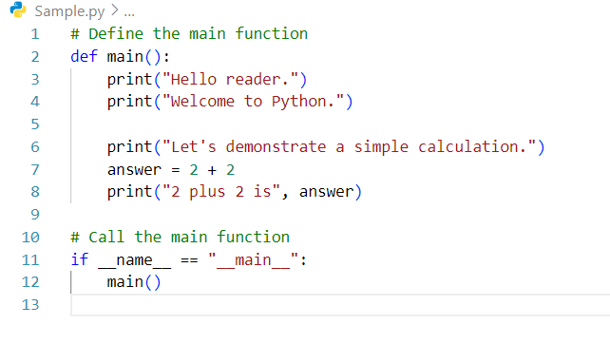
Sample Python Program

Slide 12
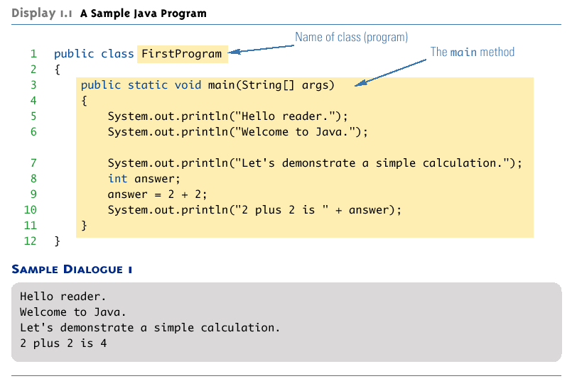
A Sample Java Application Program

Slide 13
Computer Language Levels
High-level language: A language that people can read, write, and understand
A program written in a high-level language must be translated into a language that can be understood by a computer before it can be run
Machine language: A language that a computer can understand
Low-level language: Machine language or any language similar to machine language
Compiler: A program that translates a high-level language program into an equivalent low-level language program
This translation process is called compiling

Slide 14
Byte-Code and the Java Virtual Machine
The compilers for most programming languages translate high-level programs directly into the machine language for a particular computer
Since different computers have different machine languages, a different compiler is needed for each one
In contrast, the Java compiler translates Java programs into byte-code, a machine language for a fictitious computer called the Java Virtual Machine
Once compiled to byte-code, a Java program can be used on any computer, making it very portable

Slide 15
Byte-Code and the Java Virtual Machine
Interpreter: The program that translates a program written in Java byte-code into the machine language for a particular computer when a Java program is executed
The interpreter translates and immediately executes each byte-code instruction, one after another
Translating byte-code into machine code is relatively easy compared to the initial compilation step
Most Java programs today run using a Just-In-Time or JIT compiler which compiles a section of byte-code at a time into machine code

Slide 16
Program terminology
Code: A program or a part of a program
Source code (or source program): A program written in a high-level language such as Java
The input to the compiler program
Object code: The translated low-level program
The output from the compiler program, e.g., Java byte-code
In the case of Java byte-code, the input to the Java byte-code interpreter

Slide 17
Class Loader
Java programs are divided into smaller parts called classes
Each class definition is normally in a separate file and compiled separately
Class Loader: A program that connects the byte-code of the classes needed to run a Java program
In other programming languages, the corresponding program is called a linker

Slide 18
Compiling a Java Program or Class
Each class definition must be in a file whose name is the same as the class name followed by .java
The class FirstProgram must be in a file named FirstProgram.java
Each class is compiled with the command javac followed by the name of the file in which the class resides
javac FirstProgram.java
The result is a byte-code program whose filename is the same as the class name followed by .class
FirstProgram.class

Slide 19
Running a Java Program
A Java program can be given the run command (java) after all its classes have been compiled
Only run the class that contains the main method (the system will automatically load and run the other classes, if any)
The main method begins with the line:
public static void main(String[ ] args)
Follow the run command by the name of the class only (no .java or .class extension)
java FirstProgram

Slide 20
Syntax and Semantics
Syntax: The arrangement of words and punctuations that are legal in a language, the grammar rules of a language
Semantics: The meaning of things written while following the syntax rules of a language

Slide 21
Tip: Error Messages
Bug: A mistake in a program
The process of eliminating bugs is called debugging
Syntax error: A grammatical mistake in a program
The compiler can detect these errors, and will output an error message saying what it thinks the error is, and where it thinks the error is

Slide 22
Tip: Error Messages
Run-time error: An error that is not detected until a program is run
The compiler cannot detect these errors: an error message is not generated after compilation, but after execution
Logic error: A mistake in the underlying algorithm for a program
The compiler cannot detect these errors, and no error message is generated after compilation or execution, but the program does not do what it is supposed to do

Slide 23
A Sample Java Application Program

Slide 24
System.out.println
Java programs work by having things called objects perform actions
System.out: an object used for sending output to the screen
The actions performed by an object are called methods
println: the method or action that the System.out object performs

Slide 25
System.out.println
Invoking or calling a method: When an object performs an action using a method
Also called sending a message to the object
Method invocation syntax (in order): an object, a dot (period), the method name, and a pair of parentheses
Arguments: Zero or more pieces of information needed by the method that are placed inside the parentheses
System.out.println("This is an argument");

Slide 26
Expressions and Assignment Statements

Slide 27
Importance of Expressions and Assignments
“Once a person has understood the way variables are used in programming, he has understood the quintessence of programming”
E.W DIJKSTRA, University of Texas 1969
Understanding the expressions & variables in a language will let you know how data flows through the code , and thus you will understand what the code is doing

Slide 28
Definitions
Variable: A variable in Java is a container that holds data that can be changed during the execution of a program. It has a name, a type, and a value.
int answer = 43;
Expression: An expression in Java is a combination of variables, operators, and values that evaluates to a single value. For example, a + b is an expression that adds the values of a and b.

Slide 29
Variable declarations
Variable declarations in Java are similar to those in other programming languages
Simply give the type of the variable followed by its name and a semicolon
int answer;

Slide 30
Identifiers
Identifier: The name of a variable or any other item (class, method, object, etc.) you may define in a program
Java Identifier Rules
A Java identifier must not start with a digit, and all the characters must be letters, digits, or the underscore symbol
Java identifiers can theoretically be of any length
Java is a case-sensitive language: Rate, rate, and RATE are the names of three different variables
The “$” symbol is allowed , but avoid using it for identifiers, because it has a special purpose.

Slide 31
Valid Identifier Examples
x
x1
x_1
_abc
ABC123z7
sum
RATE
Count
data2
bigBonus

Slide 32
Invalid Identifier Symbols
12
3X
%change
data-1
myfirst.java
PROG.CLASS

Slide 33
Naming Conventions
Start the names of variables, methods, and objects with a lowercase letter, indicate "word" boundaries with an uppercase letter, and restrict the remaining characters to digits and lowercase letters
topSpeed bankRate1 timeOfArrival
Start the names of classes with an uppercase letter and, otherwise, adhere to the rules above
FirstProgram MyClass String

Slide 34
Identifiers
Keywords and Reserved words: Identifiers that have a predefined meaning in Java
Do not use them to name anything else
public class void static
Predefined identifiers: Identifiers that are defined in libraries required by the Java language standard
Although they can be redefined, this could be confusing and dangerous if doing so would change their standard meaning
System String println
A full list is available in Appendix1 of the textbook.

Slide 35
Variable Declarations
Every variable in a Java program must be declared before it is used
A variable declaration tells the compiler what kind of data (type) will be stored in the variable
int numberOfCars; //compiler expects a whole number
double oneHeight, totalHeight;// compiler expects numbers with a decimal point
The type of the variable is followed by one or more variable names separated by commas, and terminated with a semicolon
Variables are typically declared just before they are used or at the start of a block (indicated by an opening brace { )
Basic types in Java are called primitive types
int numberOfBeans;
double oneWeight, totalWeight;

Slide 36
Primitive Types in Java:
Primitive types in Java are the most basic data types built into the language. They are not objects and hold their values directly in memory. They are predefined by the language and named by a reserved keyword.

Slide 37
Primitive &Basic Types
These are basic java types for characters , integers, floating-point numbers, as well as a type for True/False values.
“int” is preferred for integers/whole numbers
“char” for single characters
“double” for floating-point numbers
“boolean” for true and false
Class “String” for strings of characters put together, however String is NOT a primitive type , but is often considered a basic type along with the primitive types.

Slide 38
Examples
boolean tadiwaIsTheBestLecturer = True;
char singleCharacter = ‘%’; //char can store any Unicode Character
double deCimal7 = 3.64;
double de_cimul = 2;
String sampleString = “This is a test”;

Slide 39
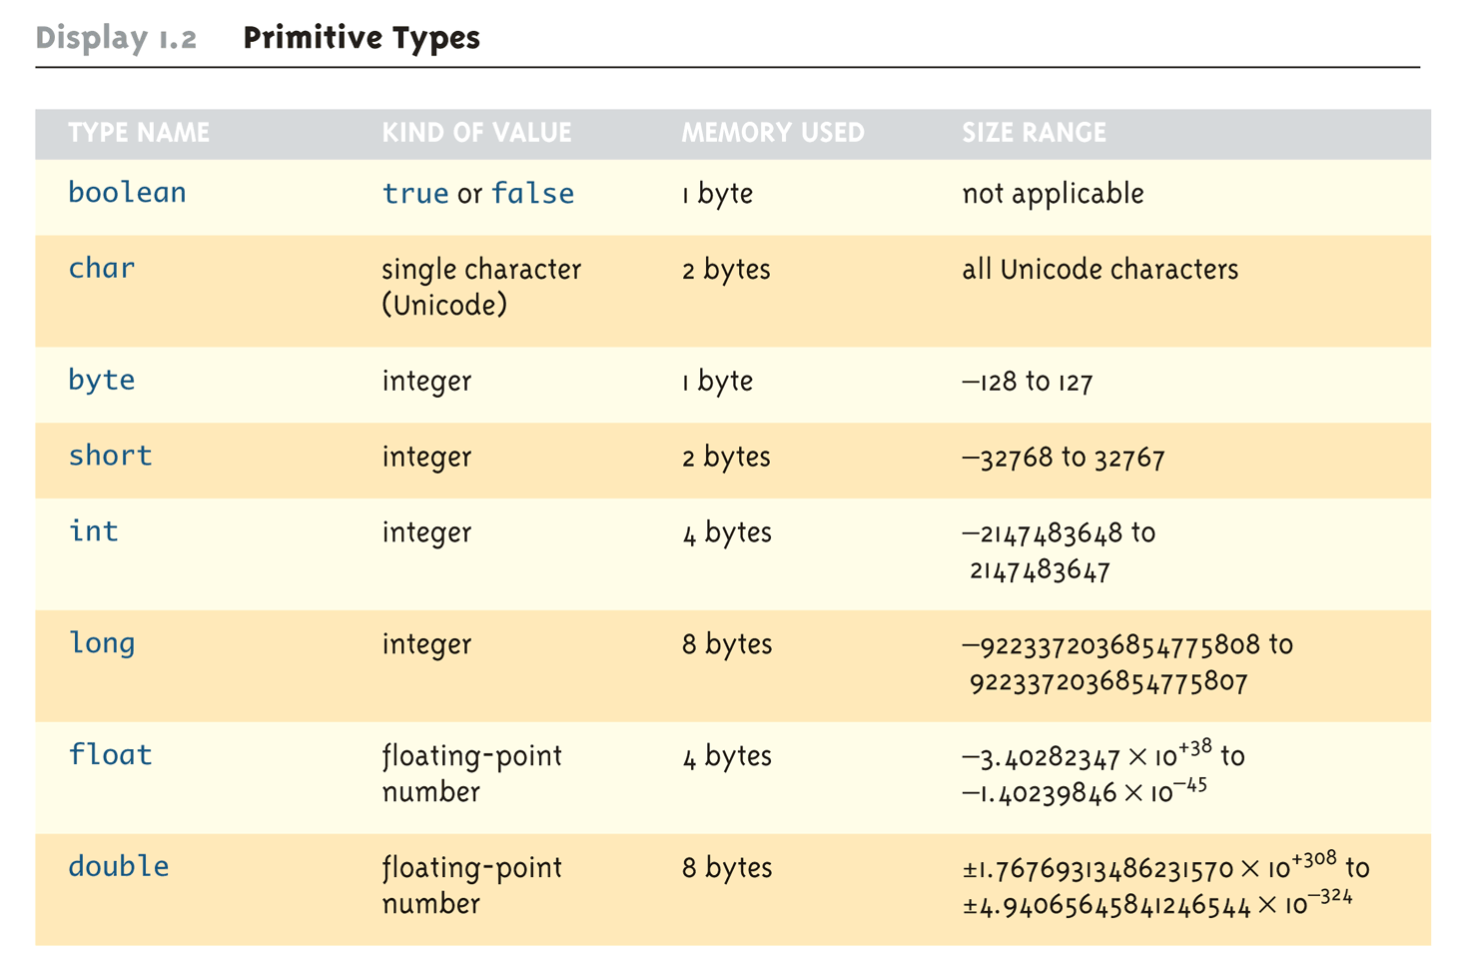
Primitive Types

Slide 40
Using = and +
In Java, the equal sign (=) is used as the assignment operator
The variable on the left side of the assignment operator is assigned the value of the expression on the right side of the assignment operator
answer = 2 + 2;
In Java, the plus sign (+) can be used to denote addition (as above) or concatenation
Using +, two strings can be connected together
System.out.println("2 plus 2 is " + answer);

Slide 41
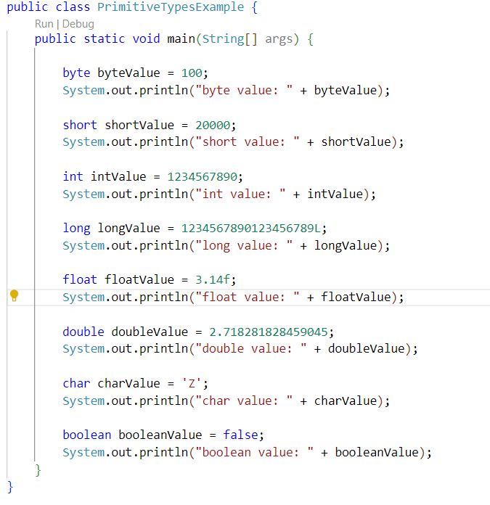
Using = and +

Slide 42
Assignment Statements With Primitive Types
In Java, the assignment statement is used to change the value of a variable
The equal sign (=) is used as the assignment operator
An assignment statement consists of a variable on the left side of the operator, and an expression on the right side of the operator
Variable = Expression;
An expression consists of a variable, number, or mix of variables, numbers, operators, and/or method invocations
int height=10, total, weight=45;
total = height * weight;
temperature = 98.6;
count = numberOfBeans;

Slide 43
Assignment Statements With Primitive Types
When an assignment statement is executed, the expression is first evaluated, and then the variable on the left-hand side of the equal sign is set equal to the value of the expression
distance = rate * time;
Note that a variable can occur on both sides of the assignment operator
count = count + 2;
The assignment operator is automatically executed from right-to-left, so assignment statements can be chained
number2 = number1 = 3;

Slide 44
Tip: Initialize Variables
Declaring and Initializing variables are 2 different things
Declaring : int count;
Initializing : count = 5;
A variable that has been declared but that has not yet been given a value by some means is said to be uninitialized
In certain cases an uninitialized variable is given a default value
It is best not to rely on this
Explicitly initialized variables have the added benefit of improving program clarity

Slide 45
Tip: Initialize Variables
The declaration of a variable can be combined with its initialization via an assignment statement
int count = 0;
double distance = 55 * .5;
char grade = 'A';
Note that some variables can be initialized and others can remain uninitialized in the same declaration
int initialCount = 50, finalCount;
So remember , declare then initialize , or do both at the same time but never initialize what you haven’t declared

Slide 46
Shorthand Assignment Statements
Shorthand assignment notation combines the assignment operator (=) and an arithmetic operator
It is used to change the value of a variable by adding, subtracting, multiplying, or dividing by a specified value
The general form is
Variable Op = Expression
which is equivalent to
Variable = Variable Op (Expression)
The Expression can be another variable, a constant, or a more complicated expression
Some examples of what Op can be are +, -, *, /, or %

Slide 47
Shorthand Assignment Statements
Example: | Equivalent To:
count += 2; | count = count + 2;
sum -= discount; | sum = sum – discount;
bonus *= 2; | bonus = bonus * 2;
time /= rushFactor; | time = time / rushFactor;
change %= 100; | change = change % 100;
amount *= count1 + count2; | amount = amount * (count1 + count2);

Slide 48
Assignment Compatibility
In general, the value of one type cannot be stored in a variable of another type
int intVariable = 2.99; //Illegal
The above example results in a type mismatch because a double value cannot be stored in an int variable
However, there are exceptions to this
double doubleVariable = 2;
For example, an int value can be stored in a double type
🫡

Slide 49
Assignment Compatibility
More generally, a value of any type in the following list can be assigned to a variable of any type that appears to the right of it
byte→short→char→int→long→float→double
Note that as your move down the list from left to right, the range of allowed values for the types becomes larger
An explicit type cast is required to assign a value of one type to a variable whose type appears to the left of it on the above list (e.g., double to int)
Note that in Java an int cannot be assigned to a variable of type boolean, nor can a boolean be assigned to a variable of type int

Slide 50
Assignment Compatibility
byte→short→char→int→long→float→double
int number = 221.3;❌//double
int number = 221; 😁//int
long num = 42; 😁//int
long num = 42352435342; 😁//long
number = num;❌ //long into num🤢
double anotherDecimal = 2323; 😁
char exampleCharacter = 32;😁
char anotherCharacter = 545235243;😁

Slide 51
Constants
Constant (or literal): An item in Java which has one specific value that cannot change
Constants of an integer type may not be written with a decimal point (e.g., 10)
Constants of a floating-point type can be written in ordinary decimal fraction form (e.g., 367000.0 or 0.000589)
Constant of a floating-point type can also be written in scientific (or floating-point) notation (e.g., 3.67e5 or 5.89e-4)
Note that the number before the e may contain a decimal point, but the number after the e may not

Slide 52
Constants
Constants of type char are expressed by placing a single character in single quotes (e.g., 'Z')
Constants for strings of characters are enclosed by double quotes (e.g., "Welcome to Java")
There are only two boolean type constants, true and false
Note that they must be spelled with all lowercase letters

Slide 53
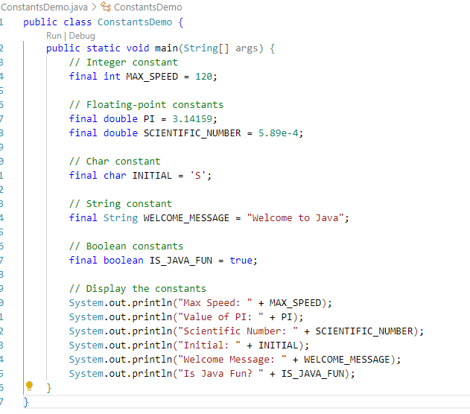
Constants Example

Slide 54
Arithmetic Operators and Expressions
As in most languages, expressions can be formed in Java using variables, constants, and arithmetic operators
These operators are + (addition), - (subtraction), * (multiplication), / (division), and % (modulo, remainder)
An expression can be used anyplace it is legal to use a value of the type produced by the expression

Slide 55
Arithmetic Operators and Expressions
If an arithmetic operator is combined with int operands, then the resulting type is int
If an arithmetic operator is combined with one or two double operands, then the resulting type is double
If different types are combined in an expression, then the resulting type is the right-most type on the following list that is found within the expression
byte→short→char→int→long→float→double
Exception: If the type produced should be byte or short (according to the rules above), then the type produced will actually be an int

Slide 56
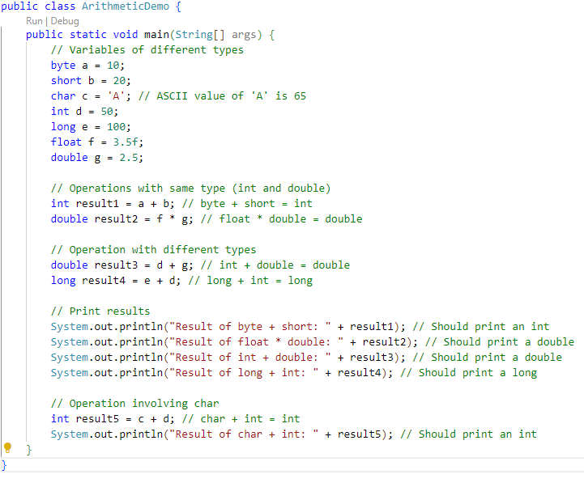
Arithmetic Demo

Slide 57
Increment and Decrement Operators
The increment operator (++) adds one to the value of a variable
If n is equal to 2, then n++ or ++n will change the value of n to 3
The decrement operator (--) subtracts one from the value of a variable
If n is equal to 4, then n-- or --n will change the value of n to 3

Slide 58
Increment and Decrement Operators
When either operator precedes its variable, and is part of an expression, then the expression is evaluated using the changed value of the variable
If n is equal to 2, then 2*(++n) evaluates to 6
When either operator follows its variable, and is part of an expression, then the expression is evaluated using the original value of the variable, and only then is the variable value changed
If n is equal to 2, then 2*(n++) evaluates to 4

Slide 59
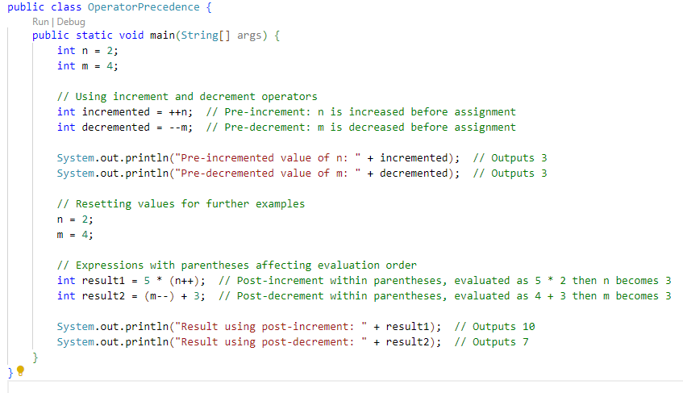
Example

Slide 60
Parentheses and Precedence Rules
An expression can be fully parenthesized in order to specify exactly what subexpressions are combined with each operator
If some or all of the parentheses in an expression are omitted, Java will follow precedence rules to determine, in effect, where to place them
However, it's best (and sometimes necessary) to include them

Slide 61
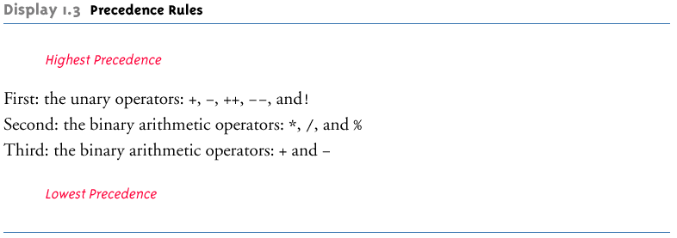
Precedence Rules

Slide 62
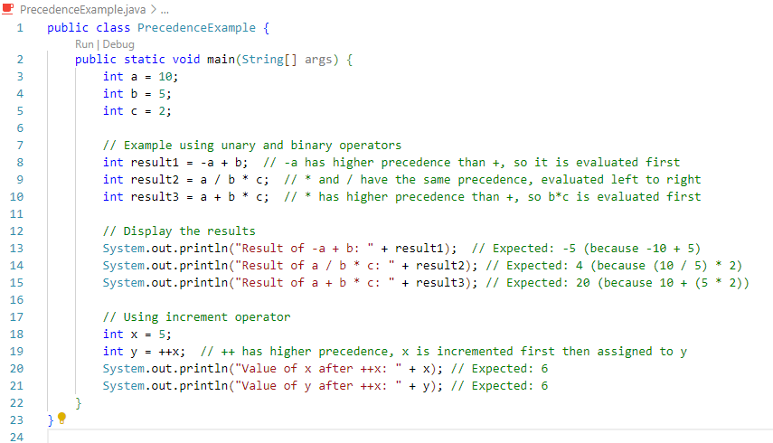
Precedence Examples

Slide 63
Precedence and Associativity Rules
When the order of two adjacent operations must be determined, the operation of higher precedence (and its apparent arguments) is grouped before the operation of lower precedence
base + rate * hours is evaluated as
base + (rate * hours)
When two operations have equal precedence, the order of operations is determined by associativity rules

Slide 64
Precedence and Associativity Rules
Unary operators of equal precedence are grouped right-to-left
+-+rate is evaluated as +(-(+rate))
Binary operators of equal precedence are grouped left-to-right
base + rate + hours is evaluated as
(base + rate) + hours
Exception: A string of assignment operators is grouped right-to-left
n1 = n2 = n3; is evaluated as n1 = (n2 = n3);

Slide 65
Pitfall: Round-Off Errors in Floating-Point Numbers
Floating point numbers are only approximate quantities
Mathematically, the floating-point number 1.0/3.0 is equal to 0.3333333 . . .
A computer has a finite amount of storage space
It may store 1.0/3.0 as something like 0.3333333333, which is slightly smaller than one-third
Computers actually store numbers in binary notation, but the consequences are the same: floating-point numbers may lose accuracy

Slide 66
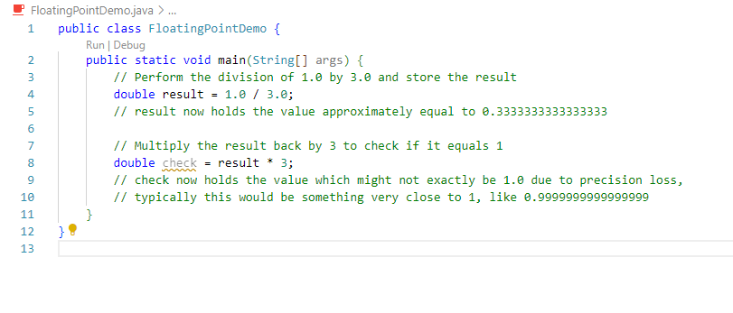
Floating Point Error example

Slide 67
Integer and Floating-Point Division
When one or both operands are a floating-point type, division results in a floating-point type
15.0/2 evaluates to 7.5
When both operands are integer types, division results in an integer type
Any fractional part is discarded
The number is not rounded
15/2 evaluates to 7
Be careful to make at least one of the operands a floating-point type if the fractional portion is needed

Slide 68
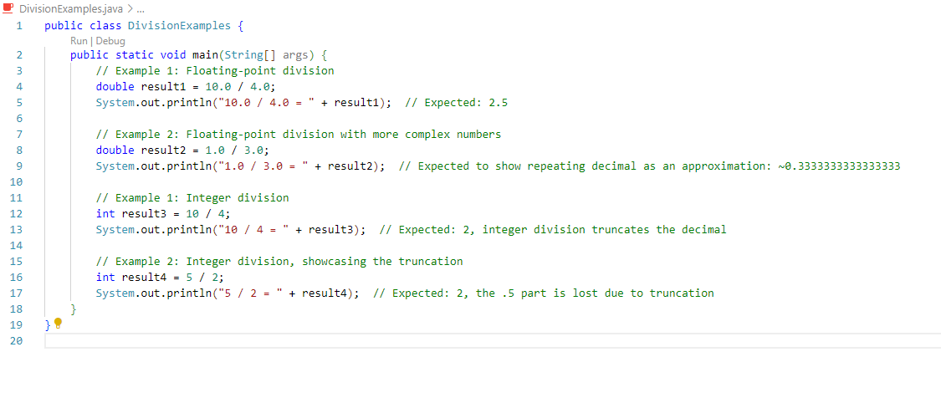
Division issue example Example

Slide 69
The % Operator
The % operator is used with operands of type int to recover the information lost after performing integer division
15/2 evaluates to the quotient 7
15%2 evaluates to the remainder 1
The % operator can be used to count by 2's, 3's, or any other number
To count by twos, perform the operation number % 2, and when the result is 0, number is even

Slide 70
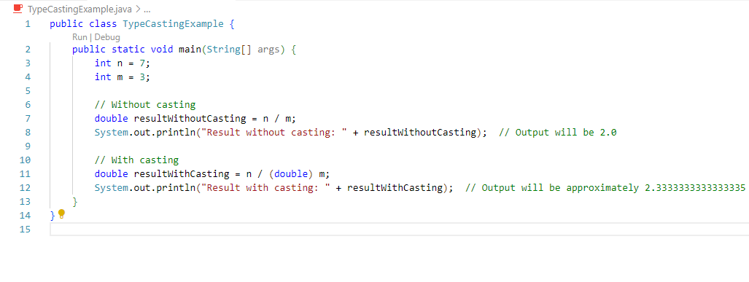
Type Casting
A type cast takes a value of one type and produces a value of another type with an "equivalent" value
If n and m are integers to be divided, and the fractional portion of the result must be preserved, at least one of the two must be type cast to a floating-point type before the division operation is performed
double ans = n / (double)m;
Note that the desired type is placed inside parentheses immediately in front of the variable to be cast
Note also that the type and value of the variable to be cast does not change

Slide 71
More Details About Type Casting
When type casting from a floating-point to an integer type, the number is truncated, not rounded
(int)2.9 evaluates to 2, not 3
When the value of an integer type is assigned to a variable of a floating-point type, Java performs an automatic type cast called a type coercion
Type Coersion works using these uses of order:
byte→short→char→int→long→float→double
double d = 5;
In contrast, it is illegal to place a double value into an int variable without an explicit type cast
int i = 5.5; // Illegal
int i = (int)5.5 // Correct

Slide 72
The Class String
There is no primitive type for strings in Java
The name ‘String’ comes from the fact Strings store strings of characters. Like stringing up ‘m’ , ‘e’, ‘s’, ‘s’, and ‘i’ would give you “messi”.
The class String is a predefined class in Java that is used to store and process strings
Objects of type String are made up of strings of characters that are written within double quotes
Any quoted string is a constant of type String
"Live long and prosper."
A variable of type String can be given the value of a String object
String blessing = "Live long and prosper.";

Slide 73
Concatenation of Strings
Concatenation: Using the + operator on two strings in order to connect them to form one longer string
If greeting is equal to "Hello ", and javaClass is equal to "class", then greeting + javaClass is equal to "Hello class"
Any number of strings can be concatenated together
When a string is combined with almost any other type of item, the result is a string
"The answer is " + 42 evaluates to
"The answer is 42"

Slide 74
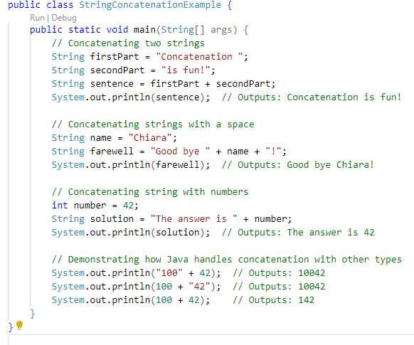
Example

Slide 75
Classes, Objects, and Methods
In Java, primitive types like int and boolean are simple data holders that store values directly and operate quickly.
They don’t have methods or attributes. Classes, on the other hand, are blueprints for creating objects that can include methods and attributes, and they support more complex behaviors and data management.
Objects from classes are passed by reference, allowing interactions and modifications directly on the original object.
A class is the name for a type whose values are objects
Objects are entities that store data and take actions
Objects of the String class store data consisting of strings of characters
The actions that an object can take are called methods
Methods can return a value of a single type and/or perform an action
All objects within a class have the same methods, but each can have different data values

Slide 76
Example: A Car
Class:
Car - Consider the class as a blueprint. It defines what a car is in general. It doesn't describe a specific car but outlines the properties (like color, make, model) and behaviors (like driving, braking) that any car will have.
Objects:
myCar - An object is a specific instance of a class. If the class is a blueprint, an object is a real building made from that blueprint. For example, your personal car is an object of the class Car. It has specific characteristics like being a red Honda Civic.
Methods:
drive(), brake(), turnOnLights() - These are actions that the car can perform. Methods define what type of functionality an object of a class can have. For example, all cars can drive, so drive() is a method of the class Car. When you perform myCar.drive(), you are using the Car class method to drive your specific car.
In this way, a class defines properties and methods, an object is an instance of that class with specific values for those properties, and methods are actions that objects can perform.

Slide 77
Classes, Objects, and Methods
Invoking or calling a method: a method is called into action by writing the name of the calling object, followed by a dot, followed by the method name, followed by parentheses
This is sometimes referred to as sending a message to the object
The parentheses contain the information (if any) needed by the method
This information is called an argument (or arguments)

Slide 78
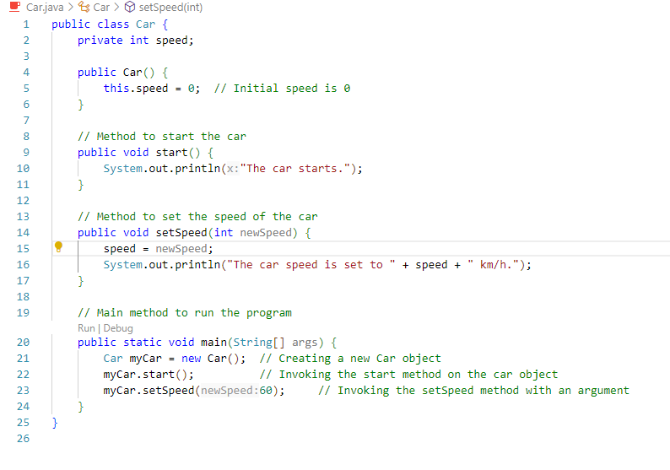
Class, Object, and Methods example

Slide 79
String Methods
The String class contains many useful methods for string-processing applications
A String method is called by writing a String object, a dot, the name of the method, and a pair of parentheses to enclose any arguments
If a String method returns a value, then it can be placed anywhere that a value of its type can be used
String greeting = "Hello";
int count = greeting.length();
System.out.println("Length is " + greeting.length());
Always count from zero when referring to the position or index of a character in a string

Slide 80
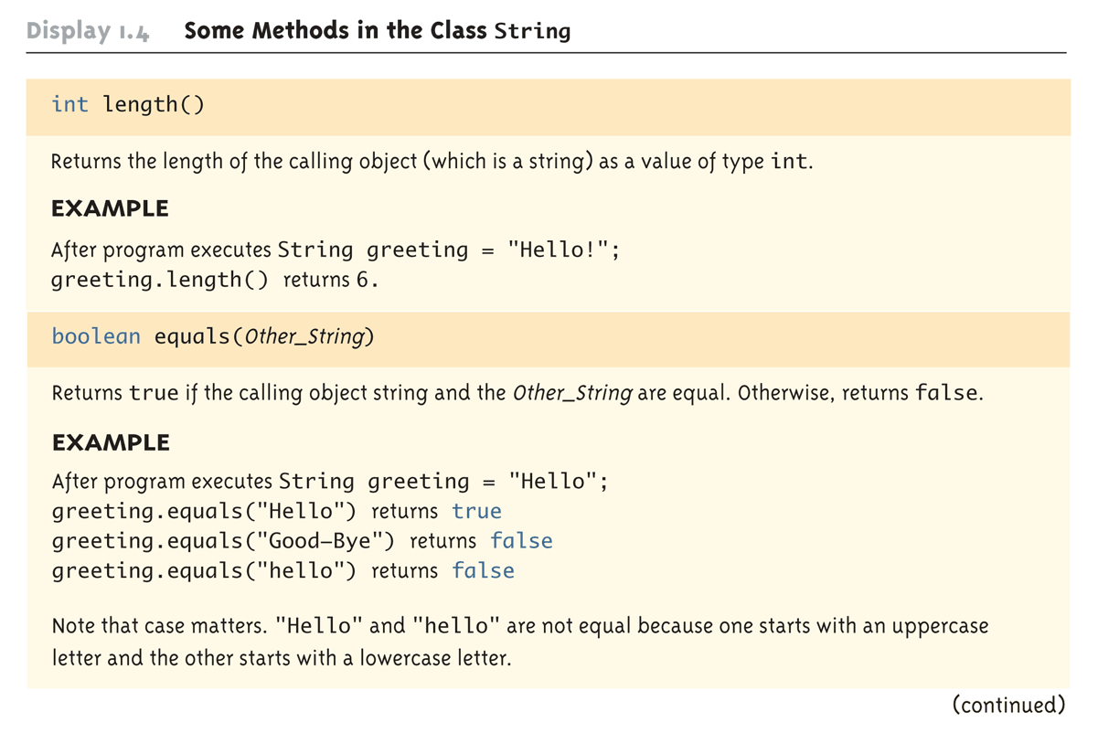
Some Methods in the Class String (Part 1 of 8)

Slide 81
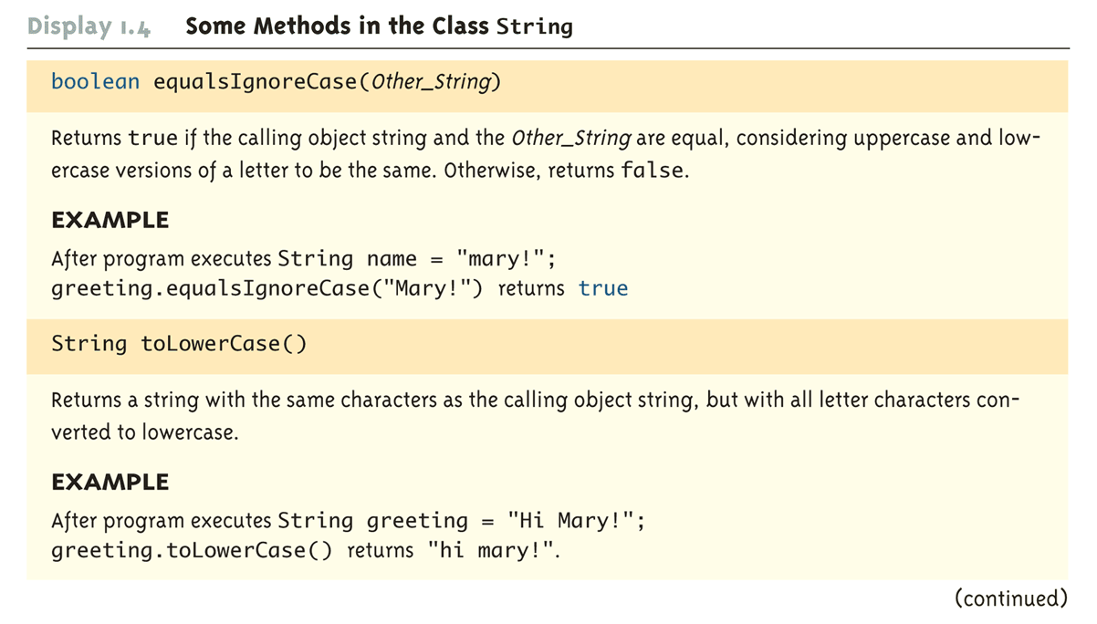
Some Methods in the Class String (Part 2 of 8)

Slide 82
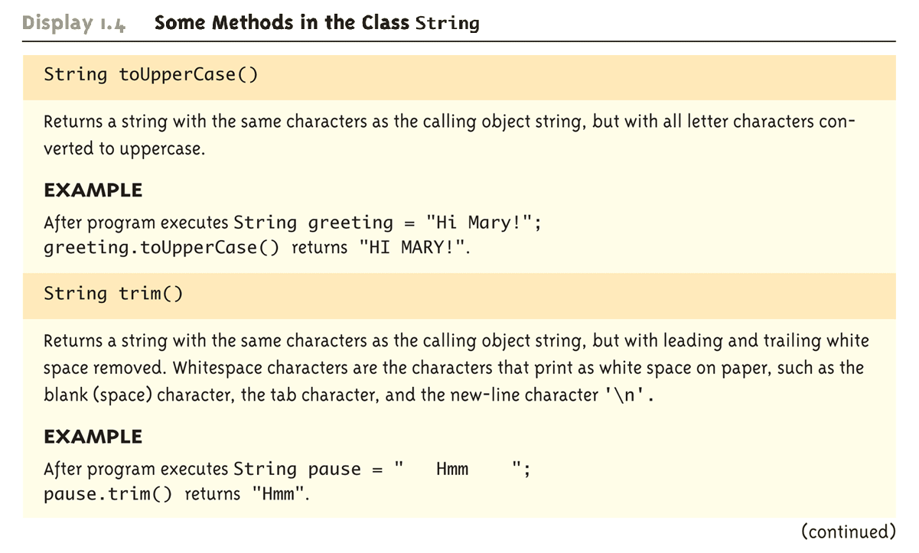
Some Methods in the Class String (Part 3 of 8)

Slide 83
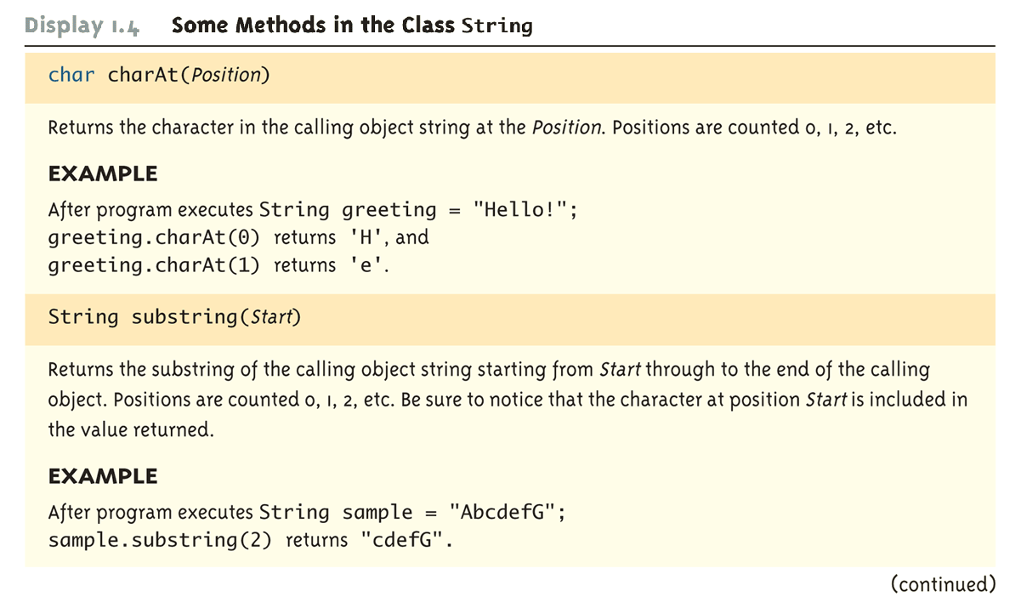
Some Methods in the Class String (Part 4 of 8)

Slide 84
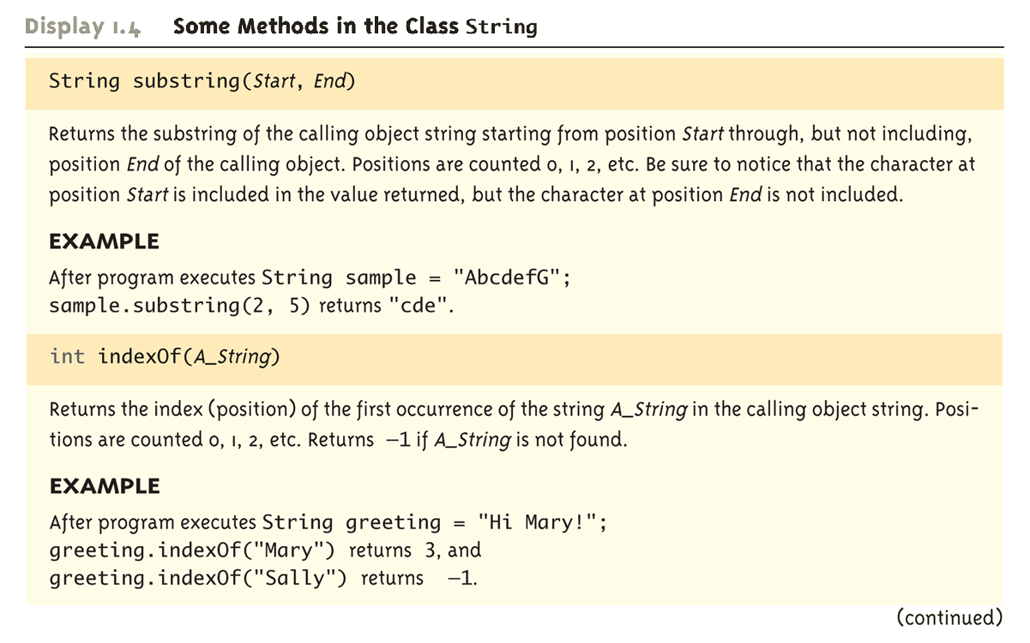
Some Methods in the Class String (Part 5 of 8)

Slide 85
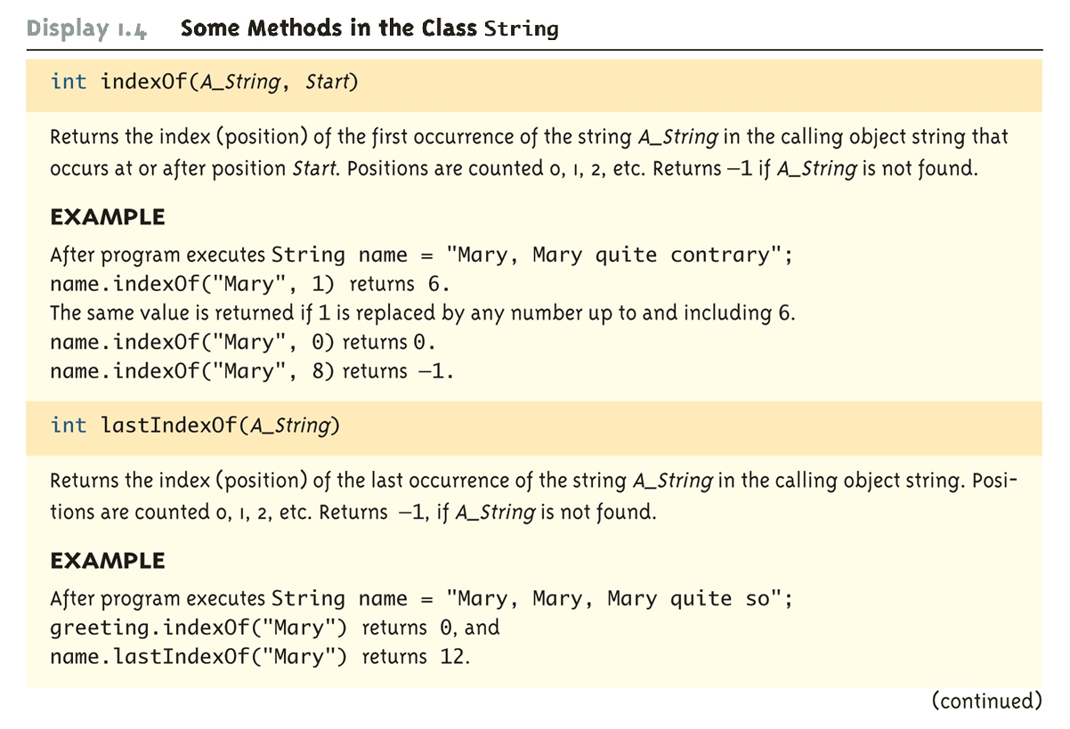
Some Methods in the Class String (Part 6 of 8)

Slide 86
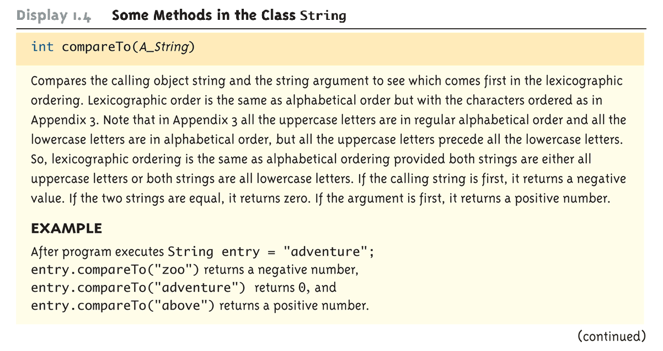
Some Methods in the Class String (Part 7 of 8)

Slide 87
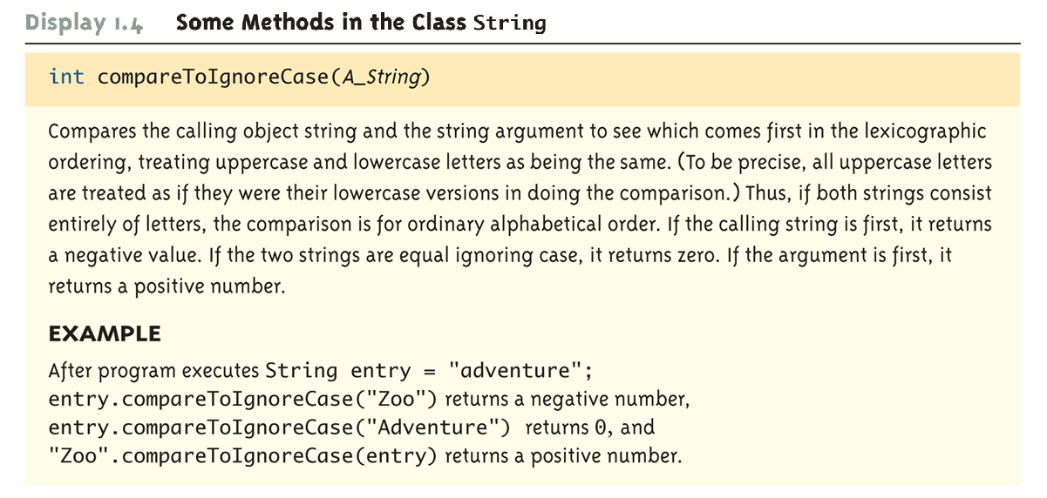
Some Methods in the Class String (Part 8 of 8)

Slide 88
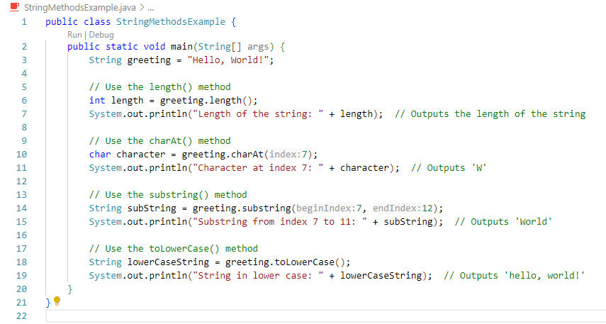
Example

Slide 89
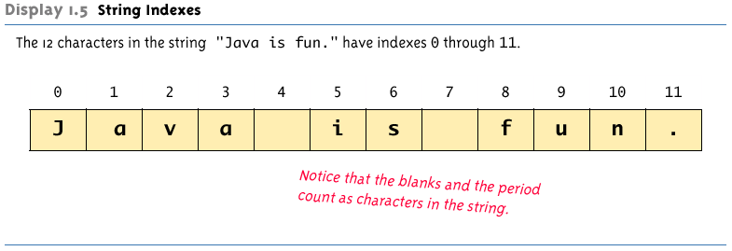
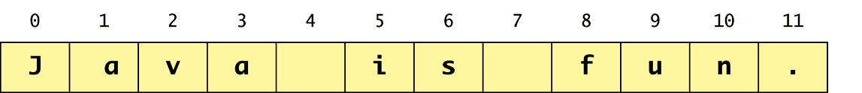
String Indexes

Slide 90
Escape Sequences
A backslash(\) tells the compiler that the character following the \ does not have it’s usual meaning.
A backslash (\) immediately preceding a character (i.e., without any space) denotes an escape sequence or an escape character
The character following the backslash does not have its usual meaning
Although it is formed using two symbols, it is regarded as a single character

Slide 91
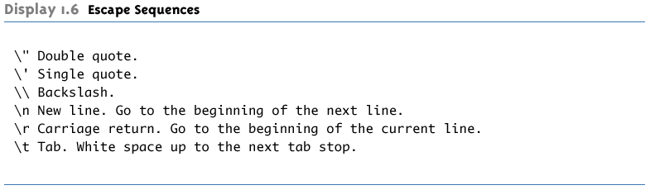
Escape Sequences

Slide 92
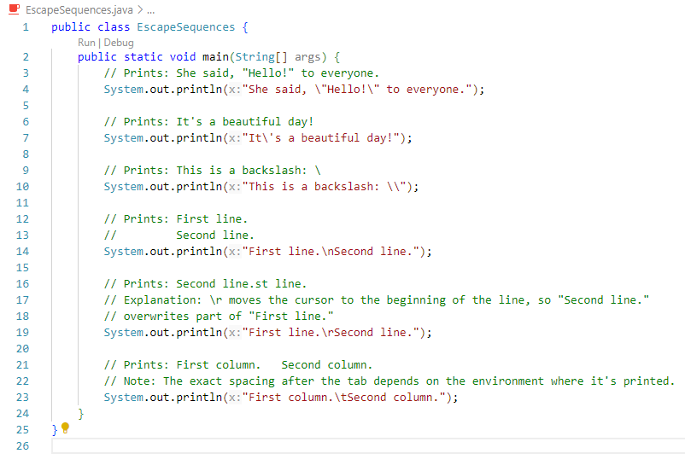
Escape Sequences Example

Slide 93
String Processing
A String object in Java is considered to be immutable, i.e., the characters it contains cannot be changed
There is another class in Java called StringBuffer that has methods for editing its string objects
However, it is possible to change the value of a String variable by using an assignment statement
String name = "Soprano";
name = "Anthony " + name;

Slide 94
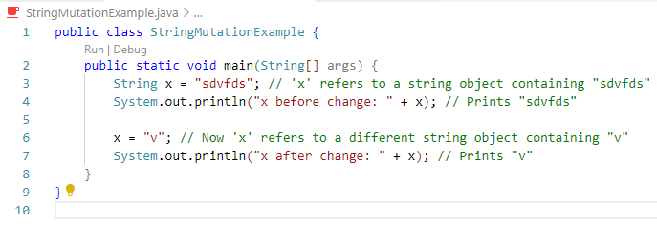
String Mutability

Slide 95
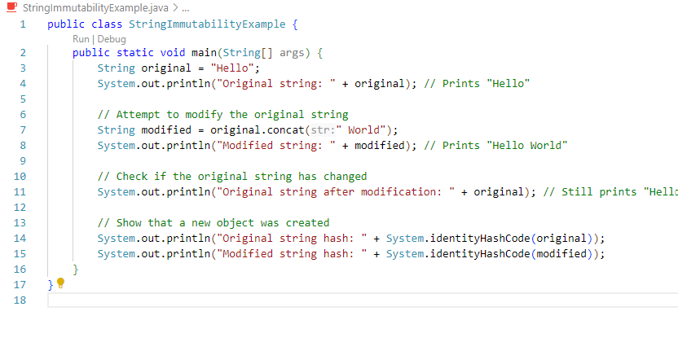
String Immutability Example

Slide 96
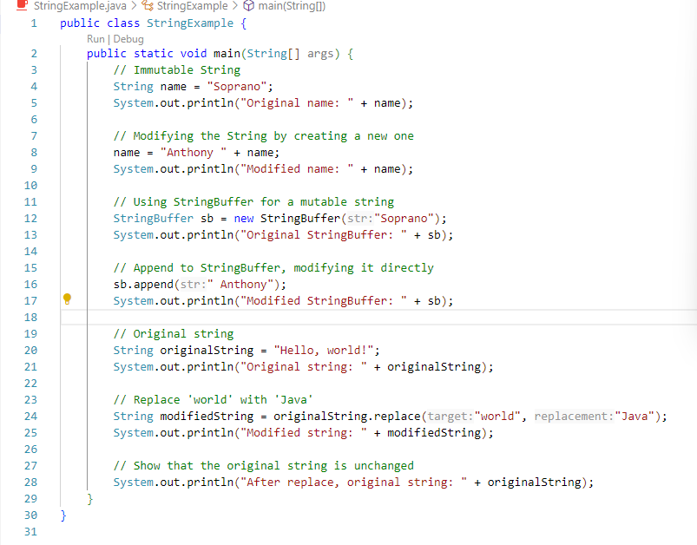
String Processing Example

Slide 97
Character Sets
ASCII: A character set used by many programming languages that contains all the characters normally used on an English-language keyboard, plus a few special characters
Each character is represented by a particular number
Unicode: A character set used by the Java language that includes all the ASCII characters plus many of the characters used in languages with a different alphabet from English

Slide 98
Naming Constants
Instead of using "anonymous" numbers in a program, always declare them as named constants, and use their name instead
public static final int INCHES_PER_FOOT = 12;
public static final double RATE = 0.14;
This prevents a value from being changed inadvertently
It has the added advantage that when a value must be modified, it need only be changed in one place
Note the naming convention for constants: Use all uppercase letters, and designate word boundaries with an underscore character

Slide 99
Comments
A line comment begins with the symbols //, and causes the compiler to ignore the remainder of the line
This type of comment is used for the code writer or for a programmer who modifies the code
A block comment begins with the symbol pair /*, and ends with the symbol pair */
The compiler ignores anything in between
This type of comment can span several lines
This type of comment provides documentation for the users of the program

Slide 100
Program Documentation
Java comes with a program called javadoc that will automatically extract documentation from block comments in the classes you define
As long as their opening has an extra asterisk (/**)
Ultimately, a well written program is self-documenting
Its structure is made clear by the choice of identifier names and the indenting pattern
When one structure is nested inside another, the inside structure is indented one more level

Slide 101
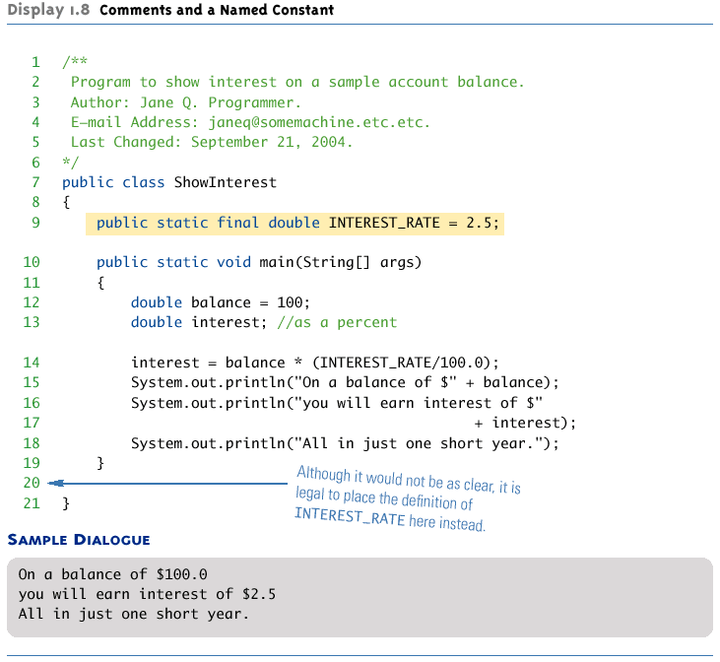
Comments and a Named Constant

