Slide 1
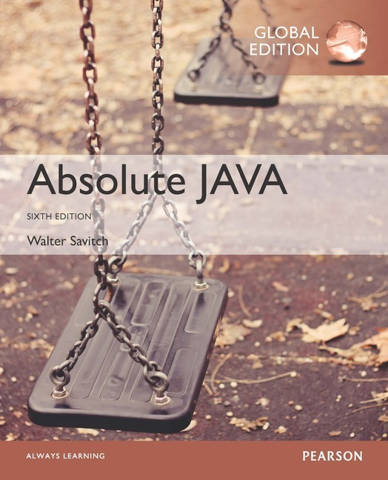
Chapter 7
Inheritance
Copyright © 2017 Pearson Ltd. All rights reserved.

Slide 2
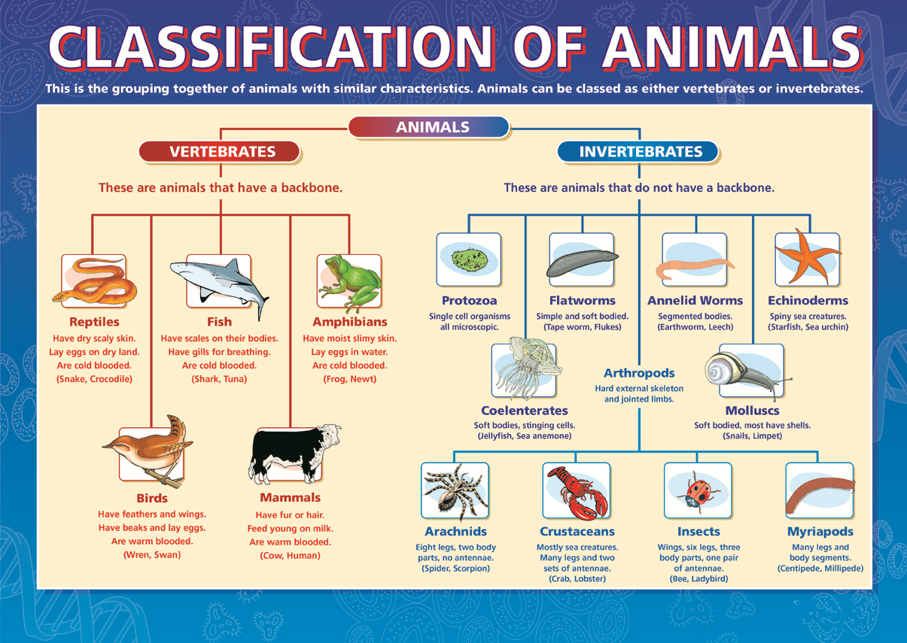

Slide 3
What do the following have in common?
Lecturer, Vice-chancellor, Post-grad student, undergrad student, scientific officer?
People at a University
Cheque, savings, investment, credit-card, home loan
Accounts offered by a bank
Human, polar bear, horse, beaver, dolphin
All mammals
Burj Khalifa, Mount Everest, Angel Falls, Redwood tree.
Tallest objects

Slide 4
Introduction to Inheritance
Inheritance is one of the main techniques of object-oriented programming (OOP)
Using this technique, a very general form of a class is first defined and compiled, and then more specialized versions of the class are defined by adding instance variables and methods
The specialized classes are said to inherit the methods and instance variables of the general class

Slide 5
Introduction to Inheritance
Inheritance is the process by which a new class is created from another class
The new class is called a derived class (or child class)
The original class is called the base class (or parent class)
A derived class automatically has all the instance variables and methods that the base class has, and it can have additional methods and/or instance variables as well
Inheritance is especially advantageous because it allows code to be reused, without having to copy it into the definitions of the derived classes

Slide 6
Derived (Child) Classes
When designing certain classes, there is often a natural hierarchy for grouping them
In a record-keeping program for the employees of a company, there are hourly employees and salaried employees
Hourly employees can be divided into full time and part time workers
Salaried employees can be divided into those on technical staff, and those on the executive staff

Slide 7
Derived Classes
All employees share certain characteristics in common
All employees have a name and a hire date
The methods for setting and changing names and hire dates would be the same for all employees
Some employees have specialized characteristics
Hourly employees are paid an hourly wage, while salaried employees are paid a fixed wage
The methods for calculating wages for these two different groups would be different

Slide 8
Derived Classes
Within Java, a class called Employee can be defined that includes all employees
This class can then be used to define classes for hourly employees and salaried employees
In turn, the HourlyEmployee class can be used to define a PartTimeHourlyEmployee class, and so forth

Slide 9
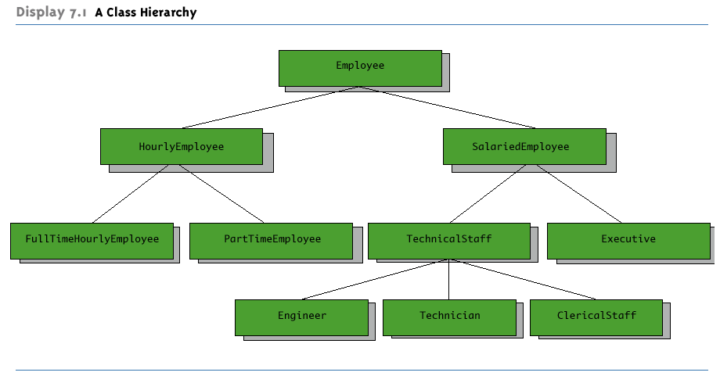
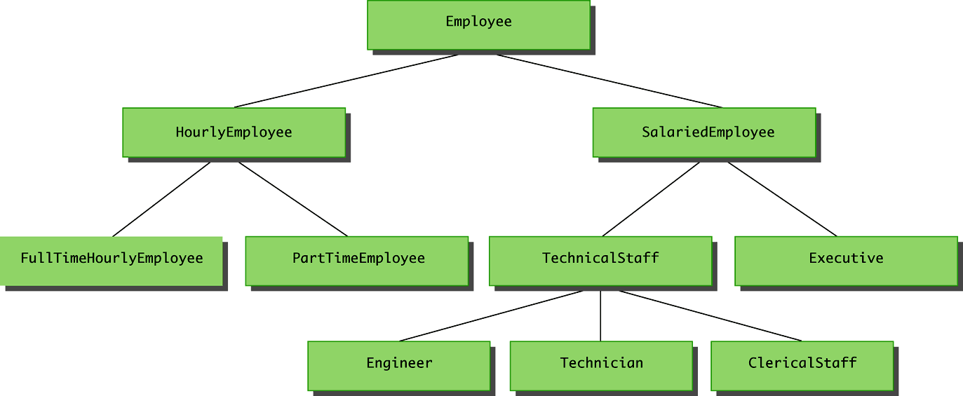
A Class Hierarchy

Slide 10
Derived Classes
Since an hourly employee is an employee, it is defined as a derived class of the class Employee
A derived class is defined by adding instance variables and methods to an existing class
The existing class that the derived class is built upon is called the base class
The phrase extends BaseClass must be added to the derived class definition:
public class HourlyEmployee extends Employee

Slide 11
Derived Classes
When a derived class is defined, it is said to inherit the instance variables and methods of the base class that it extends
Class Employee defines the instance variables name and hireDate in its class definition
Class HourlyEmployee also has these instance variables, but they are not specified in its class definition
Class HourlyEmployee has additional instance variables wageRate and hours that are specified in its class definition

Slide 12
Derived Classes
Just as it inherits the instance variables of the class Employee, the class HourlyEmployee inherits all of its methods as well
The class HourlyEmployee inherits the methods getName, getHireDate, setName, and setHireDate from the class Employee
Any object of the class HourlyEmployee can invoke one of these methods, just like any other method

Slide 13
Derived Class (Subclass)
A derived class, also called a subclass, is defined by starting with another already defined class, called a base class or superclass, and adding (and/or changing) methods, instance variables, and static variables
The derived class inherits all the public methods, all the public and private instance variables, and all the public and private static variables from the base class
The derived class can add more instance variables, static variables, and/or methods

Slide 14
Inherited Members
A derived class automatically has all the instance variables, all the static variables, and all the public methods of the base class
Members from the base class are said to be inherited
Definitions for the inherited variables and methods do not appear in the derived class
The code is reused without having to explicitly copy it, unless the creator of the derived class redefines one or more of the base class methods

Slide 15
Parent and Child Classes
A base class is often called the parent class
A derived class is then called a child class
These relationships are often extended such that a class that is a parent of a parent . . . of another class is called an ancestor class
If class A is an ancestor of class B, then class B can be called a descendent of class A

Slide 16
Overriding a Method Definition
Although a derived class inherits methods from the base class, it can change or override an inherited method if necessary
In order to override a method definition, a new definition of the method is simply placed in the class definition, just like any other method that is added to the derived class

Slide 17
Changing the Return Type of an Overridden Method
Ordinarily, the type returned may not be changed when overriding a method
However, if it is a class type, then the returned type may be changed to that of any descendent class of the returned type
This is known as a covariant return type
Covariant return types are new in Java 5.0; they are not allowed in earlier versions of Java

Slide 18
Covariant Return Type
Given the following base class:
public class BaseClass
{ . . .
public Employee getSomeone(int someKey)
. . .
The following is allowed in Java 5.0:
public class DerivedClass extends BaseClass
{ . . .
public HourlyEmployee getSomeone(int someKey)
. . .

Slide 19
Changing the Access Permission of an Overridden Method
The access permission of an overridden method can be changed from private in the base class to public (or some other more permissive access) in the derived class
However, the access permission of an overridden method can not be changed from public in the base class to a more restricted access permission in the derived class

Slide 20
Changing the Access Permission of an Overridden Method
Given the following method header in a base case:
private void doSomething()
The following method header is valid in a derived class:
public void doSomething()
However, the opposite is not valid
Given the following method header in a base case:
public void doSomething()
The following method header is not valid in a derived class:
private void doSomething()

Slide 21
Pitfall: Overriding Versus Overloading
Do not confuse overriding a method in a derived class with overloading a method name
When a method is overridden, the new method definition given in the derived class has the exact same number and types of parameters as in the base class
When a method in a derived class has a different signature from the method in the base class, that is overloading
Note that when the derived class overloads the original method, it still inherits the original method from the base class as well

Slide 22
The final Modifier
If the modifier final is placed before the definition of a method, then that method may not be redefined in a derived class
It the modifier final is placed before the definition of a class, then that class may not be used as a base class to derive other classes

Slide 23
The super Constructor
A derived class uses a constructor from the base class to initialize all the data inherited from the base class
In order to invoke a constructor from the base class, it uses a special syntax:
public derivedClass(int p1, int p2, double p3)
{
super(p1, p2);
instanceVariable = p3;
}
In the above example, super(p1, p2); is a call to the base class constructor

Slide 24
The super Constructor
A call to the base class constructor can never use the name of the base class, but uses the keyword super instead
A call to super must always be the first action taken in a constructor definition
An instance variable cannot be used as an argument to super

Slide 25
The super Constructor
If a derived class constructor does not include an invocation of super, then the no-argument constructor of the base class will automatically be invoked
This can result in an error if the base class has not defined a no-argument constructor
Since the inherited instance variables should be initialized, and the base class constructor is designed to do that, then an explicit call to super should always be used

Slide 26
The this Constructor
Within the definition of a constructor for a class, this can be used as a name for invoking another constructor in the same class
The same restrictions on how to use a call to super apply to the this constructor
If it is necessary to include a call to both super and this, the call using this must be made first, and then the constructor that is called must call super as its first action

Slide 27
The this Constructor
Often, a no-argument constructor uses this to invoke an explicit-value constructor
No-argument constructor (invokes explicit-value constructor using this and default arguments):
public ClassName()
{
this(argument1, argument2);
}
Explicit-value constructor (receives default values):
public ClassName(type1 param1, type2 param2)
{
. . .
}

Slide 28
The this Constructor
public HourlyEmployee()
{
this("No name", new Date(), 0, 0);
}
The above constructor will cause the constructor with the following heading to be invoked:
public HourlyEmployee(String theName, Date theDate, double theWageRate, double theHours)

Slide 29
Tip: An Object of a Derived Class Has More than One Type
An object of a derived class has the type of the derived class, and it also has the type of the base class
More generally, an object of a derived class has the type of every one of its ancestor classes
Therefore, an object of a derived class can be assigned to a variable of any ancestor type

Slide 30
Tip: An Object of a Derived Class Has More than One Type
An object of a derived class can be plugged in as a parameter in place of any of its ancestor classes
In fact, a derived class object can be used anyplace that an object of any of its ancestor types can be used
Note, however, that this relationship does not go the other way
An ancestor type can never be used in place of one of its derived types

Slide 31
Pitfall: The Terms "Subclass" and "Superclass"
The terms subclass and superclass are sometimes mistakenly reversed
A superclass or base class is more general and inclusive, but less complex
A subclass or derived class is more specialized, less inclusive, and more complex
As more instance variables and methods are added, the number of objects that can satisfy the class definition becomes more restricted

Slide 32
An Enhanced StringTokenizer Class
Thanks to inheritance, most of the standard Java library classes can be enhanced by defining a derived class with additional methods
For example, the StringTokenizer class enables all the tokens in a string to be generated one time
However, sometimes it would be nice to be able to cycle through the tokens a second or third time

Slide 33
An Enhanced StringTokenizer Class
This can be made possible by creating a derived class:
For example, EnhancedStringTokenizer can inherit the useful behavior of StringTokenizer
It inherits the countTokens method unchanged
The new behavior can be modeled by adding new methods, and/or overriding existing methods
A new method, tokensSoFar, is added
While an existing method, nextToken, is overriden

Slide 34
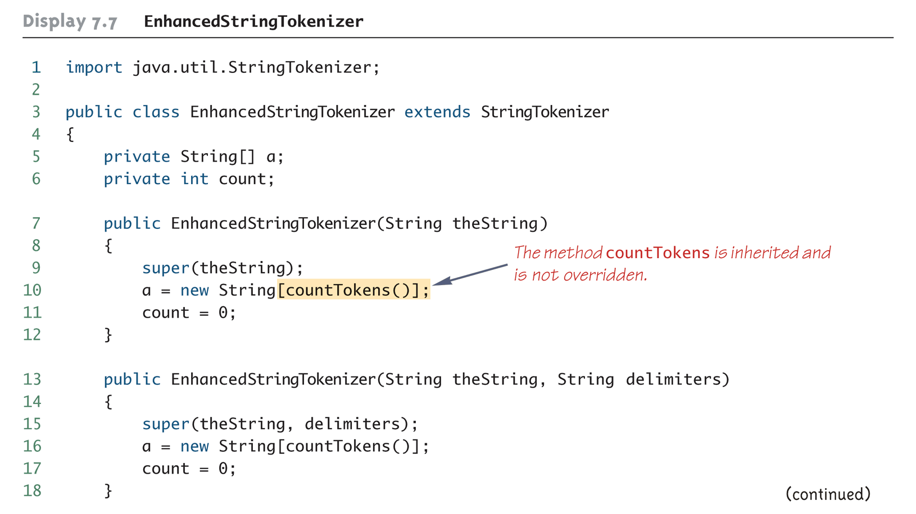
An Enhanced StringTokenizer Class (Part 1 of 4)

Slide 35
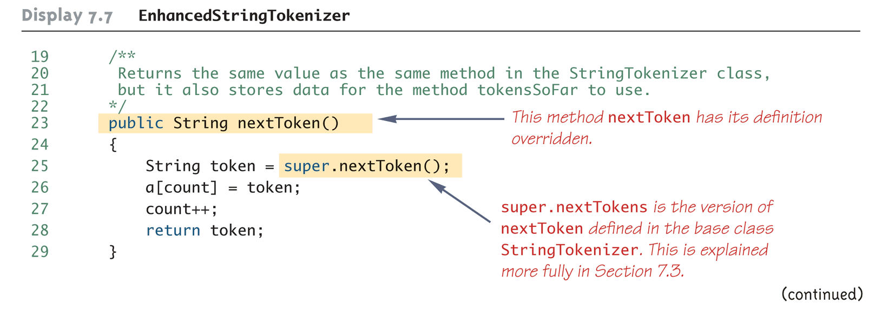
An Enhanced StringTokenizer Class (Part 2 of 4)

Slide 36
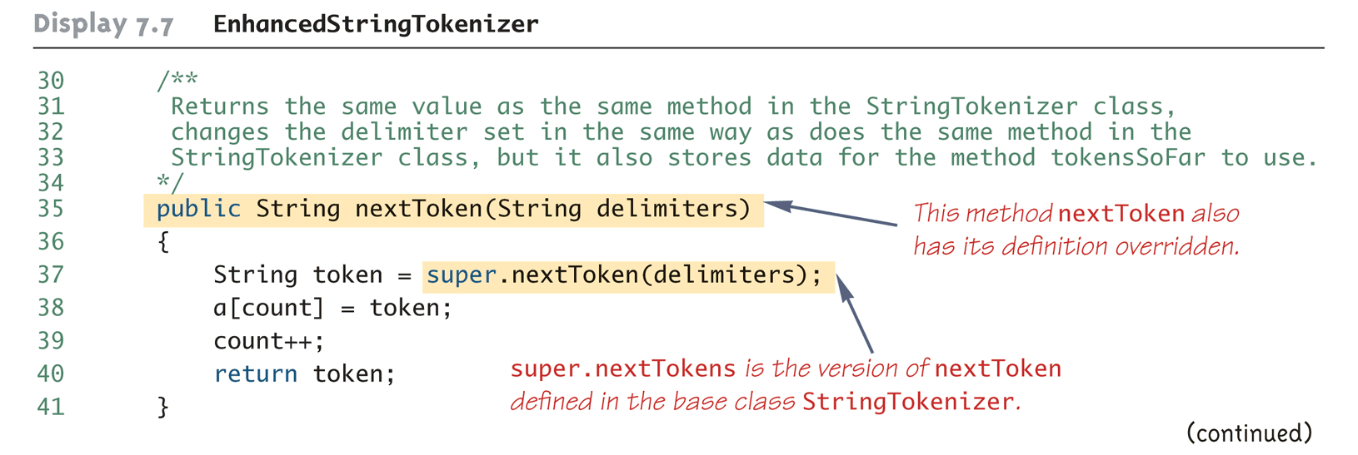
An Enhanced StringTokenizer Class (Part 3 of 4)

Slide 37
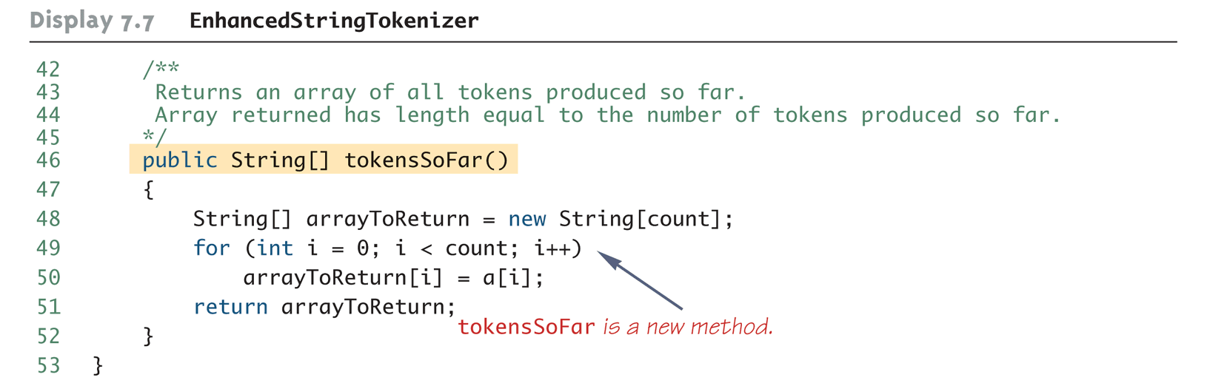
An Enhanced StringTokenizer Class (Part 4 of 4)

Slide 38
Encapsulation and Inheritance Pitfall: Use of Private Instance Variables from the Base Class
An instance variable that is private in a base class is not accessible by name in the definition of a method in any other class, not even in a method definition of a derived class
For example, an object of the HourlyEmployee class cannot access the private instance variable hireDate by name, even though it is inherited from the Employee base class
Instead, a private instance variable of the base class can only be accessed by the public accessor and mutator methods defined in that class
An object of the HourlyEmployee class can use the getHireDate or setHireDate methods to access hireDate

Slide 39
Encapsulation and Inheritance Pitfall: Use of Private Instance Variables from the Base Class
If private instance variables of a class were accessible in method definitions of a derived class, then anytime someone wanted to access a private instance variable, they would only need to create a derived class, and access it in a method of that class
This would allow private instance variables to be changed by mistake or in inappropriate ways (for example, by not using the base type's accessor and mutator methods only)

Slide 40
Pitfall: Private Methods Are Effectively Not Inherited
The private methods of the base class are like private variables in terms of not being directly available
However, a private method is completely unavailable, unless invoked indirectly
This is possible only if an object of a derived class invokes a public method of the base class that happens to invoke the private method
This should not be a problem because private methods should just be used as helping methods
If a method is not just a helping method, then it should be public, not private

Slide 41
Protected and Package Access
If a method or instance variable is modified by protected (rather than public or private), then it can be accessed by name
Inside its own class definition
Inside any class derived from it
In the definition of any class in the same package
The protected modifier provides very weak protection compared to the private modifier
It allows direct access to any programmer who defines a suitable derived class
Therefore, instance variables should normally not be marked protected

Slide 42
Protected and Package Access
An instance variable or method definition that is not preceded with a modifier has package access
Package access is also known as default or friendly access
Instance variables or methods having package access can be accessed by name inside the definition of any class in the same package
However, neither can be accessed outside the package

Slide 43
Protected and Package Access
Note that package access is more restricted than protected
Package access gives more control to the programmer defining the classes
Whoever controls the package directory (or folder) controls the package access

Slide 44
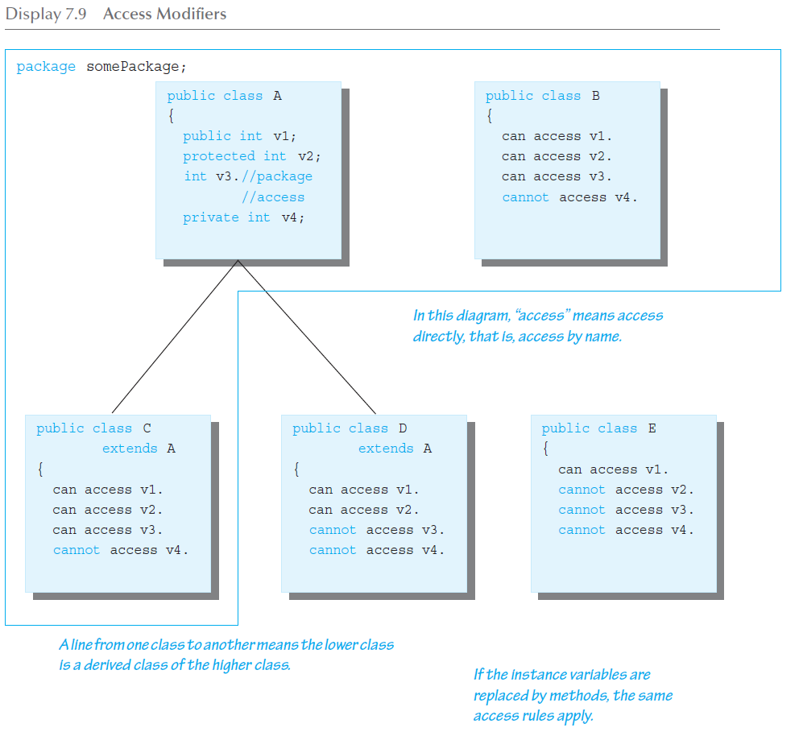
Access Modifiers

Slide 45
Pitfall: Forgetting About the Default Package
When considering package access, do not forget the default package
All classes in the current directory (not belonging to some other package) belong to an unnamed package called the default package
If a class in the current directory is not in any other package, then it is in the default package
If an instance variable or method has package access, it can be accessed by name in the definition of any other class in the default package

Slide 46
Pitfall: A Restriction on Protected Access
If a class B is derived from class A, and class A has a protected instance variable n, but the classes A and B are in different packages, then the following is true:
A method in class B can access n by name (n is inherited from class A)
A method in class B can create a local object of itself, which can access n by name (again, n is inherited from class A)

Slide 47
Pitfall: A Restriction on Protected Access
However, if a method in class B creates an object of class A, it can not access n by name
A class knows about its own inherited variables and methods
However, it cannot directly access any instance variable or method of an ancestor class unless they are public
Therefore, B can access n whenever it is used as an instance variable of B, but B cannot access n when it is used as an instance variable of A
This is true if A and B are not in the same package
If they were in the same package there would be no problem, because protected access implies package access

Slide 48
Tip: "Is a" Versus "Has a"
A derived class demonstrates an "is a" relationship between it and its base class
Forming an "is a" relationship is one way to make a more complex class out of a simpler class
For example, an HourlyEmployee "is an" Employee
HourlyEmployee is a more complex class compared to the more general Employee class

Slide 49
Tip: "Is a" Versus "Has a"
Another way to make a more complex class out of a simpler class is through a "has a" relationship
This type of relationship, called composition, occurs when a class contains an instance variable of a class type
The Employee class contains an instance variable, hireDate, of the class Date, so therefore, an Employee "has a" Date

Slide 50
Tip: "Is a" Versus "Has a"
Both kinds of relationships are commonly used to create complex classes, often within the same class
Since HourlyEmployee is a derived class of Employee, and contains an instance variable of class Date, then HourlyEmployee "is an" Employee and "has a" Date

Slide 51
Tip: Static Variables Are Inherited
Static variables in a base class are inherited by any of its derived classes
The modifiers public, private, and protected, and package access have the same meaning for static variables as they do for instance variables

Slide 52
Access to a Redefined Base Method
Within the definition of a method of a derived class, the base class version of an overridden method of the base class can still be invoked
Simply preface the method name with super and a dot
public String toString()
{
return (super.toString() + "$" + wageRate);
}
However, using an object of the derived class outside of its class definition, there is no way to invoke the base class version of an overridden method

Slide 53
You Cannot Use Multiple supers
It is only valid to use super to invoke a method from a direct parent
Repeating super will not invoke a method from some other ancestor class
For example, if the Employee class were derived from the class Person, and the HourlyEmployee class were derived form the class Employee , it would not be possible to invoke the toString method of the Person class within a method of the HourlyEmployee class
super.super.toString() // ILLEGAL!

Slide 54
The Class Object
In Java, every class is a descendent of the class Object
Every class has Object as its ancestor
Every object of every class is of type Object, as well as being of the type of its own class
If a class is defined that is not explicitly a derived class of another class, it is still automatically a derived class of the class Object

Slide 55
The Class Object
The class Object is in the package java.lang which is always imported automatically
Having an Object class enables methods to be written with a parameter of type Object
A parameter of type Object can be replaced by an object of any class whatsoever
For example, some library methods accept an argument of type Object so they can be used with an argument that is an object of any class

Slide 56
The Class Object
The class Object has some methods that every Java class inherits
For example, the equals and toString methods
Every object inherits these methods from some ancestor class
Either the class Object itself, or a class that itself inherited these methods (ultimately) from the class Object
However, these inherited methods should be overridden with definitions more appropriate to a given class
Some Java library classes assume that every class has its own version of such methods

Slide 57
The Right Way to Define equals
Since the equals method is always inherited from the class Object, methods like the following simply overload it:
public boolean equals(Employee otherEmployee)
{ . . . }
However, this method should be overridden, not just overloaded:
public boolean equals(Object otherObject)
{ . . . }

Slide 58
The Right Way to Define equals
The overridden version of equals must meet the following conditions
The parameter otherObject of type Object must be type cast to the given class (e.g., Employee)
However, the new method should only do this if otherObject really is an object of that class, and if otherObject is not equal to null
Finally, it should compare each of the instance variables of both objects

Slide 59
A Better equals Method for the Class Employee
public boolean equals(Object otherObject)
{
if(otherObject == null)
return false;
else if(getClass( ) != otherObject.getClass( ))
return false;
else
{
Employee otherEmployee = (Employee)otherObject;
return (name.equals(otherEmployee.name) &&
hireDate.equals(otherEmployee.hireDate));
}
}

Slide 60
Tip: getClass Versus instanceof
Many authors suggest using the instanceof operator in the definition of equals
Instead of the getClass() method
The instanceof operator will return true if the object being tested is a member of the class for which it is being tested
However, it will return true if it is a descendent of that class as well
It is possible (and especially disturbing), for the equals method to behave inconsistently given this scenario

Slide 61
Tip: getClass Versus instanceof
Here is an example using the class Employee
. . . //excerpt from bad equals method
else if(!(OtherObject instanceof Employee))
return false; . . .
Now consider the following:
Employee e = new Employee("Joe", new Date());
HourlyEmployee h = new
HourlyEmployee("Joe", new Date(),8.5, 40);
boolean testH = e.equals(h);
boolean testE = h.equals(e);

Slide 62
Tip: getClass Versus instanceof
testH will be true, because h is an Employee with the same name and hire date as e
However, testE will be false, because e is not an HourlyEmployee, and cannot be compared to h
Note that this problem would not occur if the getClass() method were used instead, as in the previous equals method example

Slide 63
instanceof and getClass
Both the instanceof operator and the getClass() method can be used to check the class of an object
However, the getClass() method is more exact
The instanceof operator simply tests the class of an object
The getClass() method used in a test with == or != tests if two objects were created with the same class

Slide 64
The instanceof Operator
The instanceof operator checks if an object is of the type given as its second argument
Object instanceof ClassName
This will return true if Object is of type ClassName, and otherwise return false
Note that this means it will return true if Object is the type of any descendent class of ClassName

Slide 65
The getClass() Method
Every object inherits the same getClass() method from the Object class
This method is marked final, so it cannot be overridden
An invocation of getClass() on an object returns a representation only of the class that was used with new to create the object
The results of any two such invocations can be compared with == or != to determine whether or not they represent the exact same class
(object1.getClass() == object2.getClass())

