Slide 1
Json Web Token
Makarand Bhoir

Slide 2
Initial Request
Client Application
Server Application
Client app will send authentication request to server app by sending username and password
Server application will authenticate & generate JWT if user is valid & send it back to client application
Token generated & sent by server is called as Json Web Token & used for management state
Request
request = {
user:””,
pass:””
}
Response
response = {
jwt:”….axd….”
}

Slide 3
2nd Request onwards
Client Application
Server Application
Same client request for another protected page then client app will send JWT token into request header and send the request
Server application will extract username from JWT and recognise user
Request
request = {
Authorization: “…axd….”
}
Response
response = {
jwt:”….axd….”
}

Slide 4
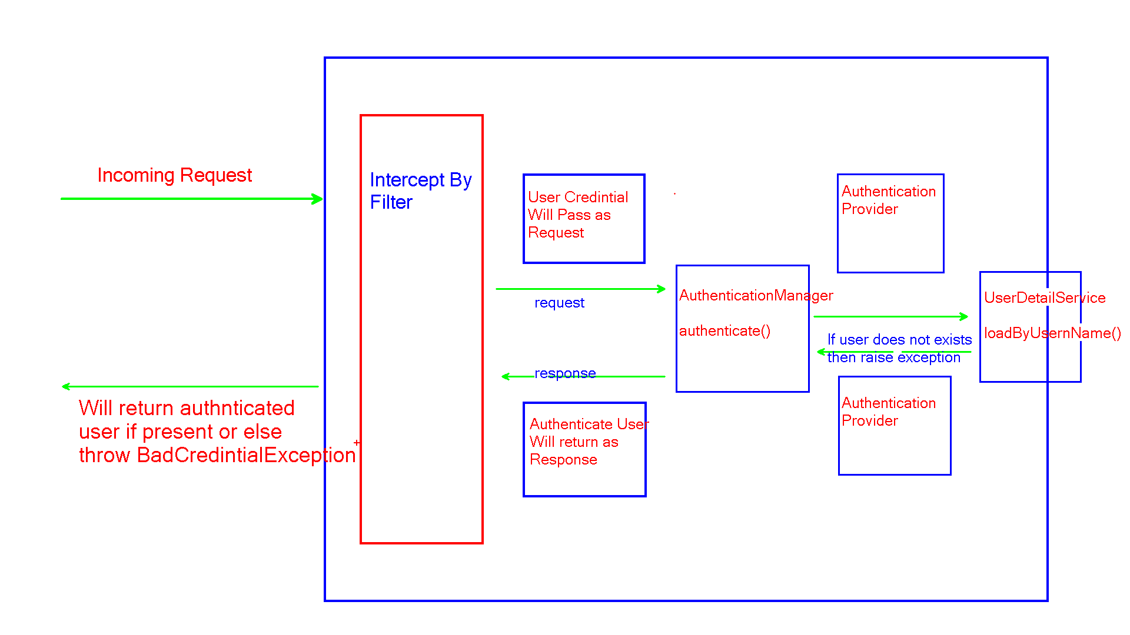
Spring Security Architecture

Slide 5
Q & A

Slide 6
Thank you

