Slide 1



Spring 5 JEE Application Development
Makarand Bhoir

Slide 2

Module 1
Introduction to Spring 5
Notes:
3 Slides - 5-10 Minute Discussion – Good to understand customers cloud strategy and see if S+S and Leveraging Existing Investments is important to them. Find out what cloud vendors and solutions they are evaluating.
For more details on the cloud definitions see wikipedia
http://en.wikipedia.org/wiki/Cloud_computing

Slide 3
Overview of Spring Framework
Light weight, Open source framework for developing Enterprise Grade Application.
Developed in 2004 by Rode Johnson
Lightweight, Simple solution to compete EJB
Provides light weight container to create objects lazily, singleton
Declarative plumbing, transaction, security and logging.
Simple Object
Dependency Injection
Aspect Oriented Programming
Enterprise Service Abstraction

Slide 4
Why Spring Framework?
Provides loose coupling with services, objects, tools and technology as they are configurable and declarative.
Encourage non-invasive approach to code
Susceptible to unit testing
Light weight as may run without server
Provides abstraction to integrate with best breed of products like Hibernate, Aceji, Struts etc.
Flexible to run in both managed and un-managed environment.
Rich of solutions for different tiers

Slide 5
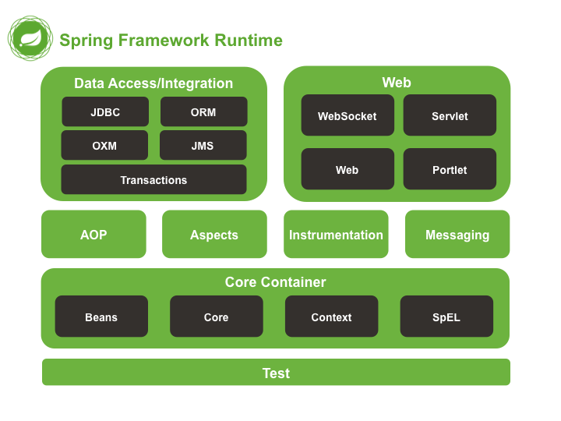
Spring Architecture

Slide 6
Spring Jars and significance
Spring has Maven, Gradle or Ivy support for setting dependencies. Following are Maven dependencies. The Group ID for following artifact Id is: ‘org.springframework’.
S.N. | Artifact Id/Module | Description
01 | spring-core and spring-beans | Provides fundamental parts of framework including IoC and DI.
02 | Bean Factory | A sophisticated implementation of Factory pattern to decouple configuration and dependency management.
03 | spring-context | It inherits features from Spring Beans and add support for internationalization, event propagation, resource loading and transparent creation of context in Servlet container. It also supports JEE features like EJB, JMS, RMI and JMX. All these features are provided through ApplicationContext interface.
04 | spring-expression | A query language to query and manipulate object graph at run time. It supports setting and getting property values, property assignment, method invocation, accessing contents of the array, collection and indexes, logical and arithmetic operators, named variables and accessing beans from Spring IoC container. It also supports list projection, selection as well as common list aggregation.

Slide 7
Spring Jars and significance
S.N. | Artifact Id/Jar | Description
05 | spring-context-support | For integrating common third party libraries into Spring application context. Library list is...Caching(EhCache, Gauva, JCache),mailing( JavaMail), Scheduling(CommonJ, Quartz) template engines (FreeMarker, JasperReport, Velocity).
06 | spring-aop | Provides AOP alliance compliant aspect oriented programming implementation.
07 | spring-aspects | Provides integration with Aspect-J.
08 | spring-messaging | New in Spring 4 for providing key abstractions like- Message, MessageChannel, MessageHandler. It also has annotations for mapping messages to methods something like in SpringMVC to map request to controllers.
09 | spring-jdbc | Provides JDBC abstraction layer and parsing of database vendor specific error codes.
10 | spring-tx | Provides programmatic and declarative transaction management.
11 | spring-jms | Contains features for producing and consuming messages.

Slide 8
Spring Jars and significance
S.N. | Artifact Id/Jar | Description
12 | spring-orm | Provides abstraction layer for object relational mapping implementation such as JAXB, Caster, XMLBeans, JiBX and XStream. This support is integrated with JPA, Hibernate and JDO.
13 | spring-web | Provides basic web oriented features like- Initialization of IoC container using Servlet Listener and web oriented application context.
14 | spring-webmvc | Contains Spring MVC and REST web service implementation. It also provides clean separation between domain model code and web forms.
15 | spring-test | Supports Unit Testing and integration testing using JUnit and TestNG. It provides loading and caching of Spring Application context. It also provides support for Mock objects to test code in Isolation.
16 | spring-ws | Supports Hassian, Burlap, Rmi, JaxRpcProxyFactory..

Slide 9
Spring 5: New Features
S.N. | Update | Description
01 | JDK Baseline Update | Java 8 is minimum requirement. Supports Java 8 Reflection Enhancements, default methods, @Nullable and @NotNull
02 | Core Container Updates | In addition to Class Path Scanner, supports Candidate Component Index which works faster for large applications with more than 200 classes. Its configuration goes into META-INF/spring.components.
03 | Functional Programming with Kotlin | Introduced by JetBrains, a language supports multiple programming paradigms as well as multiple runtime environments like: OS specific as well as JVM.
04 | Reactive Programming Model | Supports a reactive and non-blocking web application model based on Reactive Streams concepts introduced in Java 11.
05 | New library support | Hibernate 5, JDBC 4, Jackson 2.6, EhCache 2.10/3.0 GA, Netty 4.1 and few more.
06 | Discontinued Support | Portlets, Velocity, Jasper Reports, Gauva, JDO, XML Beans.

Slide 10
IoC/DI in Spring
The IoC is the broader concept with two main types:
The dependency lookup: The container provides call-backs to components and lookup context. The component uses JNDI to do lookup of other components and resources.
@Resource
private DataSource dataSource;
The dependency injection: IoC container configures the object externalizing resource lookup from application code i.e. Dependencies are injected into object calling setter/constructor. Object does not do lookup of resources.
public void setDataSource(DataSource ds){
dataSource = ds;
}
<bean id="emp_list“ class="pack_10_ioc.EmpDao">
<property name="dataSource“ ref="dsRefOrcl“/>
</bean>

Slide 11
Spring Container
Container reads configuration meta data to...
Instantiate object with the given scope.
To initialize object with configured data
To inject dependencies in object etc
Container reads meta information from...
XML configuration file.
Java Annotations
Java code.
Maven configuration in case of Spring Boot

Slide 12
Spring Container
Its a light weight implementation of BeanFactory interface
BeanFactory: Sophisticated implementation of factory pattern. Gives objects with scope- Singleton or prototype. Decouples business logic from configuration and dependency specifications.
ApplicationContext: Augments BeanFactory with enterprise centric functionalities like integration with AOP features, message resource, event propagation etc.
WebApplicationContext: Augments ApplicationContext with web application specific features like scopes- globalSession, sesssion and request etc.

Slide 13
The ApplicationContext
The ApplicationContext:
MessageSource
Access to resources such as URLs and files.
Event propagation
Multiple hierarchical context.

Slide 14
Module 2
Spring 5: Working with Beans
Notes:
3 Slides - 5-10 Minute Discussion – Good to understand customers cloud strategy and see if S+S and Leveraging Existing Investments is important to them. Find out what cloud vendors and solutions they are evaluating.
For more details on the cloud definitions see wikipedia
http://en.wikipedia.org/wiki/Cloud_computing

Slide 15
Spring as Factory of Beans
Configuring bean...
<bean id="resourceBean1" class="pack_10_ioc..GlobalInvestment">
</bean>
Instantiating bean...
BeanFactory beanFactory = new XmlBeanFactory(
new ClassPathResource(
“ path-configuration\\context.xml"));
GlobalInvestment bean = (GlobalInvestment)beanFactory..getBean(“resourceBean1”);
Class name goes in configuration file.
Client code refers bean with identification name and not by class name.
The beanFactory refers to the container.
The getBean method instantiate object and return reference.

Slide 16
Bean Initialization
Bean initialization through constructor
<constructor-arg type="String">
<value>Gobal Investment Pvt. Ltd.</value>
</constructor-arg>
<constructor-arg type="String" >
<value>Ladder of success</value>
</constructor-arg>
Type “String” is optional. But mandatory for any other type.
Order and type of <constructor-arg> decides the signature of constructor.
Spring container invokes appropriate constructor on the object while instantiating the object.
Bean initialization through setters
<property name="globalRank">
<value>104</value>
</property>
Property name is the name of the setter method without “set” word.
Spring container calls appropriate setter method and passes value on the created object.

Slide 17
Bean Initialization: Collection
Initializing ‘Set’ field...
<property name="directorsPanel">
<set>
<value>Mr. Malhotra</value>
<value>Mr. Gihrotra</value>
<value>Mr. Sanmitra</value>
</set>
</property>
Similarly, other tags for initializing array, list fields are…
<array>
and
<list>

Slide 18
Bean Initialization: Collection
Initializing ‘map’ field
<property name="branches">
<map>
<entry key="Mumbai">
<value>Shop 123, Lane 6, Subhash Road</value>
</entry>
<entry key="Delhi">
<value>Shop 234, Shoper's Stop, Link Road</value>
</entry>
</map>
</property>
Initializing ‘java.util.properties’ field
<property name="branchManagers">
<props>
<prop key="Mumbai">Mr. Jagtap</prop>
<prop key="Delhi">Mr. Bhupendra Singh</prop>
</props>
</property>

Slide 19
Bean Scope: Singleton and Prototype
Bean with scope- “singleton”
<bean id="resourceBean1" class="pack_10_ioc..GlobalInvestment“ scope=“singleton”>
</bean>
The scope singleton is optional. A bean without ‘scope’ clause is singleton.
Bean with scope- “prototype”
<bean id="resourceBean1" class="pack_10_ioc.EmpBean“ scope=“prototype”>
</bean>
The scope of Spring can not overrule the scope if declared programmatically in the object.

Slide 20
Resource Injections
Bean with constructor and setter method
public class EmpDao {
private DataSource dataSource;
private GlobalInvestment resource;
public EmpDao(GlobalInvestment resource){
this.resource = resource;
}
public void setDataSource(DataSource dataSource) {
this.dataSource = dataSource;
}
……………
}
The resource “GlobalInvestment” will be injected through Constructor injection while resource DataSource will be injected through setter method.

Slide 21
Constructor Injection
Bean of type GlobalResource
<bean id=“globalResource"
class=“pack.GlobalInvestment“>
………………….
…………………
<bean>
Constructor injection
<bean id="emp_list“ class="pack_01_xml.EmpDao">
<constructor-arg ref="globalResource“ />
</bean>
The ‘ref’ clause referes to bean of which dependency is to be injected in EmpDao object. The EmpDao class must have constructor to accept GlobalResource type of parameter.

Slide 22
Setter Injection
Bean of type DriverManager
<bean id="ds"
class="org.springframework.jdbc.datasource.DriverManagerDataSource“>
<property name="driverClassName" value="oracle.jdbc.OracleDriver"/>
<property name="url" value="jdbc:oracle:thin:@172.16.0.51:1521:orcl"/>
<property name="username" value="scott"/>
<property name="password" value="tiger"/>
<bean>
The DriverManagerDataSource is a class of Spring API.
It has already written setter methods like setUrl(), setUsername() etc.
Setter injection
<bean id="emp_list“ class="pack_01_xml.EmpDao">
<property name="dataSource“ ref="ds“ />
</bean>
The ‘ref’ clause referes to DriverManager object and brings its reference to set in EmpDao by calling setter method setDataSource().

Slide 23
Annotations to declare beans
@ Component
@ Service
@ Repository
@ Controller
Different types of annotations document a bean for a specific functionality.
@ Service: Bean having set of services.
@ Repository: The DAO types of beans.
@ Controller: The execution flow controlling functionalilties.

Slide 24
Annotations to declare beans
Bean Declaration...
@Service ("empEntity")
@Scope ("prototype")
public class EmpBean {
}
The XML description
<context:component-scan base-package="pack_02_annot" />
Bean is not declared in xml. The full name of a package container containing bean is declared.
Allows more than one component-scan declarations to declare more than one package containers for multiple beans.

Slide 25
Bean Creation using Java Config
Configuration using Java Code
@Configuration
public class AppConfig {
@Bean
public CustomerService customerService() {
return new CustomerServiceImpl();
}
@Bean
public BankService bankService() {
BankServiceImpl bankService = new BankServiceImpl();
bankService.setCustomerService(customerService());
return bankService;
}
}
Client Code…
ApplicationContext ctx = new AnnotationConfigApplicationContext(AppConfig.class);
BankService bankService = ctx.getBean("bankService", BankService.class);
CustomerService sc = (CustomerService)ctx.getBean("customerService");

Slide 26
Module 3
Spring 5: IoC and DI
Notes:
3 Slides - 5-10 Minute Discussion – Good to understand customers cloud strategy and see if S+S and Leveraging Existing Investments is important to them. Find out what cloud vendors and solutions they are evaluating.
For more details on the cloud definitions see wikipedia
http://en.wikipedia.org/wiki/Cloud_computing

Slide 27
Types of Auto-wiring
Auto-wiring: Framework automatically sets the dependency.
There are two ways-
1. By Type: Bean searched for wiring is searched on basis of type.
2. By Name: Bean searched for wiring is searched on basis of name.

Slide 28
Auto-wiring: XML Configuration
Auto-wiring by name
public class EmpDao {
private DataSource dataSource;
private GlobalInvestment resource;
public void setDataSourceRef(DataSource dataSource) {
this.dataSource = dataSource;
}
public void setMainResource(GlobalInvestment resource){
this.resource = resource;
}
}
Declaration in XML
<bean id="emp_list"
class="pack_20_wireXml.EmpDao" autowire="byName" >
<bean id=“dataSourceRef"
class="org.springframework.jdbc.datasource.DriverManagerDataSource" >
<bean id=“mainResource“ class=“pack.GlobalInvestment" >

Slide 29
Autowiring by type
public class EmpDao {
private DataSource dataSource;
private GlobalInvestment resource;
public void setDataSourceRef(DataSource dataSource) {
this.dataSource = dataSource;
}
public void setMainResource(GlobalInvestment resource){
this.resource = resource;
}
}
Declaration in XML
<bean id="emp_list"
class="pack_20_wireXml.EmpDao" autowire="byType" >
<bean id=“dataSourceRef"
class="org.springframework.jdbc.datasource.DriverManagerDataSource" >
<bean id=“mainResource“ class=“pack.GlobalInvestment" >

Slide 30
Auto-wiring: Annotations
Autowiring using annotation by name and type
@Repository("emp_list")
public class EmpDao {
private DataSource dataSource;
private GlobalInvestment resource;
@Autowired @Qualifier("dataSourceRef") // Autowiring by name
public void setDataSourceRef(DataSource dataSource) {
this.dataSource = dataSource;
}
@ Autowired // Autowiring by type
public void setMainResource(GlobalInvestment resource){
this.resource = resource;
}
}
Declaration in XML
<bean id=“dataSourceRef"
class="org.springframework.jdbc.datasource.DriverManagerDataSource" >
<bean id=“mainResource“ class=“pack.GlobalInvestment" >

Slide 31
Autowiring using @Resource
Autowiring using annotation by name and type
@Repository("emp_list")
public class EmpDao {
private DataSource dataSource;
private GlobalInvestment resource;
@Resource(name="dataSourceRef") // Autowiring by name
public void setDataSourceRef(DataSource dataSource) {
this.dataSource = dataSource;
}
@ Resource // Autowiring by type
public void setMainResource(GlobalInvestment resource){
this.resource = resource;
}
}
Declaration in XML
<bean id=“dataSourceRef"
class="org.springframework.jdbc.datasource.DriverManagerDataSource" >
<bean id=“mainResource“ class=“pack.GlobalInvestment" >

Slide 32
Injecting Context reference in a bean
Bean can receive a reference of Spring Context in two ways...
I. Injection...
public class NewsPrintManager implements ApplicationContextAware {
private ApplicationContext ctx;
public void setApplicationContext(ApplicationContext ctx)
throws BeansException {
this.ctx = ctx;
}
} // The setter is called automatically as a part of bean creation by Spring container.
II. Resource lookup...
public class NewsPrintManager {
@ Resource/@Autowire
private ApplicationContext ctx;
} // Field reference is automatically set after object is created.

Slide 33
Module 4
Spring 5: Bean Lifecycle and Callback Methods
Notes:
3 Slides - 5-10 Minute Discussion – Good to understand customers cloud strategy and see if S+S and Leveraging Existing Investments is important to them. Find out what cloud vendors and solutions they are evaluating.
For more details on the cloud definitions see wikipedia
http://en.wikipedia.org/wiki/Cloud_computing

Slide 34
Bean Construction and Destruction
There are different ways to declare container call back methods for a bean. These call back methods form a life cycle.
The init-method/destroy-method clauses.
The InitializingBean and DesposableBean.
The @ PostConstruct and @ PreDestroy annotations.

Slide 35
The InitializingBean, DisposableBean interface
Spring’s way to validate configuration inputs…
public class LeavesConfiguration implements InitializingBean, DisposableBean{
private int maxPLAnnually;
// Implementation of InitializingBean
public void afterPropertiesSet() throws Exception {
// Validating configured inputs and/or allotting mandatory resources to bean
if (maxPLAnnually>22)
throw new Exception("Wrong configuraton of max PL");
}
// Implementation of DisposableBean
public void destroy() throws Exception {
// De-allotting resources if any
}
The configuration in XML
<bean id="leavesLimits“ class="pack_20_lifecycle.LeavesConfiguration" >
<property name="maxPLAnnually">
<value>25</value> <!– The afterPropertySet() validates this value. -->
</property>
</bean>
This method is automatically executed after all configured properties are called on the created object.

Slide 36
The @PostConstruct and @PreDestroy
Spring’s way to assign mandatory resources on condition…
@ Component
public class LeavesConfiguration {
private int maxPLAnnually;
@PostConstruct
public void assignDefaultResources() throws Exception {
// Assign logger.
}
@PostConstruct
public void assignSpecificResources() throws Exception {
// Assign persistent storage.
}
@PreDestroy
public void releaseResources() throws Exception {
// Close all resources
}
}

Slide 37
The @PostConstruct and @PreDestroy
The configuration in XML…
<context:component-scan base-package="pack_20_lifecycle.pack30_annotate" />
Points to note…
Sets of initialization statements can be segregated across multiple methods.
Such multiple methods are executed in the physical order from top to bottom.
Annotation gives liberty to give context specific meaningful name to methods.
This approach is preferred for being Java standard.

Slide 38
The Interface BeanFactoryPostProcessor
Interface from org.springframework.bean.factory.config.BeanFactoryPostProcessor.
It is a factory hook for custom modifications of a ApplicationContext’s bean definitions.
Auto-detected by ApplicationContext after bean definitions are recognized but before any bean is created.
Imposes implementation of a method...
The postProcessBeanFactory(ConfigurableBeanFactory) : Executed between loading of all beans and their instantiation. Allows overriding and adding properties to lazy-eager beans.

Slide 39
The Interface BeanPostProcessor
Interface from org.springframework.bean.factory.config.BeanPostProcessor.
It is a factory hook for custom modification on/in created bean.
Auto-detected by ApplicationContext after bean creation and declarative initialization but before bean initialization using callbacks/init methods.
Imposes implementation of two methods...
The postProcessBeforeInitialization(Object, String) : Executed before bean initialization callbacks. May check for marker interfaces/custom annotations to initialize bean. The ‘Object’ is actual bean object with its alias as ‘String’.
The postProcessAfterInitilialization(Object, String) : Executed after all initialization callbacks. May wrap bean in proxy. In case of FactoryBean, it is called for both- FactoryBean and object being returned. Method needs to check ‘instanceof’ to apply ‘After’ process.

Slide 40
The InstantiationAwareBeanPostProcessor
Interface from
org.springframework.bean.factory.config.InstantiationAwareBeanPostProcessor
Provides hooks at different stages in life of bean creation.
Extended from BeanPostProcessor. Provides additional hooks for instantiation.
Auto-detected by ApplicationContext after context loading but before bean creation.
Imposes implementation of methods...
The postProcessBeforeInstantiation(Class, String) : It is for custom instantiation. If returns object, short-circuits to step- afterInitialization. If returns ‘null’ applies all steps. Not applied if bean is created using factory-method().
The postProcessAfterInstantiation(Object, String) : Executed after bean is instantiated but before applying properties. Used for field injection.
The postProcessPropertyValues(PropertyValues, PropertyDescriptor, bean, alias): Executed after instantiation after applying properties. Used to check all ‘Required’ dependencies.

Slide 41
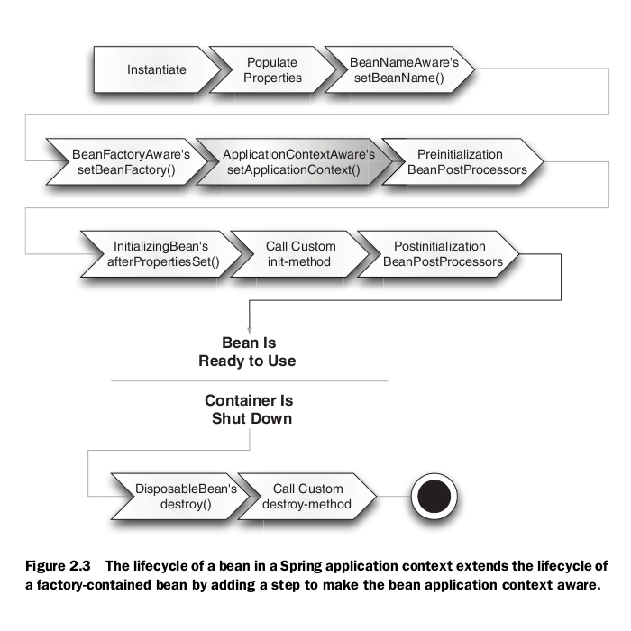
Bean Lifecycle

Slide 42
Module 5
Spring 5: Aspect Oriented Programming
Notes:
3 Slides - 5-10 Minute Discussion – Good to understand customers cloud strategy and see if S+S and Leveraging Existing Investments is important to them. Find out what cloud vendors and solutions they are evaluating.
For more details on the cloud definitions see wikipedia
http://en.wikipedia.org/wiki/Cloud_computing

Slide 43
Cross Cutting Concerns
Cross cutting concerns
Authorization
Logging
Auditing
Exception Propagation
GUI Layer
Business Logic Layer
Service Layer
DB Layer

Slide 44
The AOP: Terminologies
Aspect: A modularization of concerns that cuts across multiple classes.
Join point: A point during execution which is intercepted by aspects.
In AspectJ, methods and fields can be join points. Any call to method or change in value of a field triggers interception of advices.
private int accBal;
private void withdraw(float amt);
Advices: Action taken by aspect at a particular join point.
The authentication, logging logics can be advices.
Point cut: A predicate that matches join points.
AspectJ notation to decide targets for advicing. These targets are normally in the form of join points.
execution(* pack_40_aop.pack_10_aspect.pack_joinpoints.pack_dao.*.*(..))

Slide 45
Manual Weaving
Manual weaving...
public class EmpDao {
public Collection getAllEmps(){
// Call to interceptor1- Logger
// Call to interceptor2- Authentication check
// Logic to fetch and populate data in collection
// Call to interceptor3- Transaction management
// Call to interceptor4- Auditor
}
}

Slide 46
Benefits of AOP
The code for cross cutting concerns appear like a boiler plate code most of the time.
The business logic clutters up with such a code. Thus hampers readability.
Using AOP, business logic becomes clean.
A separate layer of advices can be designed. Managed and administrated separately.
The advices become completely transparent to join points.
Business logic layer
public class EmpDao {
public Collection getAllEmps(){
// Logic to fetch and populate data in collection
}
}
Layer of cross cutting concerns
public class Loggers {
public void log(String msg){
// Code doing logging
}
}

Slide 47
Weaving techniques
Compile time weaving...
public class EmpDao {
public Collection getAllEmps(){
// Call to interceptor1
// Call to interceptor2
// Logic to fetch and populate data in collection
// Call to interceptor3
// Call to interceptor4
}
}
Aspect J Compilers
Weaved class files with calls to interceptors.

Slide 48
Weaving techniques
JVM’s method area
Load time weaving...
Instrumented and weaved bytecode
Normal class file
Interceptor class file
Class loader with weaving agent.
Interceptor class file

Slide 49
Weaving techniques
Runtime time weaving...
JVM’s method area
A proxy class
public class ProxyEmpDao {
public void service(){
interceptor1();
service();
interceptor2();
}
}
Interceptor1()
Normal bytecode
service()
Interceptor3()

Slide 50
Join Points
Methods as join points…
public class CustomerServiceImpl implements CustomerService {
public void applyChqBk(long acno) {
// Logic to register requisition for Cheque book
………….
}
public void applyForCreditCard(String name, String address) {
// Logic to register requisition for Credit card
……………
}
public void stopChequePayment(long acno, int chequeNo) {
// Logic to stop cheque payment
…………………
}
}

Slide 51
Advices
Around type of advice…
public class LogAdvice{
public Object log(ProceedingJoinPoint call) throws Throwable {
System.out.println("\nfrom logging aspect: before method call");
Object point = call.proceed(); // Actual method call
System.out.println("from logging aspect: after method call");
return point;
}
}
Configuration in XML…
<aop:config>
<aop:aspect ref="loggingInterceptor">
<aop:pointcut id=“pointcut1" expression="execution(* pack_40_aop.*.a*(..))" />
<aop:around pointcut-ref=“pointcut1" method="log" />
</aop:aspect>
</aop:config>
<bean id="loggingInterceptor" class="pack_40_aop.LogAdvice" />
Pointcut: Predicate deciding joinpoint targets

Slide 52
Advices and Point Cuts using Annotations
Around type of advice…
@Aspect
public class LogAdvice{
@Around (“execution(* pack_40_aop.*.a*(..))")
public Object logMessage(ProceedingJoinPoint call) throws Throwable {
System.out.println("\nfrom logging aspect: before method call");
Object point = call.proceed(); // Actual method call
System.out.println("from logging aspect: after method call");
return point;
}
}
Configuration in XML…
<aop:aspectj-autoproxy />
<bean id="customerService" class="pack_40_aop.CustomerServiceImpl" />
<bean class="pack_40_aop. LogAdvice “ />

Slide 53
Ordering the Aspects
Aspects should be segregated advice wise. It may be needed to have different sets of aspects at different join points in an application. For a join point, if there are multiple aspects, their order may be relevant.
public class AuthorizationAspect implements Ordered {
private int order;
// Interface imposes implementation of this method.
public int getOrder() {
return order;
}
}
Order value can be set through XML configuration. Larger order nests the exception.
Client
Calling save()
Logging Advice-Around
Order: 200
Authentication Advice-Around
Order: 300
Auditing Advice-Around
Order: 300

Slide 54
Advice Type: Around
@Around (“execution(* pack_40_aop.*.a*(..))")
Most powerful advice among all advices.
Proxy
Executes part before proceed()
2. Calls applyChqBk() on actual bean
3. Executes part after proceed()
Client
Call to applyChqBk() on bean
Bean
applyChqBk() { }
Can bypass call to actual method by ignoring call to proceed();
Can call actual method more than once by calling proceed() more than once.

Slide 55
Advice Type: Before
@Before (“execution(* pack_40_aop.*.a*(..))")
Works like pre-call part of try block.
Client
Call to applyChqBk() on bean
Proxy
Executes advice and then executes joinpoint if no exception is thrown.
Bean
applyChqBk() { }
Can not call proceed(). No choice of at what point of time to execute a call to actual method.
After this advice actual method is bound to execute except no exception is thrown.

Slide 56
Advice Type: AfterReturning
Works like post-call part of try block.
@AfterReturning (“execution(* pack_40_aop.*.a*(..))“, returning=“retValue”)
public void businessLogic(JoinPoint jp, Object retVal) {
…………………..
}
Client
Call to applyChqBk() on bean
Proxy
Executes advice if no exception is thrown from join point
Bean
applyChqBk() { }
Can not call proceed(). No choice of at what point of time to execute a call to actual method.
After successful execution of actual method, this advice is executed.
Can be used to analyze the return value of a method. If return value breaches validity, free to update and return default value.

Slide 57
Advice Type: AfterThrowing
Works like catch block.
@AfterThrowing(“execution(* pack_40_aop.*.a*(..))“, throwing=“ex”)
public void handleException(JoinPoint jp, RuntimeException ex) throws Throwable {
// Handling exception and raising custom exception
}
Client
Call to applyChqBk() on bean
Proxy
Executes advice if exception is thrown from join point.
Bean
applyChqBk() { }
Can not call proceed(). No choice of at what point of time to execute a call to actual method.
After un-successful execution of actual method, this advice is executed.
Can be used to overcome the exception thrown and can throw outer layer specific exception. Thereby, it makes a business logic clutter free of try-catch block.

Slide 58
Advice Type: After
@AfterThrowing(“execution(* pack_40_aop.*.a*(..))")
Works like finally block.
Client
Call to applyChqBk() on bean
Proxy
Executes advice in both cases of successful or unsuccessful execution of join point.
Bean
applyChqBk() { }
Can not call proceed(). No choice of at what point of time to execute a call to actual method.
What ever be the fate of execution of actual method, this advice is executed.
Can be used to replace finally block.

Slide 59
Pointcuts
If join points are all methods within all classes of ‘service’ package
@Pointcut(“within(com.xyz.service.*))
If join points are all methods within all classes of package ‘web’ and its all subpackages.
@Pointcut(“within(com.xyz.someapp.web..*)”)
If join points are all methods taking any number of parameters (..) of all classes of service package excluding classes of sub-package of service package.
execution(* com.xyz.service.*.*(..)
If join points are all methods of implementation of interface AccountService of package ‘service’.
execution(* com.xyz.service.AccountService.*(..))
Joints points as any method annotated with given annotation.
execution(@Log * *(..) )

Slide 60
Named Pointcuts
They designs a tier of point cuts separate from advices. It makes actual point-cuts transparent from advices as well as from join points.
Naming Point-cuts in Java code
@Aspect
public class PointcutConfig {
@Pointcut("execution(public * pack_40_aop.pack_20_pointcut.*.*(..))“)
public void serviceComponents() {} //This is a name given to the pointcut expression
}
Configuration in XML
<aop:aspectj-autoproxy />
<bean id="pointcutConfig" class="pack_40_aop.pack_20_pointcut.PointcutConfig" />
Declaring Advices
@Aspect
public class LoggingAspect {
@Before("pack_40_aop.pack_20_pointcut.PointcutConfig.serviceComponents()")
public void timeLog(JoinPoint joinPoint) {
…… // Advice code
}
}

Slide 61
Module 6
Spring 5: Spring JDBC and Spring ORM
Notes:
3 Slides - 5-10 Minute Discussion – Good to understand customers cloud strategy and see if S+S and Leveraging Existing Investments is important to them. Find out what cloud vendors and solutions they are evaluating.
For more details on the cloud definitions see wikipedia
http://en.wikipedia.org/wiki/Cloud_computing

Slide 62
Spring JDBC: A JDBC Wrapper
Its a solution for designing database access layer(DAO). Its a kind of JDBC Wrapper to provide abstraction for DB access.
DB Layer encapsulates all complexities and provides well define interfaces for Service layer.
Service Layer
Calls methods on DAO layer to get data in the form of Domain Graph.
DAO Layer
JDBC
JDBC-Wrappers
Spring-JDBC
Hibernate
JPA
Data base

Slide 63
Problems with JDBC
public List<Emp> getAllEmps() throws SQLException{
String qry = "Select EMPNO, ENAME from EMP";
Statement stmt = null;
ResultSet rs = null;
Connection conn = null;
try {
conn = cf.getConnection();
stmt = conn.createStatement();
rs = stmt.executeQuery(qry);
List<Emp> lst = new ArrayList<Emp>();
while(rs.next()){
Emp e = new Emp();
e.setEmpNo(rs.getInt("EMPNO"));
e.setEmpNm(rs.getString("ENAME"));
lst.add(e);
}
} finally{
rs.close(); stmt.close(); conn.close();
}
return lst;
}
Code redundancy: Most of this code is written for another method like getEmpsWithSalRange(). Most of the code is boiler plate code.
Spring JDBC abstraction…
String query="Select EMPNO, ENAME, SAL from EMP";
List<Map<String, Object>> list = simpleJdbcTemplate.queryForList(query, new Object[] {});

Slide 64
Problems with JDBC
public void joinNewEmployee(Emp e) throws SQLException{
String qry = "INSERT INTO EMP (EMPNO, ENAME) VALUES(?, ?)";
Connection conn = cf.getConnection();
PreparedStatement pstmt = null;
try {
conn.setAutoCommit(false);
pstmt = conn.prepareStatement(qry);
pstmt.setInt(1, e.getEmpNo());
pstmt.setString(2, e.getEmpNm());
pstmt.execute();
conn.commit();
} catch(SQLException ex){
conn.rollback();
throw new SQLException("Employee not registered.");
} finally{
pstmt.close();
conn.setAutoCommit(true);
}
}
Spring JDBC abstraction…
query = "Insert into EMP(EMPNO, ENAME, SAL) values (?, ?, ?)";
jdbcTemplate.update(query, new Object[]{9000, "Suchita", 25000});

Slide 65
Spring JDBC : Features
Its a solution for designing database access layer(DAO).
The DAO layer isolates application logic from Database complexities i.e. Encapsulates DB complexities.
Manages database resources effectively. Provides configurable, automatic connection management.
Provides support for data access technologies like JDBC, Hibernate, JPA.
Eliminates boiler plate code thus reduces likelihood of bugs.

Slide 66
Spring JDBC : Features
Provides declarative transaction management. Methods form transaction boundary and takes part in existing transaction or starts own new transaction.
Better exception handling. Wide hierarchy of exceptions, proper release of resources etc.
Converts result-set into domain specific graph.
Simplifies use of JDBC by providing kind of JDBC Wrappers.

Slide 67
Driver Manager and JDBC Template
Configuration in XML…
<bean id="ds“ class="org.springframework.jdbc.datasource.DriverManagerDataSource“>
<property name="driverClassName" value="oracle.jdbc.OracleDriver"/>
<property name="url" value="jdbc:oracle:thin:@ipOfDBServer:1521:orcl"/>
<property name="username" value="scott"/>
<property name="password" value="tiger"/>
</bean>
<bean id=“templateDS“ class="org.springframework.jdbc.core.JdbcTemplate">
<property name="dataSource“ ref="ds“ />
</bean>
Getting bean reference from Spring Container…
JdbcTemplate jdbcTemplate = (JdbcTemplate)beanFactory.getBean("templateDS");

Slide 68
Using JDBCTemplate
Retrieving single primitive…
int rowctr = jdbcTemplate.queryForInt("select COUNT(0) from EMP");
Retrieving single object by binding parameters for interactive query…
String query = "Select ENAME from EMP where EMPNO=?";
String empName = jdbcTemplate.queryForObject(query, new Object[] {7499}, String.class);
Retrieving list of records…
String query = "Select EMPNO, ENAME, SAL, COMM from EMP";
List list = jdbcTemplate.queryForList(query, new Object[] {});
DML statements by binding parameters for interactive query…
String query = "Insert into EMP(EMPNO, ENAME, SAL) values (?, ?, ?)";
// query = "Update EMP set ENAME=? where EMPNO=?";
// query = "Delete from EMP where EMPNO=?";
jdbcTemplate.update(query, new Object[]{9000, "Suchita", 25000});

Slide 69
Using NamedParaJDBCTemplate
Configuration in XML…
<bean id=“namedTemplateDS“ class="org.springframework.jdbc.core.namedparam.NamedParameterJdbcTemplate">
<!-- It does not have property to set DataSource. It has a constructor -->
<constructor-arg>
<ref bean="ds"/> <!– Reference to DriverManager Bean -->
</constructor-arg>
</bean>
Mapping parameters with interactive query…
NamedParameterJdbcTemplate namedTemplate = (NamedParameterJdbcTemplate)beanFact.getBean(“namedTemplateDS ");
String query = "Select SAL from EMP where EMPNO=:givenImpId";
// Mapping the named parameter with actual value
SqlParameterSource namedPara = new MapSqlParameterSource("givenImpId", 7521);
float sal = (Float)namedParaJdbcTemplate.queryForObject(query, namedPara, Float.class);

Slide 70
Using RowMapper
Configuration in XML…
<bean id=“simpleTemplateDS“ class="org.springframework.jdbc.core.simple.SimpleJdbcTemplate">
<!-- It does not have property to set DataSource. It has a constructor -->
<constructor-arg>
<ref bean="ds"/> <!– Reference to DriverManager Bean -->
</constructor-arg>
</bean>
Creating mapper for domain object…
ParameterizedRowMapper<EmpPojo> mapper = new ParameterizedRowMapper<EmpPojo>(){
public EmpPojo mapRow(ResultSet rs, int rowNum) throws SQLException{
EmpPojo emp = new EmpPojo();
emp.setEmpNo(rs.getInt("EMPNO"));
emp.setEmpNm(rs.getString("ENAME"));
emp.setEmpSal(rs.getFloat("SAL"));
return emp;
}
};

Slide 71
Using SimpleJDBCTemplate
Get reference to SimpleJdbcTemplate…
SimpleJdbcTemplate simpleDS = (SimpleJdbcTemplate)beanFact.getBean("simpleTemplateDS ");
Get a single customized object…
String query = "Select EMPNO, ENAME, SAL from EMP where EMPNO=?";
EmpPojo emp = simpleDS.queryForObject(query, mapper, 7521);
Get a list of customized objects…
String query="Select EMPNO, ENAME, SAL from EMP";
List<Map<String, Object>> list = simpleDS.queryForList(query, mapper, new Object[] {});

Slide 72
Using SimpleJDBCCall
CreateSimpleJdbcCall…
SimpleJdbcCall procCall = new SimpleJdbcCall(ds).withProcedureName("procMaxEmpNo");
Map<String, Object> out = procReadEmployee.execute();
BigDecimal bd = (BigDecimal) out.get("MAXENO");

Slide 73
Spring ORM: Integration with Hibernate
Why Spring-Hibernate integration?
Spring JDBC is a JDBC wrapper. Does not provide all ORM facilities.
Hibernate is one of the finest ORM and most widely used tool till date. It is complete JPA compliant.
Spring does not compete with Hibernate. Instead, Spring has library classes to integrate and thus harness power of Hibernate.
Though Spring integrates with Hibernate still can use its own transaction support.
Spring framework can inject Dependency of SessionFactory (A hibernate object to provide sessions to client).using its own feature- DI. Spring also has HibernateTemplate, HibernateDaoSupport like library support to facilitate integration.

Slide 74
Configuring Hibernate in Spring
Configuring DataSource…
<bean id="ds“ class="org.springframework.jdbc.datasource.DriverManagerDataSource“>
<property name="driverClassName" value="oracle.jdbc.OracleDriver"/>
<property name="url" value="jdbc:oracle:thin:@localhost:1521:orcl"/>
…………..
</bean>
Configuring Hibernate…
<bean id=“sessFactory" class="org.springframework.orm.hibernate3.LocalSessionFactoryBean">
<property name="dataSource" ref ="ds"/>
<property name="hibernateProperties">
<value>
hibernate.dialect=org.hibernate.dialect.Oracle9Dialect
hibernate.hbm2ddl.auto=update
hibernate.show_sql=true
</value>
</property>
<property name="mappingResources">
<list>
<value>pack_60_integration\Product.hbm.xml</value>
</list>
</property>
</bean>
These properties go in cfg file of Hibernate.
Configuration of mapping file.
Notes:
74
74

Slide 75
Creating Dao
Writing Dao…
@Transactional
public class ProductRepository implements IProductRepository {
private SessionFactory sessionFactory;
public void setSessionFactory(SessionFactory sessionFactory) {
this.sessionFactory = sessionFactory;
}
public void add(Product product) {
Session session = sessionFactory.getCurrentSession();
Transaction trans = session.beginTransaction();
session.save(product);
trans.commit();
session.close();
}
Configuring Dao…
<bean id="productRepo" class="pack_60_integration.ProductRepository">
<property name="sessionFactory"><ref local=“sessFactory"/>
</bean>
Hibernate session factory will be set here.
Get a session and mark transaction boundary.
Inject dependency of Hibernate Session into DAO.
Notes:
75
75

Slide 76
Creating Dao (Contd...)
Writing Dao…
@Transactional
public class ProductRepository implements IProductRepository {
private SessionFactory sessionFactory;
public void add(Product product) {
Session session = null
Transaction trans = null;
try {
session = sessionFactory.getCurrentSession();
trans = session.beginTransaction();
session.save(product);
…………
trans.commit();
} catch (HibernateException e){
trans.rollback();
} finally {
session.close();
}
}
Get a session and mark transaction boundary.
Conclude session by committing or rollback on occurrence of exception.
Close session.
Notes:
76
76

Slide 77
Spring’s support
HibernateTemplate: On the line of JdbcTemplate, it guarantees automatic session management and participating session in transaction. Does not provide simple way of explicit managing session.
public class HibernateProductRepository2 implements ProductRepository {
private HibernateTemplate hibernateTemplate;
public void setSessionFactory(SessionFactory sessionFactory) {
hibernateTemplate = new HibernateTemplate(sessionFactory);
}
public void add(Product product) {
hibernateTemplate.save(product);
}
}
Template interfaces are thread-safe and thus re-usable.
Notes:
77
77

Slide 78
Spring’s support
HibernateDaoSupport: On the line of JdbcDaoSupport, it guarantees automatic session management and participating session in transaction. Does provide simple way of explicit managing session.
public class HibernateProductRepository2 extends HibernateDaoSupport {
public void add(Product product) {
getHibernateTemplate().save(product);
}
public Product get(int productId) {
Session sess = this.getSession();
Product product = null;
product = (Product) getHibernateTemplate().get(Product.class, productId);
return product;
}
}
Method to set SessionFactory of Hibernate comes from HibernateDaoSupport.
HibernateDaoSupport has methods to give handle of session.
Notes:
78
78

Slide 79
Spring ORM-Integration with JPA
The Java Persistence API: It’s a thin layer of persistence over hibernate. There is EntityManagerFactory instead of SessionFactory of Hibernate. There is EntityManager instead of Session of Hibernate.
Why to use JPA?
It is a standard published for Java. EJB’s are JPA compliant and EntityBeans of EJB 3.0 overcome drawbacks of old EntityBean (of 2.0).
Spring has integration support for JPA.
Spring can integrate to JPA using it DI feature to plumb to DAO the EntityManagerFactory.
Notes:
79
79

Slide 80
Configuring JPA
Configuring EntityManager…
<bean id="entityMFactory" class="org.springframework.orm.jpa.LocalContainerEntityManagerFactoryBean">
<property name="dataSource" ref ="ds"/>
</bean>
Configuring Transaction Manager…
<bean id="txManager" class="org.springframework.orm.jpa.JpaTransactionManager">
<property name="entityManagerFactory" ref=" entityMFactory" />
</bean>
<tx:annotation-driven transaction-manager="txManager" />
Notes:
80
80

Slide 81
Creating DAO
Spring’s DI to inject EntityManagerFactory…
public class JpaProductRepository implements ProductRepository {
private EntityManager entityManager;
public void setEntityManagerFactory(EntityManagerFactory factory){
this.entityManager = factory.createEntityManager();
if (entityManager!=null)
System.out.println("Manager Set.");
else
System.out.println("Manager Not Set.");
}
public void add(AnnotatedProduct product) {
EntityTransaction tx = null;
try {
tx = entityManager.getTransaction();
tx.begin();
entityManager.persist(product);
tx.commit();
} catch (JpaException e) {
tx.rollback();
}
}
Creating entity manager from factory.
Managing transactions.
CRUD on entity manager.
Notes:
81
81

Slide 82
Creating DAO
JPA’s lookup for EntityManagerFactory…
public class JpaProductRepository implements ProductRepository {
@PersistenceContext(unitName="SpringJPA")
private EntityManager entityManager;
public void add(AnnotatedProduct product) {
entityManager.persist(product);
}
Configuring Persistent Unit…
<persistence-unit name="SpringJPA">
<provider>org.hibernate.ejb.HibernatePersistence</provider>
<properties>
<property name="hibernate.dialect" value="org.hibernate.dialect.Oracle9Dialect" />
<property name="hibernate.hbm2ddl.auto" value="update" />
<property name="hibernate.show_sql" value="true" />
<property name="hibernate.auto-import" value="false" />
</properties>
</persistence-unit>
Notes:
82
82

Slide 83
Spring’s support for JPA
JpaTemplate
On the line of JdbcTemplate, it guarantees automatic session management and participating session in transaction. Does not provide simple way of explicit managing session.
JpaDaoSupport
On the line of JdbcDaoSupport, it guarantees automatic session management and participating session in transaction. Does provide simple way of explicit managing session.
Notes:
83
83

Slide 84
Module 7
Spring 5: Spring Transactions
Notes:
3 Slides - 5-10 Minute Discussion – Good to understand customers cloud strategy and see if S+S and Leveraging Existing Investments is important to them. Find out what cloud vendors and solutions they are evaluating.
For more details on the cloud definitions see wikipedia
http://en.wikipedia.org/wiki/Cloud_computing

Slide 85
Transactions
It is a unit of work consisting multiple tasks that succeeds together as a unit or fails together as a unit.
Shopping cart system…
Get confirmation of order from user,
Credit card validation and debit,
Update inventory,
Create and submit a shipping order.
These are atomic operations. Either they are...
Commit : Make the transaction final into consistent and durable state.
Rollback : Revert the transaction back to its consistent state which was before beginning the transaction.

Slide 86
Safe Transactions
The ACID Test
Atomic: Either all are finalized or all reverted back.
Consistent: Abide to database constraints.
Isolated: Until an atomic operation is completed, other operation can not be started.
Durability: Make committed data permanent.

Slide 87
Types of Transactions
I. The Local Transactions:
Transaction with only one data source.
JDBC supports local transaction only. The java.sql.Connection interface supports setAutoCommit(), commit() and rollback() methods.
The transaction boundaries are marked explicitly, programmatically.
Can not form block of atomic steps which are interacting with multiple data source.

Slide 88
Types of Transactions
II. The Distributed Transactions:
Transaction with one or multiple data source.
The JTA supports distributed transactions.
These transactions can be handled in two ways. Explicit handling and declarative handling.
For explicit handling, the transaction boundaries are marked explicitly, programmatically using UserTransaction interface’s methods like begin(), commit(), rollback().
Container/framework manages declarative transactions on the basis of metadata configuration. Spring, EJB, Hibernate supports declarative transactions also.
Spring provides flexible abstraction layer for managing transaction.

Slide 89
Transaction Support in Spring
<<Interface>>
PlatformTransactionManager
DataSourceTransactionManager
HibernateTransactionManager
JTATransactionManager

Slide 90
Configuring Transaction Manager
Prepare DataSource…
<bean id=“ds"
class="org.springframework.jdbc.datasource.DriverManagerDataSource“>
……………..
</bean>
Prepare Transaction manager set with data source…
<bean id="trnsctionMngr" class="org.springframework.jdbc.datasource.DataSourceTransactionManager">
<property name="dataSource" ref=“ds“ />
</bean>
Preparing JTA Transaction Manager…
<tx:jta-transaction-manager />

Slide 91
Programmatic Transaction Management
public class TransactionProduct extends JdbcDaoSupport {
private PlatformTransactionManager transManager;
public void setTransactionManager(PlatformTransactionManager manager){
this.transManager = manager;
}
public void purchase(int productId, int quantity) {
TransactionDefinition def = new DefaultTransactionDefinition(TransactionDefinition.PROPAGATION_REQUIRED);
TransactionStatus status = transManager.getTransaction(def);
String query="Update PRODUCT_STOCK set STOCK = ? WHERE PRODUCT_ID=?";
try { getJdbcTemplate().update(query, new Object[] {quantity, productId});
transManager.commit(status); // Atomic operations to come here.
} catch (DataAccessException e) {
transManager.rollback(status);
}
}
}

Slide 92
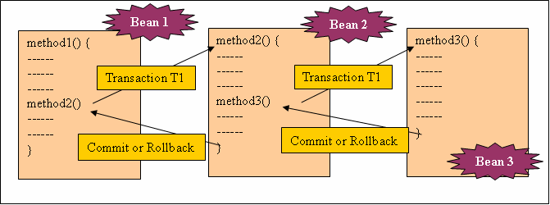
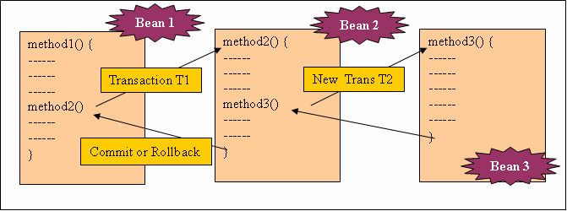
Declarative Transaction Management
Method propagating existing transaction.
Method creating new transaction.

Slide 93
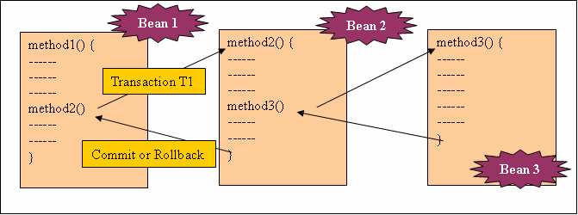
Declarative Transaction Management
Method not in any transaction.

Slide 94
Declarative Transactional Attributes
The org.springframework.transaction.annotation.Propagation interface provides following transactional attributes…
These are applicable for per method, class for defining default attribute for all methods.
Required
RequiresNew
Mandatory
Supports
NotSupported
Never

Slide 95
Trasactional Attributes
The Required (Default) attribute
The declared method must be invoked within the scope of the transaction.
The RequiredNew attribute
The declared method must be invoked always in new transaction.
Runs in propagated transaction T1
Client (T1)
T1
Atomic in T1
T1
Runs in New transaction T1
Client
Atomic in T1
Runs in new transaction T2
Client (T1)
Atomic in T2
Runs in New transaction T2
Client
Atomic in T2
Notes:
95
Transactional Attributes
Required:- If the client is running within a transaction and invokes the enterprise bean’s method ,the method executes within the client’s transaction. If the client is not associated with a transaction, the container starts a new transaction before running the method.
RequiresNew:- If the client is running within a transaction, and invokes the enterprise bean’s method ,the container takes the following steps:
Suspends the clients transaction
Starts a new transaction.
Delegates the call to the method
Resumes the clients transaction after the method completes.

Slide 96
Trasactional Attributes
The Supports attribute
The declared method is included in transaction scope if invoked within a transaction.
The NotSupported attribute
The declared method when invoked within transaction scope, suspends transaction until method completes execution.
Runs in propagated transaction T1
Client (T1)
T1
Non-Atomic in T1
T1
Runs without transaction
Client
Non-Atomic
Client (T1)
Non-Atomic
Runs without transaction
Notes:
96
Transactional Attributes
Supports :- If the client is running within a transaction and invokes the enterprise bean’s method ,the method executes within the clients transaction. If the client is not associated with a transaction, the container does not start a new transaction before running the method.
NotSupported :- If the client is not associated with a transaction, the container does not start a new transaction before running the method.
Use the NotSupported attribute for methods that don’t need transactions. Because transactions involve overhead, this attribute may improve performance.

Slide 97
Trasactional Attributes
The Mandatory attribute
The declared method is included in transaction scope if invoked within a transaction.
The Never attribute
The declared method must never be invoked in any transaction.
T1
Atomic in T1
Runs in propagated transaction T1
Client (T1)
T1
Non-Atomic
Throws exception when run without transaction.
Client
Client (T1)
Non-Atomic
Throws exception when run within transaction
Client
Non-atomic
Runs without transaction
Notes:
97
Transactional Attributes
Mandatory:- If the client is not associated with a transaction, the container throws the TransactionRequiredException. Use the Mandatory attribute if the enterprise bean’s method must use transaction of the client.
Never :- If the client is running within a transaction and invokes the enterprise bean’s method, the container throws a RemoteException. If the client is not associated with a transaction ,the container does not star a new transaction before running the method.

Slide 98
Declaring Transactions
import org.springframework.transaction.annotation.Transactional;
import org.springframework.transaction.annotation.Propagation;
@Transactional(propagation=Propagation.MANDATORY)
public void add(Material product) throws CustomException {
Session session = this.getSession(false);
Session.save(product);
}
The add() method takes part in the propagated transaction. Any exception thrown from here lead to rollback of transaction at the place this method is called.

Slide 99
Module 8
Spring 5: Spring MVC
Notes:
3 Slides - 5-10 Minute Discussion – Good to understand customers cloud strategy and see if S+S and Leveraging Existing Investments is important to them. Find out what cloud vendors and solutions they are evaluating.
For more details on the cloud definitions see wikipedia
http://en.wikipedia.org/wiki/Cloud_computing

Slide 100
Why Spring MVC?
Solution for Web and View layer designing. Well defined integration support for interacting with Service Façade.
Clear separation of each role: Controller, Validator, Command Object, form object, Model, Handler Mapping, View resolvers.
Reusable business objects: Using existing business object as command or form object.
Customizable binding and validation: Allows business object accepting data of different types. Treats type mismatches as application level validation errors.
Customizable handler mapping and view resolvers.
Model transfer into Map supports easy integration with different view technologies.
Simple yet powerful Spring Tag Library to provide features of data binding and theme selections.
Different web scopes like ‘request’, ‘session’, ‘application’ in addition to ‘singleton’ and ‘prototype’.

Slide 101
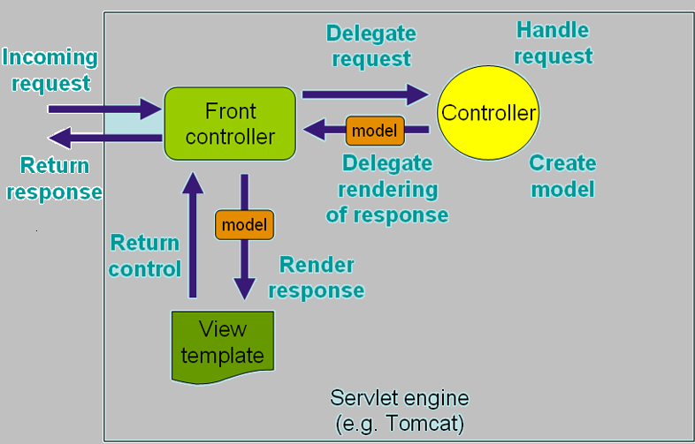
Spring MVC architecture
Notes:
101
101
The DispatchServlet: It is a central servlet that dispatches requests to the controller and offers other functionality facilitating the development of web applications. The DispatchServlet is completely integrated with IoC container and allows you to use every feature the Spring has. There can be more than one dispatcher servlets in a web application. A dispatcher servlet to handle one collection of functionality for ex. Finance. Another for HR etc. Each dispatcher servlet has its own WebApplicationContext. On initialization of DispatcherServlet, framework looks for test-servlet.xml in WEB-INF directory and create beans defined there. This servlet has to be declared in Web.xml.
The WebApplicationContext differs from normal ApplicationContext in the sense that it is capable of resolving themes and also is bound to ServletContext.
The Spring’s DispatcherServlet has a couple of special beans like- ViewResolver, HandlerMapping etc.
Handler Mappings: A list of pre-post processors and controllers that will be executed if they match certain criteria.
Controllers: The beans providing actual functionalities.
The ViewResolver: Capable of resolving view names to views used by DispatcherServlet. All controllers in Spring Web MVC framework return a ModelAndView instance. And when controller return ModelAndView(“empform”), where ‘empform’ is a view name, the viewresolver will hand the request over to the RequestDispatcher that will send the request to /WEB-INF/jsp/empform.jsp.

Slide 102
Role of a Web Layer and IOC
Spring MVC (Web layer)
Spring IOC
Service Façade
REQUEST
Front Controller
REQUEST
Controller
State, Service
DB Layer
RESPONSE
Model
Domain Model
P
A
G
E
MO
D
E
L
Views

Slide 103
MVC Components
Dispatcher Servlet: A front controller to interact with internet user. Integrated with IOC container.
Handler Mapping: Provides different matching scheme to locate Controller corresponding to client request.
Controller: Handles HTTP request, delegates to Service Façade, composes response objects (Model), passes response (Instance of ModelAndView) back to work flow managing mechanism.
Dispatcher Servlet: A front controller to interact with internet user. Integrated with IOC container.
Handler Mapping: Provides different matching scheme to locate Controller corresponding to client request.
Controller: Handles HTTP request, delegates to Service Façade, composes response objects (Model), passes response (Instance of ModelAndView) back to work flow managing mechanism.
View Resolver: Maps view names to actual view instances.
View: Responsible to render contents of ModelAndView using different view technology.
View Resolver: Maps view names to actual view instances.
View: Responsible to render contents of ModelAndView using different view technology.

Slide 104
Spring MVC architecture
2
Mapping Handler
3
Request
Dispatcher Servlet
Controller
Model & View
4
1
5
View Resolver
6
View
Notes:
104
104
Steps done on receipt of the request…
The request is intercepted and directed towards DispatchServlet
The dispatch servlet refers request to MappingHandler to know to whom to direct the request. Certainly the request is directed towards EmpFormController, particularly the the handleRequest() method.
The method returns ModelAndView instance with URL name of the next JSP in sequence. In example, this url is ‘empform’.
The ViewResolver uniquely identifies the next web component to whom to direct the request. So the url is uniquely mapped with /WEB-INF/jsp/empform.jsp.
The empform.jsp creates web page for client to allow him to enter names and click on submit button. The FORM ACTION tag refers the URL for saveempform.do.
This request again is intercepted by DispatchServlet which refers the request to MappingHandler to know whom to direct. And the request is directed toward EmpSaveController.java.
The handleRequest() of EmpSaveController.java returns URL for ‘success’.
The viewResolver identifies success.jsp as next target.
The success.jsp creates a last and final page for client.

Slide 105
MVC Processing Elements
S. | Component | Description
1 | LocaleAware | Spring MVC binds client locale to all requests. Locale Resolvers makes the locale available during entire request processing.
2 | Multipart File Uploads | Framework is integrated with two libraries- COS and Jakarta’s Commons File Upload. For further customization, implementation of MultipartResolver is possible.
3 | Request Handler Adapters | Framework provides extension points to integrate with any third party request handling framework.
4 | Handler Mapping | They map request to their handlers. Typical mapping is through URL but otherwise possible on Class names, cookies and request parameters.
5 | Interceptors | HandlerInterceptors can wrap request handlers to execute common code across many handlers.
6 | Custom Exception Handling | Possible through HandlerExceptionResolver. It can map request handler plus exception thrown.
7 | View Mappings | Facilitate flexible view mappings. Converts logical view name to physical view instance.

Slide 106
Lifecycle of framework
Context Listener loads application context.
Servlet container deployes DispatcherServlet.
DS searches for Web Application Context and loads and starts it.
On receipt of request, WebApplicationContext is bound to request under key- DispatcherServlet.WEB_APPLICATION_CONTEXT_ATTRIBUTE.
The Locale resolver is bound to the request.
The theme resolver is bound to the request.
If request is multi-part, wrapped in MultipartHttpServletRequest.
Appropriate handler is searched for and execution chain is set and executed for interceptors and controllers.

Slide 107
Lifecycle of framework
Controller returns with model for view to render.
The view resolver resolve the mapped view.
The model returned by controller is presented to resolved view.
View uses model to render on web page and returns to to DispatcherServlet to present it to end user.
If exception is thrown in whole process, handlerexception resolver comes in action and resolves to exception handling component.

Slide 108
JAR Dependencies
webmvc
web
context
beans
core
Servlet-api
Commons-logging

Slide 109
Loading Application Context
Application context is responsible to declare Service Façade and domain models. Their dependencies are declared, autowired, injected in applicationContext.xml
Application context must be loaded before DispatcherServlet is loaded.
Using Context Listener: It is a ServletContextListener with contextInitialized() method which refers applicationContext.xml in classpath and creates ApplicationContext container. If applicationContext.xml is not with default name and at default place, then Context Parameter with the name contextConfigLocation must be declared to refer to context configuration. This is Recommended approach.
Using ContextLoaderServlet: In very old Servlet (Ver 2.2), listeners are loaded after servlet. So, Servlets are responsible for loading and starting Application Context using ContextLoaderServlet.

Slide 110
Configuring DispatcherServlet
Declared in web.xml or using annotations.
Depends on Application Context.
On loading, creates a Web Context by referring to xxx-servlet.xml. Its name is derived from canonical name of a Dispatcher Servlet. Default location is class path.
This configuration file is specific to Dispatcher Servlet.
There can be more than one Dispatcher Servlet in an application each having its own configuration file identified by a canonical name of a servlet.

Slide 111
Declaring other MVC components
Controllers, HandleMappings and ViewResolvers are declared in xxx-servlet.xml
If not declared, defaults are granted where ever possible.
All they are declared as bean with appropriate properties set.

Slide 112
Mapping Handlers
Basic purpose is to map specific controller bean to url pattern sent by end user.
S.N. | Handler Mapping | Particulars
1. | BeanNameUrlHandlerMapping | Controller’s bean names are mapped to URL. (default)
2. | SimpleUrlHandlerMapping | Mappings are explicitly specified.
3. | ControllerClassNameHandlerMapping | Maps class names from URL to actual controller class.

Slide 113
Handler Mappings
BeanNameUrlHandlerMapping.
SimpleUrlHandlerMapping
ControllerClassNameHandlerMapping
Dispatcher Servlet
Controller

Slide 114
Exception Resolvers
Exception Resolvers map raised exception to exception views.
The HandlerExceptionResolver resolves exception raised from Controllers, Interceptors or Views.
Spring MVC’s exception handler overrides exception handling feature of Servlet API. If exception handler is not declared, exceptions are handled as per declared in web.xml if any.
The default implementation is…
org.springframework.web.servlet.handler.SimpleMappingExceptionResolver.
If code throws exception which is not mapped, it is ignored.
The HandlerExceptionResolver resolves exception raised from Controllers, Interceptors or Views.

Slide 115
Multi-action Controller
One controller managing more than one workflow of logical group of read-only operations.
It groups multiple actions or request handler within one controller.
Features…
By default, URL is mapped to method names.
Command bean binding.
Support for one or more validaters.
Exception handling.
Supporting of HTTP method type can be set for each controller method.
Does not support form handling workflow.
Uses reflection inside.

Slide 116
View Hierarchy
<<Interface>>
View
AbstractView
AbstractExcelView
AbstractUrlBasedView
AbstractPdfView
AbstractXsltView
AbstractJasperReportView
InternalResolverView
JstlView
TilesView

Slide 117

Module 9
Spring 5: Spring Boot
Notes:
3 Slides - 5-10 Minute Discussion – Good to understand customers cloud strategy and see if S+S and Leveraging Existing Investments is important to them. Find out what cloud vendors and solutions they are evaluating.
For more details on the cloud definitions see wikipedia
http://en.wikipedia.org/wiki/Cloud_computing

Slide 118
Overview of Spring Boot
An Open Source Java-Spring Framework to create Micro-services.
Used to build stand-alone and production ready spring application.
Powerful batch processing and easy publishing of REST end points.
Prefer Convention over Configuration.
Has embedded Servlet Container.
Can reduce complex xml configuration. Can go in combination with Spring configuration ways like: XML, Annotations, Spring Config.
Create its own container with own runtime environment within it.
Goal is to reduce development time and increase production capacity.
Recent Stable Release is 2.2.1 with Snapshot version 2.2.2
The stable release depends on Spring 5.x and JPA 2.x.

Slide 119
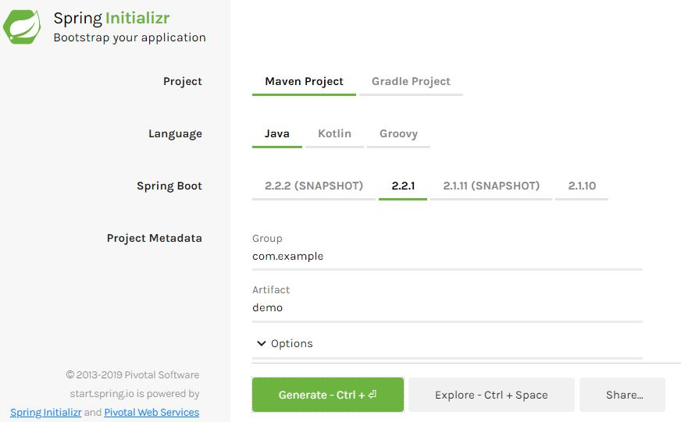
Spring Boot Components
Spring Tool Suit: An eclipsed based IDE for Spring Project Development. It comes with Pivotal tc server, Pivotal Cloud Foundry, Git, Maven and AspectJ.
Eclipse with Spring Plugin is also an equally good option. It comes with Tomcat Server, Git, Maven and other basic dependencies.
Spring Initializer: Easy way to create Spring Boot Project structure. Provides choices like which build tool to choose from Maven/Gradle. Visit https://start.spring.io/ to get it. The Initializer also comes with STA and Eclipse with Spring Plugin.

Slide 120
Spring Boot Components
Spring Boot CLI: A command line interface to run Spring Groovy Script.
Spring Boot Starters: To be added on class path through Maven’s pom.xml. They resolve all the dependencies needed for specific module.
The format is spring-boot-starter-*.
spring-boot-starter-data-jpa: Manage Spring Data for JPA.
spring-boot-starter-actuator: Used to monitor and manage application.
spring-boot-starter-web: Used to manage all Spring MVC and Spring REST related dependencies.

Slide 121
Spring Boot Annotations
@EnableAutoConfiguration: Triggers automatic configuration by referring to pom.xml
@ComponentScan: Directs spring to the package and sub packages to search for annotated beans.
@SpringBootConfiguration: Refers to the Java Config Class.
@SpringBootApplication: Collectively does job of above configurations.

Slide 122
Spring Boot: Actuater
Spring Boot provides actuator to monitor and manage our application. Actuator is a tool which has HTTP endpoints. when application is pushed to production, you can choose to manage and monitor your application using HTTP endpoints.
The Maven Dependency is as below…
<dependencies>
<dependency>
<groupId>org.springframework.boot</groupId>
<artifactId>spring-boot-starter-actuator</artifactId>
</dependency>
</dependencies>
End Points: Actuator endpoints allow us to monitor and interact with our Spring Boot application. Spring Boot includes number of built-in endpoints and we can also add custom.

Slide 123
Spring Boot: Actuator Endpoints
End Point | Description
actuator | It provides a hypermedia-based "discovery page" for the other endpoints. It requires Spring HATEOAS to be on the classpath.
auditevents | It exposes audit events information for the current application.
autoconfig | It is used to display an auto-configuration report showing all auto-configuration candidates and the reason why they 'were' or 'were not' applied.
beans | It is used to display a complete list of all the Spring beans in your application.
configprops | It is used to display a collated list of all @ConfigurationProperties.
dump | It is used to perform a thread dump.
env | It is used to expose properties from Spring's ConfigurableEnvironment.

Slide 124
Spring Boot: Actuator Endpoints
End Point | Description
health | It is used to show application health information.
info | It is used to display arbitrary application info.
loggers | It is used to show and modify the configuration of loggers in the application.
Metrics | It is used to show metrics information for the current application.
mappings | It is used to display a collated list of all @RequestMapping paths.
shutdown | It is used to allow the application to be gracefully shutdown.
trace | It is used to display trace information.

Slide 125
Q & A
Contact: makarandbhoir@synergetics-india.com

Slide 126
References
Online reference:
https://docs.spring.io/spring/docs/current/spring-framework-reference/
https://howtodoinjava.com/spring-5-tutorial/
https://www.baeldung.com/spring-5
https://www.journaldev.com/20714/spring-5

Slide 127
Thank You

