Slide 1
Group 3
Electric Production
-Makarand
-Rajesh
-Swetha
-Vishal

Slide 2
Forecasting Motivation:
Wind extinguish candle and energises fire - Nicholas Taleb
Common people fear the uncertain, great people solve the uncertainty

Slide 3
About Data:
www.valueline.
An electric utility is a company in the electric power industry (often a public utility) that engages in electricity generation and distribution of electricity for sale generally in a regulated market. The electrical utility industry is a major provider of energy in most countries.
The given data is about Electric Utilities Production Index from 1939 to 2018.
Features are IPG, DATE(YYYY-MM-DD)
IPG( Industrial Production Growth) provides the insight about present month Electric utilities Production Growth with respect to previous month.

Slide 4
Data Pre-processing Steps:
Step 1: In the given dataset, date column is of datatype=object. So, parse_dates = True is used to get the date as datatype = datetime and set as index using index_col.
Step 2: Null values are checked and we found no null values in data.
Step 3: Cross tab of given dataset for year wise Industrial Production Growth Index is tabulated.

Slide 5
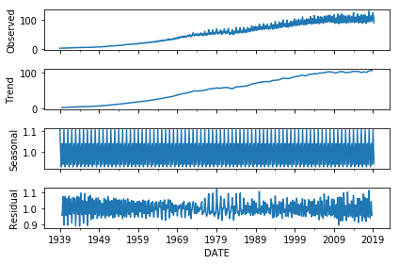
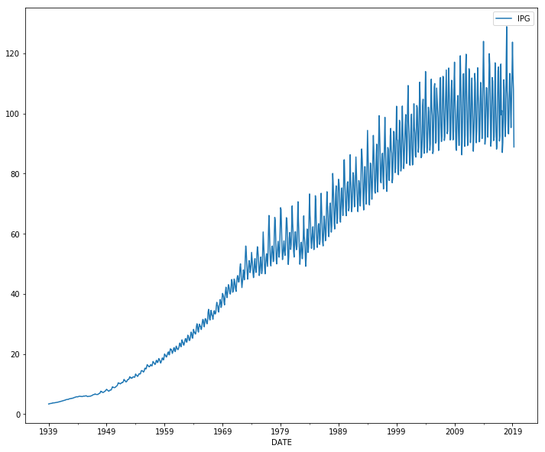
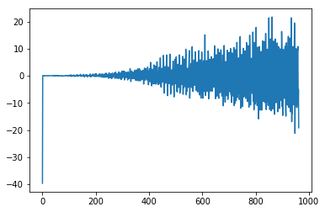
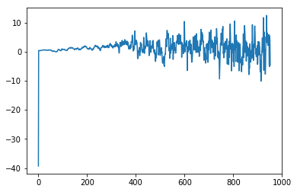
EDA:
Decomposition : Multiplicative
Data Plot:
De trend :
De Seasonalize :

Slide 6
EDA Contd.
The data plot from the previous slide shows us that the industrial growth has not been the same during 1939-2018.
From 1939-45 the US was an active member of World War II which adversely affected the IPG.
From 1945-75, the US was involved in many wars such as the Cold War, Korean War and the infamous Vietnam War which also did not allow the industrial sector to grow at a rapid pace.
As you can see in the data plot, the plot has trend and seasonality and they appear to be multiplicative in nature.

Slide 7
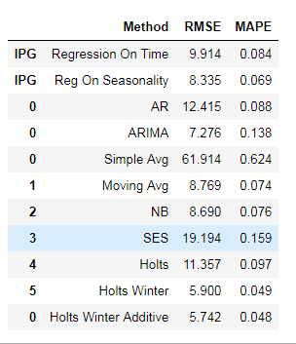
Model Comparison:
Top Three Models

