Slide 1
Bluestock Mutual Fund Analytics Capstone Project
Prepared By: Makarand Patil
Organization: Bluestock Fintech Pvt. Ltd.
Technology Stack: Python | Pandas | SQL | SQLite | Power BI | Plotly
Date: June 2026

Slide 2
Problem Statement & Business Objective
Business Problem
The Indian Mutual Fund industry generates large volumes of NAV, AUM, SIP and investor transaction data. However:
• Data is fragmented across multiple sources. • Performance comparison between funds is difficult. • Risk-adjusted analytics are not readily available. • Investor behavior insights are limited. • Reporting is mostly static and time-consuming.
Project Objectives
Build an ETL pipeline for mutual fund data.
Create a centralized analytical database.
Perform Exploratory Data Analysis.
Calculate performance and risk metrics.
Build an interactive dashboard.
Generate actionable investment insights.

Slide 3
Data Sources
Datasets Used
Fund Master Dataset
Scheme information
Fund category
Risk classification
NAV History Dataset
Daily NAV values
Historical performance tracking
AUM Dataset
Assets under management
AMC-level growth analysis
SIP Inflow Dataset
Monthly SIP contributions

Slide 4
Investor Transactions Dataset SIP Lumpsum Redemption transactions Portfolio Holdings Dataset Sector allocations Portfolio concentration Benchmark Dataset NIFTY50 NIFTY100 Dataset Scale • 40 Mutual Fund Schemes • 1000+ Investor Transactions • Multi-year NAV History • Multiple Market Benchmarks Speaker Notes: These datasets collectively provide a comprehensive view of the mutual fund ecosystem, allowing both investor-level and scheme-level analysis.

Slide 5
System Architecture & ETL Pipeline
Data Engineering Workflow
Data Sources ↓ Extract ↓ Transform ↓ Load ↓ Analytics ↓ Dashboard
ETL Activities
• Data ingestion using Python • Missing value handling • Data validation • Data standardization • Feature engineering • SQLite database loading

Slide 6
Database Design
Dimension Tables: • dim_fund • dim_date
Fact Tables: • fact_nav • fact_transactions • fact_performance

Slide 7
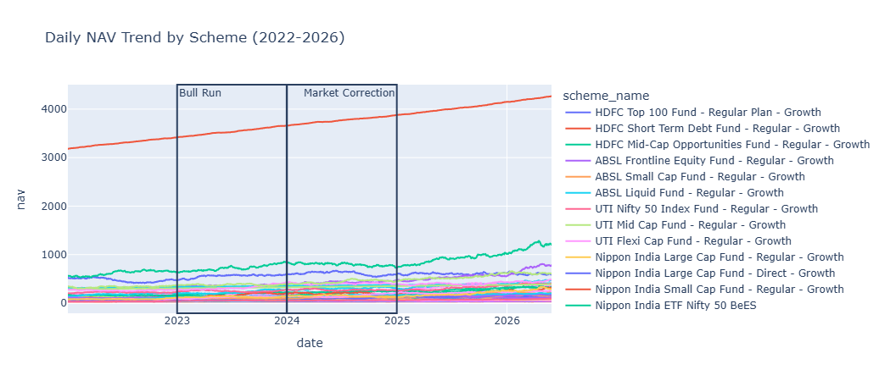
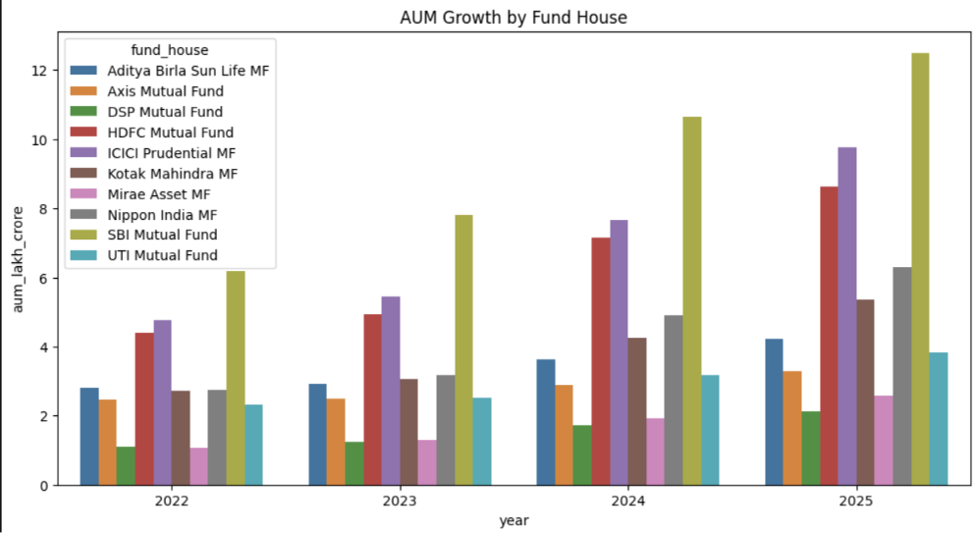
EDA Highlights – NAV & AUM Analysis
NAV Trend Analysis
Observations:
• Consistent NAV growth from 2022–2026. • Strong recovery after market corrections. • Large-cap funds showed lower volatility.
AUM Analysis
Observations:
• SBI Mutual Fund maintained highest AUM. • HDFC and ICICI Prudential followed closely. • Industry AUM showed continuous expansion.

Slide 8
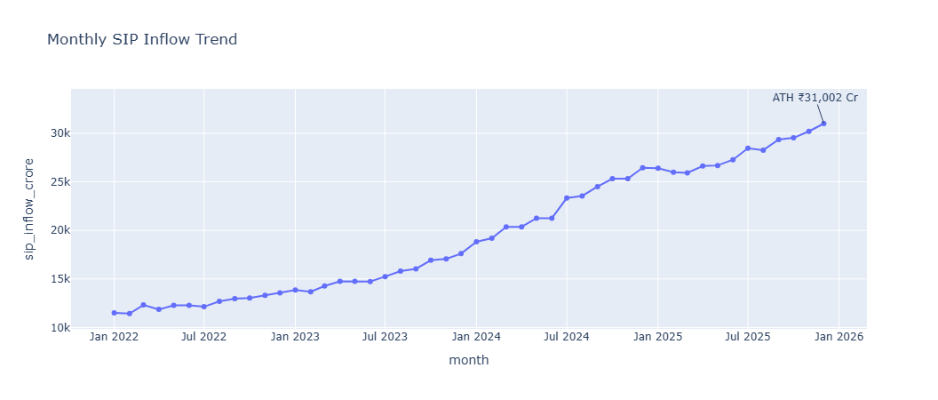
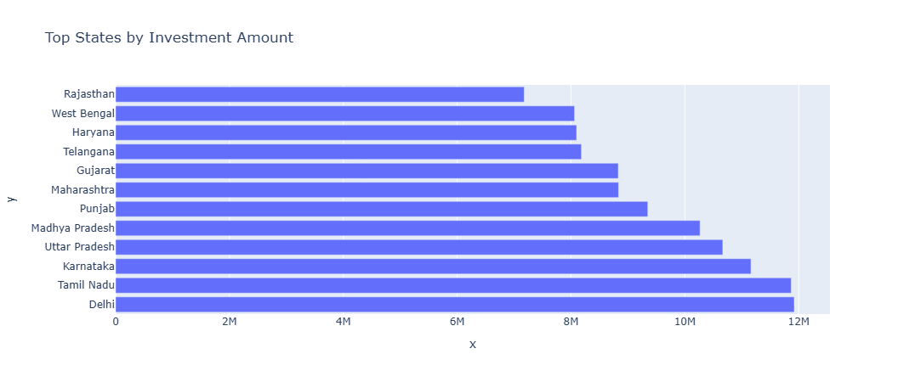
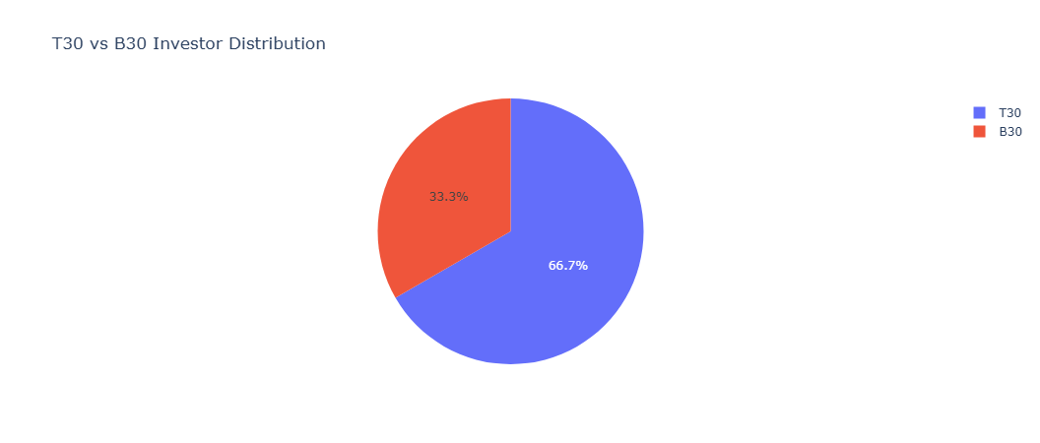
EDA Highlights – SIP & Investor Analytics
SIP Trend Analysis
Findings:
• SIP inflows increased steadily. • December 2025 crossed ₹31,002 Cr milestone.
Investor Demographics
Findings:
• 26–35 age group contributed most investments. • SIP is the dominant investment mode. • T30 cities contribute majority investment volume.

Slide 9
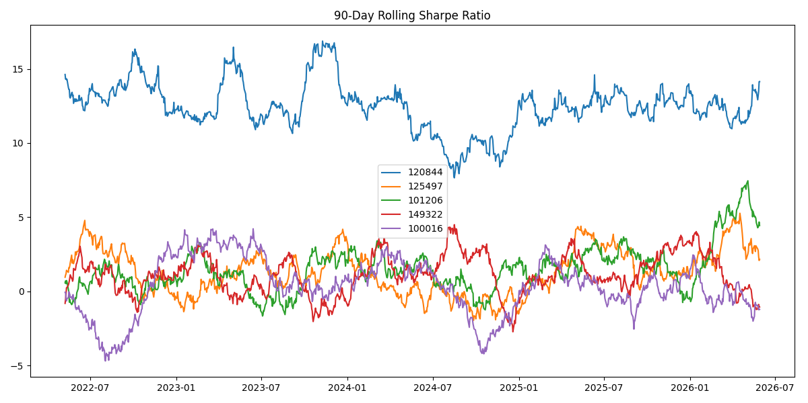
Performance Analytics
Key Performance Metrics
Calculated:
• CAGR • Annualized Returns • Sharpe Ratio • Sortino Ratio • Alpha • Beta • Standard Deviation • Maximum Drawdown
Objective
Measure risk-adjusted fund performance and benchmark comparison.

Slide 10
Fund Scorecard & Benchmark Analysis
Fund Scoring Model
Composite Score Components
• 30% Return Rank • 25% Sharpe Rank • 20% Alpha Rank • 15% Expense Ratio Rank • 10% Drawdown Rank
Benchmark Comparison
Compared Against:
• Nifty 50 • Nifty 100 • BSE SmallCap

Slide 11
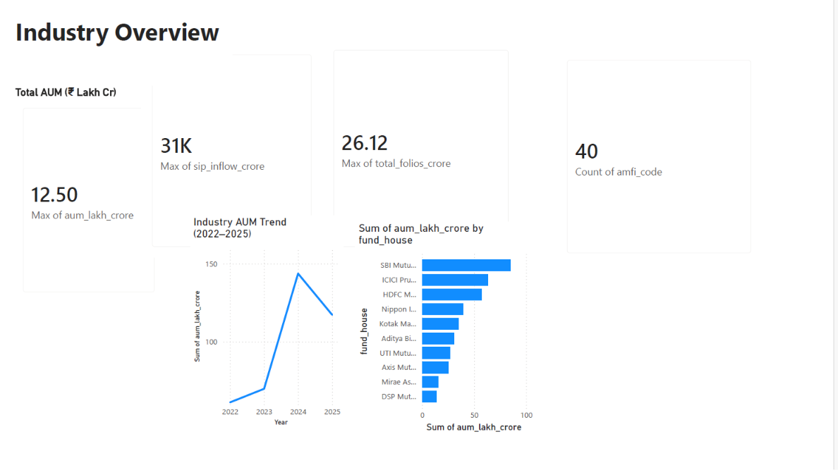
Dashboard – Industry Overview
Dashboard Features
KPIs:
• Total Industry AUM • SIP Inflows • Folio Count • Total Schemes
Visualizations:
• AUM Trend • Top Fund Houses • Industry Growth
Filters:
• Fund House • Category • Date Range

Slide 12
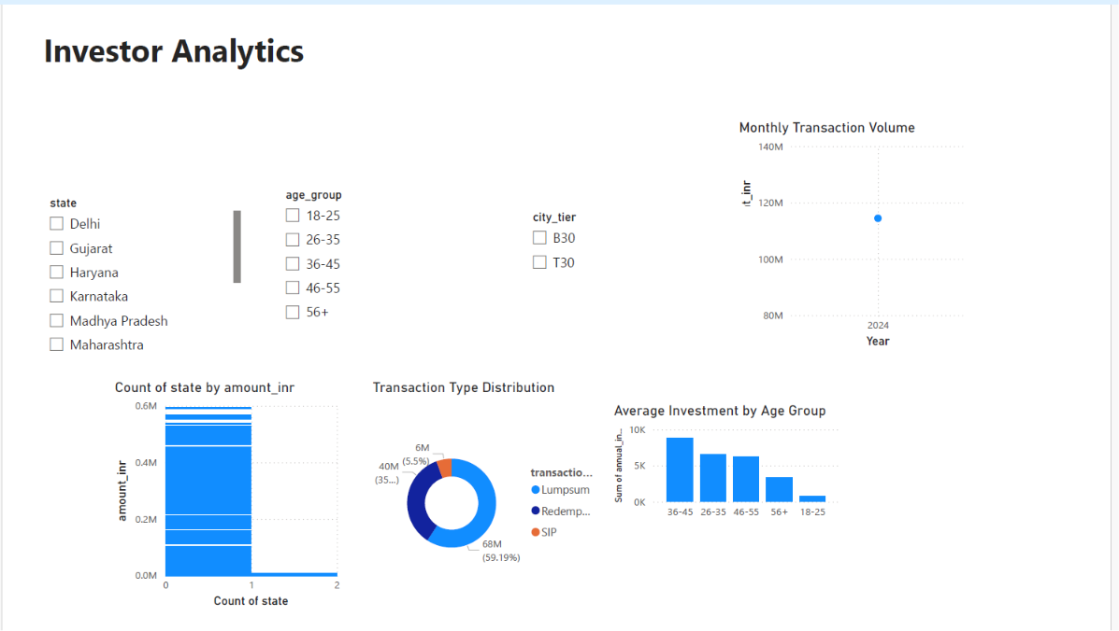
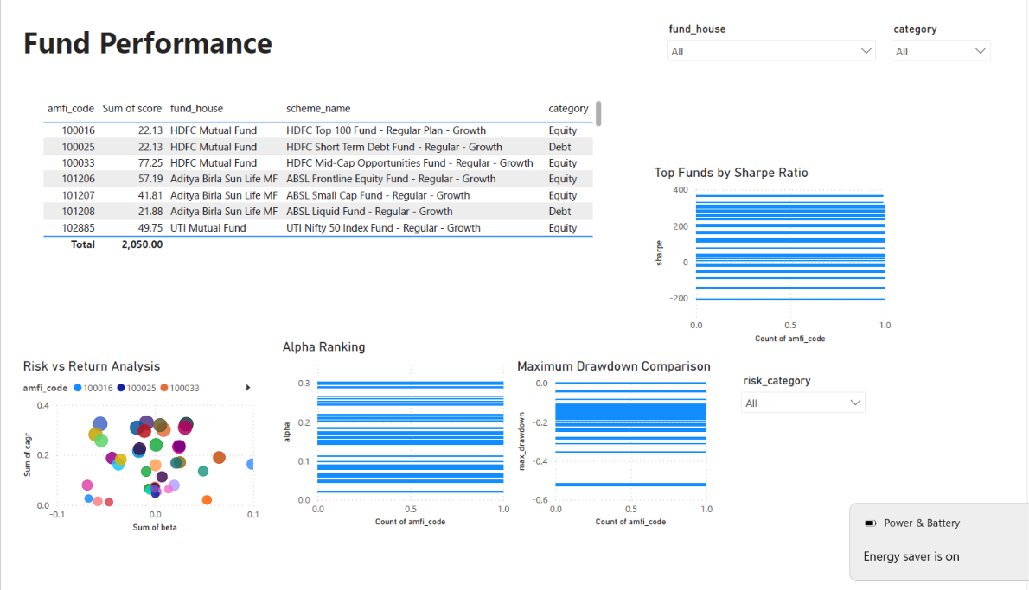
Dashboard – Investor & Performance Analytics
Dashboard Features
Investor Analysis
• State-wise Investments • Age Group Analysis • SIP vs Redemption
Performance Analysis
• Fund Ranking • Benchmark Comparison • Risk Metrics
Interactive Filters
• State • Category • Fund House

Slide 13
Key Findings & Recommendations
Key Findings
SIP inflows achieved record growth.
Large-cap funds showed stable performance.
SBI MF maintained highest AUM.
Younger investors dominate SIP participation.
Several schemes generated positive alpha.
Risk-adjusted metrics improved fund comparison.
Recommendations
• Increase focus on SIP-based investors. • Expand digital investor engagement. • Monitor alpha-generating schemes. • Enhance portfolio diversification.

Slide 14
Conclusion & Thank You
Project Outcomes
✔ Built complete ETL pipeline
✔ Developed analytical database
✔ Performed EDA
✔ Computed risk metrics
✔ Created interactive dashboard
✔ Generated business insights
Technologies Used
Python | SQL | SQLite | Pandas | Plotly | Power BI

Slide 15
Thank You !!

