Slide 1
CHAT BOT DEPLOYMENT WITH IBM CLOUD WATSON ASSISTENT
PRESENTED By
MAKATHI R

Slide 2
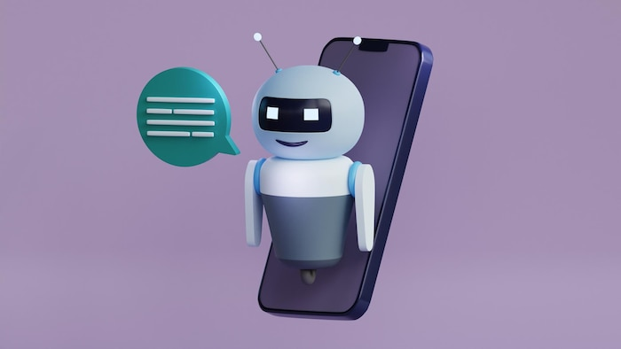
Streamlining Object Storage Development
Deploying Chat Bots with IBM Cloud Watson Assistant

Slide 3

Object storage development
Object storage is a modern approach to storing and managing large amounts of unstructured data. It provides scalability, durability, and flexibility for various applications and workloads.

Slide 4
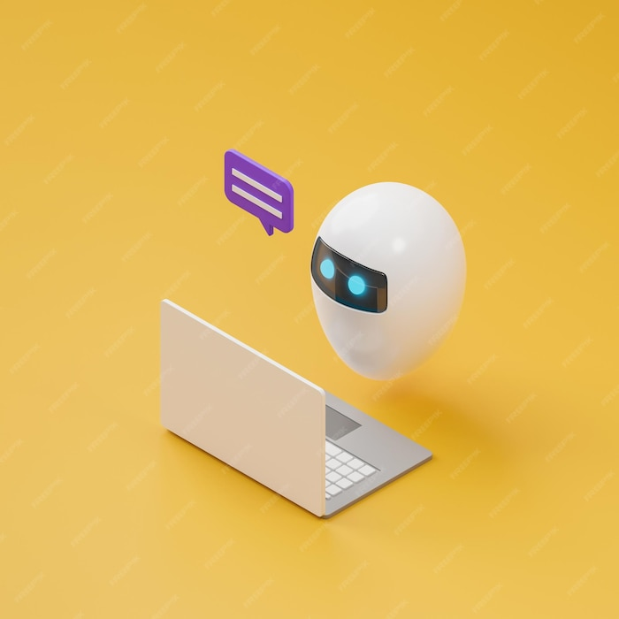
CHATBOTs
Chat bots are AI-powered virtual assistants that can interact with users in natural language. They can be deployed in various applications to provide automated support, enhanced customer experiences, and 24/7 availability.

Slide 5

IBM Cloud Watson Assistant
IBM Cloud Watson Assistant is a powerful tool for building and deploying chat bots. It leverages natural language processing, machine learning, and contextual understanding to provide intelligent and personalized responses.

Slide 6

Benefits of Streamlining Object Storage Development
By streamlining object storage development, organizations can achieve faster time-to-market, improved scalability, and reduced costs. Deploying chat bots with IBM Cloud Watson Assistant further enhances these benefits by enabling efficient data retrieval and seamless user interactions.

Slide 7

Use Cases for Object Storage and Chat Bots
Object storage and chat bots can be used in various industries and scenarios, such as customer support, e-commerce, healthcare, and banking. They enable organizations to deliver personalized experiences, automated assistance, and data-driven insights.

Slide 8
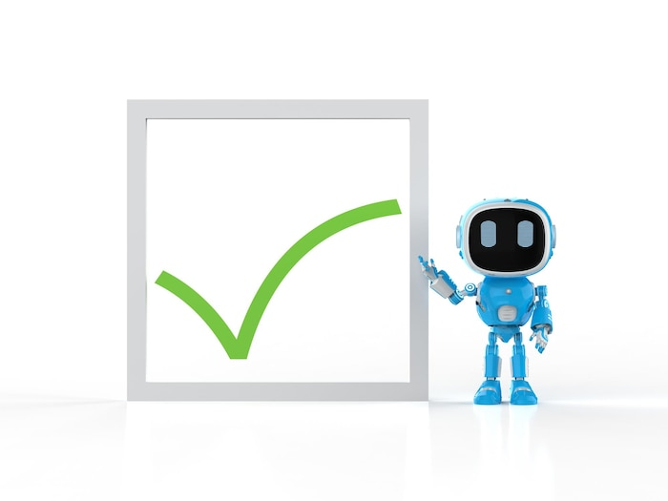
To successfully deploy chat bots, consider defining clear use cases, training the AI models with relevant data, implementing continuous learning, and monitoring performance. Additionally, ensure seamless integration with existing systems and regular updates based on user feedback.

Slide 9
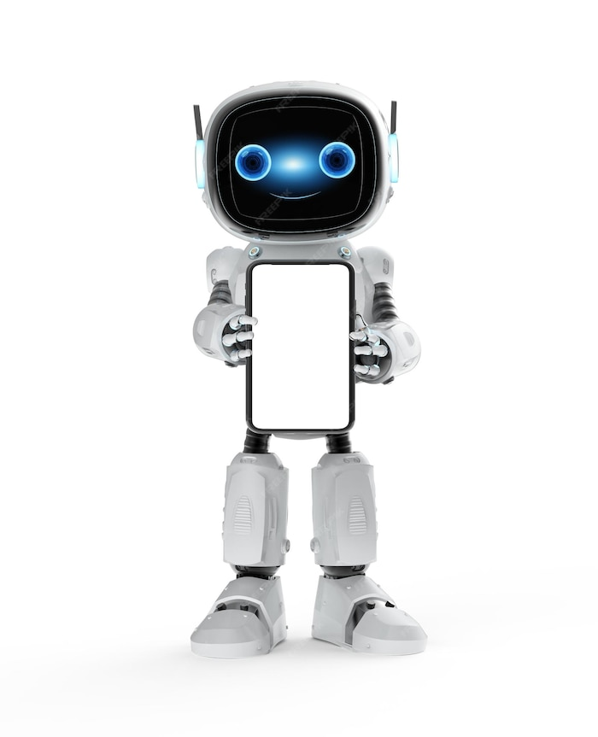
Case Study: Object Storage and Chat Bots in Action
Explore a real-world case study showcasing how an organization streamlined object storage development and deployed chat bots with IBM Cloud Watson Assistant. Learn about the challenges, solutions, and benefits they experienced.

Slide 10
Coding
from ibm_watson import AssistantV2 from ibm_cloud_sdk_core.authenticators import IAMAuthenticator
# Create an IAM Authenticator authenticator = IAMAuthenticator('your_api_key’)
# Create an Assistant instance assistant = AssistantV2( version='2021-09-16', authenticator=authenticator )
# Set the service URL assistant.set_service_url('your_service_url’)
# Interact with the assistant response = assistant.message( assistant_id='your_assistant_id', input={ 'message_type': 'text', 'text': 'Hello, chatbot!' } )

Slide 11

Future Trends in Object Storage and Chat Bots
As technology continues to advance, we can expect object storage and chat bots to evolve further. Some future trends include enhanced natural language understanding, voice-enabled interactions, advanced analytics, and integration with lot devices.

Slide 12

Conclusion
Streamlining object storage development and deploying chat bots with IBM Cloud Watson Assistant offer organizations a powerful combination for efficient data management, enhanced user experiences, and competitive advantage. Embrace these technologies to stay ahead in the digital era

Slide 13


