Slide 1
Life Science Foundation
(Biol. 1012)
For Computer Science students
2024/25 : Academic year

Slide 2
Chapter 1: Introduction
At the end of this chapter you will be able to:
Define the term Biology
Explain the scientific methods briefly
Explain the origin and nature of life

Slide 3
The Meaning and Scope of Biology
What is meant by Biology/Biological sci.?
Who Coined the Term?
What is the Scope of Biology?

Slide 4
1.1. The Meaning and Scope of Biology
Biological Sciences is the study of life and living organisms
Biology (Gk., bios, life; logous, study) is the study of living beings
Also called Life Science
The term biology was coined by Pierre-Antoine de Monet and Jean-Baptiste de Lamarck in the late 1700s
Earlier study of living things was restricted to the pure Science like Botany and Zoology that together comprise the Biology, but as the time passed new branches evolved

Slide 5
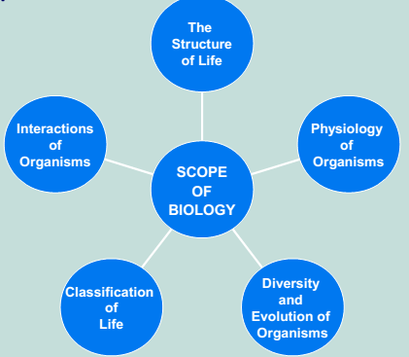
Scope of Biology
Biological Sciences is an extensive study covering the minute workings of chemical substances inside living cells to the broad scale concepts of ecosystems and global environmental changes

Slide 6
1.2. The 0rigin and Nature of Life
What is life?
One of the biggest and most important of emergent phenomena is that of the origin or emergence of life
The mystery of life's origin is still a big debating issue in science
There are a number of theories about the origin of life
Special Creationism
Spontaneous Generation
Theory of Catastrophism
Cosmozoic Theory (Theory of Panspermia)
Chemical Evolution

Slide 7
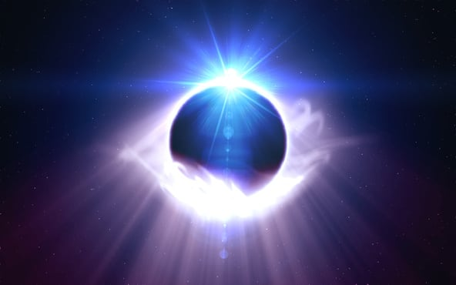

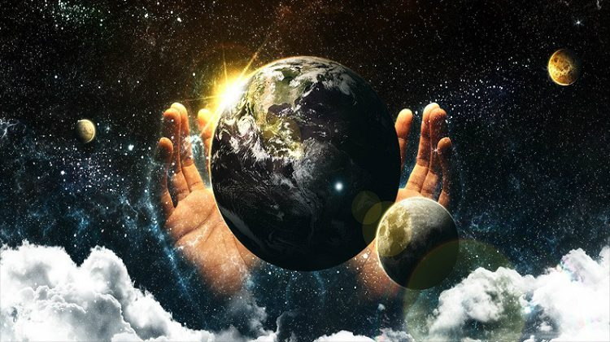
1.2 The origin and nature….Cont’d
Theory of Special Creation: according to this theory, all the different forms of life that occur today on planet earth have been created by God, the almighty

Slide 8
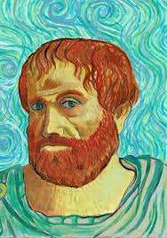
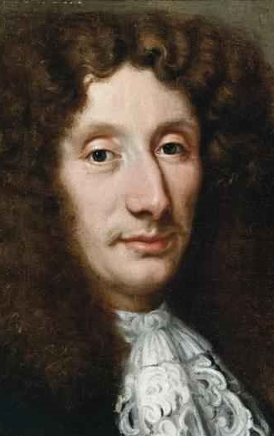
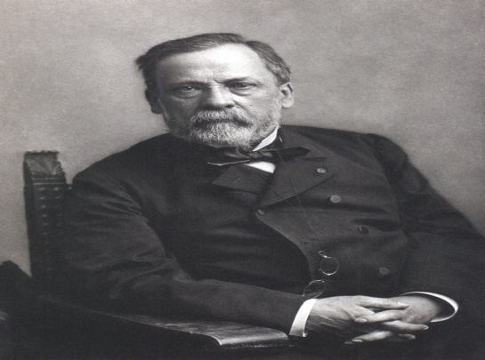
1.2 The origin and nature of life
2 . Theory of Spontaneous Generation:
This theory assumed that living organisms could arise suddenly and spontaneously from any kind of non-living matter.
One of the firm believers in spontaneous generation was Aristotle, the Greek philosopher
Francesco Redi and Louis Pasteur disproved spontaneous generation and they suggested that life came from pre-existing life
Thus, they are biogenesists
Francesco Redi-1626- 1697
Louis Pasteur 1822- 1895
Aristotle (384-322 BC).

Slide 9
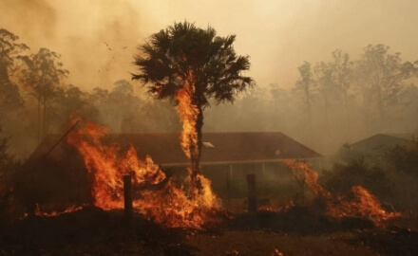

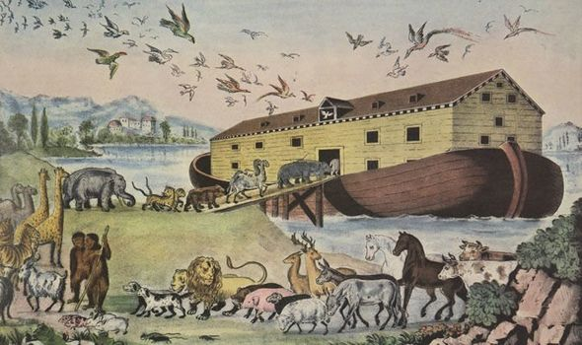
1.2 The origin and nature….Cont’d
Theory of Catastrophism:
It is simply a modification of the theory of Special Creation
It states that there have been several creations of life by God, each preceded by a catastrophe resulting from some kind of geological disturbance
Each catastrophe completely destroyed the existing life, each new creation consisted of life form different from that of previous ones

Slide 10
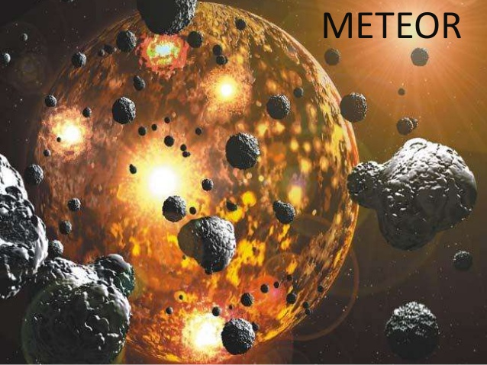
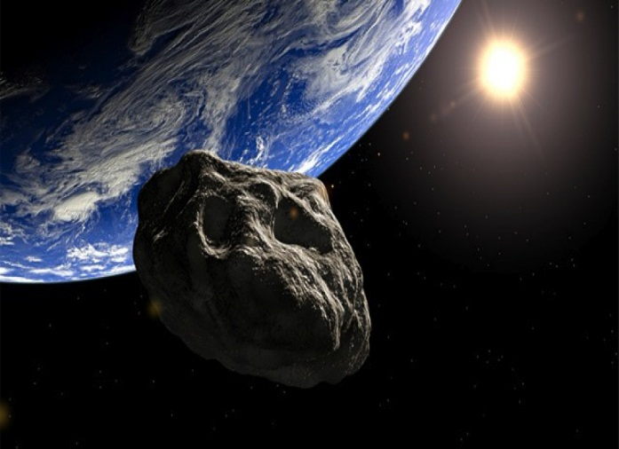
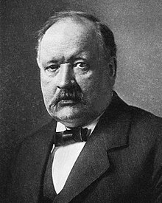
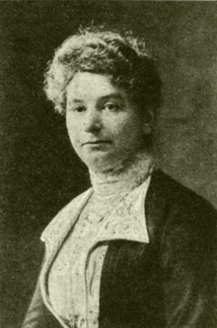
1.2 The origin and nature….Cont’d
Cosmozoic Theory (Theory of Panspermia):
life has reached this planet Earth from other heavenly bodies such as meteorites, in the form of highly resistance spores of some organisms.
This idea was proposed by Richter in 1865 and supported by Arrhenius (1908).
The theory did not gain any support.
This theory lacks evidence, hence it was discarded
Svante Arrhenius-Swedish
Elise Richter-Australia

Slide 11
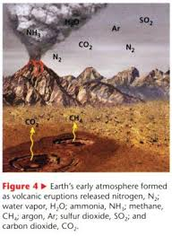
1.2 The origin and nature….Cont’d
Theory of Chemical Evolution:
Also known as Materialistic Theory or Physico-chemical Theory
Oparin and Haldane theory
Origin of life on earth is the result of a slow and gradual process of chemical evolution that probably occurred about 3.8 billion years ago
This theory was proposed independently by two scientists - A. I. Oparin, a Russian scientist in 1923 and J.B.S Haldane, an English scientist, in 1928.
The entire process of chemical evolution can be divided in the following steps/ways
Origin of earth and primitive ATM
Formation of NH4, CO2 and H2O vapor
Synthesis of simple OCs
Synthesis of complex OCs
Formation of nucleic acids
Formation of 1st cell
Biological evolution

Slide 12
Nature and Characteristics of Life
Life is defined as a "condition" that distinguishes Animals and Plants from inorganic materials and dead organisms
An individual living creature is called an Organism
There are many characteristics that living organisms share, They all:
Irritability: the ability to be excited or detect stimuli and to respond to changes in their environment
Growth and Reproduction: this consists of the power of multiplication and duplication, regeneration and differentiation

Slide 13
Nature and characteristics…Cont’d
Adaptability: permitting both change and maintenance of balances (homeostasis)
Metabolism: the transformation of energy and the use of materials
Excretion: the removal of waste products from the cell of metabolism. In plant cells the major excretory products are oxygen from photosynthesis and carbon dioxide from cell respiration

Slide 14
1.3. Scientific Methods
What is a scientific method?
It is a process for experimentation that is used to explore observations and answer questions
It is also the technique used in the construction and testing of a scientific hypothesis.
The scientific method has Five Basic Steps, plus One Feedback Step:
Observation
Question or problem
Hypothesis
Experiment
Results/conclusions
Recommendations

Slide 15
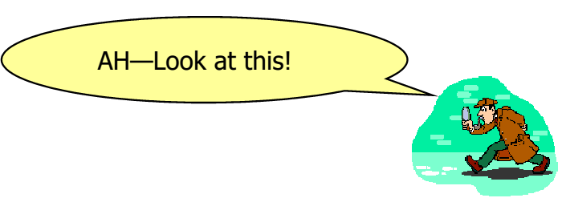

1.3 Scientific Methods…Cont’d
Observation- You observe something using your senses
What you see makes you ask a question or state a problem

Slide 16

1.3 Scientific Methods…Cont’d
2. Problem or Question: You ask a question about what is being observed, State the problem or question

Slide 17

1.3 Scientific Methods…Cont’d
3. Hypothesis-You make an educated guess on what you think the outcome of the experiment, or the answer to your question will be.

Slide 18


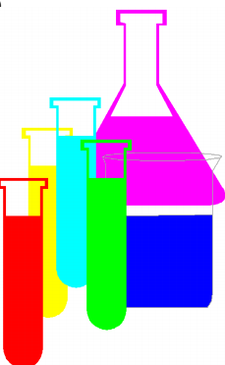
1.3 Scientific Methods…Cont’d
4. Experiment- You figure out a way to test whether the hypothesis is correct. The outcome must be measurable. Record and analyze data.

Slide 19


1.3 Scientific Methods…Cont’d
5.Results/Conclusion. You will record the results of your experiment, and repeat the experiment if need be. You will state if your hypothesis was accepted or not and try to explain your results.
Rejected Hypothesis - An explanation that has been ruled out through experimentation.
Accepted Hypothesis - An explanation that has not been ruled out through excessive experimentation and makes verifiable predictions that are true.

Slide 20
1.3 Scientific Methods…Cont’d
Summary of the scientific method
Step 1: Observe behavior or other phenomena
Step 2: Form a tentative answer or explanation (a hypothesis/guess a reason)
Step 3: Use your hypothesis to generate a testable prediction
Step 4: Make systematic, planned observations (data collection)
Step 5: Results and Discussion Use the observations to evaluate (support, refute, or refine) the original hypothesis
Step 6: Conclusion
Step 7: Recommendation

Slide 21
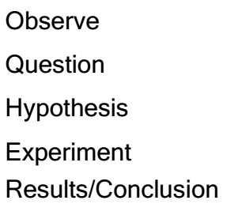

Exercise
Q1. Which step in the Scientific Method is given here?
If I water and feed the plants, then they will grow to be tall and healthy.
My hypothesis is accepted. When I watered and fed the plants daily, they grew.
Today while walking home, I noticed that the plants in my front yard were starting to die.
Why is it that some plants are growing, and other plants are dying? What affects the growth of plants?
To answer my questions, I watered and fed the plants daily and recorded my findings.
1. hypothesis
2. Results/Conclusion
3. observation
4. Problem/Questions
5. An experiment

Slide 22
Chapter Two

