Slide 1
Term Project REPORT 접근방식 ( 로봇 및 스마트시스템 공학과 김진성 / 2020223631 )
1. 목적 : Cifar-10 Data 인식률 향상 모델 생성
2. CIFAR-10 데이터 특징
가. 32x32 픽셀의 10개의 클래스로 라벨링된 60,000개 이미지
1) 클래스 : 비행기, 자동차, 새, 고양이, 사슴, 개, 개구리, 말, 배, 트럭
2) 트레이닝 이미지 50000개, 테스트용 이미지 10000개
3. 텀 프로젝트 규칙
가. Baseline Code 에서 좋은 성능을 가지는 모델 만들기
- git clone https://github.com/kuangliu/pytorch-cifar.git
나. Deep learning architecture : AlexNet, VGG, ResNet
,SqueezeNet, DenseNet, Inception v3, GoogLeNet, ShuffleNet v2
,MobileNetV2, MobileNetV3, ResNeXt, Wide ResNet, MNASNet,
EfficientNet.
다. You can use ImageNet pre-trained model.
4. 접근 방법론
STEP1. Baseline Code 코드 파악
가. Baseline code 먼저 실행 : Default Resnet
STEP2. 기존 모델을 잡고 수업시간의 활용한 내용 확인하기
가. Learning Rate 조정 : 스케쥴링이 효율적
나. Learning 스케쥴링 + Batch Size 조정 : 큰 효과 없음
다. Activation Function(gelu) 및 poolingI(globalPooing) 변경
- 학습 속도 빨라짐, 부분이 아닌 전체 특징을 학습하는 개념
라. Dropout 혹은 Batch-nomarlization
- BatchNorm2d 이 대중적으로 사용됨을 확인
마. 전이학습 활용하기
- 활용모델 : ResNet(잘 되서), MobileNetV3(하드웨어 포팅 고려)
- freeze / freeze 스케쥴링
바. 앙상블 구현 : softvoting
STEP3. 아이디어 적용해보기
가. 데이터 증강 : 뭉갠 데이터 학습 vs super 레졸루션 데이터 학습

Slide 2
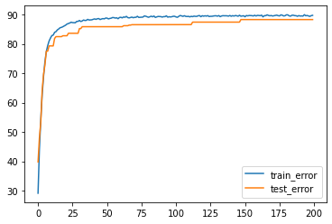
Term Project REPORT 접근방식 ( 로봇 및 스마트시스템 공학과 김진성 / 2020223631 )
bASE
※ base line code 설정
※ 실행결과
Data 증강 | RandomCrop(32, padding=4), RandomHorizontalFlip()
Shulffle | True
batch_size | 128
모델 | ResNet18
criterion | CrossEntropyLoss
optimizer | SGD
scheduler | none
learning rate | 0.1
epoch | 200
Epoch: 199
Epoch: 199 | Batch_idx: 0 | Loss: (0.3132) | Acc: (89.84%) (115/128)
Epoch: 199 | Batch_idx: 50 | Loss: (0.2809) | Acc: (90.61%) (5915/6528)
Epoch: 199 | Batch_idx: 100 | Loss: (0.2833) | Acc: (90.34%) (11679/12928)
Epoch: 199 | Batch_idx: 150 | Loss: (0.2858) | Acc: (90.24%) (17441/19328)
Epoch: 199 | Batch_idx: 200 | Loss: (0.2911) | Acc: (90.00%) (23156/25728)
Epoch: 199 | Batch_idx: 250 | Loss: (0.2938) | Acc: (89.87%) (28874/32128)
Epoch: 199 | Batch_idx: 300 | Loss: (0.2958) | Acc: (89.82%) (34604/38528)
Epoch: 199 | Batch_idx: 350 | Loss: (0.2976) | Acc: (89.79%) (40340/44928)
# TEST : Loss: (0.5925) | Acc: (80.90%) (8090/10000)

Slide 3
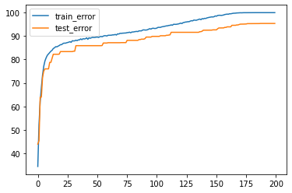
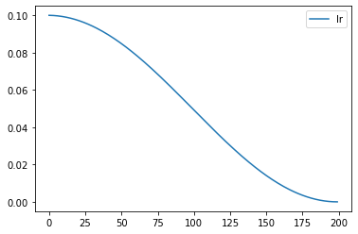
러닝 스케쥴
※ base line code 설정
※ 실행결과
Data 증강 | RandomCrop(32, padding=4), RandomHorizontalFlip()
Shulffle | True
batch_size | 128
모델 | ResNet18
criterion | CrossEntropyLoss
optimizer | SGD
scheduler | CosineAnnealingLR
learning rate | 0.1
epoch | 200
Epoch: 199
Epoch: 199 | Batch_idx: 0 | Loss: (0.0032) | Acc: (100.00%) (128/128)
Epoch: 199 | Batch_idx: 50 | Loss: (0.0019) | Acc: (100.00%) (6528/6528)
Epoch: 199 | Batch_idx: 100 | Loss: (0.0018) | Acc: (100.00%) (12928/12928)
Epoch: 199 | Batch_idx: 150 | Loss: (0.0018) | Acc: (100.00%) (19328/19328)
Epoch: 199 | Batch_idx: 200 | Loss: (0.0018) | Acc: (100.00%) (25728/25728)
Epoch: 199 | Batch_idx: 250 | Loss: (0.0018) | Acc: (100.00%) (32128/32128)
Epoch: 199 | Batch_idx: 300 | Loss: (0.0017) | Acc: (100.00%) (38528/38528)
Epoch: 199 | Batch_idx: 350 | Loss: (0.0017) | Acc: (100.00%) (44928/44928)
# TEST : Loss: (0.1814) | Acc: (95.31%) (9531/10000)

Slide 4
#첨부
러닝 스케쥴
※ base line code 설정
※ 실행결과
Data 증강 | RandomCrop(32, padding=4), RandomHorizontalFlip()
Shulffle | True
batch_size | 128
모델 | ResNet18
criterion | CrossEntropyLoss
optimizer | SGD
scheduler | 사용자 지정 lr_lambda=lambda epoch: 0.95 ** epoch
learning rate | 0.1
epoch | 200
Epoch: 180
Epoch: 180 | Batch_idx: 0 | Loss: (0.0017) | Acc: (100.00%) (128/128)
Epoch: 180 | Batch_idx: 50 | Loss: (0.0017) | Acc: (100.00%) (6528/6528)
Epoch: 180 | Batch_idx: 100 | Loss: (0.0017) | Acc: (100.00%) (12928/12928)
Epoch: 180 | Batch_idx: 150 | Loss: (0.0018) | Acc: (100.00%) (19328/19328)
Epoch: 180 | Batch_idx: 200 | Loss: (0.0018) | Acc: (100.00%) (25728/25728)
Epoch: 180 | Batch_idx: 250 | Loss: (0.0018) | Acc: (100.00%) (32128/32128)
Epoch: 180 | Batch_idx: 300 | Loss: (0.0018) | Acc: (100.00%) (38528/38528)
Epoch: 180 | Batch_idx: 350 | Loss: (0.0018) | Acc: (100.00%) (44927/44928)
# TEST : Loss: (0.2096) | Acc: (94.52%) (9452/10000)

Slide 5
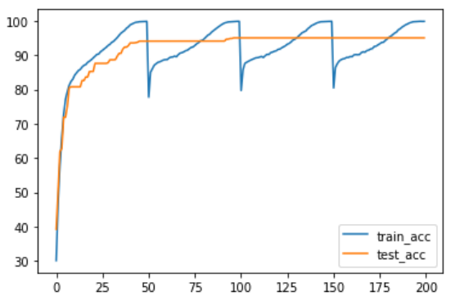
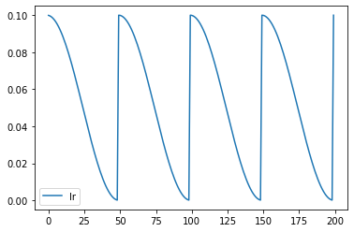
#첨부
러닝 스케쥴
※ base line code 설정
※ 실행결과
Data 증강 | RandomCrop(32, padding=4), RandomHorizontalFlip()
Shulffle | True
batch_size | 128
모델 | ResNet18
criterion | CrossEntropyLoss
optimizer | SGD
scheduler | CosineAnnealingWarmRestarts(optimizer, T_0 = 50, T_mult=1)
learning rate | 0.1
epoch | 200
Epoch: 198
Epoch: 198 | Batch_idx: 0 | Loss: (0.0028) | Acc: (100.00%) (128/128)
Epoch: 198 | Batch_idx: 50 | Loss: (0.0073) | Acc: (99.86%) (6519/6528)
Epoch: 198 | Batch_idx: 100 | Loss: (0.0066) | Acc: (99.85%) (12909/12928)
Epoch: 198 | Batch_idx: 150 | Loss: (0.0066) | Acc: (99.86%) (19300/19328)
Epoch: 198 | Batch_idx: 200 | Loss: (0.0064) | Acc: (99.86%) (25693/25728)
Epoch: 198 | Batch_idx: 250 | Loss: (0.0061) | Acc: (99.87%) (32086/32128)
Epoch: 198 | Batch_idx: 300 | Loss: (0.0060) | Acc: (99.88%) (38481/38528)
Epoch: 198 | Batch_idx: 350 | Loss: (0.0060) | Acc: (99.88%) (44873/44928)
# TEST : Loss: (0.1906) | Acc: (94.80%) (9480/10000)

Slide 6
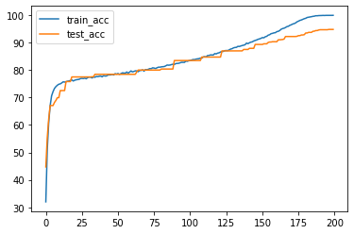
#첨부
러닝 스케쥴+ 배치사이즈
※ base line code 설정
※ 실행결과
Data 증강 | RandomCrop(32, padding=4), RandomHorizontalFlip()
Shulffle | True
batch_size | 32
모델 | ResNet18
criterion | CrossEntropyLoss
optimizer | SGD
scheduler | CosineAnnealingLR
learning rate | 0.1
epoch | 200
Epoch: 199 | Batch_idx: 800 | Loss: (0.0037) | Acc: (99.95%) (25620/25632)
Epoch: 199 | Batch_idx: 850 | Loss: (0.0037) | Acc: (99.95%) (27219/27232)
Epoch: 199 | Batch_idx: 900 | Loss: (0.0039) | Acc: (99.95%) (28818/28832)
Epoch: 199 | Batch_idx: 950 | Loss: (0.0038) | Acc: (99.95%) (30418/30432)
Epoch: 199 | Batch_idx: 1000 | Loss: (0.0038) | Acc: (99.96%) (32018/32032)
Epoch: 199 | Batch_idx: 1050 | Loss: (0.0038) | Acc: (99.96%) (33618/33632)
Epoch: 199 | Batch_idx: 1100 | Loss: (0.0038) | Acc: (99.95%) (35216/35232)
Epoch: 199 | Batch_idx: 1150 | Loss: (0.0038) | Acc: (99.96%) (36816/36832)
Epoch: 199 | Batch_idx: 1200 | Loss: (0.0037) | Acc: (99.96%) (38416/38432)
Epoch: 199 | Batch_idx: 1250 | Loss: (0.0038) | Acc: (99.96%) (40014/40032)
Epoch: 199 | Batch_idx: 1300 | Loss: (0.0039) | Acc: (99.95%) (41612/41632)
Epoch: 199 | Batch_idx: 1350 | Loss: (0.0039) | Acc: (99.95%) (43212/43232)
Epoch: 199 | Batch_idx: 1400 | Loss: (0.0039) | Acc: (99.95%) (44811/44832)
Epoch: 199 | Batch_idx: 1450 | Loss: (0.0039) | Acc: (99.95%) (46408/46432)
Epoch: 199 | Batch_idx: 1500 | Loss: (0.0040) | Acc: (99.95%) (48006/48032)
Epoch: 199 | Batch_idx: 1550 | Loss: (0.0040) | Acc: (99.95%) (49605/49632)
# TEST : Loss: (0.2100) | Acc: (94.75%) (9475/10000)

Slide 7
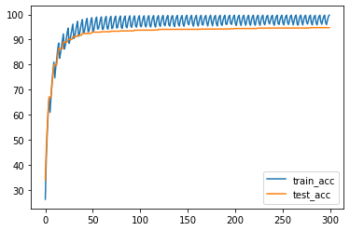
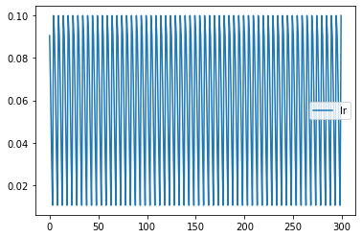
#첨부
러닝 스케쥴+ 배치사이즈
※ base line code 설정
※ 실행결과
Data 증강 | RandomCrop(32, padding=4), RandomHorizontalFlip()
Shulffle | True
batch_size | 32
모델 | ResNet18
criterion | CrossEntropyLoss
optimizer | SGD
scheduler | CosineAnnealingWarmRestarts(optimizer, T_0 = 5, T_mult=1,eta_min=0.001)
learning rate | 0.1
epoch | 300
Epoch: 284
Epoch: 284 | Batch_idx: 0 | Loss: (0.0828) | Acc: (99.22%) (127/128)
Epoch: 284 | Batch_idx: 50 | Loss: (0.0962) | Acc: (97.04%) (6335/6528)
Epoch: 284 | Batch_idx: 100 | Loss: (0.0907) | Acc: (97.21%) (12567/12928)
Epoch: 284 | Batch_idx: 150 | Loss: (0.0881) | Acc: (97.19%) (18785/19328)
Epoch: 284 | Batch_idx: 200 | Loss: (0.0832) | Acc: (97.35%) (25046/25728)
Epoch: 284 | Batch_idx: 250 | Loss: (0.0806) | Acc: (97.41%) (31295/32128)
Epoch: 284 | Batch_idx: 300 | Loss: (0.0805) | Acc: (97.42%) (37534/38528)
Epoch: 284 | Batch_idx: 350 | Loss: (0.0784) | Acc: (97.51%) (43808/44928)
# TEST : Loss: (0.1750) | Acc: (94.28%) (9428/10000)

Slide 8
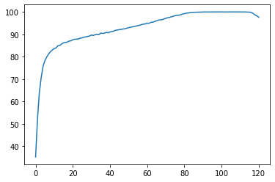
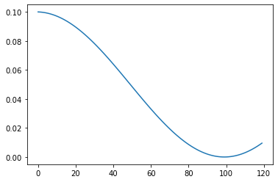
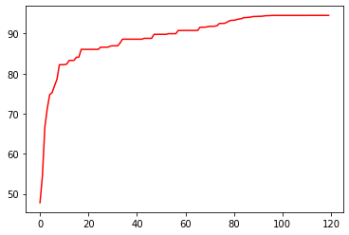
#첨부
모델 수정
※ base line code 설정
※ 실행결과
Data 증강 | RandomCrop(32, padding=4), RandomHorizontalFlip()
Shulffle | True
batch_size | 128
모델 | ResNet18
criterion | CrossEntropyLoss
optimizer | SGD
scheduler | CosineAnnealingLR
learning rate | 0.1
epoch | 200
activation | gelu
pooling | Global average pooling
기타 | BatchNorm2d (Dropout 대신 사용)
Epoch: 111
Epoch: 111 | Batch_idx: 0 | Loss: (0.0018) | Acc: (100.00%) (128/128)
Epoch: 111 | Batch_idx: 50 | Loss: (0.0029) | Acc: (99.98%) (6527/6528)
Epoch: 111 | Batch_idx: 100 | Loss: (0.0032) | Acc: (99.98%) (12926/12928)
Epoch: 111 | Batch_idx: 150 | Loss: (0.0034) | Acc: (99.96%) (19320/19328)
Epoch: 111 | Batch_idx: 200 | Loss: (0.0034) | Acc: (99.96%) (25717/25728)
Epoch: 111 | Batch_idx: 250 | Loss: (0.0035) | Acc: (99.95%) (32112/32128)
Epoch: 111 | Batch_idx: 300 | Loss: (0.0036) | Acc: (99.95%) (38510/38528)
Epoch: 111 | Batch_idx: 350 | Loss: (0.0036) | Acc: (99.96%) (44908/44928)
# TEST : Loss: (0.2258) | Acc: (94.54%) (9454/10000)

Slide 9
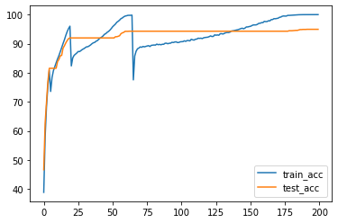
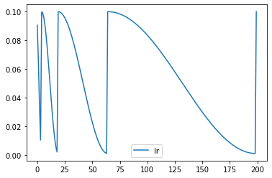
#첨부
모델 수정
※ base line code 설정
※ 실행결과
Data 증강 | RandomCrop(32, padding=4), RandomHorizontalFlip()
Shulffle | True
batch_size | 128
모델 | ResNet18
criterion | CrossEntropyLoss
optimizer | SGD
scheduler | CosineAnnealingWarmRestarts(optimizer, T_0 = 5, T_mult=3,eta_min=0.001)
learning rate | 0.1
epoch | 200
activation | gelu
pooling | Global average pooling
기타 | BatchNorm2d (Dropout 대신 사용)
Epoch: 198
Epoch: 198 | Batch_idx: 0 | Loss: (0.0064) | Acc: (100.00%) (128/128)
Epoch: 198 | Batch_idx: 50 | Loss: (0.0028) | Acc: (99.98%) (6527/6528)
Epoch: 198 | Batch_idx: 100 | Loss: (0.0029) | Acc: (99.99%) (12927/12928)
Epoch: 198 | Batch_idx: 150 | Loss: (0.0026) | Acc: (99.99%) (19327/19328)
Epoch: 198 | Batch_idx: 200 | Loss: (0.0026) | Acc: (99.99%) (25726/25728)
Epoch: 198 | Batch_idx: 250 | Loss: (0.0026) | Acc: (99.99%) (32124/32128)
Epoch: 198 | Batch_idx: 300 | Loss: (0.0027) | Acc: (99.98%) (38521/38528)
Epoch: 198 | Batch_idx: 350 | Loss: (0.0027) | Acc: (99.98%) (44920/44928)
# TEST : Loss: (0.2142) | Acc: (94.85%) (9485/10000)

Slide 10
#첨부
모델 수정
※ base line code 설정
※ 실행결과
Data 증강 | RandomCrop(32, padding=4), RandomHorizontalFlip()
Shulffle | True
batch_size | 128
모델 | ResNet18
criterion | CrossEntropyLoss
scheduler | CosineAnnealingWarmRestarts(optimizer, T_0 = 23, T_mult=4)
learning rate | 0.1
epoch | 482
activation | gelu
pooling | avg pooling
optimizer | SGD
기타 | BatchNorm2d (Dropout 대신 사용)
Epoch: 198
Epoch: 198 | Batch_idx: 0 | Loss: (0.0064) | Acc: (100.00%) (128/128)
Epoch: 198 | Batch_idx: 50 | Loss: (0.0028) | Acc: (99.98%) (6527/6528)
Epoch: 198 | Batch_idx: 100 | Loss: (0.0029) | Acc: (99.99%) (12927/12928)
Epoch: 198 | Batch_idx: 150 | Loss: (0.0026) | Acc: (99.99%) (19327/19328)
Epoch: 198 | Batch_idx: 200 | Loss: (0.0026) | Acc: (99.99%) (25726/25728)
Epoch: 198 | Batch_idx: 250 | Loss: (0.0026) | Acc: (99.99%) (32124/32128)
Epoch: 198 | Batch_idx: 300 | Loss: (0.0027) | Acc: (99.98%) (38521/38528)
Epoch: 198 | Batch_idx: 350 | Loss: (0.0027) | Acc: (99.98%) (44920/44928)
# TEST : Loss: (0.2142) | Acc: (94.85%) (9485/10000)

Slide 11
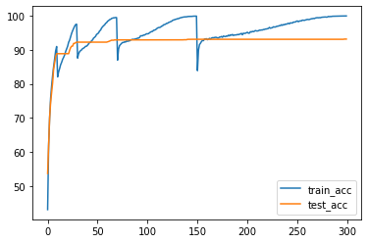
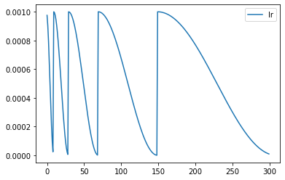
#첨부
옵티마이저 수정
※ base line code 설정
※ 실행결과
Data 증강 | RandomCrop(32, padding=4), RandomHorizontalFlip()
Shulffle | True
batch_size | 128
모델 | ResNet18
criterion | CrossEntropyLoss
scheduler | CosineAnnealingWarmRestarts(optimizer, T_0 = 23, T_mult=4)
learning rate | 0.1
epoch | 482
activation | gelu
pooling | avg pooling
optimizer | SGD → adam
기타 | BatchNorm2d (Dropout 대신 사용)
Epoch: 299
Epoch: 299 | Batch_idx: 0 | Loss: (0.0057) | Acc: (100.00%) (128/128)
Epoch: 299 | Batch_idx: 50 | Loss: (0.0045) | Acc: (99.97%) (6526/6528)
Epoch: 299 | Batch_idx: 100 | Loss: (0.0044) | Acc: (99.98%) (12925/12928)
Epoch: 299 | Batch_idx: 150 | Loss: (0.0045) | Acc: (99.95%) (19319/19328)
Epoch: 299 | Batch_idx: 200 | Loss: (0.0044) | Acc: (99.96%) (25718/25728)
Epoch: 299 | Batch_idx: 250 | Loss: (0.0045) | Acc: (99.95%) (32112/32128)
Epoch: 299 | Batch_idx: 300 | Loss: (0.0045) | Acc: (99.95%) (38507/38528)
Epoch: 299 | Batch_idx: 350 | Loss: (0.0047) | Acc: (99.94%) (44901/44928)
# TEST : Loss: (0.3244) | Acc: (93.10%) (9310/10000)

Slide 12
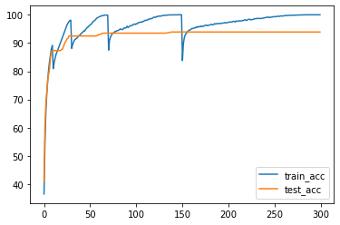

#첨부
옵티마이저 수정
※ base line code 설정
※ 실행결과
Data 증강 | RandomCrop(32, padding=4), RandomHorizontalFlip()
Shulffle | True
batch_size | 512
모델 | ResNet18
criterion | CrossEntropyLoss
scheduler | CosineAnnealingWarmRestarts (T_0 = 10, T_mult=2)
learning rate | 0.1
epoch | 300
activation | gelu
pooling | Global average pooling
optimizer | Adambelief
기타 | BatchNorm2d + Dropout(0.25)
Epoch: 298
Epoch: 298 | Batch_idx: 0 | Loss: (0.0018) | Acc: (100.00%) (512/512)
Epoch: 298 | Batch_idx: 50 | Loss: (0.0019) | Acc: (99.99%) (26110/26112)
# TEST : Loss: (0.2896) | Acc: (93.61%) (9361/10000)

Slide 13
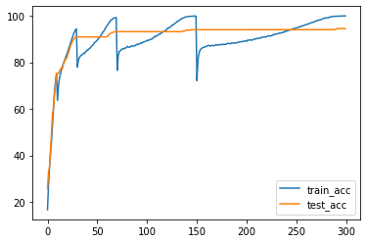
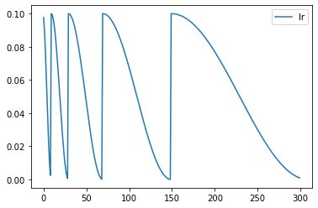
#첨부
옵티마이저 수정
※ base line code 설정
※ 실행결과
Data 증강 | RandomCrop(32, padding=4), RandomHorizontalFlip()
Shulffle | True
batch_size | 512
모델 | ResNet18
criterion | CrossEntropyLoss
scheduler | CosineAnnealingWarmRestarts (T_0 = 10, T_mult=2)
learning rate | 0.1
epoch | 300
activation | gelu
pooling | Global average pooling
optimizer | SGD
기타 | BatchNorm2d + Dropout(0.5)
모델 구조 변경 | Deep 하게 수정
Epoch: 298
Epoch: 298 | Batch_idx: 0 | Loss: (0.0020) | Acc: (100.00%) (128/128)
Epoch: 298 | Batch_idx: 50 | Loss: (0.0036) | Acc: (99.95%) (6525/6528)
Epoch: 298 | Batch_idx: 100 | Loss: (0.0037) | Acc: (99.94%) (12920/12928)
Epoch: 298 | Batch_idx: 150 | Loss: (0.0039) | Acc: (99.92%) (19313/19328)
Epoch: 298 | Batch_idx: 200 | Loss: (0.0038) | Acc: (99.93%) (25709/25728)
Epoch: 298 | Batch_idx: 250 | Loss: (0.0038) | Acc: (99.93%) (32104/32128)
Epoch: 298 | Batch_idx: 300 | Loss: (0.0037) | Acc: (99.94%) (38503/38528)
Epoch: 298 | Batch_idx: 350 | Loss: (0.0037) | Acc: (99.93%) (44897/44928)
# TEST : Loss: (0.2269) | Acc: (94.45%) (9445/10000)

Slide 14
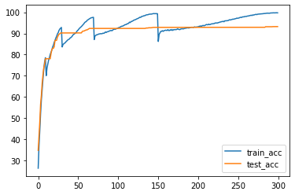
#첨부
옵티마이저 수정
※ base line code 설정
※ 실행결과
Data 증강 | RandomCrop(32, padding=4), RandomHorizontalFlip()
Shulffle | True
batch_size | 512
모델 | ResNet18
criterion | CrossEntropyLoss
scheduler | CosineAnnealingWarmRestarts (T_0 = 10, T_mult=2)
learning rate | 0.1
epoch | 300
activation | gelu
pooling | Maxpooling
optimizer | SGD
기타 | BatchNorm2d + Dropout(0.5)
모델 구조 변경 | Deep 하게 수정
Epoch: 298
Epoch: 298 | Batch_idx: 0 | Loss: (0.0071) | Acc: (100.00%) (128/128)
Epoch: 298 | Batch_idx: 50 | Loss: (0.0094) | Acc: (99.72%) (6510/6528)
Epoch: 298 | Batch_idx: 100 | Loss: (0.0095) | Acc: (99.77%) (12898/12928)
Epoch: 298 | Batch_idx: 150 | Loss: (0.0091) | Acc: (99.77%) (19284/19328)
Epoch: 298 | Batch_idx: 200 | Loss: (0.0092) | Acc: (99.77%) (25668/25728)
Epoch: 298 | Batch_idx: 250 | Loss: (0.0094) | Acc: (99.75%) (32047/32128)
Epoch: 298 | Batch_idx: 300 | Loss: (0.0095) | Acc: (99.75%) (38431/38528)
Epoch: 298 | Batch_idx: 350 | Loss: (0.0095) | Acc: (99.75%) (44817/44928)
# TEST : Loss: (0.3165) | Acc: (93.13%) (9313/10000)

Slide 15
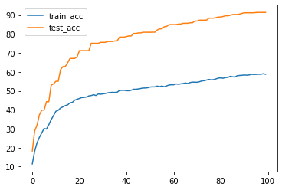
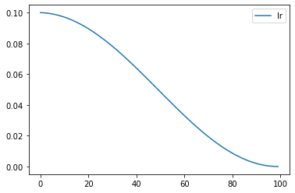
#첨부
옵티마이저 수정
※ base line code 설정
※ 실행결과
Data 증강 | RandomCrop(32, padding=4), RandomHorizontalFlip()
Shulffle | True
batch_size | 128
모델 | ResNet18
Criterion | CrossEntropyLoss
Scheduler | CosineAnnealingLR
learning rate | 0.1
epoch | 100
activation | gelu
pooling | global
optimizer | SGD
기타 | BatchNorm2d + Dropout(0.5)
모델 구조 변경 | Deep 하게 더 수정
Epoch: 98
Epoch: 98 | Batch_idx: 0 | Loss: (0.7324) | Acc: (66.41%) (85/128)
Epoch: 98 | Batch_idx: 50 | Loss: (0.9009) | Acc: (58.29%) (3805/6528)
Epoch: 98 | Batch_idx: 100 | Loss: (0.8936) | Acc: (58.86%) (7610/12928)
Epoch: 98 | Batch_idx: 150 | Loss: (0.8932) | Acc: (58.92%) (11389/19328)
Epoch: 98 | Batch_idx: 200 | Loss: (0.8892) | Acc: (59.10%) (15206/25728)
Epoch: 98 | Batch_idx: 250 | Loss: (0.8887) | Acc: (59.02%) (18962/32128)
Epoch: 98 | Batch_idx: 300 | Loss: (0.8876) | Acc: (59.10%) (22771/38528)
Epoch: 98 | Batch_idx: 350 | Loss: (0.8879) | Acc: (59.10%) (26553/44928)
# TEST : Loss: (0.2701) | Acc: (91.38%) (9138/10000)
결과가 특이하여 저장 : 리니어 앞에 드랍아웃 하는… 멍청한 짓을 하였다.

Slide 16
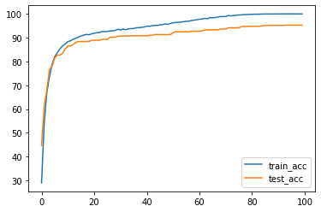
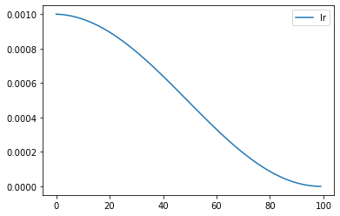
#첨부
옵티마이저 수정
※ base line code 설정
※ 실행결과
Data 증강 | RandomCrop(32, padding=4), RandomHorizontalFlip()
Shulffle | True
batch_size | 128
모델 | ResNet50 + Bottleneck
Criterion | CrossEntropyLoss
Scheduler | CosineAnnealingLR
learning rate | 0.001
epoch | 100
activation | gelu
pooling | global
optimizer | Adambelief
기타 | BatchNorm2d + Dropout(0.01)
모델 구조 변경 | 오리진
Epoch: 93
Epoch: 93 | Batch_idx: 0 | Loss: (0.0022) | Acc: (100.00%) (128/128)
Epoch: 93 | Batch_idx: 200 | Loss: (0.0035) | Acc: (99.96%) (25718/25728)
Epoch: 93 | Batch_idx: 390 | Loss: (0.0037) | Acc: (99.96%) (49979/50000)
# TEST : Loss: (0.1975) | Acc: (95.24%) (9524/10000)
8.85637463565564e-06

Slide 17
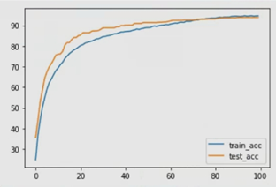
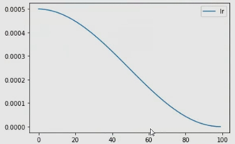

#첨부
옵티마이저 수정
※ base line code 설정
※ 실행결과
Data 증강 | RandomCrop(32, padding=4), RandomHorizontalFlip()
Shulffle | True
batch_size | 128
모델 | ResNet50 + Bottleneck
Criterion | CrossEntropyLoss
Scheduler | CosineAnnealingLR
learning rate | 0.0005
epoch | 100
activation | gelu
pooling | global
optimizer | adambeilif
기타 | BatchNorm2d + Dropout(0.3)
모델 구조 변경 | 오리진 + 리니어 드랍(0.1)
결과가 특이하여 저장 : 리니어 앞에 드랍아웃을 다시 한번 해보았다.
생각해보니 멍청한 짓이었다..

Slide 18
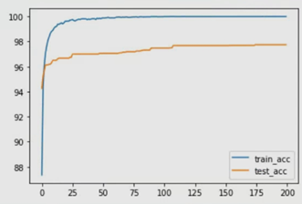
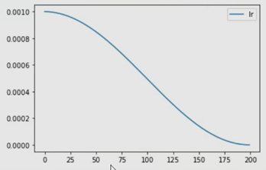
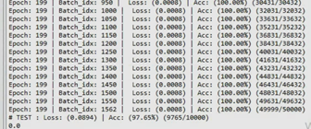
#첨부
전이학습
※ base line code 설정
※ 실행결과
Data 증강 | RandomCrop(32, padding=4), RandomHorizontalFlip()
Shulffle | True
batch_size | 32
모델 | ResNet50 전이학습
Criterion | CrossEntropyLoss
Scheduler | CosineAnnealingLR
learning rate | 0.001
epoch | 200
activation | -
pooling | -
optimizer | SGD
기타 | Freeze = False
모델 구조 변경 | -
Named 모델을 쓰자!

Slide 19
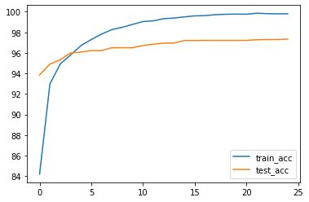
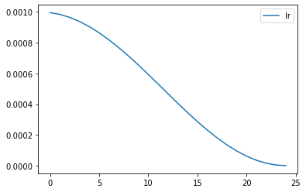
#첨부
전이학습
※ base line code 설정
※ 실행결과
Data 증강 | RandomCrop, RandomHorizontalFlip, RandomRotation, ColorJitter
Shulffle | True
batch_size | 32
모델 | ResNet50 전이학습
Criterion | CrossEntropyLoss
Scheduler | CosineAnnealingLR
learning rate | 0.001
epoch | 10
activation | Gelu
pooling | -
optimizer | SGD
기타 | Frozen, Dropout(0.3)
모델 구조 | class MyNewNet(nn.Module): def __init__(self): super(MyNewNet, self).__init__() self.resnet50 = torchvision.models.resnet50(pretrained=True) self.linear1 = nn.Linear(512*4, 512) self.drop1 = nn.Dropout(0.3) self.linear2 = nn.Linear(512, 10) # Forward Pass 정의 부분 def forward(self, x): x = self.resnet50(x) #x = self.linear1(x) x = F.gelu(self.drop1(self.linear1(x))) return self.linear2(x) my_model = MyNewNet() for param in my_model.parameters(): param.requires_grad = False for param in my_model.linear1.parameters(): param.requires_grad = True for param in my_model.linear2.parameters(): param.requires_grad = True
Epoch: 24
Epoch: 24 | Batch_idx: 1550 | Loss: (0.0078) | Acc: (99.81%) (49536/49632)
Epoch: 24 | Batch_idx: 1562 | Loss: (0.0078) | Acc: (99.81%) (49904/50000)
# TEST : Loss: (0.1017) | Acc: (97.34%) (9734/10000)

Slide 20
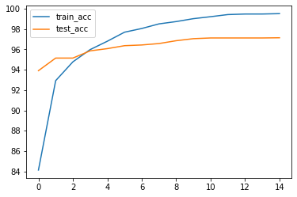
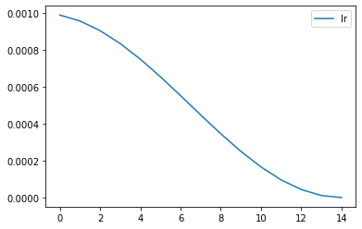
#첨부
전이학습
※ base line code 설정
※ 실행결과
Data 증강 | RandomCrop, RandomHorizontalFlip, RandomRotation, ColorJitter
Shulffle | True
batch_size | 32
모델 | ResNet50 전이학습
Criterion | CrossEntropyLoss
Scheduler | CosineAnnealingLR
learning rate | 0.001
epoch | 15
activation | Gelu
pooling | -
optimizer | SGD
기타 | No Frozen, Dropout(0.3)
모델 구조 | class MyNewNet(nn.Module): def __init__(self): super(MyNewNet, self).__init__() self.resnet50 = torchvision.models.resnet50(pretrained=True) self.linear1 = nn.Linear(512*4, 512) self.drop1 = nn.Dropout(0.3) self.linear2 = nn.Linear(512, 10) # Forward Pass 정의 부분 def forward(self, x): x = self.resnet50(x) #x = self.linear1(x) x = F.gelu(self.drop1(self.linear1(x))) return self.linear2(x) my_model = MyNewNet() for param in my_model.parameters(): param.requires_grad = True for param in my_model.linear1.parameters(): param.requires_grad = True for param in my_model.linear2.parameters(): param.requires_grad = True
Epoch: 14 | Batch_idx: 1450 | Loss: (0.0175) | Acc: (99.51%) (46203/46432)
Epoch: 14 | Batch_idx: 1500 | Loss: (0.0176) | Acc: (99.51%) (47796/48032)
Epoch: 14 | Batch_idx: 1550 | Loss: (0.0174) | Acc: (99.52%) (49395/49632)
Epoch: 14 | Batch_idx: 1562 | Loss: (0.0173) | Acc: (99.52%) (49762/50000)
# TEST : Loss: (0.1029) | Acc: (97.15%) (9715/10000)

Slide 21
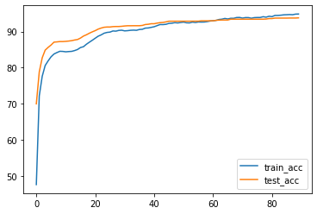
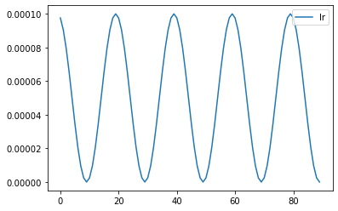
#첨부
전이학습
※ base line code 설정
※ 실행결과
Data 증강 | RandomCrop, RandomHorizontalFlip, RandomRotation, ColorJitter
Shulffle | True
batch_size | 128
모델 | mobileNet_v2 전이학습
Criterion | CrossEntropyLoss
Scheduler | CosineAnnealingLR
learning rate | 0.001
epoch | 90
activation | none
pooling | -
optimizer | SGD
기타 | Frozen
모델 구조 | # 전이학습 Frozon 추가 class MyNewNet(nn.Module): def __init__(self): super(MyNewNet, self).__init__() self.resnet50 = torchvision.models.resnet50(pretrained=True) self.linear1 = nn.Linear(512*4, 512) self.bn1 = nn.BatchNorm1d(512) self.drop1 = nn.Dropout(0.3) self.linear2 = nn.Linear(512, 10) # Forward Pass 정의 부분 def forward(self, x): x = self.resnet50(x) #x = self.linear1(x) x = F.gelu(self.drop1(self.bn1(self.linear1(x)))) return self.linear2(x) my_model = MyNewNet() for param in my_model.parameters(): param.requires_grad = True for param in my_model.linear1.parameters(): param.requires_grad = True for param in my_model.linear2.parameters(): param.requires_grad = True
Epoch: 89 | Batch_idx: 200 | Loss: (0.1481) | Acc: (94.80%) (24391/25728)
Epoch: 89 | Batch_idx: 250 | Loss: (0.1460) | Acc: (94.87%) (30480/32128)
Epoch: 89 | Batch_idx: 300 | Loss: (0.1473) | Acc: (94.85%) (36542/38528)
Epoch: 89 | Batch_idx: 350 | Loss: (0.1473) | Acc: (94.87%) (42624/44928)
Epoch: 89 | Batch_idx: 390 | Loss: (0.1484) | Acc: (94.85%) (47426/50000)
# TEST : Loss: (0.1953) | Acc: (93.79%) (9379/10000)

Slide 22
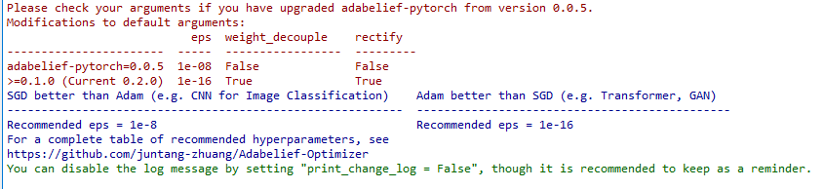
#첨부
전이학습
※ base line code 설정
※ 실행결과
Data 증강 | RandomCrop, RandomHorizontalFlip, RandomRotation, ColorJitter
Shulffle | True
batch_size | 32
모델 | mobileNet_v2 전이학습
Criterion | CrossEntropyLoss
Scheduler | CosineAnnealingLR
learning rate | 0.001
epoch | 25
activation | none
pooling | -
optimizer | adambeilif
기타 | Frozen
모델 구조 | # 전이학습 Frozon 추가 class MyNewNet(nn.Module): def __init__(self): super(MyNewNet, self).__init__() self.resnet50 = torchvision.models.resnet50(pretrained=True) self.linear1 = nn.Linear(512*4, 512) self.bn1 = nn.BatchNorm1d(512) self.drop1 = nn.Dropout(0.3) self.linear2 = nn.Linear(512, 10) # Forward Pass 정의 부분 def forward(self, x): x = self.resnet50(x) #x = self.linear1(x) x = F.gelu(self.drop1(self.bn1(self.linear1(x)))) return self.linear2(x) my_model = MyNewNet() for param in my_model.parameters(): param.requires_grad = True for param in my_model.linear1.parameters(): param.requires_grad = True for param in my_model.linear2.parameters(): param.requires_grad = True

Slide 23
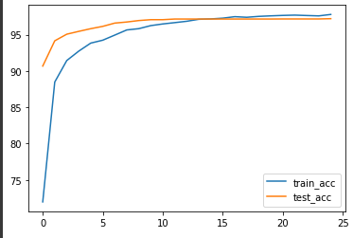
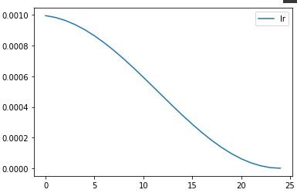
#첨부
전이학습
※ base line code 설정
※ 실행결과
Data 증강 | RandomCrop, RandomHorizontalFlip, RandomRotation, ColorJitter
Shulffle | True
batch_size | 32
모델 | Efficientnet 전이학습
Criterion | CrossEntropyLoss
Scheduler | CosineAnnealingLR
learning rate | 0.001
epoch | 25
activation | none
pooling | -
optimizer | SGD
기타 | Frozen
모델 구조 | class MyNewNet(nn.Module): def __init__(self): super(MyNewNet, self).__init__() self.efficientnet_b1 = torchvision.models.efficientnet_b1(pretrained=True) self.linear1 = nn.Linear(1280, 2*10) self.linear2 = nn.Linear(2*10, 10) # Forward Pass 정의 부분 def forward(self, x): x = self.mobilenet_v2(x) x = self.linear1(x) return self.linear2(x) my_model = MyNewNet() for param in my_model.parameters(): param.requires_grad = False for param in my_model.linear1.parameters(): param.requires_grad = True for param in my_model.linear2.parameters(): param.requires_grad = True
Epoch: 24 | Batch_idx: 1450 | Loss: (0.0663) | Acc: (97.76%) (45392/46432)
Epoch: 24 | Batch_idx: 1500 | Loss: (0.0660) | Acc: (97.78%) (46966/48032)
Epoch: 24 | Batch_idx: 1550 | Loss: (0.0659) | Acc: (97.78%) (48532/49632)
Epoch: 24 | Batch_idx: 1562 | Loss: (0.0658) | Acc: (97.79%) (48895/50000)
# TEST : Loss: (0.0886) | Acc: (97.21%) (9721/10000)

