Slide 1
PMD_Utility
A User Interface that manages Parts Manual Developer (PMD) tools.

Slide 2
Scope
This tool is designed to “set it and forget it”.
If the file structure has been set up the preferred way, you will be able to make your selections and come back when it is done.
This tool will open, write, and update, all files based on your selections in the required order.
While using SVN you will need to obtain locks on your files before running, but you will never need to lock the PMD_Utility or anything in the Arbortext_Tools and Databases folders, during its process.

Slide 3
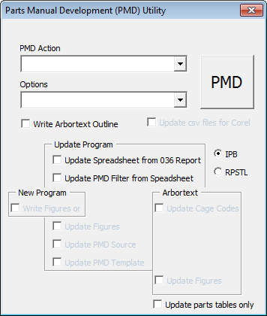
The UserForm
When you open this tool a UserForm will automatically pop up (if macros are enabled).
There are multiple input methods designed for what is usually done.
The PMD button will act on your selections.
Read the prompts once the PMD button is pressed.

Slide 4
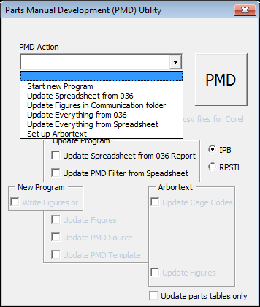
Where to start?
You may select from the first box what you want to do…
Or you may select checkboxes that apply to what you want to do.
If it will not let you select something, it is because it is not designed to work that way.

Slide 5
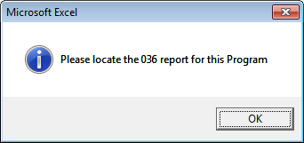
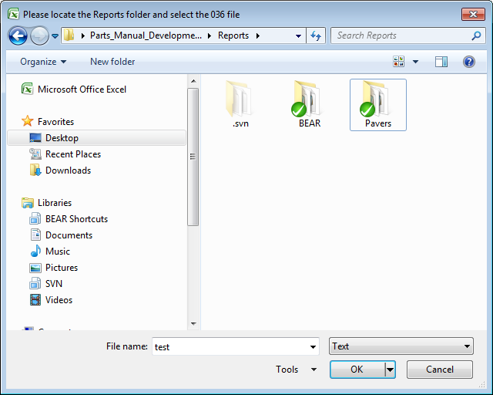
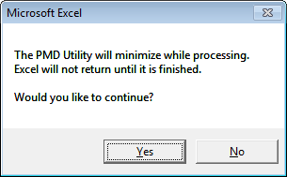
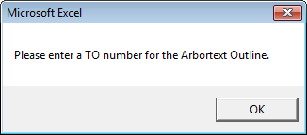
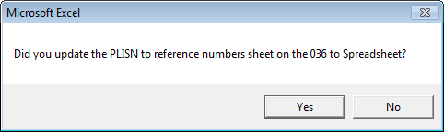
Possible initial message boxes.
Depending on what is selected, this utility will prompt you with a number of questions or request for information initially.

Slide 6
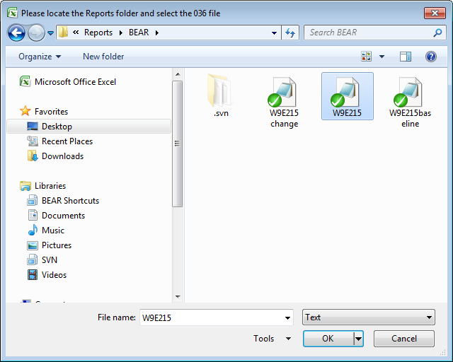
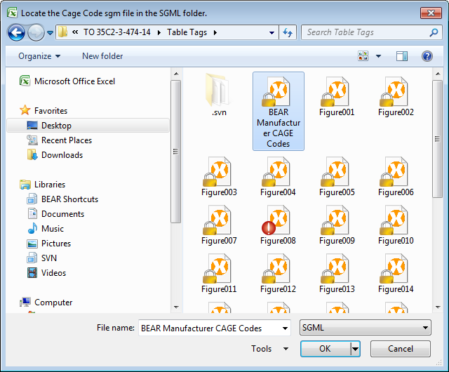
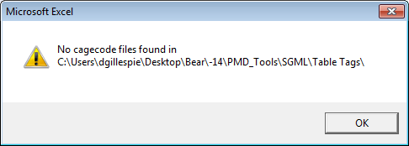
Possible dialog boxes during the process.
If the file structure is set up differently than what is recommended, this tool will not be able to find the files without assistance.
You will be prompted to locate files or folders related to your requested actions, similar to the dialog boxes to the right and below.
If this happens, what it is looking for will be written in the top left of the dialog box that appears.

Slide 7
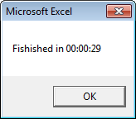
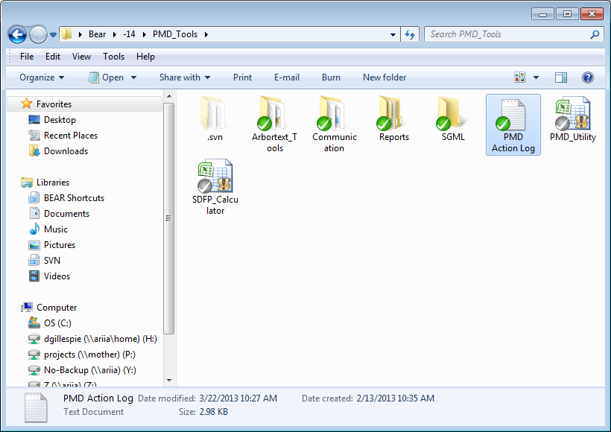
When is the process completed?
When the process is finished, it will tell you with the message box to the right.
A log is written or updated in the same folder as the PMD_Utility, detailing what the tool did.

