Slide 1
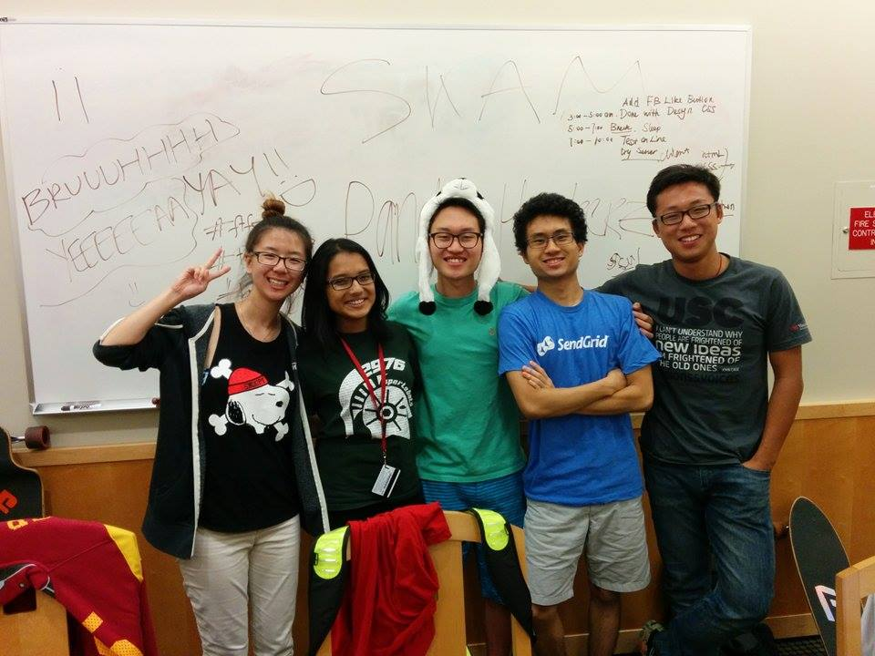


Pandy_Hackerz presents:
A mobile and web-based application promoting a collaborative study environment.

Slide 2
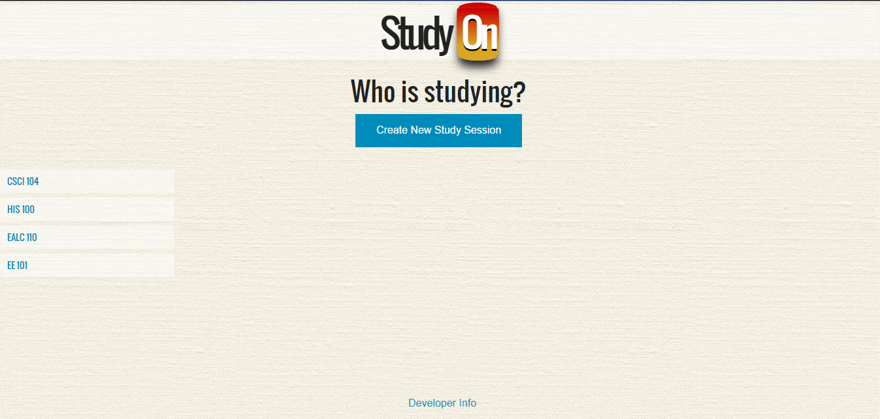
Web Application
Track study groups hosted by your peers that are happening right now!

Slide 3

Mobile Application
Access the real-time StudyOn feed on any iOS device on-the-go!

Slide 4
Mobile Application

Slide 5
Features (slide for each one)
Host your own study session
Join a pre-existing study group
Chat with those in a similar study group
Filter search by class
Log in using Facebook

