Slide 1
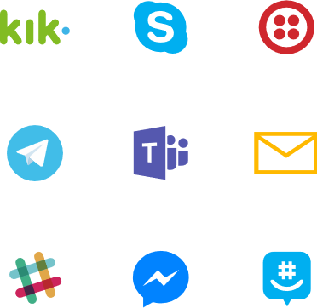

Bot
Connector
Bot
(Web アプリ)
ユーザー
チャネル
State Service
自分で開発する箇所
Microsoft が提供する箇所

Slide 2
Stack of Conversation
Push
Pop
Push
Pop
Push
Pop
AskName
AskDemand
AskAttendee
Processing
Process AskName
Push AskDemand
Process AskDemand
Push AskAttendee

Slide 3
Stack of Conversation
FlightDialog.
AskOrigin
FlightDialog.
BookFlight
RootDialog. ResumeAfterDialog
RootDialog. ResumeAfterDialog
RootDialog. ResumeAfterDialog
RootDialog. ResumeAfterDialog
Processing
Push ResumeAfterDialog
Call FlightDialog
Process AskOrigin
Push BookFlight
Process BookFlight
Done FlightDialog
Process ResumeAfterDialog
Push MessegeReceieveAsync

