Slide 1
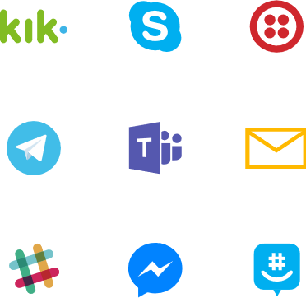

Bot
Connector
Bot
(Web アプリ)
ユーザー
チャネル
State Service
自分で開発する箇所
Microsoft が提供する箇所

Slide 2
Stack of Conversation
Push
Pop
Push
Pop
Push
Pop
AskName
AskDemand
AskAttendee
Processing
Process AskName
Push AskDemand
Process AskDemand
Push AskAttendee

Slide 3
Push
Pop
Push
Pop
Push
Pop
AskName
AskDemand
AskAttendee

Slide 4
Push
Pop
Push
.function1
MeetingDialog.function2
話題1.文脈1
話題1.文脈1
話題1.文脈1
RootDialog.function1

Slide 5
Push
Pop
Push
.function1
MeetingDialog.function2
Ask Name
RootDialog.function1
RootDialog.function1
RootDialog.function1

Slide 6
Push
Pop
Push
MeetingDialog.function1
MeetingDialog.function2
MessageController

Slide 7
Push
Pop
Push
MeetingDialog.function1
MeetingDialog.function2
MessageController

Slide 8
Push
Pop
Push
MeetingDialog.function1
MeetingDialog.function2
RootDialog.function1
RootDialog.function1
RootDialog.function1
RootDialog.function1

