Slide 1
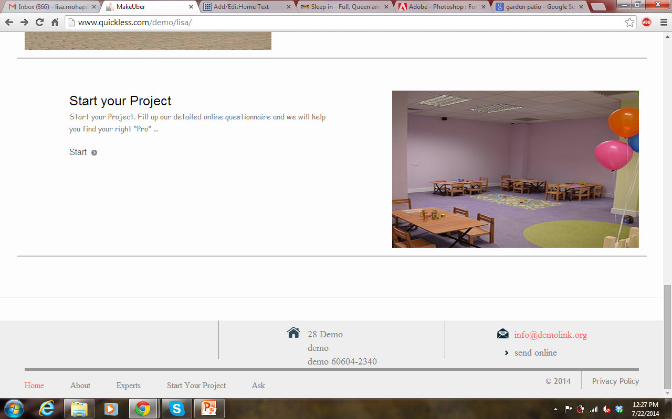
I am not sure what this symbol is

