Slide 1
6. Programming Online Experiments in PsychoPy
PSYC 5P02
Computer Programming for Experimental Psychology
Stephen Emrich
Brock University

Slide 2

Online Experiments
You can (fairly) easily create on-line experiments using Psychopy
To do so you must use the builder view
Has procedures for converting the python code into java script (PsychoJS)
This means you should be very careful about modifying the code directly or it may not translate
Not all functions can be handled by PsychoJS/java script!

Slide 3
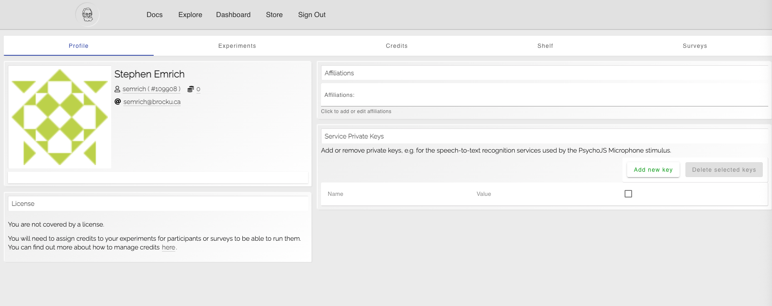
Pavlovia
To run experiments online the need to be hosted on Pavlova
Experiments can then be linked to Sona, mTurk, Prolific
Can store your work in the GitLab repository
Has a database of freely available experiments

Slide 4
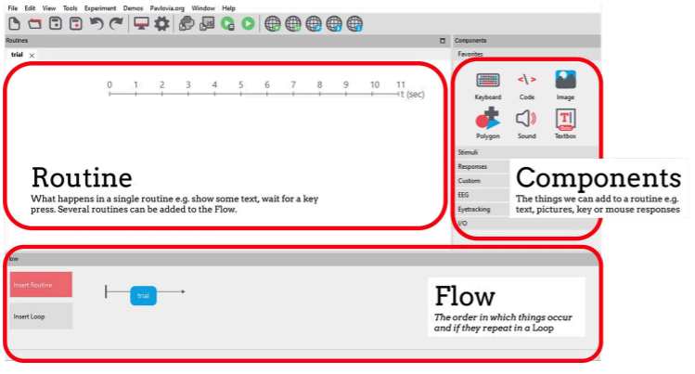
PsychoPy Experiments in Builder
Your experiment is comprised of routines and components
Routines are organized within the flow
Parameters of each component configured within a routine

Slide 5
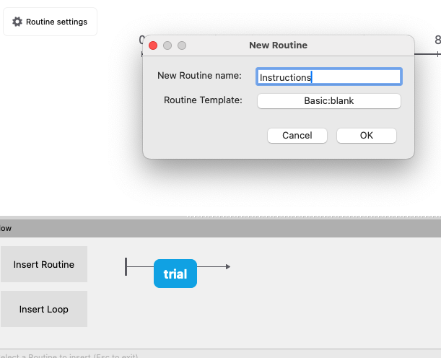
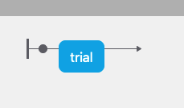
Add a Routine
Start by making a new Routine and name it “Instructions”
You then indicate where in the flow you want it go

Slide 6
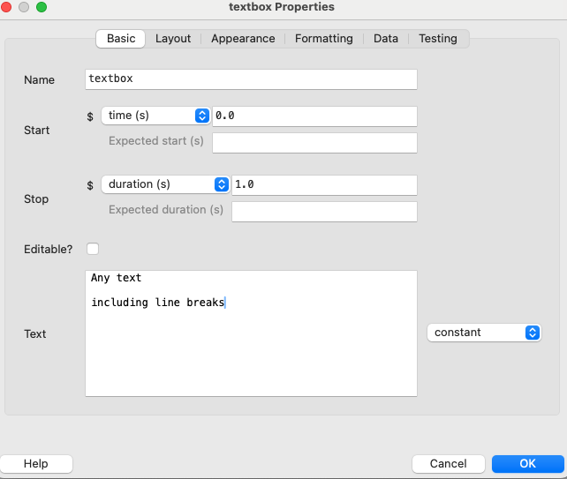
Add a component
Add a Textbox component to your instructions routine
Each component you create will have a series of properties that you can modify to suit your experiment
Be sure to give it a meaningful name as we may need to use it later (e.g., ‘instruct_txt’)
Leave duration blank for now

Slide 7
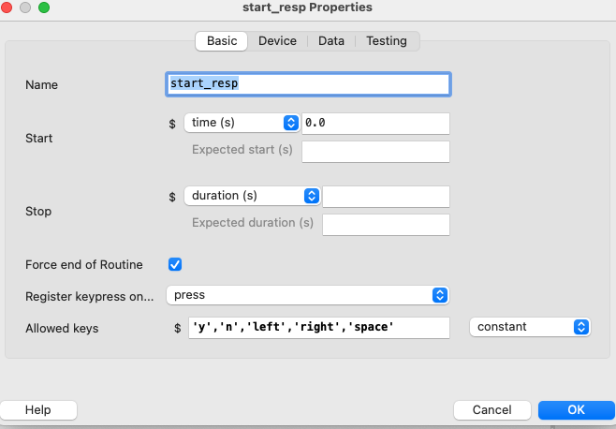
Get a response
Now add a keyboard response
Use the “Force end of Routine” option to make sure it completes the routine and moves to the next routine

Slide 8
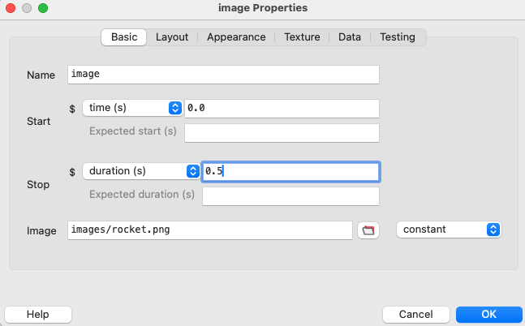
Making a Posner Cueing Task (with images!)
Be sure to download and unzip the resources from Lesson6 for this
Note - you can use the bash shell command unzip to unzip files
Start out by adding to your trial an image stimulus (rocket.jpg) with a duration of 0.5

Slide 9
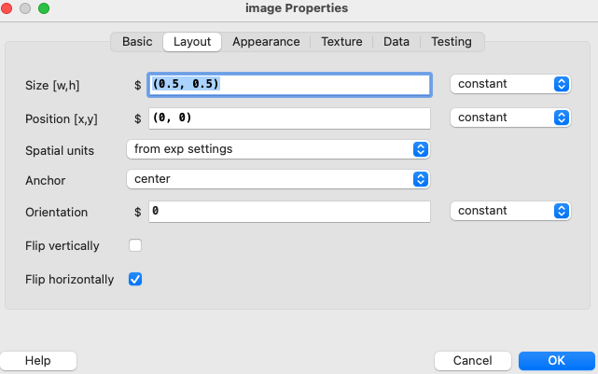
Image properties
Note that we can change the size, position, and orientation of the stimulus
These will set the stimulus default, but we’re going to want to change them trial-by-trial (we’ll do that next)

Slide 10
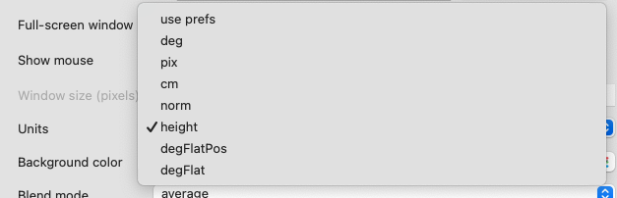

Experiment Settings
The gear icon at the top will open up the experiment settings
Some important settings here, but perhaps the most important one for now is the units setting under Screen, as it will determine the units that we will be using to determine the height and location of our stimuli

Slide 11
Making a Posner Cueing Task (with images!)
Add to your trial the following:
Rotate your cue by 90 degrees
Add a green alien that appears left or right of fixation, at 0.5 seconds and with an unknown duration
Get a response after the alien appears

Slide 12
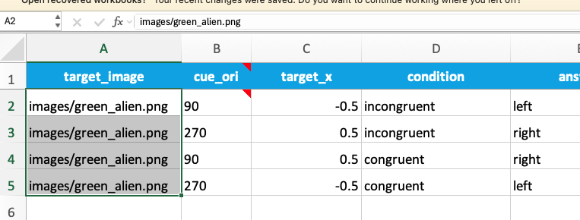
Modifying parameters and looping trials
To create a list of trials/conditions, you can create your different trial types in a spreadsheet that contains all the relevant info for your experiment
Note the names of the columns are the labels we’ll need to call elsewhere in the experiment

Slide 13
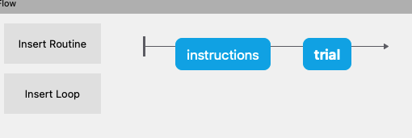
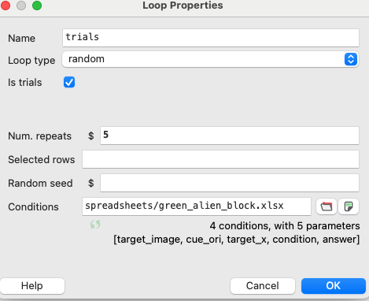
Modifying parameters and looping trials
Insert a loop into your flow (click around the locations you want to loop)
Psychopy will determine the number of trials based on the number of rows in your spreadsheet x the number of repeats
Trial types and order are determined by the loop type

Slide 14
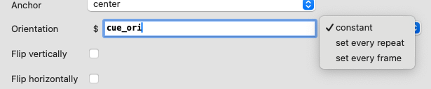
Modifying stimuli parameters
Stimuli parameters can then be modified on each trial based on the information of a designated column in the spreadsheet
Be sure this is set to update every repeat (or every frame) and not set it to constant

Slide 15
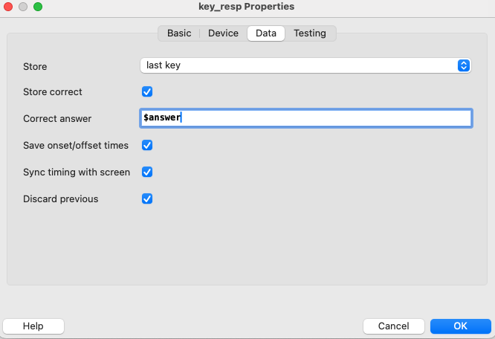
Saving responses
Under the ‘Data’ tab of your keyboard response, you can indicate which keys to store, and whether to store whether the response is correct
Correct responses are defined by a specific response (e.g., ‘left’) or by a variable from the spreadsheet (e.g., ‘$answer’)

Slide 16
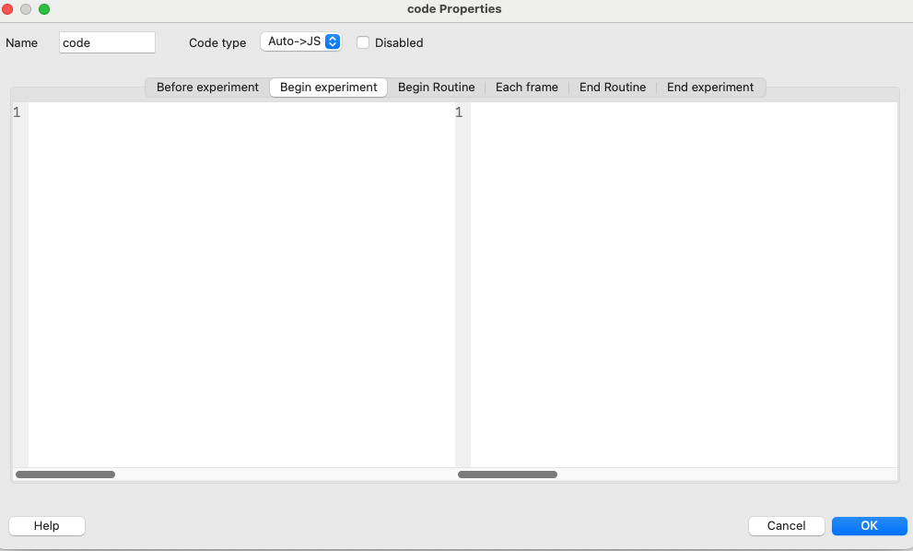
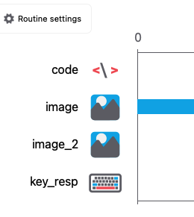
Adding custom code
Using the custom > code component it is possible to add code to modify the built-in functions of the builder
Two important things to keep in mind:
Where you want the code to run (before experiment, before routine, etc.)
Where the code is placed in the routine relative to other defined variables (make sure it is above the other components of your routine)

Slide 17
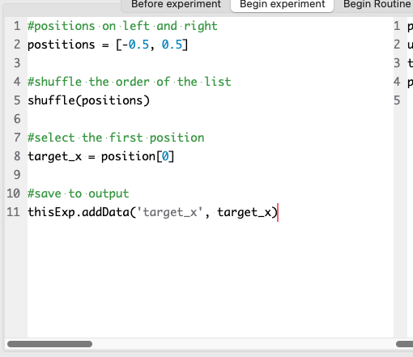
Adding custom code
Let’s figure out how to run this code to randomize the location of the target
Note the translated Java Script code!
Exercise: add a new routine that provides feedback to the participant based on their accuracy
Make correct feedback an image of a rotating star

Slide 18
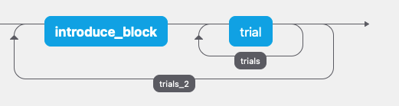
Blocked designs
You can add loops around trial routines to create blocks
You can manage the blocks and variables with a separate spreadsheet
Exercise: create a blocked design that changes the color of the target randomly for separate blocks

Slide 19
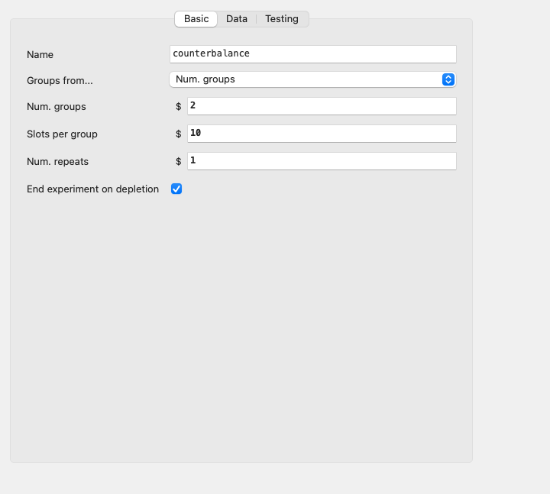
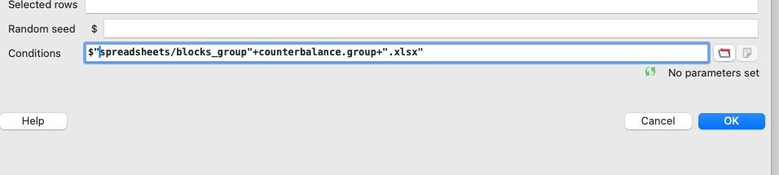
Counterbalancing
Can add a routine (form the components) to create a counterbalance routine that counterbalances subjects into different groups
Then indicate in your blocks loop different spreadsheets that define the different condition types

Slide 20
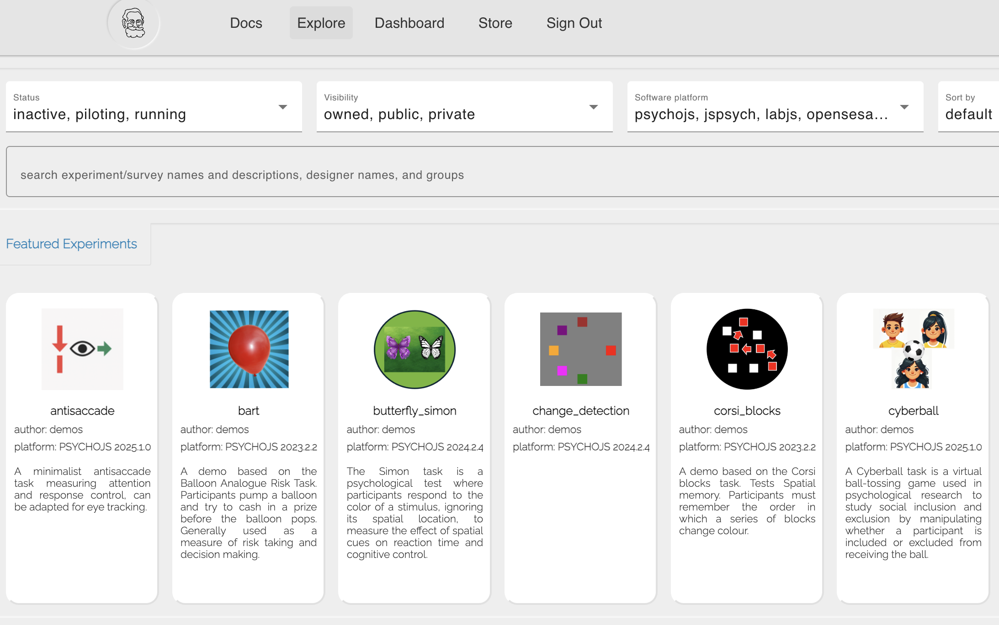
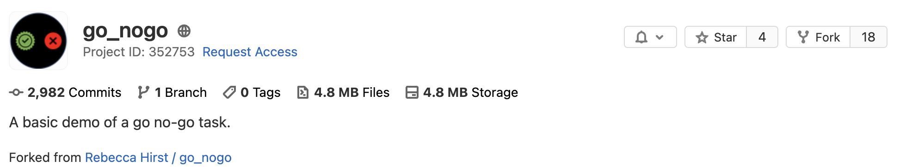
Using Pavlovia
PsychoPy experiments can be hosted on Pavlovia
Built on gitlab (similar to github)
Allows for full version control
Also contains a database of demos and experiments made public by other users
Can fork these projects and use the existing code

Slide 21
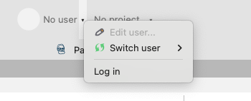
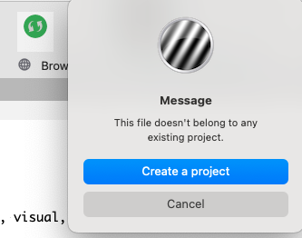
Using Pavlovia
First, login to Pavlovia using the builder
Press the green ‘sync’ button, and create a project
NOTE: will need to configure SSH key first as well
NOTE: may need to have folder same name as project based on a bug I ran into

Slide 22
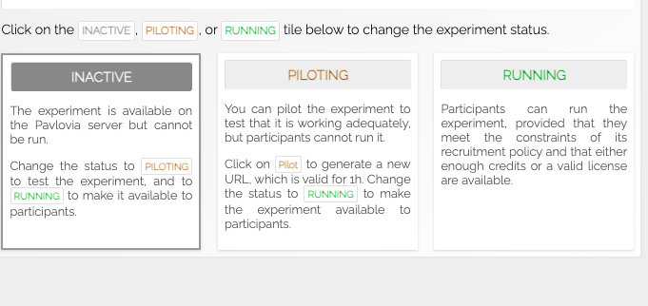
Pavlovia Project Page
The project page contains different statuses for the experiment
Can pilot and test data collection
Need to pay for licenses to run a full experiment

Slide 23
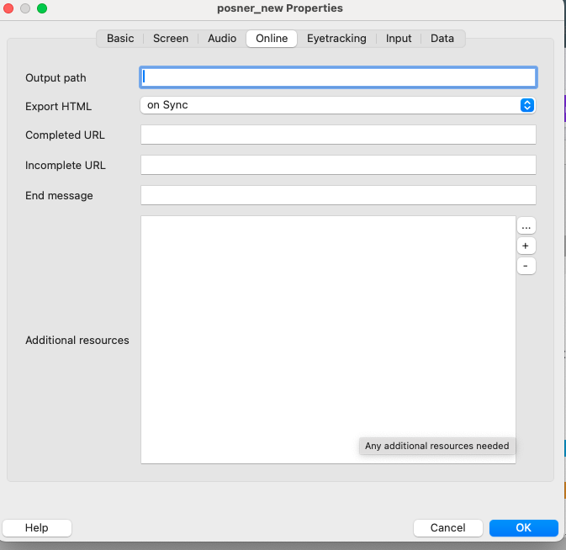
Online Experiment Settings
The online tab of the Experiment Settings has a few additional settings you may want to change
Will need to upload additional resources here (e.g., spreadsheets, images, sounds, etc)
Can use the completed URLs to send them to a website when complete (e.g., SONA)

Slide 24
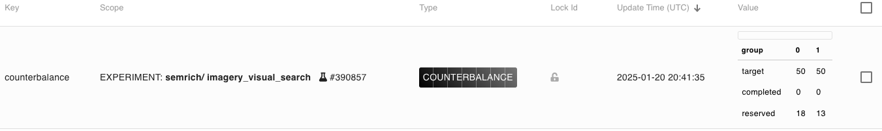
Online Counterbalancing
Online counterbalancing requires you to add a counterbalance variable to the shelf in your Pavlovia Dashboard
Can access this variable in the experiment through $counterbalance.group

