Slide 1
5. Programming Laboratory Experiments in PsychoPy
PSYC 5P02
Computer Programming for Experimental Psychology
Stephen Emrich
Brock University

Slide 2
Why PsychoPy?
Python + OpenGL (graphics language) based tool for programming experiments and visual stimuli
Open = large userbase and contributions
Contains builder (GUI) and coder modes
Builder mode creates experiments suitable for converting to online-experiments using PsychoJS (Java Script)
Compatible with a range of hardware (EEG, fMRI, eye-tracking)
Excellent timing control
Based (loosely) on the MATLAB PsychToolBox (PTB) - but in Python!

Slide 3
PsychoPy
Peirce, J. W., Gray, J. R., Simpson, S., MacAskill, M. R., Höchenberger, R., Sogo, H., Kastman, E., Lindeløv, J. (2019). PsychoPy2: experiments in behavior made easy. Behavior Research Methods. 10.3758/s13428-018-01193-y
Peirce, J. W., & MacAskill, M. R. (2018). Building Experiments in PsychoPy. London: Sage.
Peirce J. W. (2009). Generating stimuli for neuroscience using PsychoPy. Frontiers in Neuroinformatics, 2 (10), 1-8. doi:10.3389/neuro.11.010.2008
Peirce, J. W. (2007). PsychoPy - Psychophysics software in Python. Journal of Neuroscience Methods, 162 (1-2):8-13 doi:10.1016/j.jneumeth.2006.11.017

Slide 4
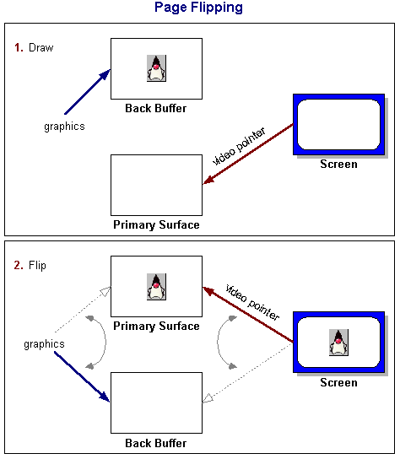
PsychoPy Basics
PsychoPy works on a few basic principles:
A “window” is opened or created, on which things are presented
It uses double buffering to draw things, which are then “flipped” onto the screen
Things on the screen are on the “front buffer”
Things that you perform operations on are on the “back buffer”

Slide 5
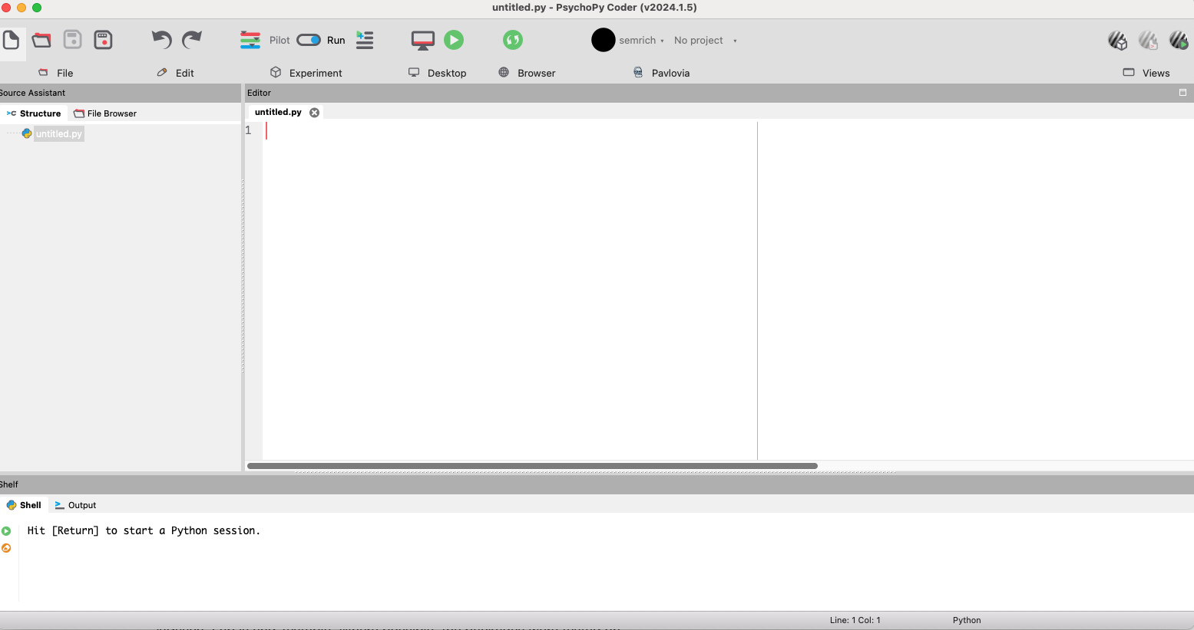
PsychoPy Coder view:

Slide 6
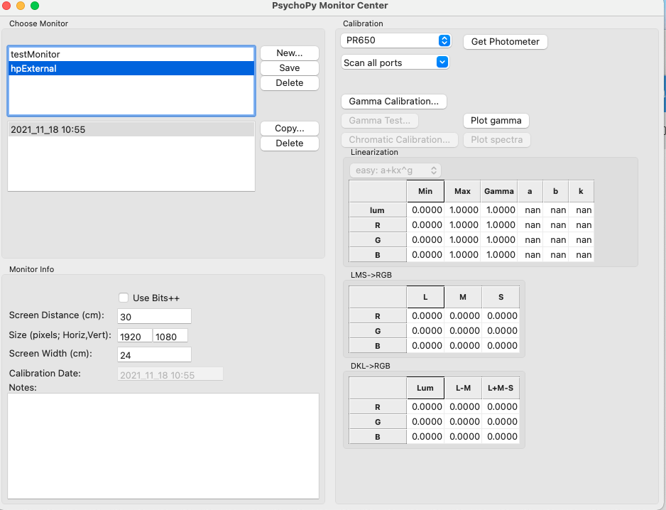
Starting out: monitor set-up
In order to use PsychoPy functions must first create a window that you can draw to
Window should be assigned to a monitor
Useful for multiple monitors
Especially useful for setting up units for controlling stimuli
Tools → Monitor Settings

Slide 7
Height Units | Everything specified relative to the height of the screen (total = 1) | 4:3 ratio bottom left: (-0.6667, -0.5); top right: (+0.6667, +0.5) | Scales with window size Must know dimensions of screen
Normalised Units | Both x and y range from -1 to +1 |  | Will not result in square stimulus if screen is not square
Centimeters on screen | Describe in terms of physical size | Requires: info about screen width and size in pixels | Assumes: pixels are square
Degrees of visual angle | Describe in terms of perceived size of stimulus | Requires: screen width in cm and pixels, as well as viewing distance | Deg (standard) DegFlatPos and degFlat can account for flat screen distortions
Pixels on screen | Describe in terms of pixels | Requires: size of screen in pixels

Slide 8
Using Psychopy outside of Psychopy
NOTE: you do not need to use Psychopy (the IDE) to run Psychopy. Can install on other IDEs (e.g., Spyder) using: $pip install python
To create a monitor outside of the Monitor Center, you can modify the following code: # Define a monitor my_monitor = monitors.Monitor(name='my_monitor_name’) my_monitor.setSizePix((1280, 800)) my_monitor.setWidth(20) my_monitor.setDistance(100) my_monitor.saveMon()

Slide 9
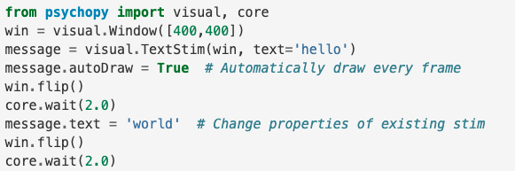
Let’s make a really simple experiment

Slide 10
Let’s break that down
from psychopy import visual, core win = visual.Window([400,400]) message = visual.TextStim(win, text='hello') message.autoDraw = True # Automatically draw every frame win.flip() core.wait(2.0) message.text = 'world' # Change properties of existing stim win.flip() core.wait(2.0)
Need to import psychopy library
Also import specific modules from psychopy
https://psychopy.org/py-modindex.html#cap-p
Will almost always import visual, event, data, and core modules

Slide 11
Let’s break that down
from psychopy import visual, core win = visual.Window([400,400]) message = visual.TextStim(win, text='hello') message.autoDraw = True # Automatically draw every frame win.flip() core.wait(2.0) message.text = 'world' # Change properties of existing stim win.flip() core.wait(2.0)
Must create a window to draw to
Assign the window a name
Must include window size
Can include other options:

Slide 12
Let’s break that down
from psychopy import visual, core win = visual.Window([400,400]) message = visual.TextStim(win, text='hello') message.autoDraw = True # Automatically draw every frame win.flip() core.wait(2.0) message.text = 'world' # Change properties of existing stim win.flip() core.wait(2.0)
Draw a stimulus to the back buffer
Assign it a label
Specify the type of stimulus
Assign it to a window and properties

Slide 13
Let’s break that down
from psychopy import visual, core win = visual.Window([400,400]) message = visual.TextStim(win, text='hello') message.autoDraw = True # Automatically draw every frame win.flip() core.wait(2.0) message.text = 'world' # Change properties of existing stim win.flip() core.wait(2.0)
If autoDraw == true → will draw on every frame
Otherwise, will draw one frame at a time
Drawing frame x frame can be useful for timing control

Slide 14
Let’s break that down
from psychopy import visual, core win = visual.Window([400,400]) message = visual.TextStim(win, text='hello') message.autoDraw = True # Automatically draw every frame win.flip() core.wait(2.0) message.text = 'world' # Change properties of existing stim win.flip() core.wait(2.0)
Flip the stimulus to the screen!
Stimulus does not appear until the buffer is ”flipped”

Slide 15
Let’s break that down
from psychopy import visual, core win = visual.Window([400,400]) message = visual.TextStim(win, text='hello') message.autoDraw = True # Automatically draw every frame win.flip() core.wait(2.0) message.text = 'world' # Change properties of existing stim win.flip() core.wait(2.0)
Use the wait command to delay next events

Slide 16
Let’s break that down
from psychopy import visual, core win = visual.Window([400,400]) message = visual.TextStim(win, text='hello') message.autoDraw = True # Automatically draw every frame win.flip() core.wait(2.0) message.text = 'world' # Change properties of existing stim win.flip() core.wait(2.0)
Modify the properties of the stimulus by calling the handle
Flip it again
Wait for some time

Slide 17
Let’s start building an experiment: Posner Cueing Task
Step 1. Import the necessary libraries
Step 2. Create a window:

Slide 18


Let’s start building an experiment: Posner Cueing Task
Step 3a: Create (but don’t draw) a stimulus:
Step 3b: Create a second stimulus

Slide 19


Let’s start building an experiment: Posner Cueing Task
Step 3c: Create a third stimulus:
Step 4: Define some attributes for the stimuli:

Slide 20
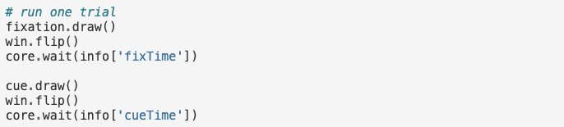

Let’s start building an experiment: Posner Cueing Task
Step 5a: Create a single trial

Slide 21
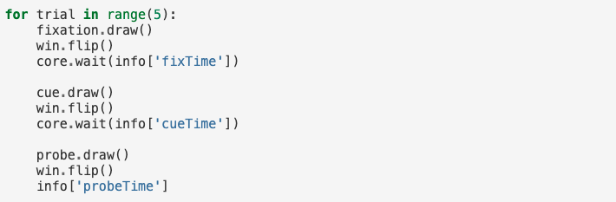
Let’s start building an experiment: Posner Cueing Task
Step 5b. Run multiple trials:

Slide 22
Let’s start building an experiment: Posner Cueing Task
Step 5: randomize some parameters to have multiple different trial types
There are different ways to do this, including by using the built in TrialHandler functions.
Exercise: let’s create a series of trials that will randomly have valid and invalid trials

Slide 23
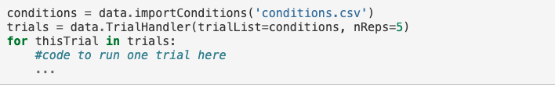

Let’s start building an experiment: Posner Cueing Task
Step 6: change the trials using the TrialHandler (data module)
(trials defined by ‘conditions.csv’)

Slide 24
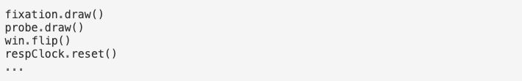
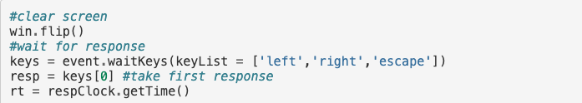
Let’s start building an experiment: Posner Cueing Task
Step 6: Get responses
Step 7a: Create a clock
Step 6b: reset the clock when presenting stimulus:

Slide 25
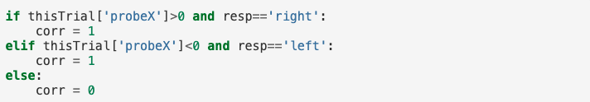
Let’s start building an experiment: Posner Cueing Task
Step 6c: Check for response accuracy:
Step 6d: save the responses:
Exercise: how to do this?

Slide 26
Writing files
Open file:
fileID = open(filename, ‘w’)
w = write
x = open (error if duplicate)
a = append
Write to file fileID.write(‘format’, vars)
Format: s = string, i = int, f = floating point (for a specified number of decimals)
‘/n/ = new line
Close file fileID.close()

Slide 27
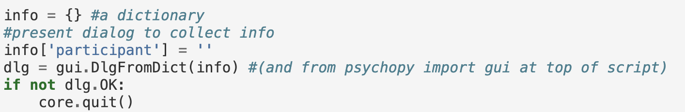
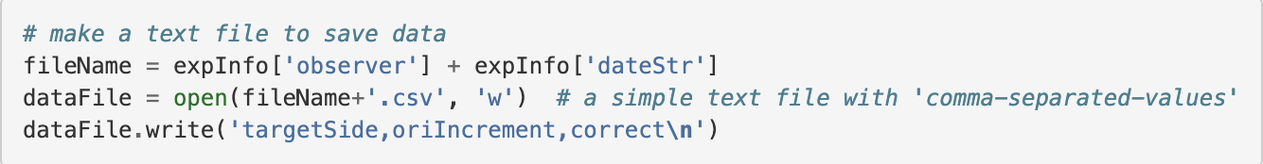

Let’s start building an experiment: Posner Cueing Task
Step 7: Log data
Option 1: manually set up file, and write after each trial:

Slide 28
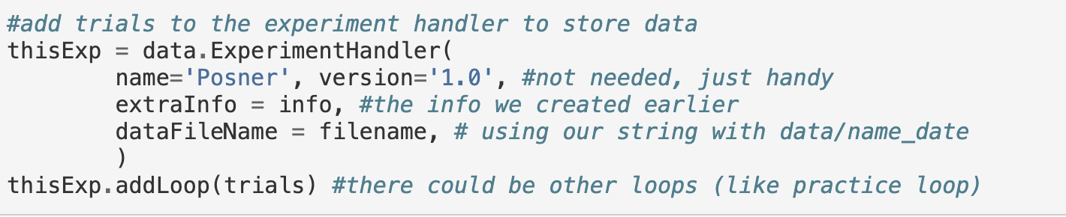
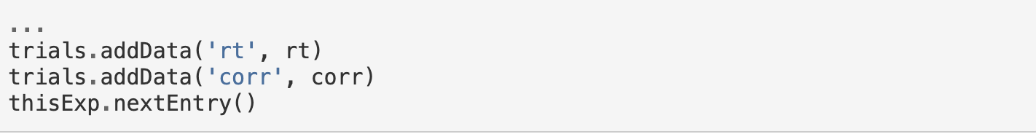
Let’s start building an experiment: Posner Cueing Task
Step 7: Log data
Option 2: use the ExperimentHandler:

Slide 29
Let’s start building an experiment: Posner Cueing Task
Other things:
Build in global keys

Slide 30
In class exercises:
Move a stimulus to a new location
Present an image
Present an audio stimulus
Take a mouse input
Read keyboard responses

