Slide 1
Data Handling and Analysis in Python
PSYC 5P02
Computer Programming for Experimental Psychology
Stephen Emrich
Brock University

Slide 2
Handling data
Often in psychology we need to deal with multi-dimensional data
fMRI: Voxels x time
EEG: Electrodes x time
Questionnaires: Subjects x responses
Lists are not inherently multi-dimensional, although you can embed lists within lists (or tuples within lists)
Exercise: create a multidimensional list of x + y coordinate pairs (as tuples)

Slide 3
Dictionaries
Dictionaries are a type of data structure in python that allows you to store items in key-value pairs.
They are like a List but instead of using a numerical index it uses an assigned key to reference an item.
Dictionaries are usually declared by curly brackets { } and each element has a <key> : <value> pair.

Slide 4
Dictionaries
nbaTeams = {
'Los Angeles':'Lakers',
'Toronto':'Raptors',
'Chicago':'Bulls'
}

Slide 5
Dictionaries
Unlike sequences, which are indexed by a range of numbers, dictionaries are indexed by keys, which can be any immutable type; strings and numbers can always be keys.
Think of a dictionary as a set of key: value pairs, with the requirement that the keys are unique (within one dictionary).
You can also use the dict() function to construct a dictionary. Takes in a sequence of key-value pairs but slightly different syntax:
nbaTeams =
dict([('Los Angeles','Lakers'),('Toronto','Raptors'),('Miami','Heat')])

Slide 6
Dictionaries
Retrieve a dictionary item by key: nbaTeams["Toronto"] nbaTeams.get("Toronto")

Slide 7
Numpy
While lists and libraries have their use cases, can be kind of clunky and limiting
Python has a number of libraries commonly used in (data)science to deal with n-dimensional arrays
One such library is NumPy (Numerical Python)
Import using:
import numpy as np

Slide 8
Numpy arrays
To create an array, you can have to call the array method
arr = np.array([1, 2, 3, 4, 5])
You can separate different dimensions of an array using , arr = np.array([[[1, 2, 3], [4, 5, 6]], [[1, 2, 3], [4, 5, 6]]])
Exercise: try making a 3D array. Check the number of dimensions of the array using ndim

Slide 9
Other methods
arr.reshape(4,3): reshapes an existing 1 x 12 array into a 4 x 3 array
np.vsstack(arr1,arr2): stacks the two 1D arrays arr1 and arr2 ontop of each other, making a 2d array
np.array_split(arr,3): splits an existing 1D array arr into 3 separate parts

Slide 10
Iterating through arrays
Sometimes you may want to loop through arrays (e.g., trials, conditions, etc.)
Iterate through this array: arr = np.array([[1, 2, 3], [4, 5, 6]])
Compare
for x in arr: print(x)
To:
for x in arr: for y in x: print(y)

Slide 11
Indexing and masking
Finding specific values in your data is one of the most common things you will need to do (e.g., RTs < 2.5SD, acc == True, cond ==1)
Can index the specific values using a Boolean in a few different ways
mask = data >=2
data.mask(mask)
data[data>=2]

Slide 12
Other ways of indexing
np.nonzero(a) returns all the non-zero elements
np.where(condition, [x,y], /) returns elements from x or y depending on condition

Slide 13
Numpy
Let’s create a large array by loading in some large data sets from the inflammation study
data = np.loadtxt(fname='inflammation-01.csv', delimiter=',’)
Note this is a comma-separated values file (.csv)
Indicate what the delimiter is (files can also be tab or character delimited
If you’re using Spyder you should be able to see the size and type of your variable using the variable explorer
If not, use print(data.type) and print(data.shape)

Slide 14
Multi-dimensional numpy arrays
Our data is in an m x n array (60 x 40)
Also called an r x c array as it’s rows followed by columns
We can index the location of the value in the 1st row and 1st column using data[0,0]
We can get slices of data using, e.g.: print(data[0:4, 0:10])
The slice 0:4 says “start at index zero and go up to but not including index 4”

Slide 15
Statistics using numpy
Numpy also includes a number of functions for analyzing data. Let’s try a few using multiple assignment:
meanval, maxval, minval, stdval = np.mean(data), np.amax(data), np.amin(data), np.std(data)
print(mean inflammation:’, meanval) print('maximum inflammation:', maxval)
print('minimum inflammation:', minval)
print('standard deviation:', stdval)
Exercise: obtain the maximum inflation value for patient 1, the mean mean value for day 10
Obtain values for each patient/day using the axis option

Slide 16
Numpy random
Numpy has a number of useful random methods. Can import directly as from numpy import random
random.randint(100): generates a random integer form 0 to 100
Can include optional size size argument
random.rand() generates a random float from 0 to 1
random.choice() : selects a random value from an array
random.shuffle() and random.permutation()create random permutations of an array, either on the original or on a new object
Have methods for creating random values with normal, binomial, poisson, uniform, or custom distributions

Slide 17
Numpy
Numpy also has a number of other useful methods for analyzing data including:
Mathematical functions
Linear algebra
Fourier transform (time-series analysis)
Strings
Full documentation here:
https://numpy.org/doc/2.1/index.html

Slide 18
Pandas
pandas is a software library written for the Python programming language for data manipulation and analysis.
It aims to be the fundamental high-level building block for doing practical, real world data analysis in Python.
Built on top of the Numpy library, which means that most of the methods defined for Numpy arrays apply to Panda data structures

Slide 19
Pandas
Panda has two main data structures:
Series: A pandas Series is a one-dimensional labeled array capable of holding data of any type (integer, string, float, python objects, etc.).
DataFrame: The primary data structure in pandas, the DataFrame is a two-dimensional, mutable, and potentially heterogeneous tabular data structure with labeled axes (rows and columns).

Slide 20
Pandas - Series
Getting started: import panda
import pandas as pd
A Series in pandas is simply a 1 dimensional list, e.g., a list with only 1 column.
pd.Series(['4 cups','1 cup','2 large','1 can'])
pd.Series(data=['4 cups','1 cup','2 large','1 can'])

Slide 21
Panda - data cleaning
Pandas can convert easily between data types (str, int, float, etc), which can be useful for cleaning data
s = pd.Series(data = [1,'2',3,4,'5',6,7,8,'99','1000'])
print(s) s.astype(‘int') s.mean() s.std() s.max() s.min() s.var() s.sum()

Slide 22
Panda - data cleaning
You can also easily remove or replace missing data
data = pd.Series([1,2,pd.NA,4,5])
data.dropna(inplace=True)
Can also fill an emtpy cell with a specific value:
data.fillna(‘Nan’, inplace = True)

Slide 23
Pandas - apply
You can apply functions to values inside a Series or Data Frame
data.apply(np.sqrt)
You can also write short anonymous functions to pass to the data using the lambda function
data.apply(lambda x: x + 1)

Slide 24
Pandas - DataFrame
DataFrame is the primary data structure in pandas.
The DataFrame is a two-dimensional, mutable, and potentially heterogeneous tabular data structure with labeled axes (rows and columns).
You can think of it like a spreadsheet.

Slide 25
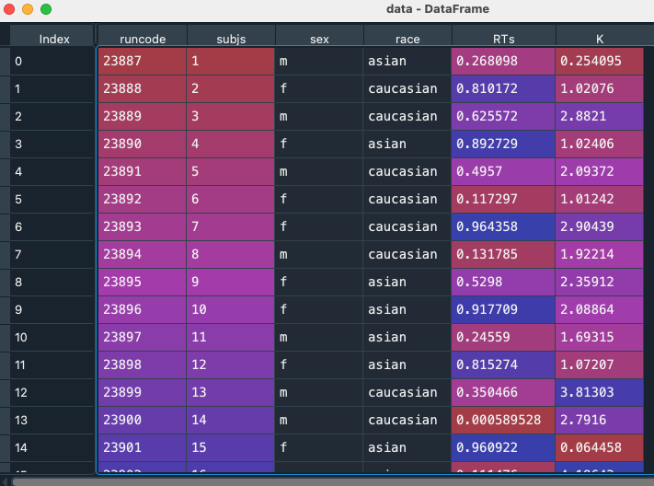
Pandas - DataFrame
Import the RTdata.csv file using data pandas .read_csv method
Note the column labels are imported from the CSV file. The row labels are the indices
You can use the index_col option to provide a column to use as row headings (e.g., ‘subjs’)
Exercise: get the RTs for Caucasian males (might need bool operators for | & and ~)

Slide 26
Pandas - DataFrame indexing
As with Series, can specify a location within a DataFrame using row x colum indices using the method iloc: data.iloc[2,5] data.iloc[2:5,2:5]
You can also index using names using the method loc: data.loc[:,’K’]
Exercise: create a mask to find only male RTs

Slide 27
DataFrames - groupby
Groupby creates groupings or categories based on common values in columns
data.groupby(‘sex’).mean()
Exercise: try grouping for both sex and race

Slide 28
Pandas - manipulating textual data
Pandas has a number of methods for dealing with textual (string) data under the str accessor
E.g., import the titanic data set, and change the names of all passengers using the lower method:
titanic[“Name”].str.lower()

Slide 29
Pandas - manipulating textual data
You can separate strings of text into new columns using the split method titanic["Name"].str.split(",")
Each of the values is returned as a list of 2 elements (one each before and after the split character) titanic["Surname"] = titanic["Name"].str.split(",").str.get(0)
titanic["Surname"]

Slide 30
Pandas - manipulating textual data
Other methods:
str.contains()
str.len()
str.replace()
.replace()
To use a dictionary of pairs
Saving and exporting data
to_csv
to_excel
to_markdown

Slide 31

Let’s make a jeopardy game!

Slide 32
Sources
https://swcarpentry.github.io/python-novice-inflammation/02-numpy.html
https://swcarpentry.github.io/python-novice-gapminder/07-reading-tabular.html
https://www.w3schools.com/python/numpy/default.asp
https://pandas.pydata.org/docs/getting_started/intro_tutorials/10_text_data.html

