Slide 1
9. Introduction to MATLAB
PSYC 5V46
Intro to Programming for Experimental Psychology
Stephen Emrich
Brock University

Slide 2
The matlab environment

Slide 3
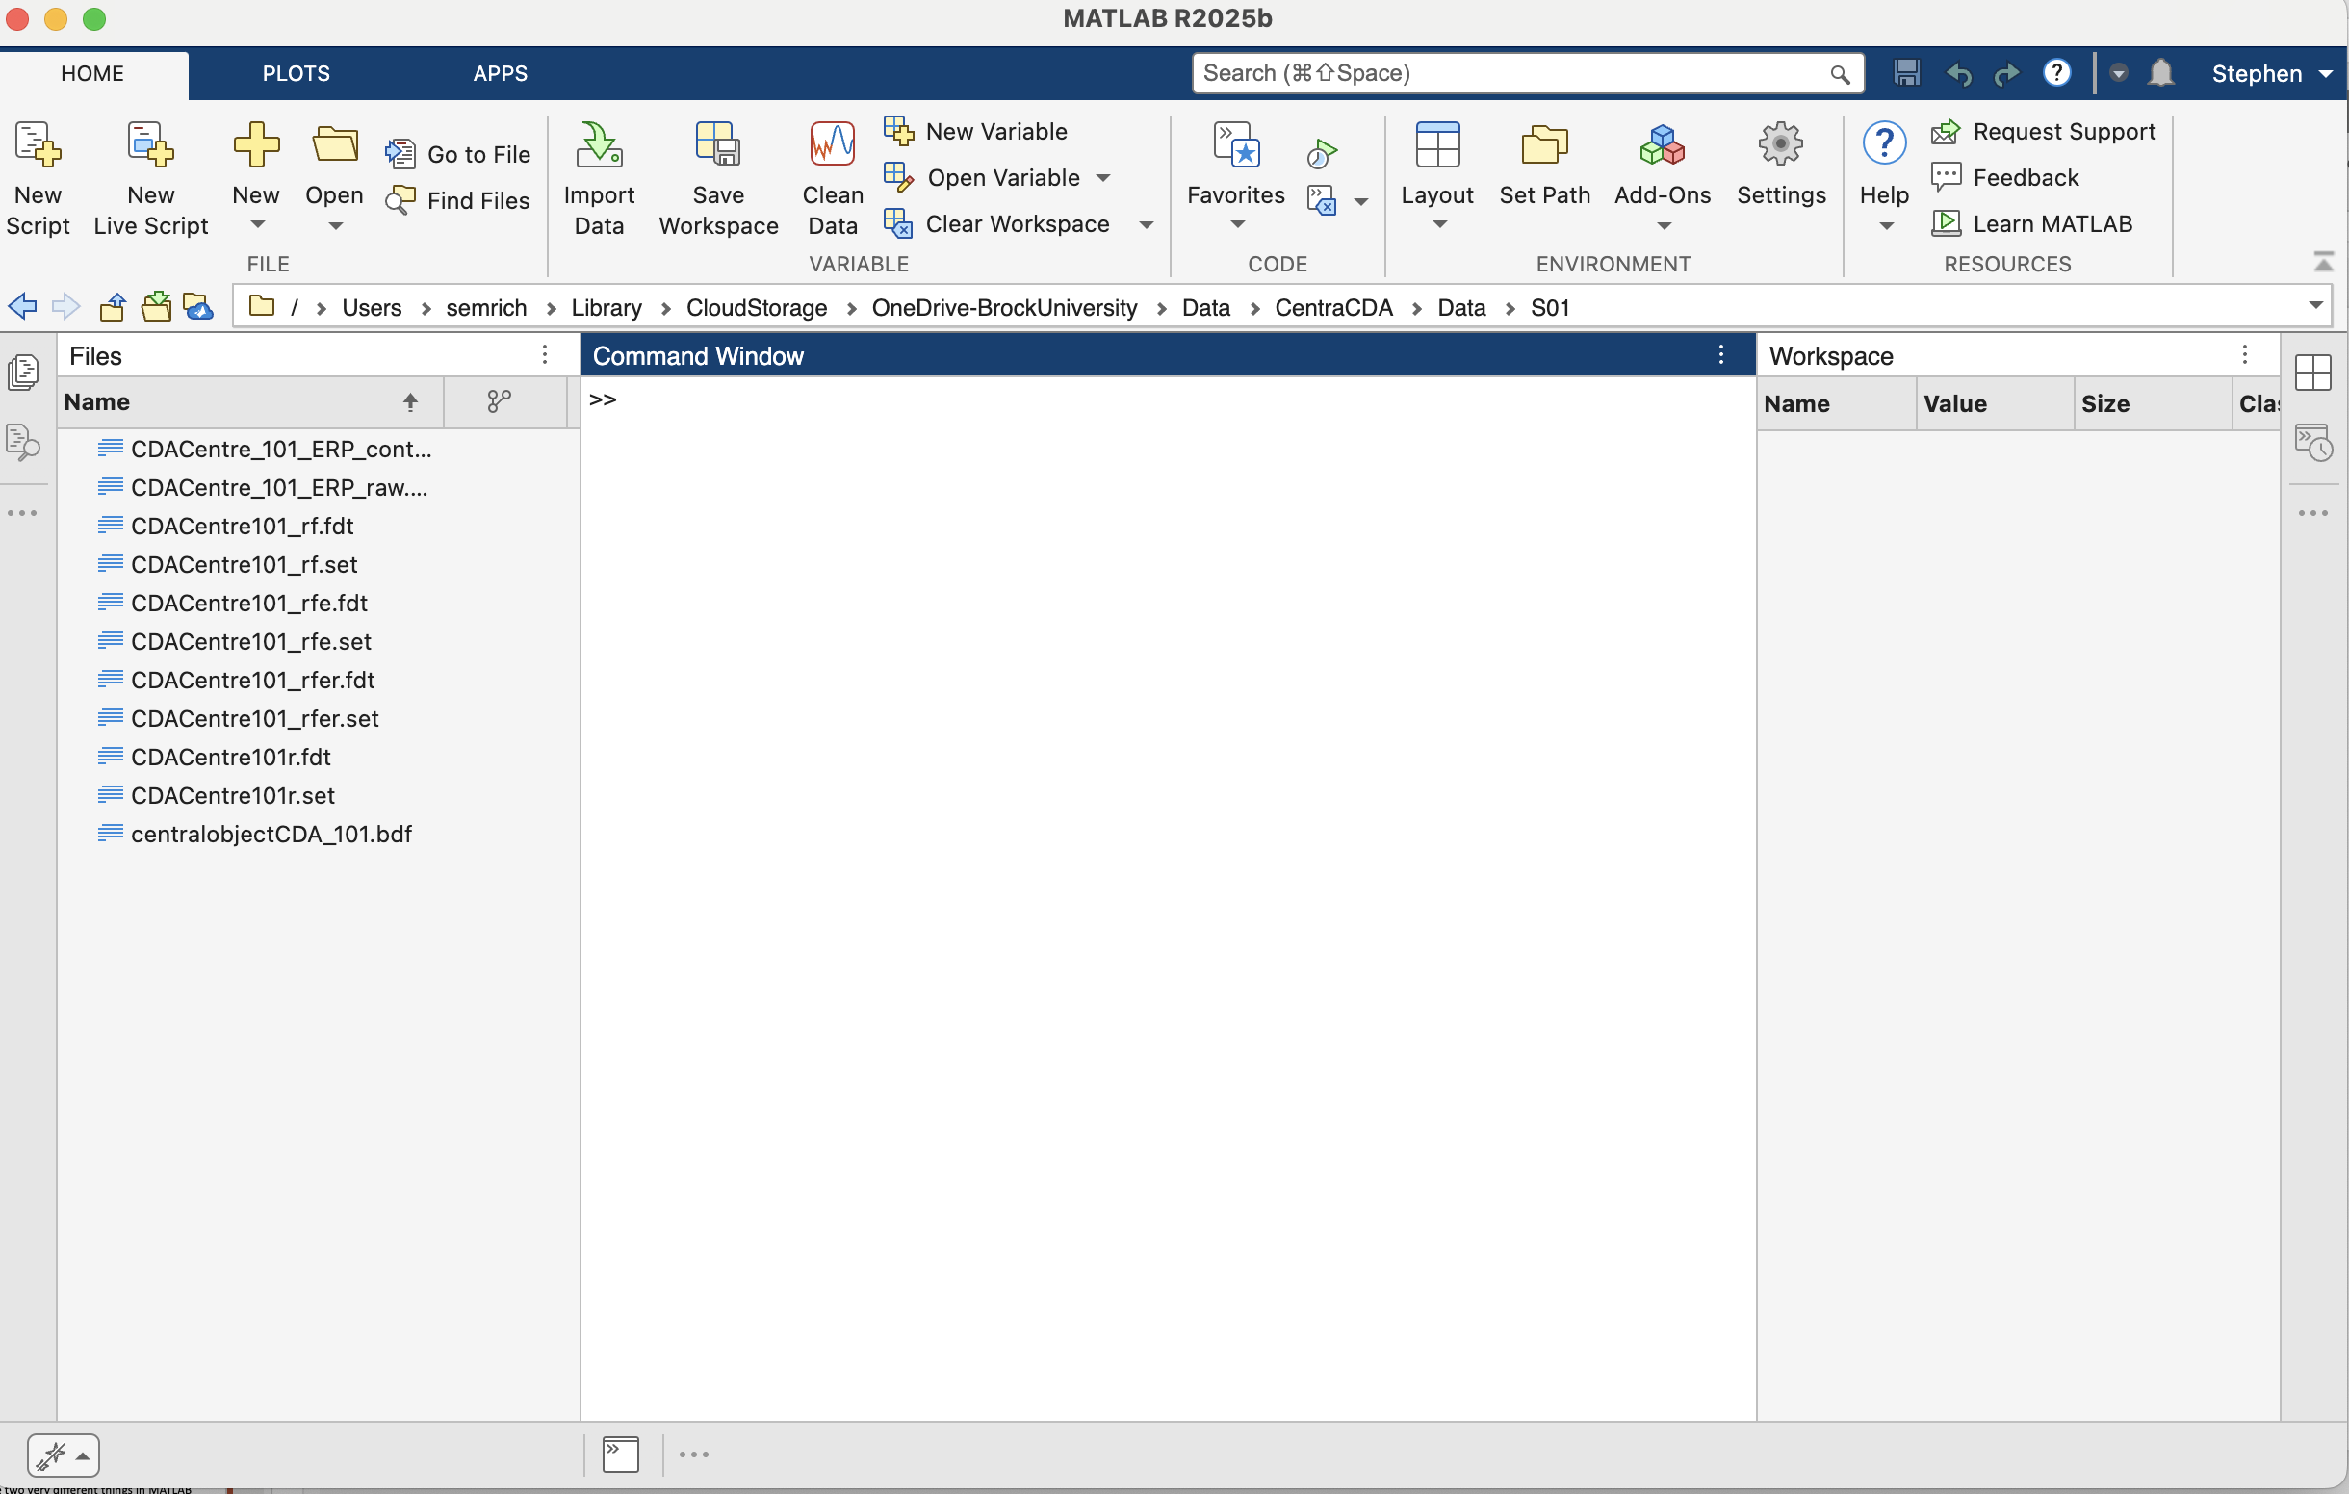
The Desktop

Slide 4
The Command Window
Type command here

Slide 5
The working directory
Working Directory

Slide 6

The working directory
The current folder you are in right now
All files within that folder are accessible (can be “read”) automatically
Can click path link or folders to modify, or use the tools:
Specified as, eg: /Users/stephenemrich/Documents/MATLAB
Emrich’s Tip: Do not include spaces or special characters in folder or file names

Slide 7
The Path
Files outside of the current working directory (e.g., the contents of toolboxes like EEGlab or PsycToolBox can be read by adding them to your path directories
Can be specified 3 ways:

Slide 8
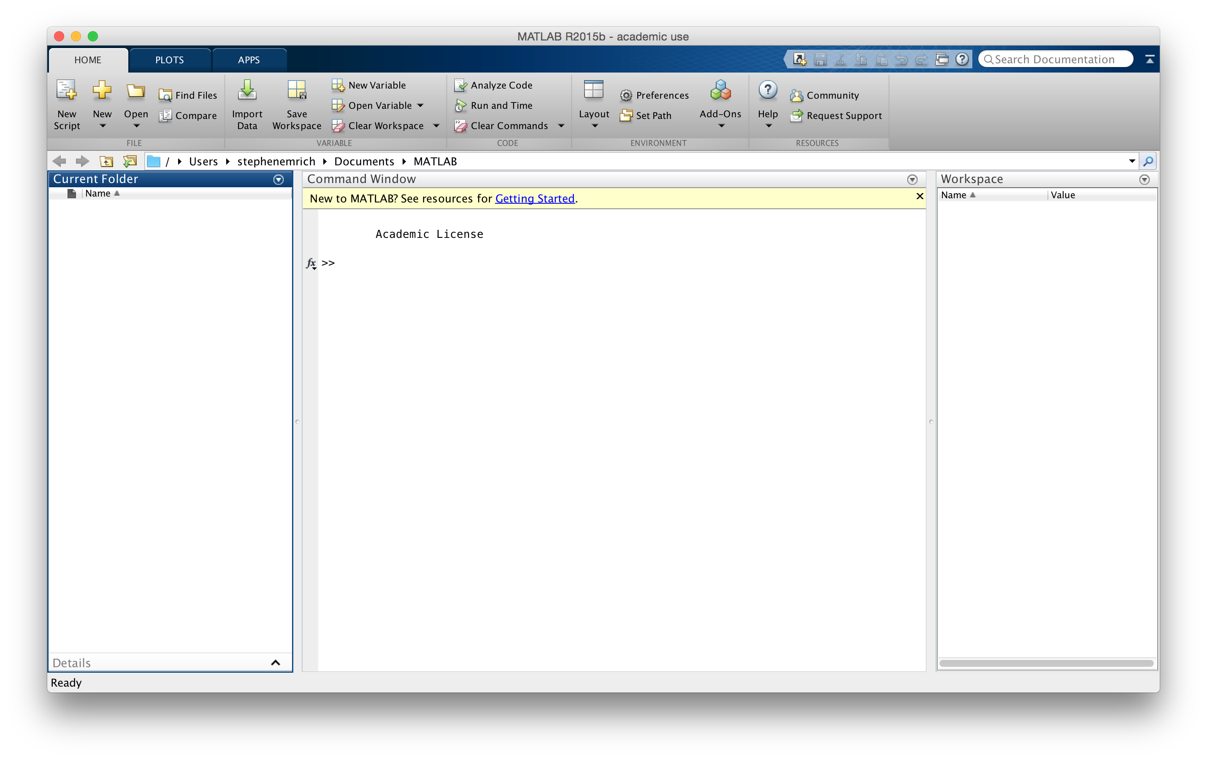
1. Set Path (GUI)
Set Path

Slide 9
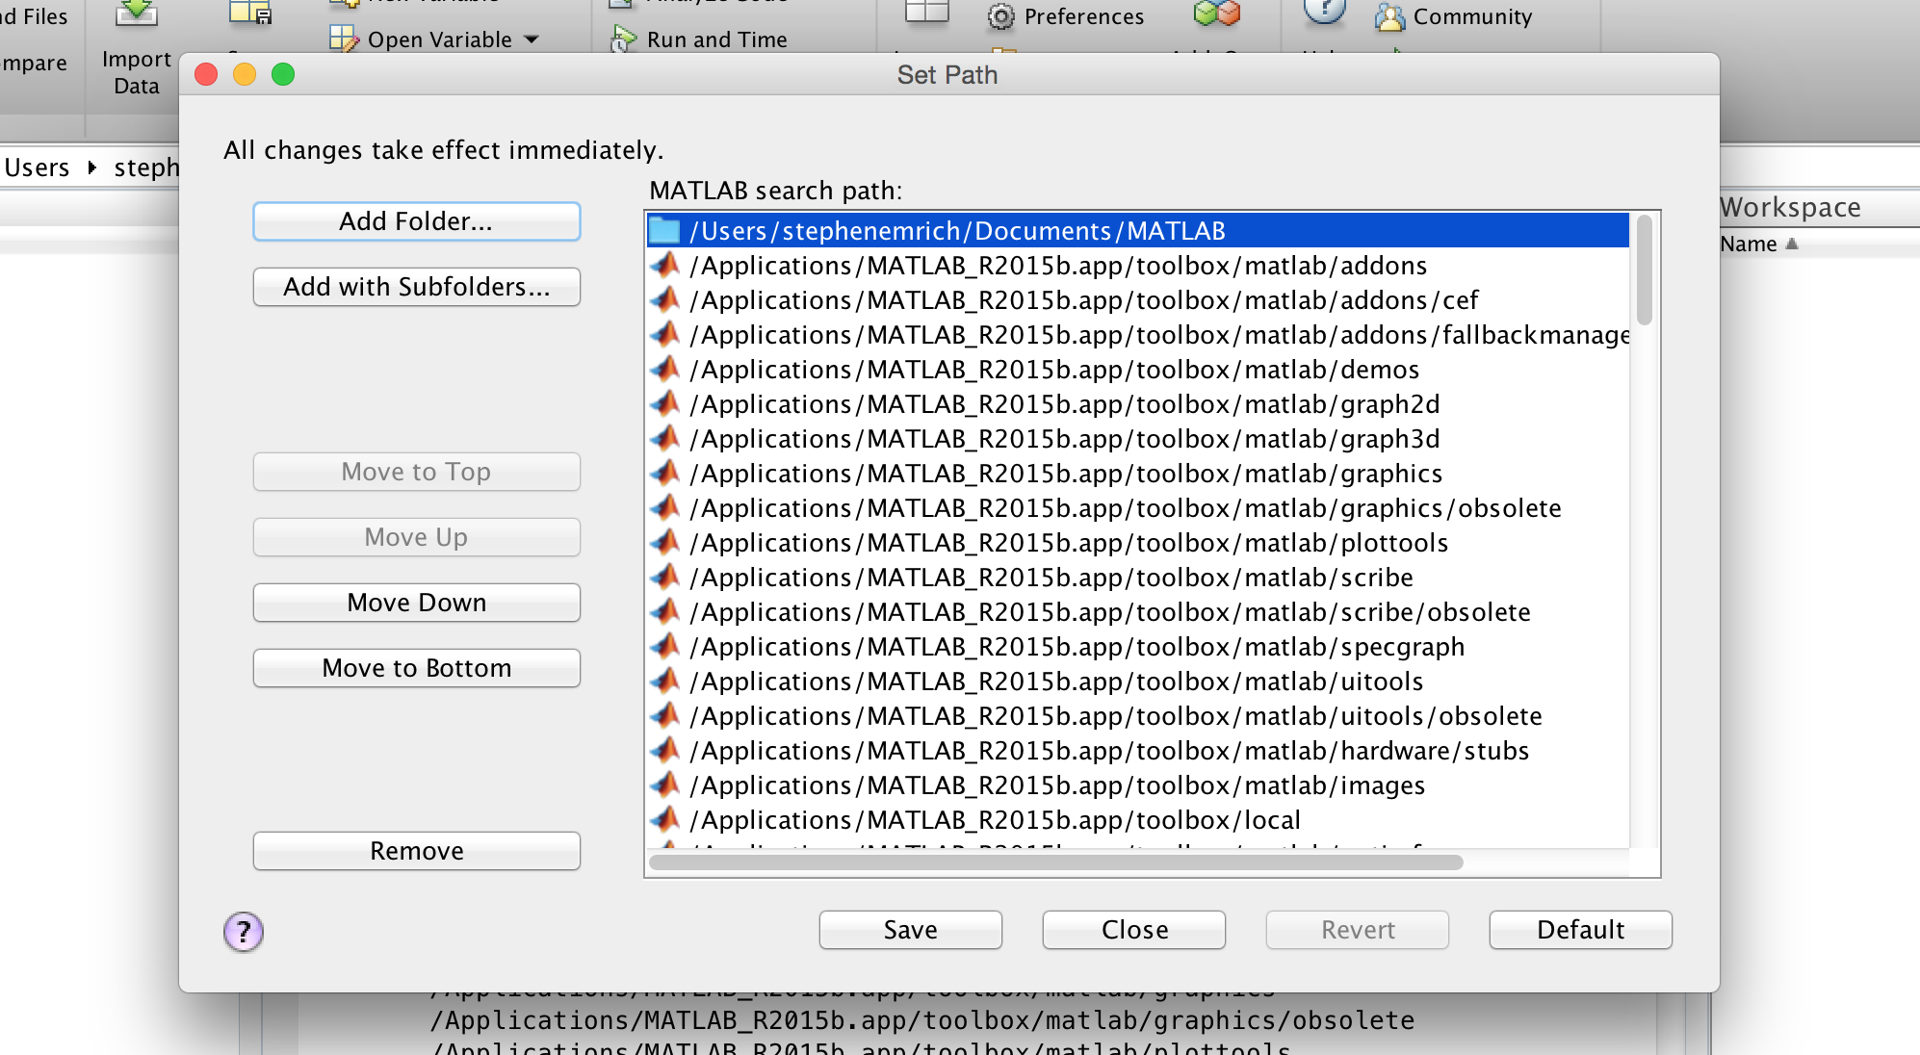
‘Add folder…’ will add single folders
‘Add with Subfolders…’ will add a folder and all its subdirectories
You can save the path for future sessions
WARNING!: Be very careful with this function. Always want to know which files are being accessed on every session. Better to do through startup.m or some other function

Slide 10
2. Set Path (command)
Use the addpath + genpath commands
Addpath will work on its own but will not contain the subfolders of the path
addpath(genpath(‘/location/of/my/directory/’))
NOTE: single quotations must be included around the text
Use the path command to view folders currently in your path
Can also call the pathtool function to open the Path dialogue tool

Slide 11

3. Set Path (startup.m)
Click ‘New Script’
Specify a path to include using addpath and genpath:
addpath(genpath(‘~/’))
Save the file as startup.m in a folder that is in your current path
Close and re-open MATLAB
Check your path

Slide 12
startup.m
NOTE: if your statup.m file is in your default start-up directory, and if you start MATLAB from the command line (Linux, MAC) your startup.m file might not be read (if the start-up directory is not automatically in the path)
Best to include startup.m file in a folder that’s read by default

Slide 13
Emrich’s Tips
After you get used to the syntax I’d estimate that 50% of runtime errors can be attributed to Path Errors (i.e., the file or function you are calling is not in your working directory or in your path)
Making path definitions within a function/script and adding common toolboxes to your startup.m file can help avoid this

Slide 14
Current Folder Window
Current Folder Window

Slide 15
Current Folder Window
The Current Folder Window contains all of the contents of your current (working) directory
Useful for viewing and identifying files, scripts, directories you may be working with (or wanting to work with – ie., finding a path error)

Slide 16
Workspace
Workspace

Slide 17
The Workspace
The Workspace contains all user-defined variables that have be loaded into MATLAB
Variables that haven’t been read or defined cannot be operated on
Tells you some info about the variables (more on that later…)

Slide 18
Command History & Layout
Layout
Command History

Slide 19
Command History
A history of the commands you have executed is stored in a history file
This can be viewed in the Command Window by pressing the ⬆ key or by viewing it in the History Window
Whether your history is present in the Desktop depends on your Layout which you can customize for your own needs or preferences

Slide 20
Other Desktop Things
Preferences → Just as it sounds, can be useful for defining certain aspects of how MATLAB behaves by default
Dialogues for opening files, importing data, opening variables, etc.
Note: We’re going to try to use these things minimally. Almost all of these things can be done via commands and relying on point-and-click interfaces doesn’t help improve your efficiency or reduce errors

Slide 21
MATLAB File Types
*.m → MATLAB code files
Contain bits of code or functions that you will want to execute and run
*.fig → MATLAB figure files
Self-explanatory
*.mat → MATLAB MAT-file
Contains variables, arrays, matricies, structures, etc.
i.e., the “stuff” from your workspace, as opposed to the code you run on it (which is stored in m-files)

Slide 22
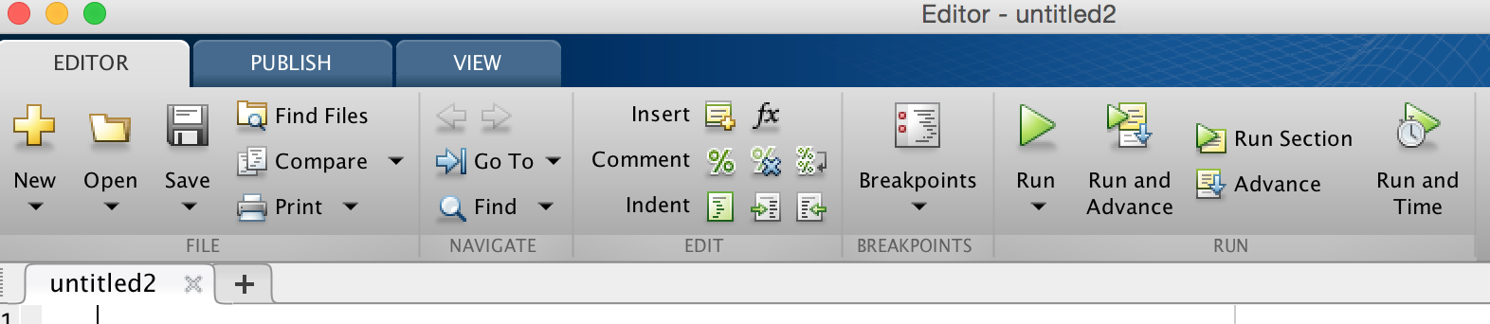
m-files
m-files are used to save and run pieces of code
Can be functions or just pieces of code
Can be run two ways:
Via the ‘Run’ button in the Editor window
By typing the name of the m-file into the command window
Requires the file be in the current folder or a path folder
Can also select text in file and right click + ‘run selection OR shift + F7

Slide 23
Key differences between matlab and python

Slide 24
Key Differences
Python
Matlab
Treats everything as an object
Uses 0-based indexing
Uses indentation to define code blocks
Uses the # symbol for single-line comments and “””…””” for multi line strings used as docstrings
Treats everything as an array (intuitive for matrix manipulations and linear algebra)
Uses 1-based indexing
Uses the end keyword to terminate blocks of code (e.g., if…end)
Uses the % symbol for single-line comments and %{…%} for multi-line comments

Slide 25
Variables

Slide 26
Vectors and Matrices
One of the reasons MATLAB is so popular in scientific computing is that it is specifically designed to deal with vectors and matrices
Vector: contains multiple values/elements within 1-dimension
Matrix: contains multiple values/elements within n-dimensions
This is particularly useful in Psychology as vectors can contain:
Subjects
Trials
Time points
Image values
Etc.

Slide 27
Defining Vectors
Vectors and matrices (arrays) are contained within square-brackets: []
A = [1 2 3 4 5]
Although you don’t need them, it can be useful to separate the elements with , . So the above is the same as:
A = [1, 2, 3, 4, 5]
Type whos to note the size of this vector

Slide 28
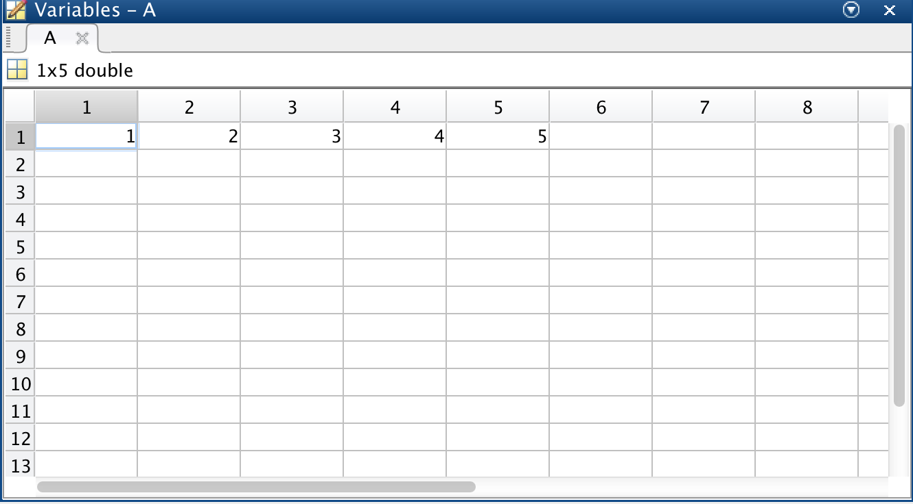
Vectors
Notice that the array is 1 x 5

Slide 29
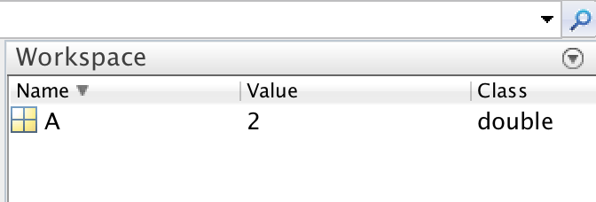
Making variables
Now that you have made a variable it should appear in your workspace
Note that the workspace tells you information about the variable (e.g., value, class, etc.)
Tip: You can change the information shown about variables in the workspace by right-clicking the menu

Slide 30
Making/removing variables
Another way to see all the variables in your workspace is through the who command
who will list all the variables
whos will also include class information, size, etc.
clear will remove all variables from the workspace
clear varname1 varname2 will remove the variables varname1 and varname2 only

Slide 31
Vectors
Can create a vector along the row dimension using semicolon (;) in place of the commas (,)
Using
B = [1; 2; 3; 4; 5]
…produces a 5 x 1 vector instead of a 1 x 5 vector
In other words, MATLAB uses a ROW x COLUMN structure (r * c)

Slide 32
Matrix
Combining these two dimensions means we can create a matrix of size m * n
C = [1 2; 3 4; 5 6] produces
C =
1 2
3 4
5 6
> C = [1 2; 3 4; 5 6]
Rows
Columns

Slide 33
Matrix
Matrices MUST be rectangular
i.e., they must contain the same number of elements in each row/column
BUT…what about missing data, different trial numbers, etc.
Different data types: structures & cells
Not-a-number: NaN

Slide 34
Indexing Vectors and Matrices
You can easily find the value of specific items in vectors and matrices by specifying (indexing) it’s position.
The round brackets () are used after the variable name, are organized in r * c, separated by commas. So if:
A = [1 2 3 4 5] and
C = [1 2; 3 4; 5 6]
Then:
A(5) returns 5
C(2,1) returns 3
Row
Column

Slide 35
Vectors and Matrices
Can specify multiple values by providing a vector:
C([1 3],1)
ans =
1
5
The vector (or single value) can be its own variable
D = [2 3];
C(D,2)

Slide 36
The Colon (:)
The colon is extremely useful for both setting and looking up the values of a matrix
Can use it three ways:
By itself: specify all the elements of a vector or matrix
C(1,:) =
2
Between two numbers: specify every number from first to last
D = 1:10
D = 1 2 3 4 5 6 7 8 9 10

Slide 37
The Colon (:)
Between three numbers: middle number specifies the step size between the first and last numbers
E = 1:2:10
E = 1 3 5 7 9

Slide 38
Other useful stuff
end can specify the last element of a vector
Useful when you take everything from one point in time (or trial) onwards but don’t know the number of points
Of course, can figure this out using whos
A more effective strategy: can use size() to return the length or size of a variable
Size on a r * c matrix will produce two values, length of r and length of c

Slide 39
Matrix Transpose
One of the most useful (and dangerous) characters in MATLAB is the single quotation: ‘
The ‘ will transpose or ‘flip’ your matrix along the r * c dimensions:
>> A = 1:5
A =
1 2 3 4 5
>> B = A'
B =
1
2
3
4
5

Slide 40
Matrix Transpose
The matrix transpose is useful because of how certain matrix operations are performed
Particularly useful when some variables are imported or defined along wrong dimension
Emrich’s tip: Be very careful with matrix transpose. And if possible, try to avoid creating perfectly square matrices (e.g., 10 * 10) in order to avoid confusion

Slide 41
Combining variables
You can combine variables into larger matrices (or vectors) by concatenating them
Simple to do: just treat them like numbers and put them inside a matrix:
>> A = 1:5
>> B = 6: 10
>> C = [A B]
>> D = [A; B]

Slide 42
Concatenating Matrices
Remember: the resulting matrix must be ‘square’
i.e., it must have the same number of elements in each row and column:
>> [A;D']
Error using vertcat
Dimensions of matrices being concatenated are not consistent.
These are special cases of the cat, horzcat and vertcat commands

Slide 43
Reshaping Matrices
Can add elements to the end of a matrix:
A = 1:5
A(6) = 6;
Emrich’s tip #1: Only use for adding at the end of the matrix. Doing so within an existing matrix will replace the current value
Emrich’s tip #2: Avoid doing this in big jobs as it is memory demanding and slows things down
Pre-allocate instead (I’ll show you how in a minute)
Can also do:
A = 1:5;
A = [A 6];

Slide 44
Reshaping Matrices
Can do so manually:
A = 1:9;
B(1,1:3) = A(1:3);
B(2,1:3) = A(4:6);
B(3,1:3) = A(7:9);
But that’s inefficient! Why do with 3 lines what you can do with 1?
B = reshape(A,3,3);
First element is the input matrix, then r * c
reshape(X,[M,N])
Fills in matrix moving down rows first!
Transpose!

Slide 45
Deleting items
Can also delete items from an array to make it smaller
A = 1:10;
A(5) = [];
If you do so to a matrix must make sure you do so for all dimensions to keep it square

Slide 46
Pre-Allocating Matrices
It is good coding practice to pre-allocate your matrix
Faster, fewer demands on memory
Prevents the need to flip and reshape
Prevents errors if matrices are all in the proper dimensions
Can fill it with zeros or ones:
A = zeros(3,2);
B = ones(2,3);
C = NaN(3,4);
Empty with ‘[]’

Slide 47
Other “fun” tricks
linspace(x1, x2, N): creates N evenly spaced values between x1 and x2
logspace(x1, x2, N): same thing, but log-linear
flip(x): Flips a matrix keeping order intact
1:10 → 10:1
fliplr
flipud
rot90(x): rotates a matrix by 90 degrees counter-clockwise
rot90(x,k): rotates by k * 90 degrees

Slide 48
Saving & Loading Variables
You can save variables into the MAT-file type using the save command
You can load the MAT-files that contain variables (as well as other things) using the load command
You should have two variables in your Workspace, A and myString. Now type:
save(‘firstMatFile’);
clear;

Slide 49
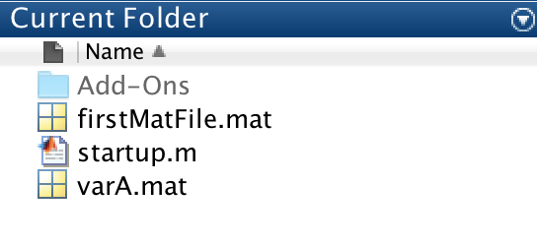
Saving & Loading Variables
You should now have a file in your Current Folder window called ‘firstMatFile.mat’
Confirm you have nothing in your workspace by typing who
Now load the variables back into the workspace:
load(‘firstMatFile’);
who;

Slide 50
Saving and Loading Variables
You can also save and load specific variables:
save(‘varA’,‘A’);
clear;
Now you should have a variable with only the A variable. Now lets load in the myString variable from firstMatFile.mat
load(‘firstMatFile’,‘myString’);
load(‘varA’);

Slide 51
NaN vs Empty Values
Can create an empty variable using: [ ]
emptyVar = [];
Type whos to check its size
NaN in contrast actually has a size. It stands for “Not a Number” and is particularly useful for missing values in data sets
B = NaN;
whos
Note that this takes up the same size and memory as the variable A

Slide 52
Matrix operations

Slide 53
Matrix operations
Many operations you can perform on single values you can perform on entire arrays/matrices:
>>a = 2:2:10;
>>b = a – 5;
>>c = a / 2;
>>d = abs(b);
Can also do things like adding together two matrices of the same size
> e = a + b;
These things are done element-by-element

Slide 54
Matrix operations
Things start getting tricky for multiplication, division, and exponents
They work according to matrix algebra
e.g., the dot product:

Slide 56
Matrix operations
For simple operations you unlikely want to do matrix algebra
Luckily, can do non-matrix (elemental) multiplication etc simply by adding ‘.’ in front of the operation:
* becomes .*
/ becomes ./
^ becomes .^

Slide 57
Matrix operations
a = [1:5; 6:10]
b = [2:2:10; 1:2:9]
ab = a .* b
bDiva = b ./a
aSquare = a .^2
aSqrt = sqrt(a)
aRounded = round(a)

Slide 58
Matrix calculations:
Since we’re doing calculations between matrices, it probably wouldn’t surprise you to find out that we can do calculations within matrices as well
These include:
sum(x)
mean(x)
median(x)
std(x)
var(x)
min(x)
max(x)
When given a 1 * x array, performs over the array

Slide 59
Matrix calculations
When given an r * c matrix, performs it row by row
Can also specify the dimension (c = 1, 4 = 2) via:
mean(X,1) or mean(x,2) or mean(x,dim)
#exercise

Slide 60
Other useful functions
May need to use other math functions:
rem(x,y): gives the remainder of x./y
mod(x,y): similar to rem (but different)
#exercise

Slide 61
Other useful functions
Often in research you need to randomize numbers:
Trials, stimuli, etc.
Generating data to test analysis
Numerous ways to obtain random numbers in MATLAB
rand(x): produce x * x uniform random values between 0:1
rand(m,n): produce m * n random values
randi(nmax,m,n): produce m * n random integers between 1 and nmax
randn(m,n): produce m * n normally distributed random values
#exercise

Slide 62
Other useful functions
Many times you don’t just want random numbers, you want specific numbers in a random order
e.g., use all of 10 stimuli in a random order
Two ways:
randperm(x): produces a matrix of 1:x numbers in a random order
Randperm(x,K) produces k values.
perms([]): produce every possible combination of the values contained in the matrix
#exercise

Slide 63
A note about random numbers (seeding)
In all programs, random numbers aren’t truly random.
Generally not a problem, except that MATLAB loads a default pseudo-random sequence upon startup
Can do the same with the command rng(‘default’)
To avoid this problem, can reset the random number generator using rng(‘shuffle’)
Also, can SEED random numbers to a particular value. e.g.: rng(10);
This can be useful if you want to tie it to a particular subject (for reproducing errors)

Slide 64
Imaginary numbers
One other thing that may come up in matrix calculations are imaginary numbers
a = sqrt(-1)
a =
0.0000 + 1.0000i
Complex double that contains two values
Can think of it as a special notation
Can represent a point in a plane with one complex number (one real, one imaginary)

