Slide 1
Computer Programming for Experimental Psychology
PSYC 5P02
Computer Programming for Experimental Psychology
Stephen Emrich
Brock University

Slide 2
Outline
Introductions
What is programming?
Why programming?
The Zen of Debugging
Why Python vs MATLAB?
This course

Slide 3

About me
Started programming in HTML 1.0 when I got my first modem in ~1995
Took a few courses in high school
C++? Visual Basic?
Programmed my first experiment in Adobe Flash
Self-taught otherwise
Matlab
Python
Presentation
Others?

Slide 4
What is Programming?
Writing a computer program to carry out a specific task
Contain 5 basic components:
Inputs: code, peripheral devices (e.g., mouse, keyboard, response box, fMRI, etc.)
Outputs: variables (ways to modify the code), files, monitor, peripherals, etc.
Conditionals: formal logic, “If”-statements
Repetition: loops
Operations: mathematical and textual manipulations

Slide 5
Programming
“A sequence of instructions that instruct a computer which computations to carry out.”
Programs only do what we (or someone else) tell them to do
Hacker jargon: “It’s not a bug; it’s a feature”
There are no schemas in programs. Must specify every step of a process, unless it’s already built in.

Slide 6
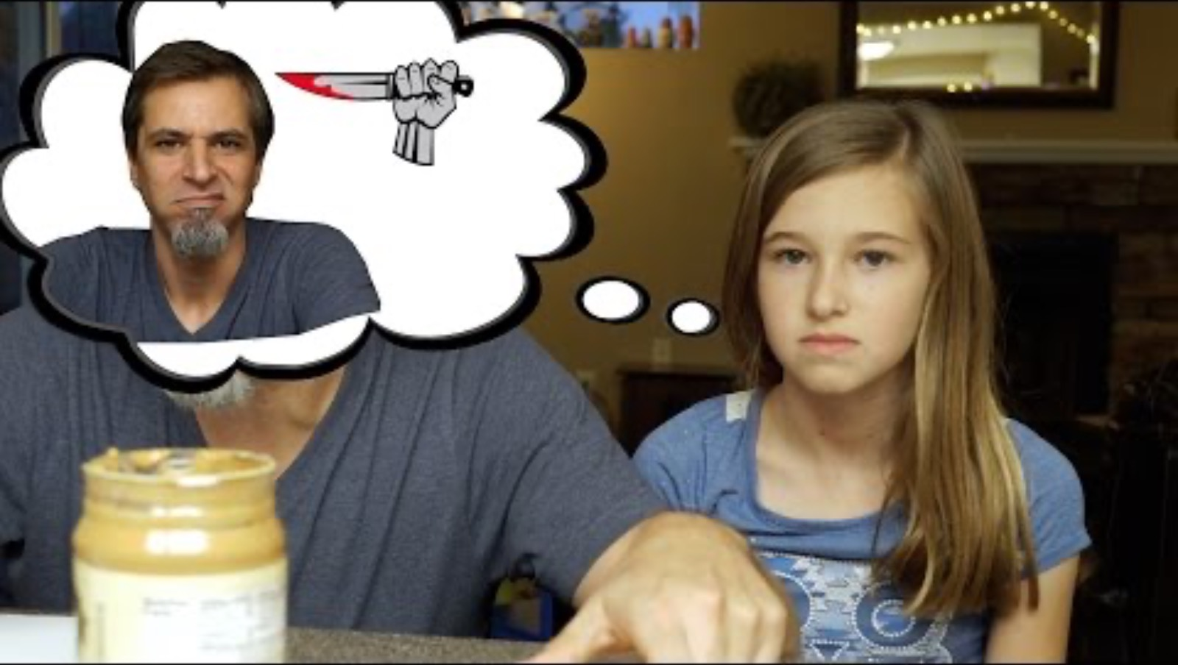

Slide 7
Etc…
Check for:
“bread”
Move to: “car”
Go to: “cupboard”
No
Yes
Is “egg” present?
Is “eggs selected” == 2
Go to: “Fridge”
Check for: “egg”
Select: “egg”
Yes
No
Already would have had to define functions (“go to”, “check for” etc.) and objects (e.g., “fridge”, “egg’, etc.)

Slide 8
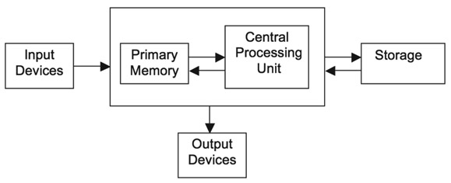
Programming
From Rosenbaum, Vaughn & Wyble (2015)
Primary memory (RAM): like WM, is limited
Be mindful of how much “stuff” you’re putting into the program. Less is better.
CPU: Operates in serial, NOT in parallel
Can only specify one operation at a time
Operations must come in logical order

Slide 9
Etc…
Check for:
“bread”
Move to: “car”
Go to: “cupboard”
No
Yes
Is “egg” present?
Is “eggs selected” = 2
Go to: “Fridge”
Check for: “egg”
Select: “egg”
Yes
No

Slide 10
Why Programming?
There are concrete and abstract reasons for the experimental psychologist to learn how to become “proficient” at programming in one or more languages
Concrete reasons:
Increased efficiency
Reduction in errors
Greater control
Innovation - move closer to the bleeding edge
Documented (replicable) methodology

Slide 11
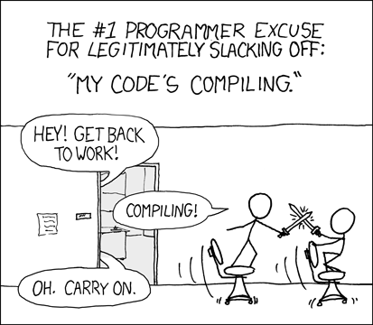

Slide 12
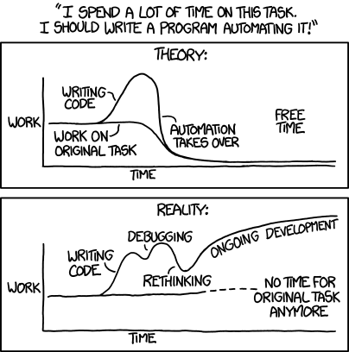
Optimizing vs Satisficing
xkcd

Slide 13
Why Programming?
Most difficult aspect of program is often reasoning out the solution
E.g., you have a 2 x 2 experiment (condition and time)
One variable from output file codes from one condition (1 vs 2)
One variable codes for time (0.2 vs 1.5)
Also have missing data (outcome variable)
How do you create a new variable that differentiates all 4 trials while ignoring missing data?
Doing this once by hand might save you a few minutes
Doing this hundreds of times by hand will cost you hours
Emrich’s tip: write your script the first time to maximize time savings

Slide 14
Why Programming?
Abstract reason:
Computer programming is one of the best methods for practicing problem solving
The type of problem solving done in computer programming mirrors that of science extremely well
Identify goal/problem
Identify solutions/approaches
Break problem into sub-goals
Work incrementally
Debugging

Slide 15
“The single most important skill for a computer scientist is problem solving. Problem solving means the ability to formulate problems, think creatively about solutions, and express a solution clearly and accurately. As it turns out, the process of learning to program is an excellent opportunity to practice problem-solving skills.
- Allen Downey, Think Python: Thinking Like a Computer Scientist

Slide 16
The Zen of Debugging
Your programs, much like your science, will rarely ever do what you expect it to the first time out
Need to identify problems through debugging
Much like experimental science!
Prediction → Manipulation → Outcome
When something isn’t working as expected, manipulate the variables involved
Do known manipulations produce predicted results?
What kind of results do unknown manipulations produce?
If manipulate multiple variables simultaneously, can’t identify cause/effect

Slide 17
One of the major aims of this course is to help you feel comfortable to do this on your own
I won’t teach you everything you will need, but I am hoping to give you the tools to help you find it on your own
Consequently, if you’re looking to perform a particular task, I may not provide the answer for you, but instead may tell you to try one of these approaches:

Slide 18
Tips to Programming & Debugging
Google
Plenty of people have probably encountered your specific problem before
There can be an art to identifying the correct search string to find solution
Need to know the name of the thing you want to do
Help files/documentation
Almost all programs/functions will come with some sort of help file or documentation
Must become comfortable reading/interpreting these sources as they’re intended to provide you with the information you need

Slide 19
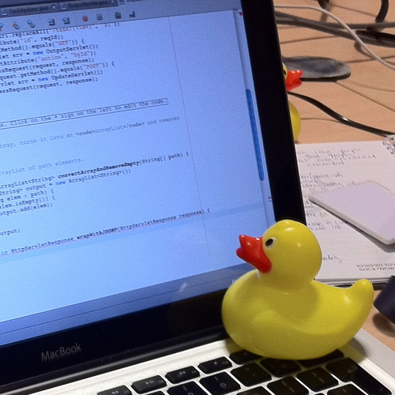
Tips to Programming & Debugging
Asking
Other people around you may know.
Always Google and read the documentation first. Otherwise you may find yourself getting the cold shoulder from colleagues/friends/supervisors/students/spouses if you continue to ask them things you could have easily Googled first
Be specific. What are you running? What does the error say? What have you tried?
Rubber duck-debugging
Talk to yourself about your logic
Surprisingly effective

Slide 20
“Hacking”
One of the best ways to learn how to code is to modify or “hack” someone else’s code
No sense in re-inventing the wheel
BUT…hacking is often inelegant and can lead to problems
Obviously not OK for this course

Slide 21
The elephant in the room:
“AI” and LLMs (Copilot, ChatGPT, etc.) have become extremely useful tools to help people write code
As a researcher, I would 100% endorse your using AI to help you write your code
HOWEVER, in order to be able to use AI to help you code you need to be able to understand what the code means and how to use it
For that reason, I am going to ask that everyone avoid using AI for the first several weeks
Your grade in this course will be based in large part on your ability to explain what your code does

Slide 22
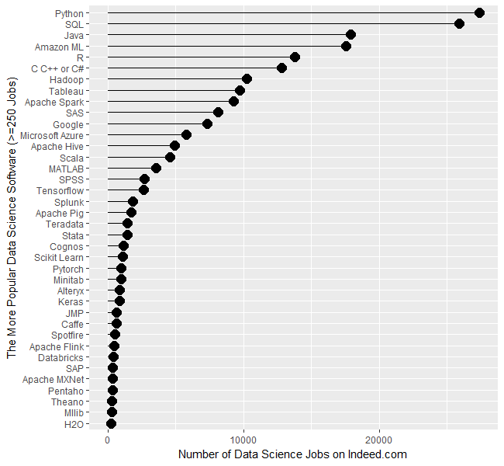
Why Python
Very popular
Very flexible
“General Purpose Language”
Open source (i.e., free!)

Slide 23
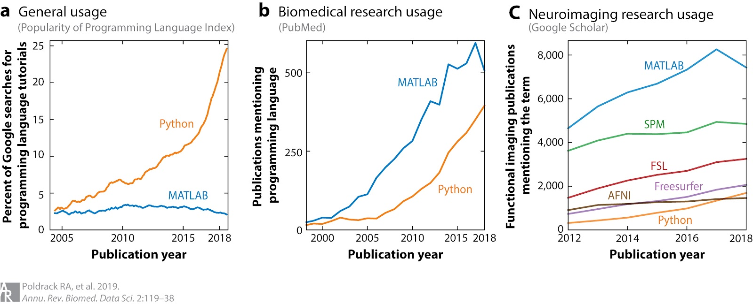

Slide 24

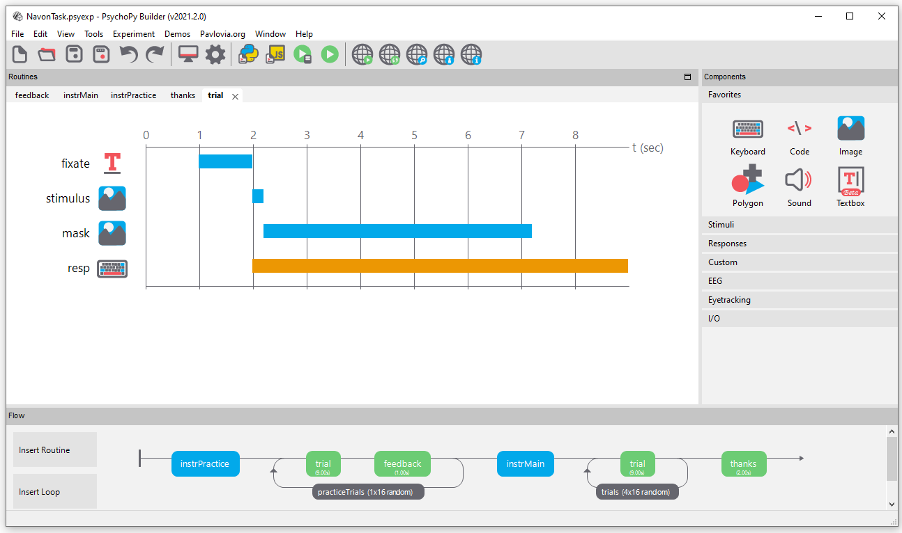
PsychoPy
Runs on Python
Free, open source, etc.
Many similarities to MATLAB PsychToolBox
Both scripting and GUI capabilities
Easily convert to online

Slide 25
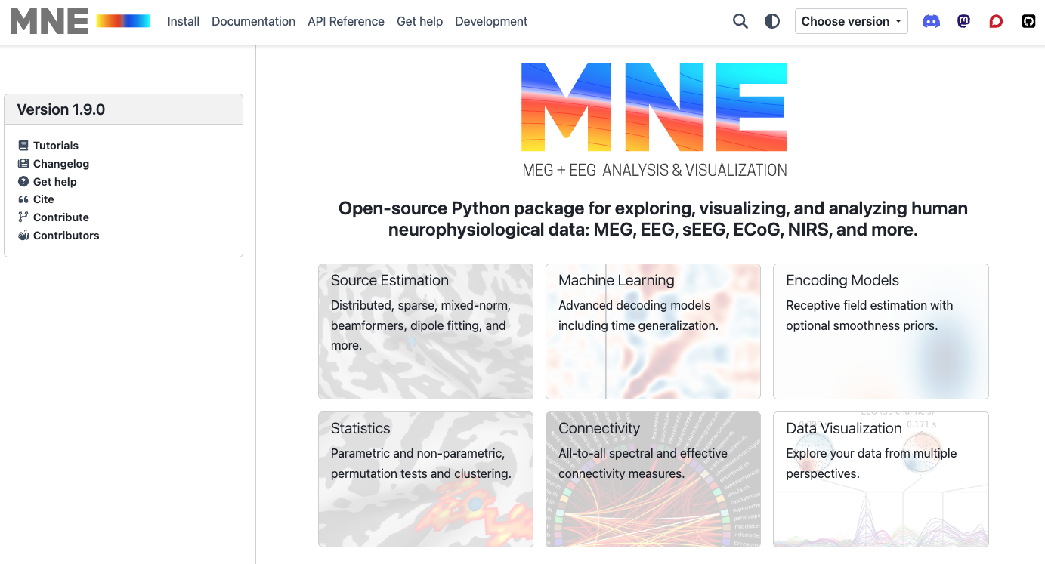
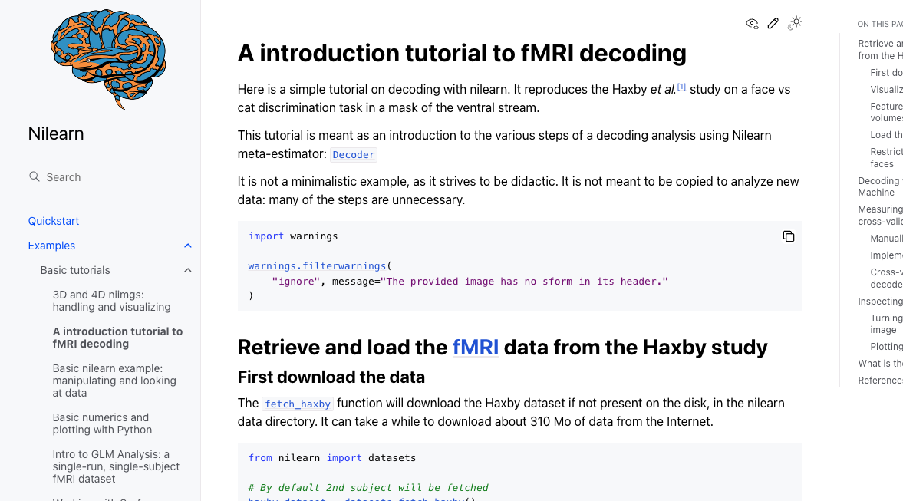
Analysis Packages

Slide 26
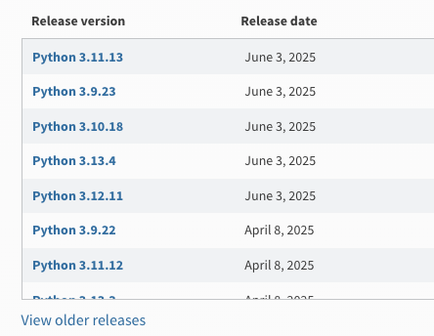
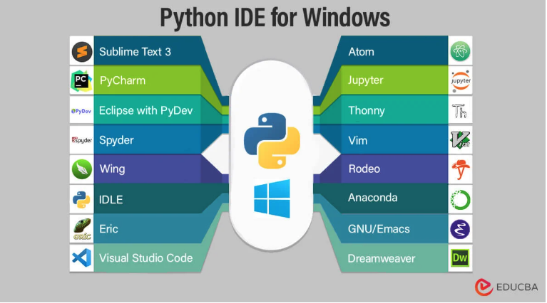
Why not Python?
More difficult learning curve
Ugly (IMHO)
Poor debugging tools*
Can run into versioning issues
Several different ways to implement (terminal, Jupiter, PsychoPy, etc.)
You are not computer scientists! (optimizing vs satisficing)

Slide 27
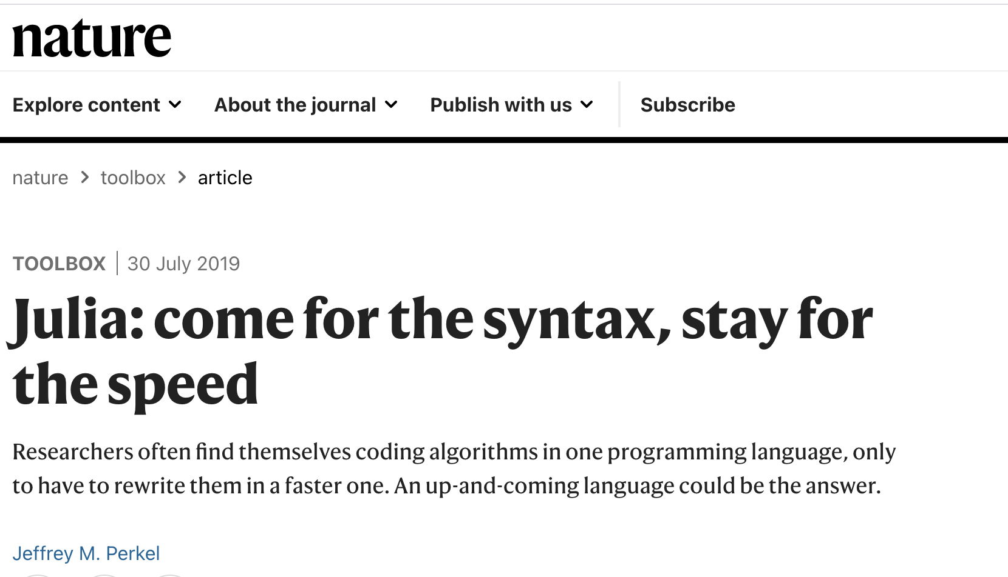
Why not Python?

Slide 28
Why MATLAB?
(Relatively) easy to learn
Single interface
Powerful number cruncher
Deals in matrix algebra (Domain-Specific Language; DSL)
Most of what we do uses multi-dimensional matrices of some kind or another, e.g.,
responses * conditions * trials
EEG recording * channels * time points
Image x * image y * image color
Good debugging interface
Well-documented packages (although main functions can be opaque)

Slide 29

Why MATLAB?
Popular
Wide usage mean scientists everywhere have already created toolboxes that you might want to use
Examples
EEGLab
ERPLab
Statistical Parametric Mapping (SPM)
Psychophysics Toolbox (PTB)
CogToolBox
Biopsychology Toolbox
GazeAlyze
Possibilities are endless. Make your own…

Slide 30
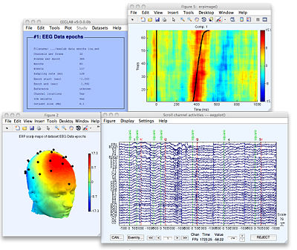
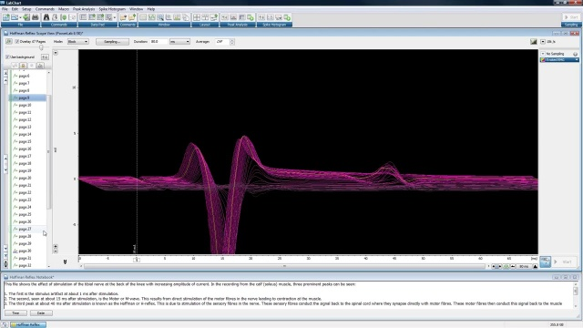
Very popular in Neuroscience

Slide 31
https://www.mathworks.com/matlabcentral/fileexchange/40961-super-mario-bros-demo

Slide 32
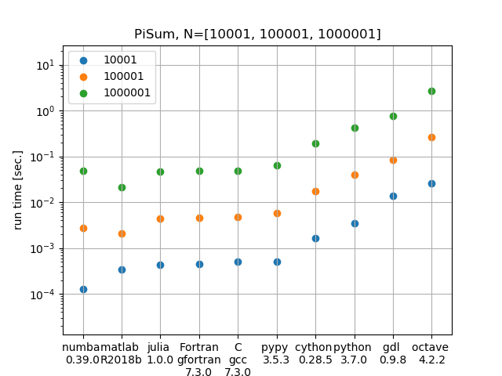
In defense of MATLAB

Slide 33
Why (not) MATLAB(?)
Expensive ($)
Open source version: Octave
https://www.gnu.org/software/octave/
Proprietary
Need MATLAB on a system to be able to run it
Cannot see workings of all code
Somewhat limited (relative to other languages like C++ or Python)
Has been a large move towards open-source software like R and Python in the scientific community of late
Notes:
----- Meeting Notes (16-01-08 14:57) -----
add slowness of loops

Slide 34
Why it doesn’t matter
Remember: the goal is not to teach you everything!
Learn fundamentals
Teach yourself new languages
Always need to learn and adapt

Slide 35
This course
Aims to provide you with
The tools to write basic shell scripts and interact with your computer
The tools to use GitHub to manage version control
The tools to program in Python and MATLAB for your own research
The tools to continue to code independently through debugging, help files, on-line support, etc.
The tools to learn how to program experiments in PsychoPy
The tools to understand the basics of programming languages in general so will apply it to new languages

Slide 36
What this course is not
Will not teach you everything you want/need to know
Not aimed at specific areas/tasks/analyses
Starts out slow (aimed to assume you know nothing) and then will increase in difficulty rapidly
Caveat: I don’t consider myself an expert
Will cover topics I’ve never explored myself
Will see me make errors (and debug) in real-time
Emphasize that programming is something you will continue to learn (especially if you want to stay current)

Slide 37
Course Outline
Bash shell & Terminal
Manuals and help files
Version Control and Git
Maintaining an online repository with Github
Python Basics
Variables
Commands
If statements
Data types
Help files
Functions
Loops
Libraries
Classes
Running Experiments Using Python
Lab experiments using Psychopy
Online experiments using Psychopy/Pavlovia
Data Analysis
Data handling and analysis
Plotting
Statistics
Curve fitting
Machine learning
Advanced techniques
Image processing
Text analysis
Time/frequency analysis
Bootstrapping/ Monte Carlo
Intro to Matlab
Matlab environment
Matlab basics

Slide 38

What do you want to know??!

Slide 39
Lectures
Lectures: Thursdays 2:30 – 5:30 pm
Must have a laptop with all required software!
Will have slides available (after lecture)
Must follow along with own code
Will also switch to Python/Matlab to demonstrate code
I will always try to specify code using Courier New text, and whole lines of code will typically be specified like this:
>code = ‘this is some code’;
Will be required to submit notes/code from each lecture

Slide 40
Required software
The following is a list of software that will be used throughout the course. All are free. Students are responsible for maintaining working order of these applications.
Terminal window (Mac)/WSL 2 (PC)
Git
A Github.com account
Anaconda Navigator
Jupyter Notebooks
Spyder
Psychopy
A Pavlovia.com account
Matlab
(free with brocku.ca email address)

Slide 41
Course Grading
Assessment Component | Grade Weight | Due Date
Problem sets (best of 4) | 40 | See below
In-class exercises | 10 | Weekly
In-class midterm (“hackathon”) | 15 | October 23
Peer evaluation | 5 | November 6
Final project proposal presentation | 5 | November 13
Final project | 25 | December 11
Total | 100%

Slide 42
Problem Sets (10% each - best 4 of 5)
Tere will be 5 short problem sets assigned. Problem sets must be submitted before the start of the following lecture (i.e., the week after the problem set was assigned). Assignments not submitted will receive a grade of 0 with no late assignments accepted. Only the top 4 assignments will be used in the calculation of the course grade (40% of final grade). Assignments may involve a combination of specific questions and code that must be “debugged ”. Assignments must all be submitted to a github repository shared with me (user: SMEmrich) in order to be considered submitted. Problem sets will be grades on accuracy and efficiency (50%), and explanations and documentation (50%).

Slide 43
In-class exercises (10%)
In each class (with the exception of the hackathon weeks), students will be expected to follow along with code, and to attempt to complete exercises related to the lesson. All files and code will need to be upload to a shared Github repository after each lecture. Exercises will not be graded on accuracy or completeness – instead these serve as proof of attendance and participation. In the event that a student has an excused absence for a lecture, an alternative assignment will be provided.

Slide 44
Mid-term hackathon (15%)
There will be one in-class mid-term (“hackathon”). The exam will pose a problem to the students to solve within the 3-hour lecture time. Students will only be permitted to use class notes, lecture slides, and previous assignments as aids. The midterm will be graded using the same rubric as the problem sets. Students who are unable to write the exam during the scheduled time due to illness or other factors should contact the instructor to make alternative arrangements.

Slide 45
Peer evaluation (5%)
Each student will be required to critique and provide feedback on another student’s mid-term project or problem set. The evaluation will be graded on how thorough and detailed the feedback is.

Slide 46
Final project proposal (5%)
Students will be required to present their proposed project to the class on November 13th. The Final Project must be a new procedure or experiment; it cannot be a modification of an existing experiment or procedure unless these modifications would be significant. If a data analysis procedure is chosen it can be performed on data that has already been collected. The proposal should have clear objectives and well-defined project/software requirements.
Specifically, these items/headings should be addressed in the presentation:
Background and Overview (include relevant citations and literature)
Identify Technical Problem(s)
Design (detailed description of experiment/analysis procedure)
Approach to solution(s)

Slide 47
Final Project (25%)
The final project will be a large-scale project that is aimed at developing the student’s expertise in programming in areas related to the student’s own research. The project must contain at least two or more of these 3 components:
Data collection: some means of collecting data through.
Data simulation: simulating the outputs of an experiment.
Data analysis and plotting: analyzing the outputs of real/simulated data and producing publication-quality figures through code.
Students are free to use whichever software and language they like to complete the project.
The final assignment is due on December 11th. The assignment will be graded on complexity/scale of the tasks/analysis performed, code efficiency, documentation, clarity, and completeness.

Slide 48
Week | Date | Topic | Assignments Due
1 | September 4 | Intro Set up The Bash Shell & Terminal
2 | September 11 | Git & Version control
3 | September 18 | Python Basics (variables, commands, if statements) Jupyter Notebooks | Problem Set 1
4 | September 25 | Novice Python (loops, functions, libraries, classes) Spyder
5 | October 2 | Running Lab Experiments in Psychopy | Problem Set 2
6 | October 9 | Running Online Experiments in Psychopy/Pavlovia
 | October 16 | Reading Week
7 | October 23 | Hackathon (in-person exam) | Problem Set 3
8 | October 30 | Data handing and analysis (Numpy, Pandas)
9 | November 6 | Plotting, curve fitting, machine learning | Peer Evaluation
10 | November 13 | Final Project Proposal Presentation Special topics (e.g., data simulation, text analysis, image analysis) | Presentation, Problem Set 4
11 | November 20 | Intro to Matlab
12 | November 27 | Hackathon (Final project push) | Problem Set 5

Slide 49
A Note on Plagiarism:
One the main goals of this course is to have students become comfortable discussing coding problems/solutions with other people, to be able to seek solutions to problems from online sources, and to read and incorporate other people’s code. As such, it is expected that students will engage in such behaviors during this course without it being considered “plagiarism”. However, at the end of the day each student must do his or her own work on all assignments. Thus, copying directly someone else’s code (either through AI, Google, or another student) would be considered plagiarism. The focus should be on understanding how to solve problems with the code you are using over completing the assignments. If you completed an assignment without understanding the code (or being able to explain it to me), it’s probably plagiarism.

Slide 50
A Note on Ethics
“With great power comes great responsibility”
Learning to program will give you more control over data analysis, collection, etc.
Could more easily manipulate data to have it conform to hypothesis
Even more frightening, can write code that will produce desired results, leaving us tempted not to check the inputs/outputs

Slide 51
How to use materials in this course:
Whenever I provide code or refer to code in the text, DO NOT simply run the entire thing
Run it line-by-line
Try to predict what each line of code is doing
I will try to slip in “bugs” for you to search out and squash
”Play” with the code
Replace values, change functions, etc.
The course will build on previous material so be sure to refresh yourself occasionally

