Slide 1
The Terminal and Shell
PSYC 5P02
Intro to Programming for Experimental Psychology
Prof. Stephen Emrich
Brock University

Slide 2


Slide 3
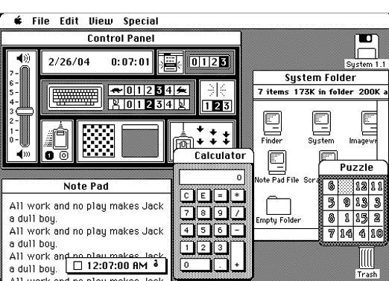
The Terminal and the Shell
Every time you interact with a computer (including phone, Nintendo Switch, fridge, etc.) you are executing a series of commands
The most common method for interacting through modern applications is through the Graphical User Interface (GUI)
This typically works well for simple tasks, but can require several dozen clicks to do something (like save a file to a particular place)
Becomes even more onerous when doing things repeatedly

Slide 4
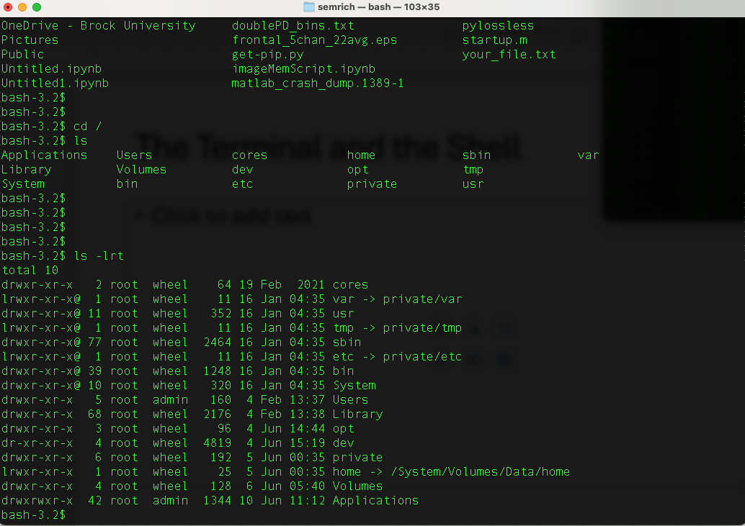
The Terminal and the Shell
A shell is a command line interface and scripting language that allows you to interact with the operating system of a computer
Different shell languages (e.g., bash, zsh)
Allows you to complete tasks more quickly
Allows you to automate tasks through scripting
Executed through a Terminal

Slide 5
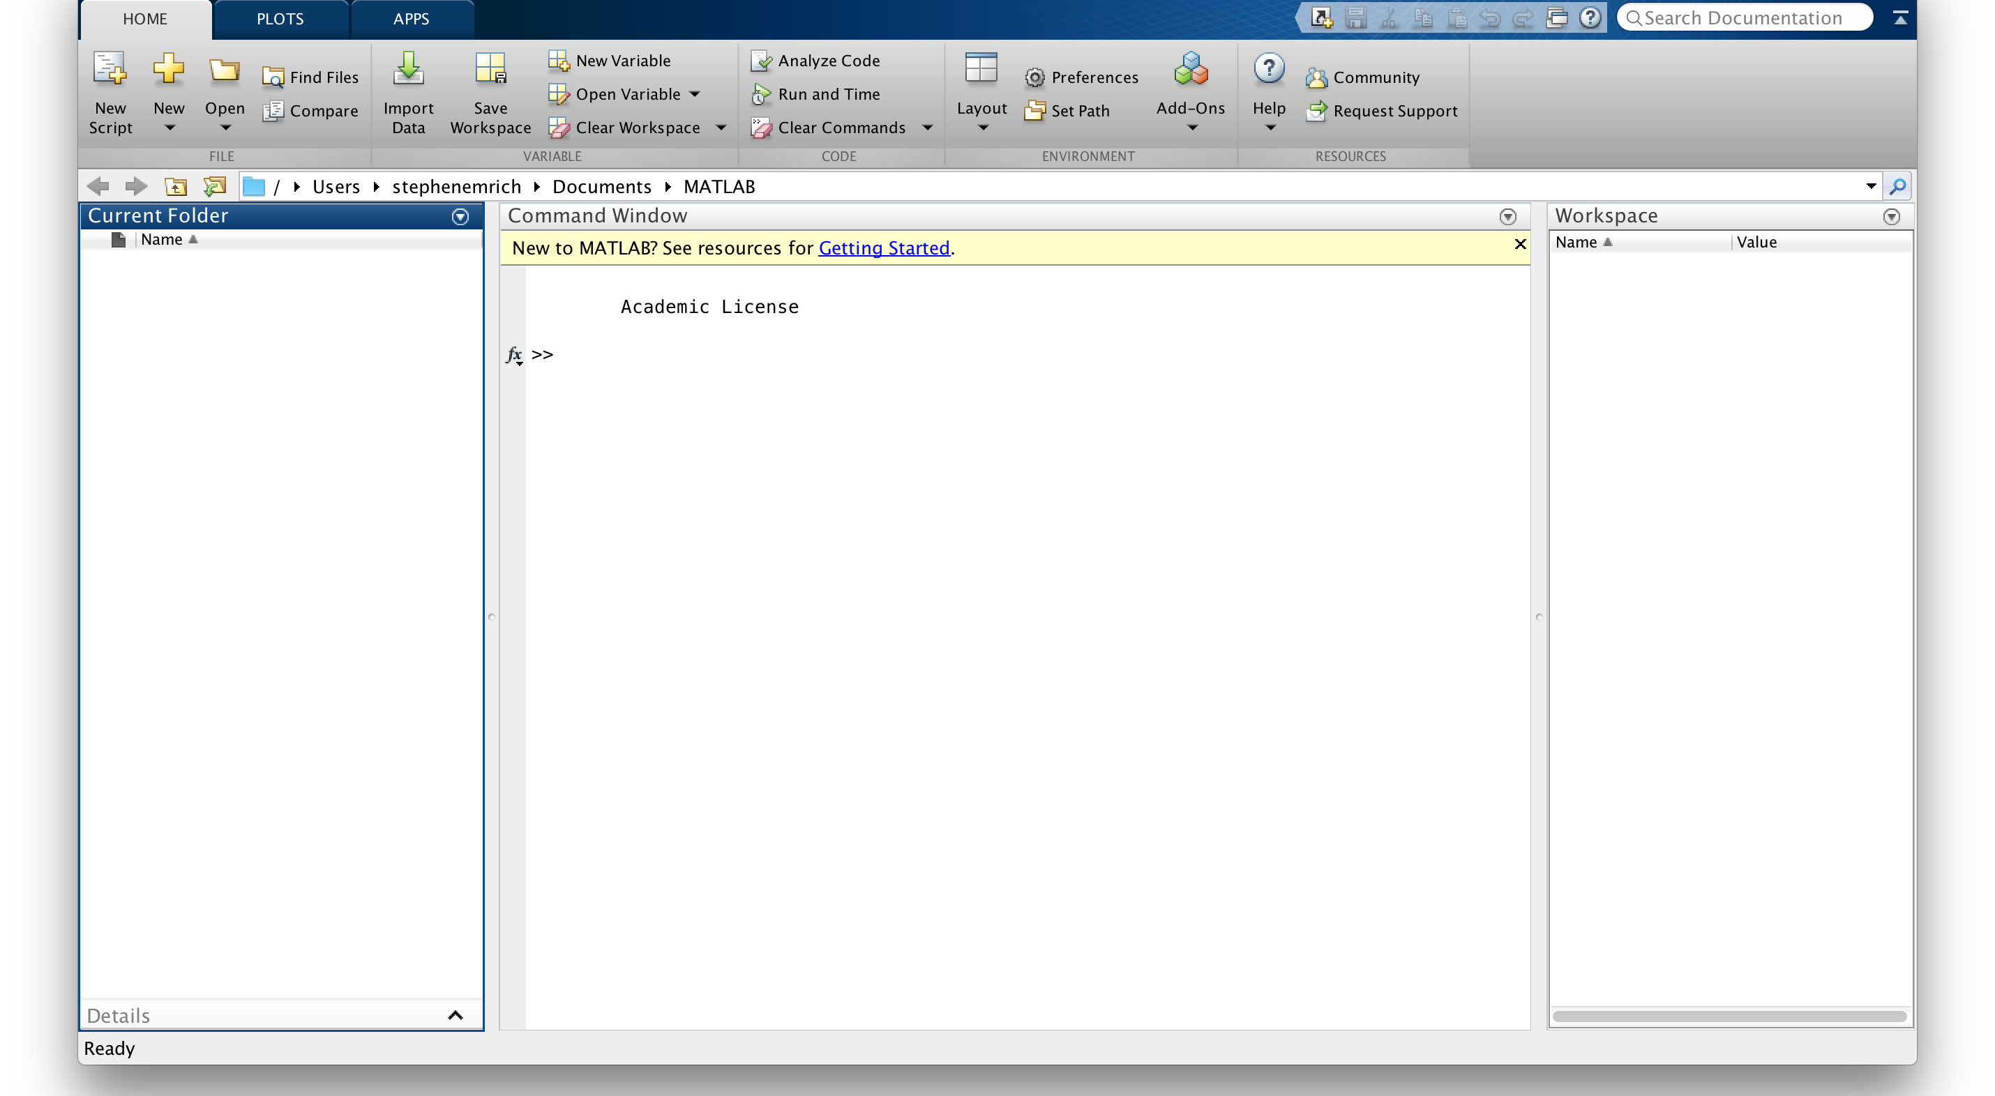
Why know the terminal and the shell?
Powerful
Most programming IDEs (Integrated Development Environments) also include a terminal
Some tasks might require you execute commands through a terminal (specifically through a shell)

Slide 6
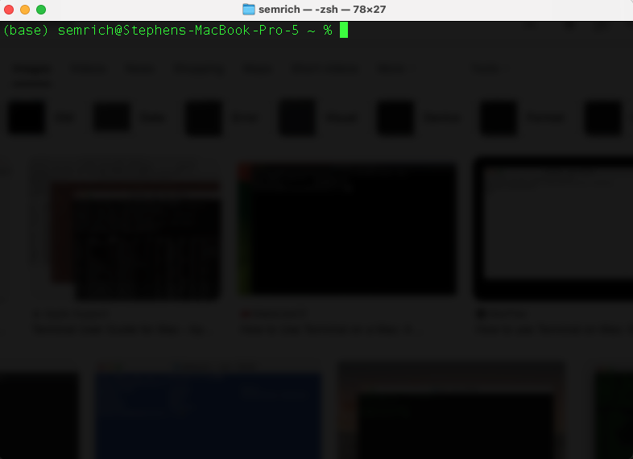
Getting started: Mac OSX
Mac has a native Linux-based shell that you can access through the Terminal application
Default shell is ‘zsh’.
Type ‘bash’ to change to the bash shell

Slide 7
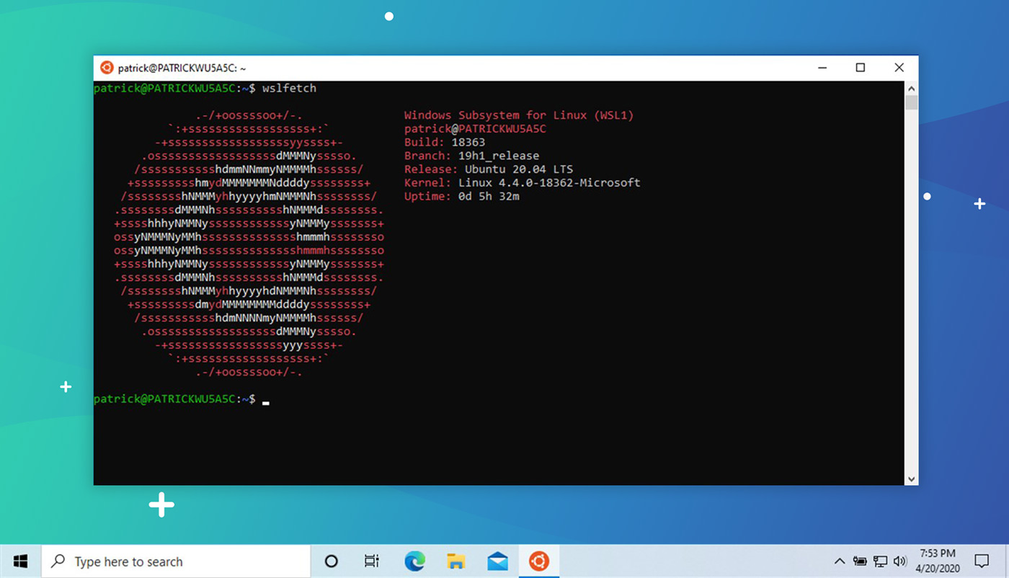
Getting started: Windows
Windows default is to run Microsoft Power Terminal
For this course, use WSL 2
Emulates a UNIX/LINUX bash shell.
Can enable running of LINUX-based applications
Should also download ‘Windows Terminal’

Slide 8
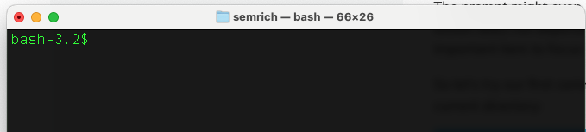
Getting started: bash shell
The $ character is the prompt. Sometimes may have user name or other info ahead of it
NOTE: Do NOT enter the ‘$’ into the terminal ahead of commands

Slide 9
Getting started: bash shell
Let’s type our first command. Enter:
$ ls
What happens?

Slide 10
ls command
What is the ls command?
Every command should come with a manual that provides information about the command
To access the manual, type $ man before the name of the command:
$ man ls

Slide 11
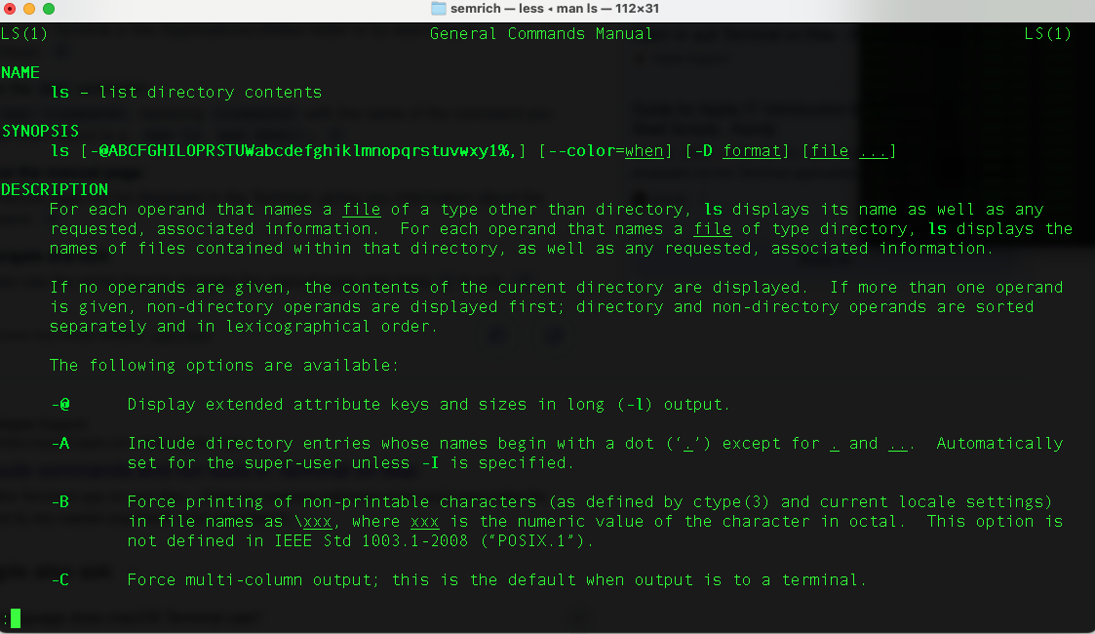
Components of a manual:
Name of command:
Usage:
Description:
List of options:
NOTE: Navigate the manual with keyboard. Press ‘q’ to quit the manual and return to the shell prompt NOTE: Can sometimes also get info about the function by typing --help after the command

Slide 12
ls command options to note:
-a: “all” - reveals files/folders beginning with a . – aka hidden files
-G: “colorize” – prints different folders/files in different colors
-t: “time” – sort by time modified
-r: “reverse” – reverse the order of the sort:
Commands can be combined:
$ ls -lrt
NOTE:
Options are case sensitive!!!
Often options will be similar across different commands

Slide 13
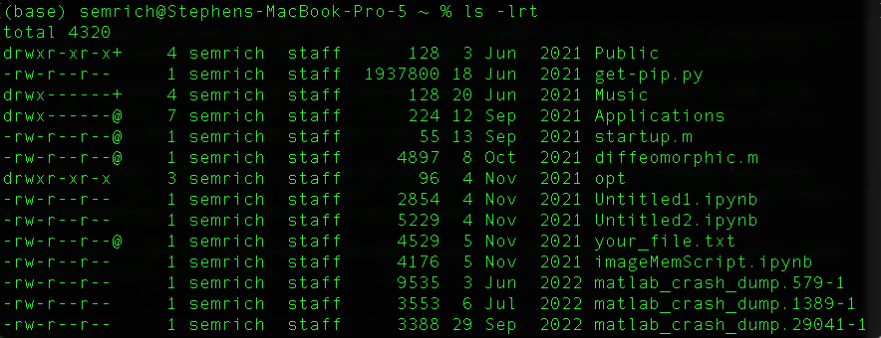
-l ”Long format”
# of Links
Group
Last modified
File mode
Owner
Size (bites)
File

Slide 14
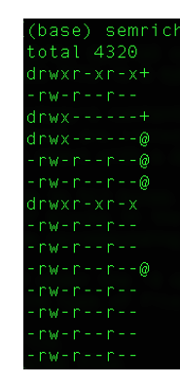
File mode:
First character: d if directory; -
Next nine are organized in triplets
r for ‘read’ permission
w for ‘write’ permission
x for ‘executable’ permission
Triplets are for different users:
Owner
Group
All
So, the following:
-rw - r --r--
Corresponds to: file, “read and write” access for owner, read access for the group and all

Slide 15
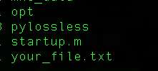
A note about file naming
No “.” : Directory
Filename
.
File Format

Slide 16
Special characters
Different characters are reserved for different functions that can modify the commands in different ways:
/ - directory (NOTE: \ in Windows!)
$ - variable
Some characters serve as wildcards in a string (i.e., text:
* - string wildcard
? – character wildcard
Try:
$ ls *.txt

Slide 17
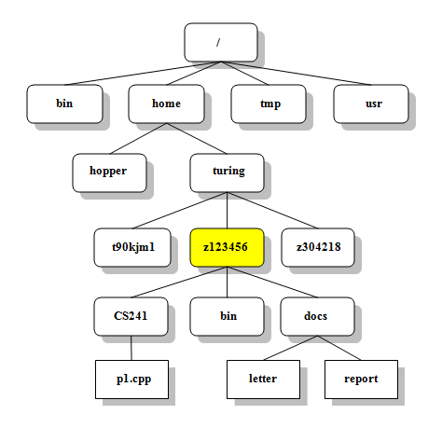
Navigating your computer
Files on your computer are stored in directories or folders
To find the current working directory use the command:
$ pwd
Note: you can remove previous outputs to the terminal by typing $ clear

Slide 18
Navigating your computer
$ pwd will return something like this:
/Users/semrich
This is your current working directory
By default, can only operate on files/directories visible within this directory
Any file saved will save to this directory
Each directory/folder is separated by the / character
The highest level directory (i.e., before any other folders are defined) is called the root directory (i.e., pwd = /)

Slide 19
Navigating your computer
If you want do move to the root directory, you can do so with the cd command:
$ cd /
Verify with pwd or ls
Your home directory is specified by ~/
Navigate there now and tell me what your home directory is

Slide 20
Navigating your computer
From your current working directory, you can move UP a directory (towards the root) by using
$ cd ../
You can also specify a specific directory. E.g
$ cd /System/Applications
./ specifies the current directory
What does $ cd ./ do?

Slide 21
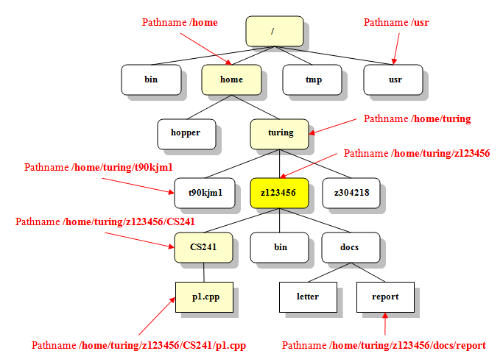
Navigating your computer
You can navigate down into a subdirectory by just typing the name of the directory
Tip: use ‘tab’ to provide suggestions and auto-complete
Use ‘../’ to move UP a directory
Remember, when specifying a directory, ‘dir’ and ‘/dir’ are very different.

Slide 22
Creating directories and files
Navigate to a directory you want to use to create files in this course
Once there, we can make a new directory via:
$ mkdir ClassFiles
Check that it exists (and its permissions) using $ ls -l

Slide 23
Creating directories and files
Once in there, we can make a new file with the touch command:
$ touch tmp.txt
Again, check that it exists using $ ls –l
We can see the contents of this text editor by opening it in a text editor. There are lots of text editors you can use (Notepad, Sublime, Vscode)
Can use vi in terminal to view/edit text files:
$ vi tmp.txt

Slide 24
A few rules for naming files
Don’t use spaces
Spaces are a special character used to separate arguments in the command line, so using spaces can cause issues
Don’t begin the name with a dash
Used for options
Stick with letters, numbers, ., - or _
Other characters like & and ^ can be special characters

Slide 25
Vi/vim
Some key commands in vi:
i – insert (begin typing)
esc – exit insert
:q – quit
:w – write (save)
:wq – write + quit
Write some text in your text file, save and exit vi

Slide 26
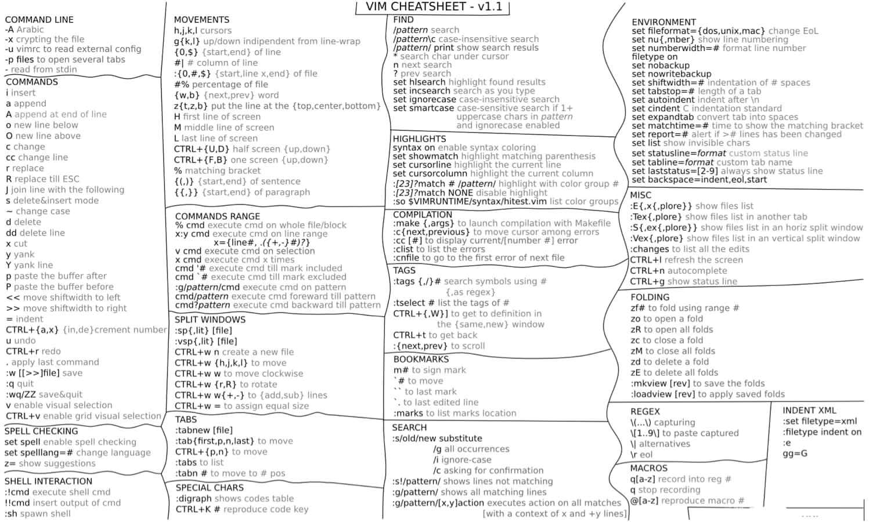
https://www.splunk.com/content/dam/splunk-blogs/images/2012/08/VIM-cheatsheet1.png

Slide 27
Copying/(re)moving files
Let’s make a few copies of our file:
$ cp tmp.txt tmp2.txt
$ cp tmp.txt tmp3.txt
$ cp tmp.txt tmpNew.txt
Now let’s make a new subdirectory called ‘replicas’
Now we can move the files with the mv command
Can delete files with the rm command
Question: how to move only those files that are copies?
Warning: rm removes files permanently!

Slide 28
Combining commands (piping and filtering)
We’re going to use the files in the Lesson 1 Resources directory for this part of the lesson (taken from https://swcarpentry.github.io/shell-novice)
Download the files and put them in a directory. Then, type the command :
$wc cubane.pdb
Question:
What does this command to?
How can we apply it to all .pdb files in the directory?

Slide 29
Combining commands (piping and filtering)
Let’s say we only want to know the number of lines in each file, and we want to put that info in a new file lengths.txt?
> - appends the output of a command to a new file
How would you accomplish this?
Once accomplished, verify the contents of the files with the concatenate command:
$ cat lengths.txt
(for longer files, less command shows only a page at a time)

Slide 30
Combining commands (piping and filtering)
If we wanted to sort the list of files by length, we could do so with the sort command:
$ sort –n lengths.txt
(the –n sorts by number, not alphanumerically)
If we want, we can then put this in a new file:
$ sort –n lengths.txt > sorted-lengths.txt
>> will append outputs to an existing file

Slide 31
Combining commands (piping and filtering)
You can pass the output from one command to become the input of a second command using a pipe: |
Try to figure out what these commands are doing (be sure to be in the correct directories):
$ sort -n lengths.txt | head -n 1
$ wc -w *.pdb | sort -n | head -n 1

Slide 32
Scripting
Can write full scripts that implement loops, commands and other scripts
Not going to cover it here
May return to it after we go through loops and functions in Python

Slide 33
Finding things
The grep and find commands are useful ways to find files or information within files
Compare the output of cat haiku.txt to grep the haiku.txt
Exercises:
How can you make it only search for the complete word “the”
How can you make it search for a phrase such as “is not”?
How can you make it case sensitive?

Slide 34
Finding things
The find command finds files themselves
May need to specify the directory (cwd = .)
Try combining wildcards to find files of the same filetype (e.g., .txt)
Try it from different levels of diretories
Hint: You may need to put the wildcard in quotes

Slide 35
Moving files between locations
Use case for the terminal: how do I transfer hundreds of gigabytes of data between researchers at different institutions?
ssh – “secure shell”: allows you to “pipe” into the shell of another host computer
scp – “secure copy”: allows you to securely copy files between two (networked) computers

Slide 36
Screen
A useful command for working with remote environments is the screen command which creates a virtual terminal inside the terminal
Allows you to disconnect from the connection, while the job is still running in the background
Steps:
Create a new screen using screen
After starting your job, press CTRL + A and then D to “detach” the screen
At this point you can disconnect from the terminal and the job will continue to run on the server side
To get the screen back type screen –r on the server side.
screen –ls will provide a list of all possible screens

Slide 37
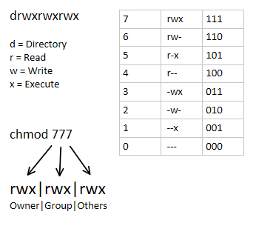
A note about permissions
Not all files are accessible to all users
Recall the file mode:
The chmod command plus a number for each of owner/group/other can change the permissions for each file/directory
May need ”super user” access to make changes via sudo (“super-user do”)

Slide 38
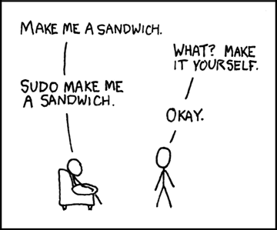
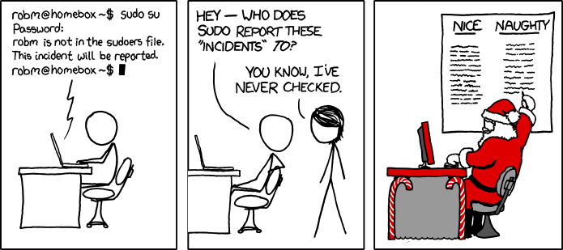
Sudo
With great power comes great responsibility
xkcd

Slide 39
Sources:
https://swcarpentry.github.io/shell-novice/
https://linuxconfig.org/understanding-of-ls-command-with-a-long-listing-format-output-with-permission-bits
https://www.oreilly.com/library/view/learning-the-bash/1565923472/ch01s09.html
https://faculty.cs.niu.edu/~mcmahon/CS241/Unix_Tutorial/file_structure.html

