Slide 1
Introduction to Python and Jupyter Notebooks
PSYC 5P02
ComputerProgramming for Experimental Psychology
Stephen Emrich
Brock University

Slide 2
Jupyter Notebook
As discussed, there are different ways to implement Python
(can just run it from the bash shell on a Mac)
There are several popular IDEs (Integrated Development Environments)
We’re going to use two from Anaconda: Jupyter Notebook and Spyder
Jupyter Notebook is a popular environment for writing and running code in a user-readable way through the use of Markup tools

Slide 3
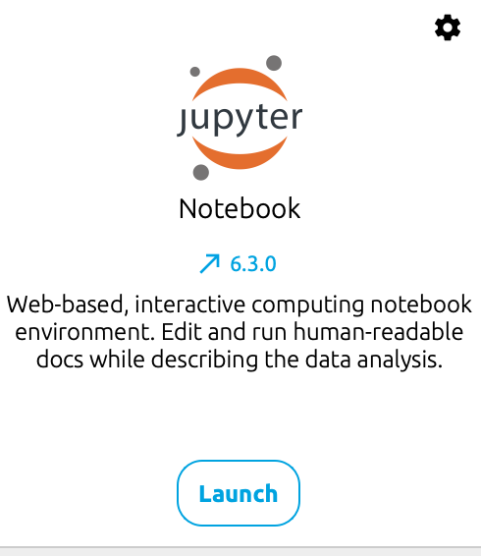
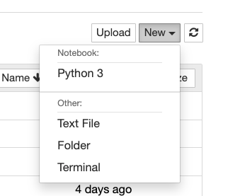
Jupyter Notebooks
Open Anaconda Navigator
Launch Jupyter Notebook
Create a new Python 3 document

Slide 4
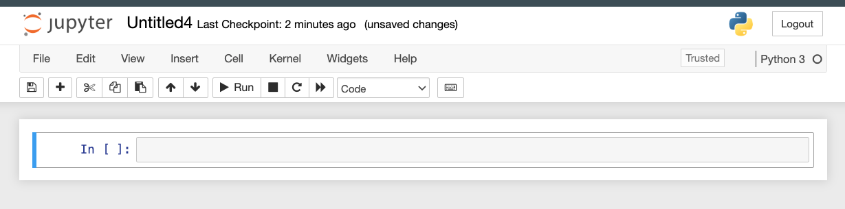
Code (and text) are contained in cells
This document currently has one empty cell
Let’s go ahead and write our first piece of code:
print(‘hello world’)

Slide 5
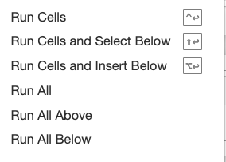


First bits of code
Can run the cell with the run button, through the Cells menu or shift/command + enter
Note that the “output” (results”) of this line of code is printed beneath
Now let’s add another cell and run this line: 1 + 1

Slide 6
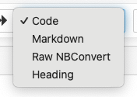
Markdown in Notebooks
One of the reasons that Jupyter Notebooks is a popular way to write and distribute code is it is possible to add non-code elements into your Notebook using Markdown
Can change whether a cell is code or text using the dropdown menu:
Or, you can put the cell into command mode using the ‘esc’ key, then switch between code mode (Y) and markdown mode (M)
Be sure to use markdown to jot down some notes in your Notebook describing what you’re doing

Slide 7
Next bits of code
Now try the code print(‘1 + 1’)
Why does this result differ from the last one?
Highlights the difference between different data types, as well as the difference between operators and functions

Slide 8
Data types
There are different kinds of ‘data types’ in python
Affects how the information is stored, and the ways they interact with other code
Common types:
Text type: “string” - str
Numeric types: “integer” - int “floating point” - float
Many others we’ll get into later…

Slide 9
Operators
Operators are used to perform operations on variables and values
Arithmetic operations operate on number types:
+, -, x, /, % (modulus), ** (exponent), // (floor division)
Other types of operators we’ll describe shortly
Key thing is they work without any special notation or added info from yourself

Slide 10
Functions
Functions are more elaborate pieces of code that take the form of: name(arguments)
Note that the arguments go within round brackets!
Square brackets will be used for something else later
There is a help file associated with most built-in functions which can be found with
help(functionName)
Exercise: look at the help file for the print function

Slide 11
Variables
Variables are placeholders (memory locations) for storing data values
Variables are declared using the = character. E.g.:
x = 1 + 1
text = ‘hello world’
Cannot be empty (we’ll get to empty variables later)

Slide 12

Variable naming
Rules for naming variables
Variables must start with a letter or underscore
Can only contain numbers, letters, and underscore
CANNOT start with a number
Is case sensitive
Often people will use “camel case”
Can do multiple assignments:
a, b, c = 1, 2, 3
x = y = z = 10
Try it out: Declare your own variables using multiple assignment

Slide 13
Variables
Try playing with a few variables
What happens if you try to add a + b?
What about x + y?
What about ‘hello’ + x
Variables must be of the same type
+ serves to concatenate between two strings
Can find the type of the variable using type(var)

Slide 14
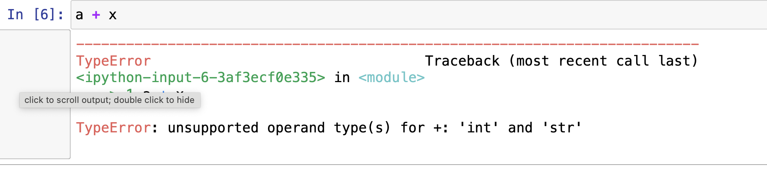
Errors
When you “do something wrong”, the program with throw an error
It’s important to read the error message, because it will provide information about what went wrong, and where:

Slide 15
Errors
Syntax error: error in the syntax (language) or python -- i.e., something is written wrong that it doesn’t understand
print(‘hello world’):
Type error: variables of different types are being called
Name error: a call to a variable that doesn’t exist

Slide 16
More on variables
Whatever is on the left of the = is always performed before variable assignment
If you assign a new value to a variable it will overwrite the old one
Important to remember to use meaningful variables and not re-use them
If you want to remove a variable from memory, use del()

Slide 17
Indexing
Some variables only have a single element
E.g., an int of x = 111 still only has one value
Strings and other types have multiple elements within them
You can find the length of a variable with len()
Each value within the length of that variable is a location, also known as an index
Important: Python does 0 - indexing -- the first element is at location 0
Other languages (like MATLAB) are 1-indexed - meaning the first element starts at 1

Slide 18
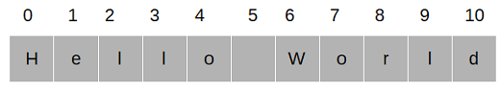
Indexing
You can index or select a specific element of that variable using the [] characters
Referred to as “string slicing” for strings
myString = “hello world”
myString[2]

Slide 19
Indexing
You can also specify a range of values separated by a “:”
Optionally, you can indicate the step size between locations
str_object[start_pos:end_pos:step]
You can also index starting from the end of the string using negative values
Exercise: from myString = ‘hello world’ find different ways to obtain:
“hello”
“world”
“elowrd”
“dlrow olleh’

Slide 20
Lists, Tuples, Sets, & Dictionaries
There are other kinds of data types that allow you to store collections of data: Lists, Tuples, Sets, & Dictionaries
Each one has a slightly different properties and usage
Next week we will also add to out Python functionality to add different kinds of data types that are more useful for the kinds of data we deal with

Slide 21
Lists
A list is created using square brackets: drinks = [ ”whiskey”, “vodka”, “lager”, “cider”]
Lists are:
Ordered: they have a defined order that will not change. New items are added to the end of the list (with some exceptions)
Changeable: we can change, add and remove items from the list
Lists can store variables of different data types
Exercise: create a list of different data types, then find you the type() of the list

Slide 22
Lists
Lists are ordered in the same way as strings and can be indexed in the same manner of myList[start_pos:end_pos:step]
You can change the item of a list simply by replacing through indexing:
myList[3] = ‘tequila’
You can add a single element to the list with myList.append(), or add multiple elements with myList.extend()
Note you can use the + operator instead of extend
You can also insert to a specific index using myList.insert(index, listItem)

Slide 23
List Methods
You can also remove items in different ways
myList.remove(‘cider’) will remove the first instance of ‘cider’
myList.del(1) will remove the element at position 1
myList.pop(1) will remove and return the element at position 1
myList.clear() will clear the list
Note, it is possible to have empty lists. Declared using list = []
Other list methods include reverse(), sort(), and count()

Slide 24
Tuples, Sets and Dictionaries
The other data types we will deal with a bit more later, but the basics are:
A tuple is ordered and unchangeable and is defined using round brackets ():
myTuple = (”whiskey”, “vodka”, “lager”, “cider”)
A set is unordered, unchangeable, and unindexed, and is defined using curly brackets. Sets cannot have repeat values
mySet = {”whiskey”, “vodka”, “lager”, “cider”}
A dictionary stores data values in key:value pairs. It is orderd, changeable, and does not allow supplicates
patientInfo = {”age”: 48, “gender”: male}

Slide 25
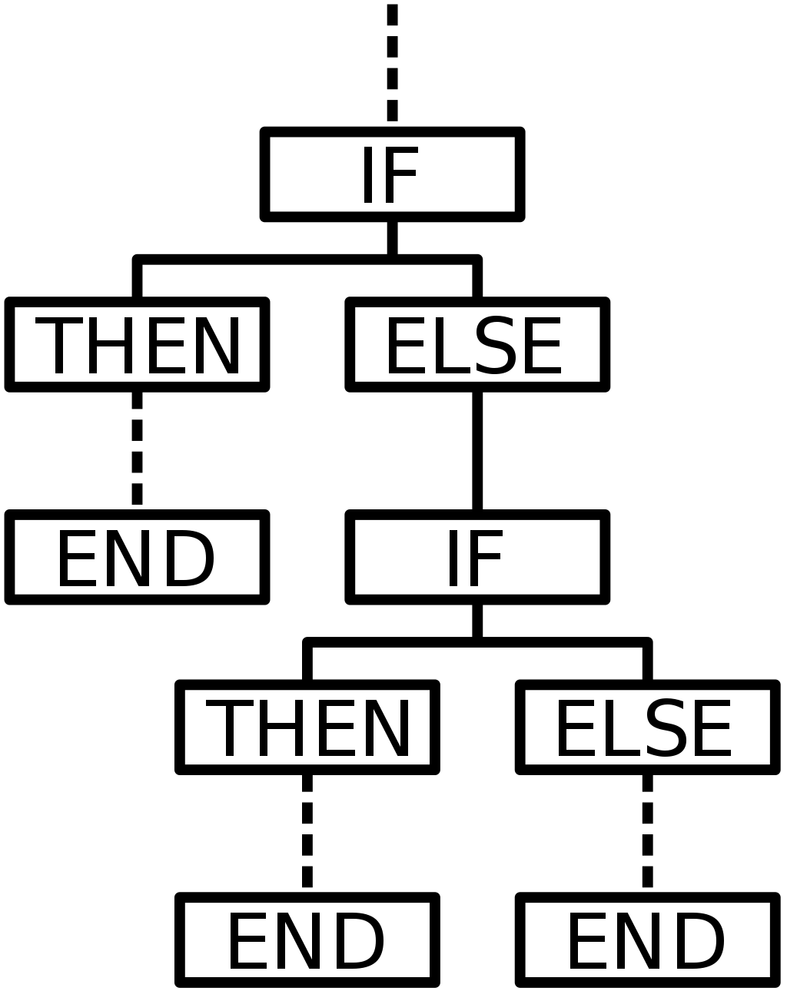
If statements (conditional statements)
Programming uses conditional statements to control the flow of a program and perform actions
Carried out by evaluating booleans (“if a condition is true, do one thing; if it is false, do another)

Slide 26
Boolean Values
In programming you often need to identify whether an expression is true or false
Referred to as boolean values, which is its own data type
Expressed via operators:
Comparison operators: ==, !=, >, < , <=, >=
Note that a single = is for variable assignment, but == is for comparison between two values
Logical operators: and, or, not
Membership operators: in, not in
Or simply bool() will return True if it has a value that isn’t 0 or isn’t an empty var
Exercise: try printing the Boolean value using the different kinds of comparisons

Slide 27
Let’s break down an if statement
Begins with ‘if’
a = 200
b = 33
if b > a: print("b is greater than a")
elif a == b:
print("a and b are equal")
else:
print("a is greater than b")
A conditional (can been evaluated as True or False)
Ends in ‘:’
An indent!!!
A second conditional - ”else if”
What to do if all of the other conditionals return “false”

Slide 28
Spacing matters in Python!!
Python relies on indentation (whitespace at the beginning of a line) to define scope in the code. Other programming languages often use curly-brackets for this purpose.
Whitespace indentation of a piece of code affects its meaning. A logical block of statements should all have the same indentation, set in from the indentation of their parent function or "IF”.
If one of the lines in a group has a different indentation, it is flagged as a syntax error.
TAB will work in Jupyter notebook as adding spaces. Generally, you should indent with 2 or 4 spaces.

Slide 29
Match & Case
The other way to evaluate different outcomes (especially when you have a fixed number of outcomes) is through match and case
day = 4 match day: case 1: print("Monday") case 2: print("Tuesday") case 3: print("Wednesday") case 4: print("Thursday") case 5: print("Friday") case 6: print("Saturday") case 7: print("Sunday")

Slide 30
Committing your file to git from Notebooks
Last week we went through Git, which is great for version control and collaborative work. So how can you use git effectively with your notebook?
One option is to save your file, open the terminal, and commit from there
Other option is you can use the ! character at the beginning of a line of code in python to execute a system command. Thus, you can commit using:
!git add test-Copy1.ipynb !git commit -m ‘uploading my work from class today’

Slide 31
In-Lab Final Exercise:
You are going to create a ‘Psychic app’ that will guess a student’s focus area (BCN; LD; SP) based on the length of their name.
Use the code:
name = input(“Enter student name: ")
to allow the user to input their name. Then using if statements, check a list to see if it matches a particular in the list. If the name doesn’t match any in the list, have it guess based on the length of the name entered

Slide 32
Sources:
https://swcarpentry.github.io/python-novice-inflammation/
https://allendowney.github.io/ThinkPython/

