Slide 1
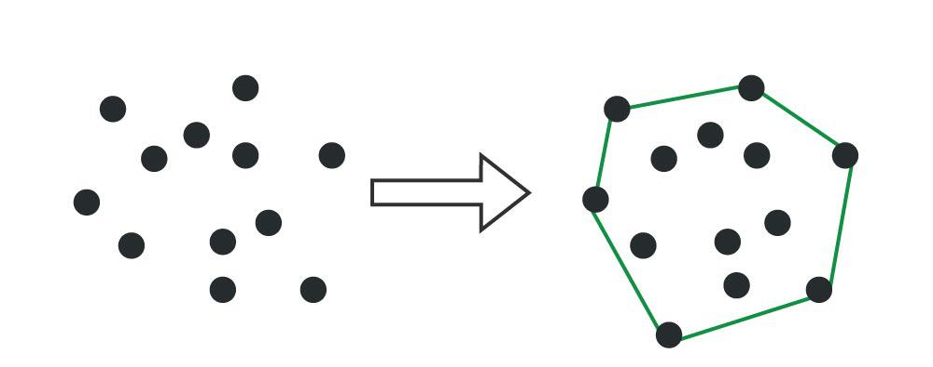
Convex Hull
Exploring the U.S. Cities Data with the construction of Convex Hulls

Slide 2
Goals and Context
Convex hulls are fundamental in computational geometry, used to find the smallest convex boundary around a set of points.
This project applied brute force and divide-and-conquer algorithms to compute these hulls and visualization from Matplotlib.

Slide 3
Methods and Algorithms
Brute force method using slope: Tested all points to create a slope then testing all points to find boundary edges.
Brute force method using determinant: Testing all combinations of three points to find boundary edges.
Quick hull (divide and conquer): Get the largest triangle using the left most, right most, and top/bottom most points; continue this until all points are within these triangles.
Merge hull (divide and conquer): Split the data until less than 3 datapoints are in each section and merge the sections together to get the hull.

Slide 4
Challenges
Handling edge cases (collinear points and tightly clustered data)
Debugging
Floating point errors adding up

Slide 5
Lessons Learned
Algorithm efficiency is crucial for large-scale data
Visualizations helped in debugging and verifying results quickly

Slide 6
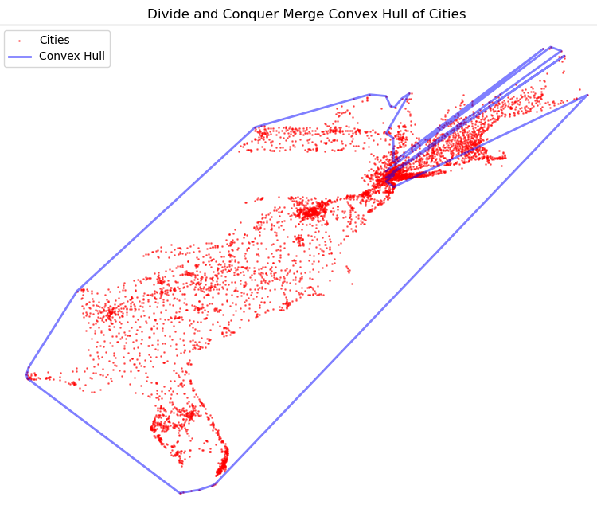
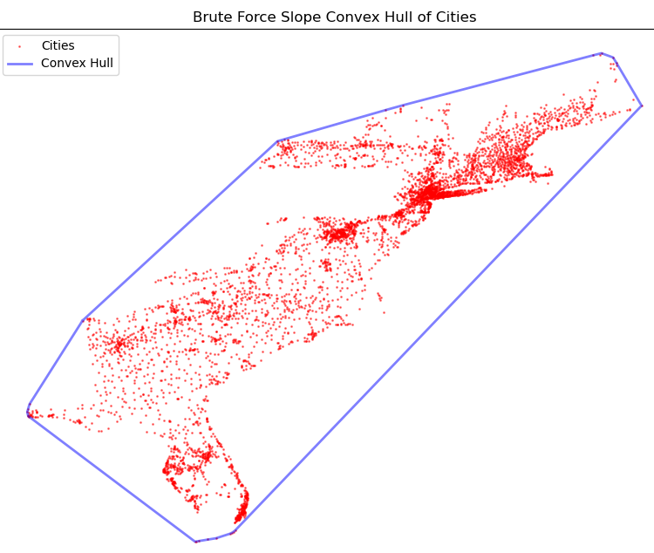
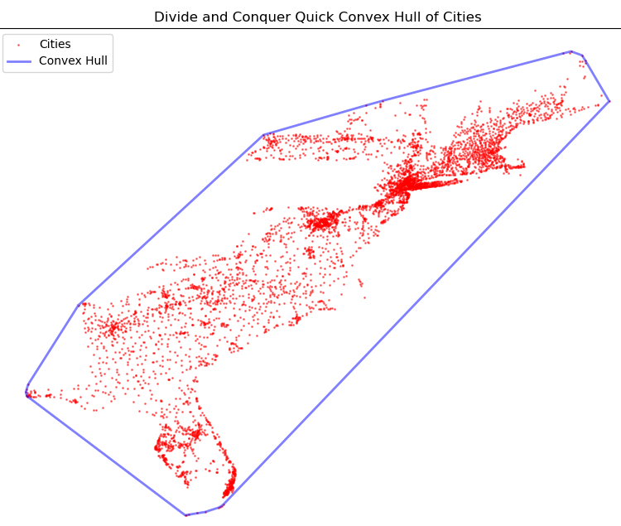

East Coast
5,203 cities and 20 cities make up the hull
Brute force with slope: 12 minutes 26 seconds
Brute force with determinant: 17 minutes 21 seconds
Quick Hull: 0.72 second
Merge Hull (buggy): 1.06 seconds

Slide 7
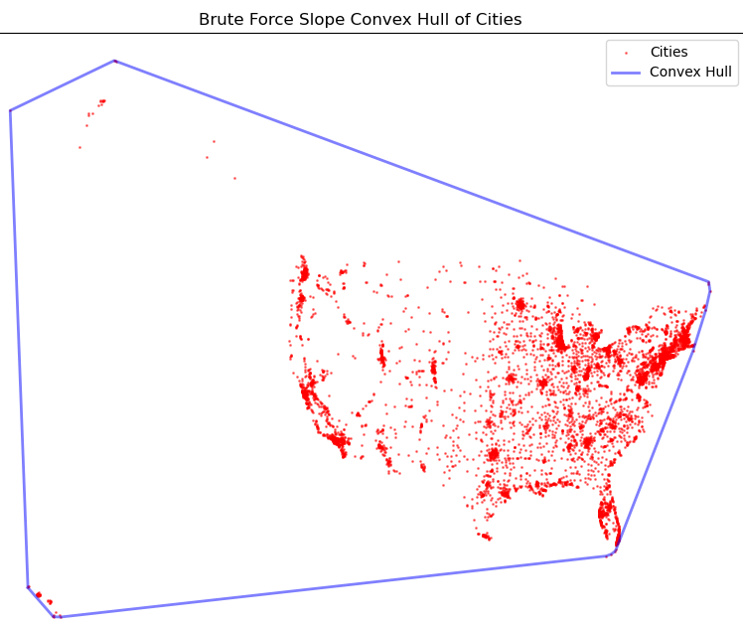
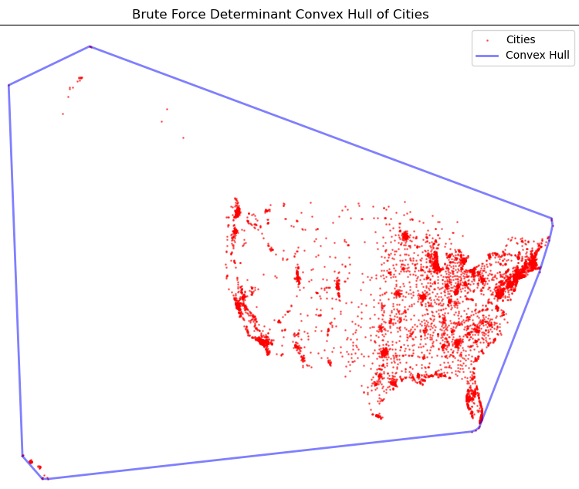


US: Population above 5000
7,102 cities and 15 cities make up the hull
Brute force with slope: 57 minutes 52 seconds
Brute force with determinant: 1 hour 56 seconds
Quick Hull: 0.78 second
Merge Hull (buggy): 1.34 seconds

Slide 8
Algorithms Overview
Time complexity:
Brute force has time complexity n³
DAC has time complexity of n log(n)
Space complexity:
Brute force has space complexity of n
DAC has space complexity of log(n) + n or approx. n

Slide 9
Future Improvements
Getting the merge convex hull to work (issues with closely clustered data points)

