Slide 1
AAML Final Project - Pruned Wav2Letter

Slide 2
Outline
Challenge
Methodology
Evaluation Result
Conclusion

Slide 3
Outline
Challenge
Methodology
Evaluation Result
Conclusion

Slide 4
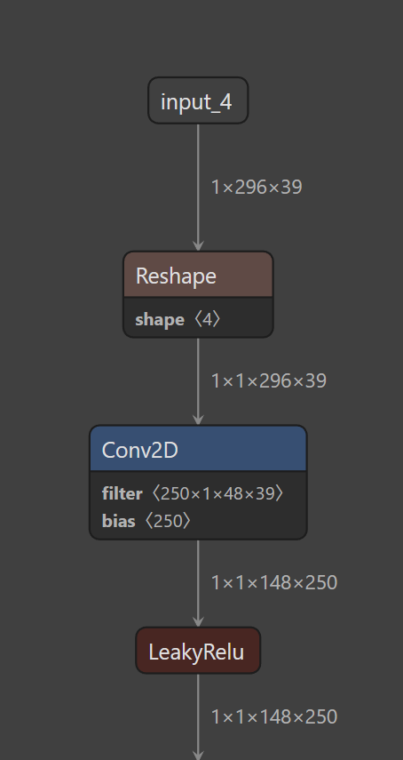
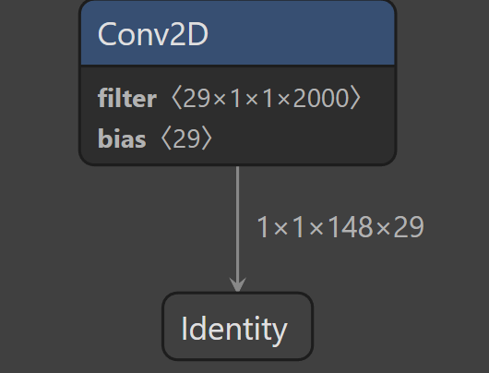
Challenge
Pruned Wav2Letter
X10

Slide 5
Challenge
Baseline (Software) Convolution
  Multi-level for-loops (out_y / out_x / out_ch / filter_y / filter_x / in_ch)
  Each MAC is surrounded by address computation, boundary checks, and loop-control overhead.
acc += filter_val * (input_val + input_offset);
#MAC≈B⋅OH⋅OW⋅OC⋅FH⋅FW⋅C_in/group​

Slide 6
Outline
Challenge
Methodology
Evaluation Result
Conclusion

Slide 7
Quantization
operate
Buffer B
HW Architure & SW implement
Quad-Core Data Parallelism
  Utilizes a SIMD-like architecture with 4 parallel TPU cores driven by software scheduling.
  Distributes output pixel computation (M-dimension) across cores using QUAD_CORE_STEP to maximize hardware utilization.
Buffer A0
TPU 0
C0
CFU
Buffer A1
TPU 1
C1
Buffer A2
TPU 2
C2
Buffer A3
TPU 3
C3

Slide 8
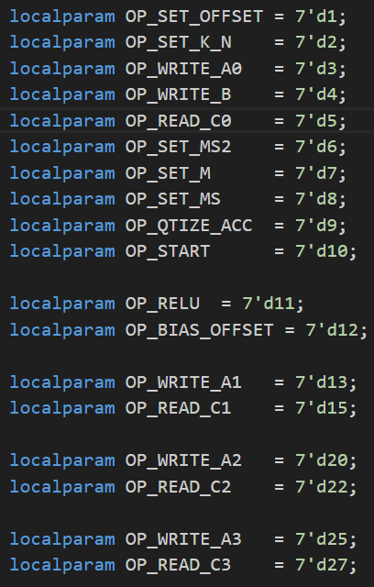
ISA (OP code)
OP_1: Set Input Offset
OP_2 / 7: Set K, N / M
OP_3 / OP_13 / OP_20 / OP_25: Write Buffer A0–A3
  Write packed input to A buffers of each TPU
OP_4: Write Global Buffer B
  Broadcast to all TPU cores
OP_10: TPU Start Computing
  Launch 4 TPU cores simultaneously
OP_5 / OP_15 / OP_22 / OP_27: Read Buffer C0–C3
  Read accumulator results from each TPU
OP_6 / OP_8: Set quantization parameters
OP_9 / OP_11: Quantize and activate output

Slide 9
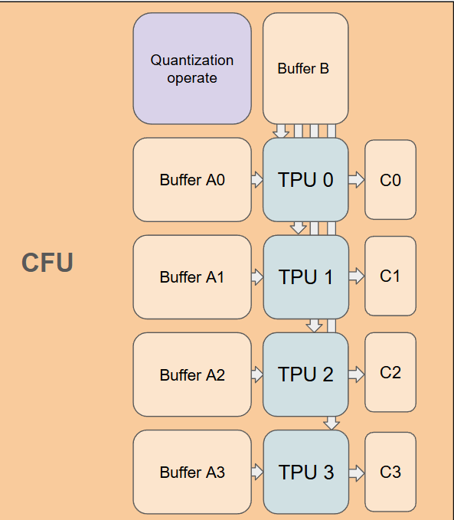
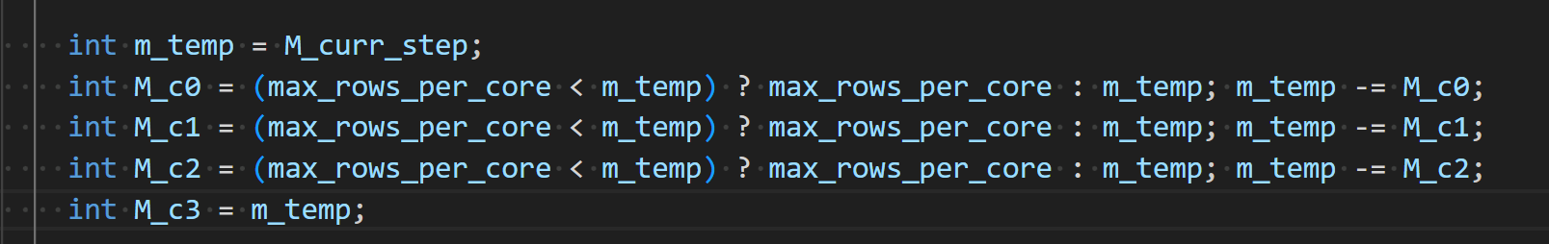
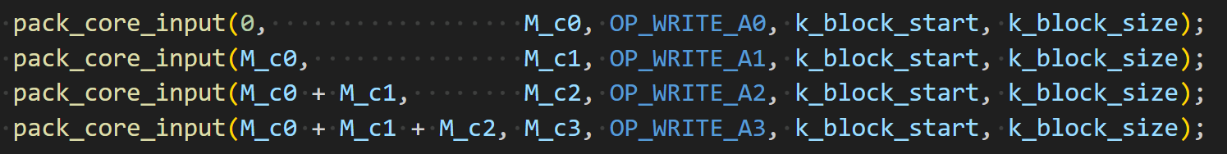
Conv
OP_3: Write A0 buffer
A[ 0 : M0−1 ] × K
OP_13: Write A1 buffer
A[ M0 : M0+M1−1 ] × K
OP_20: Write A2 buffer
A[ M0+M1 : M0+M1+M2−1 ] × K
K_size
A0
1 | 2
3 | 4
5 | 6
7 | 8
OP_25: Write A3 buffer
A[ M0+M1+M2 : M−1 ] × K
A1
M_size
A2
A3

Slide 10
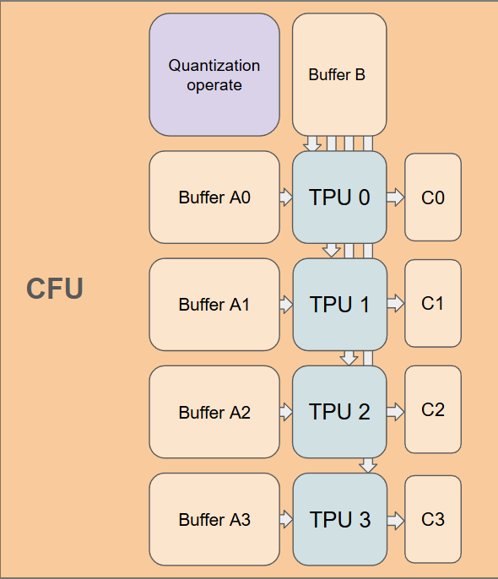
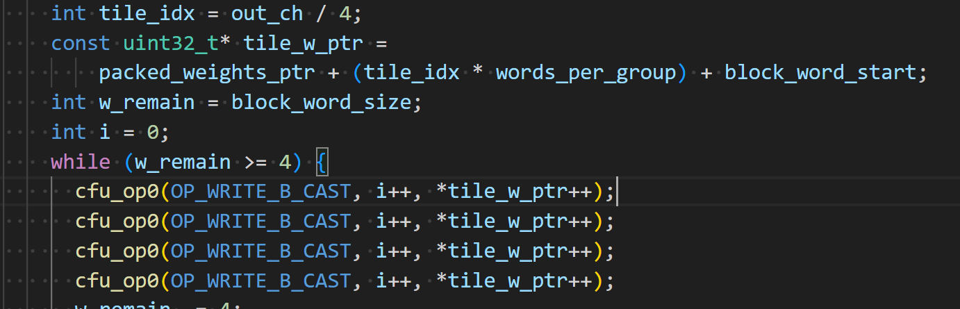
Conv
OP_4:
Write global B buffer
K_size
1 | 2
3 | 4
B
Ｎ_size

Slide 11
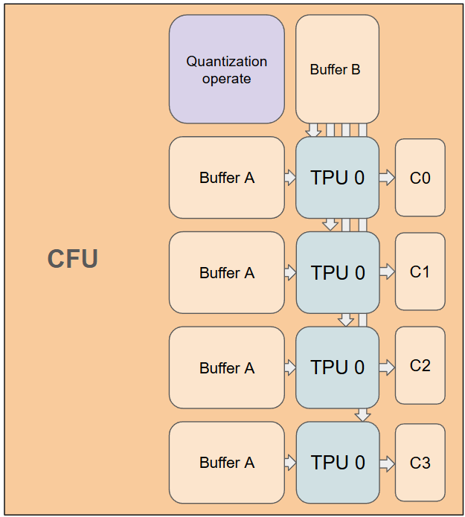
Conv
OP_10:
Launch 4 TPU cores simultaneously
When input and weight buffers are ready, we issue OP_START to launch all four TPU cores simultaneously.

Slide 12
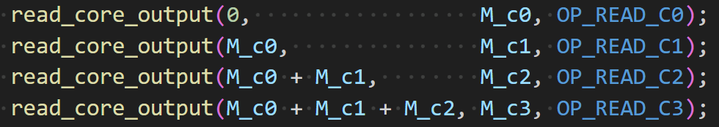
Conv
OP_5: Read C0 buffer
C[ 0 : M0−1 ] × N
N_size
OP_15: Read C1 buffer
C[ M0 : M0+M1−1 ] × N
C0
7 | 10
15 | 22
23 | 34
31 | 46
C1
OP_22: Read C2 buffer
C[ M0+M1 : M0+M1+M2−1 ] × N
M_size
C2
C3
OP_27: Read C3 buffer
C[ M0+M1+M2 : M−1 ] × N

Slide 13
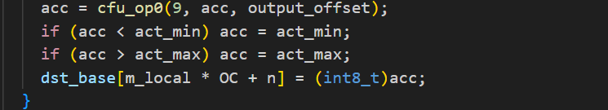
Conv
OP_6 / OP_8: Set quantization parameters
OP_9 / OP_11: Quantize and output
acc is the accumulator value read from the C buffer, which is then processed by bias addition, quantization, activation, and finally written back as the output.

Slide 14
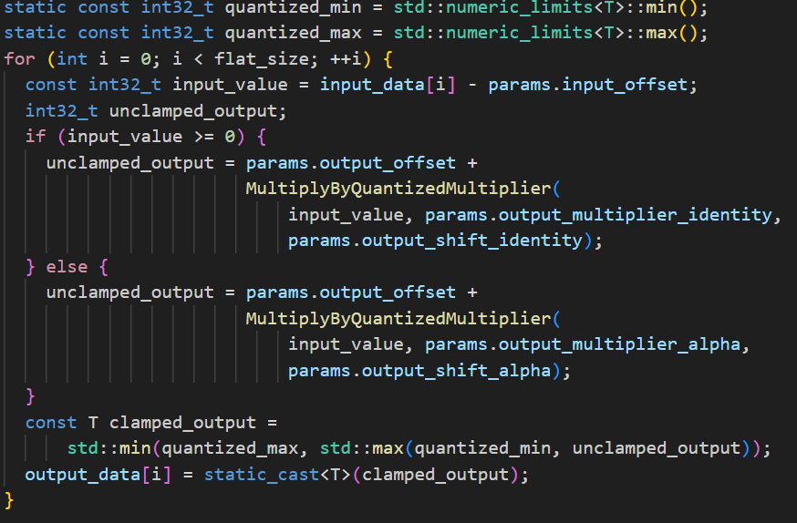
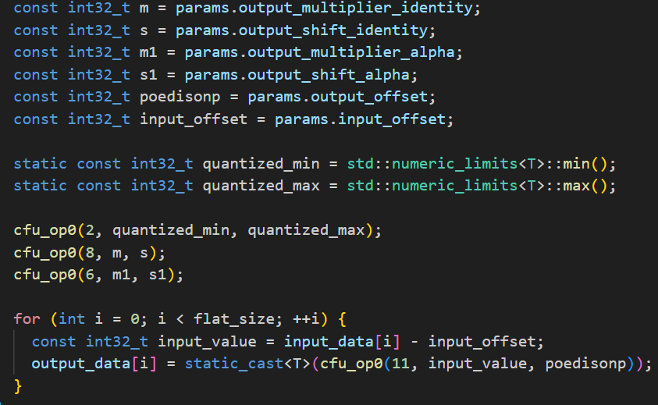
Leaky Relu
Left: Software-only implementation of quantization and activation using MultiplyByQuantizedMultiplier, branch on sign, then clamp in software.
Right: Quantization and activation offloaded to CFU hardware.

Slide 15
Outline
Challenge
Methodology
Evaluation Result
Conclusion

Slide 16
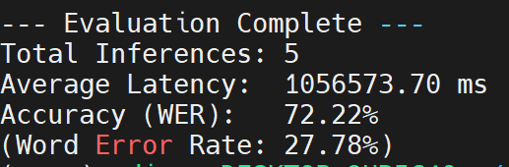
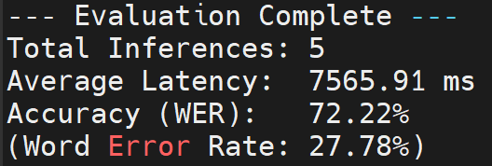
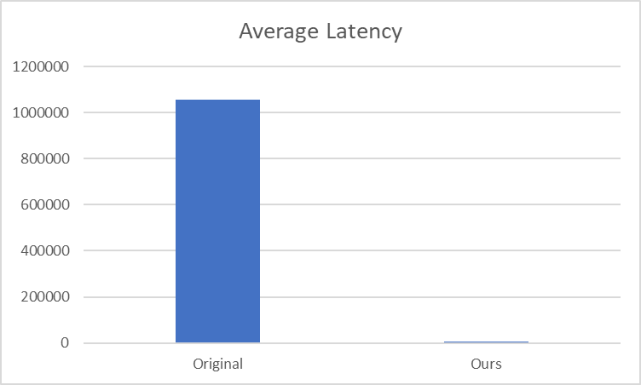
Evaluation Results
Original
Ours
Latency speedup = 139.64

Slide 17
Outline
Challenge
Methodology
Evaluation Result
Conclusion

Slide 18
Conclusion
The current design is primarily limited by buffer I/O overhead (data loading and unloading).
Future work could focus on implementing burst mode transfers by holding the CMD signal high, allowing for continuous data streaming to the buffer and significantly reducing handshake overhead.
It may be necessary to implement a FIFO to enable continuous data streaming into the buffer.

Slide 19
Thanks for listening

