Slide 2
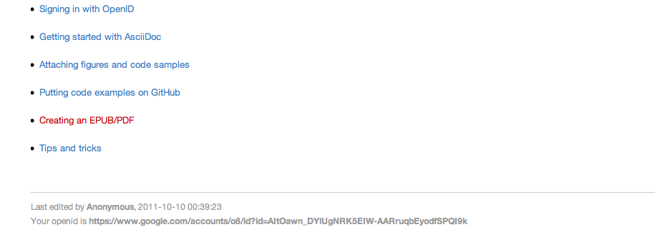
Your OpenID is listed in the footer of each page.

Slide 3
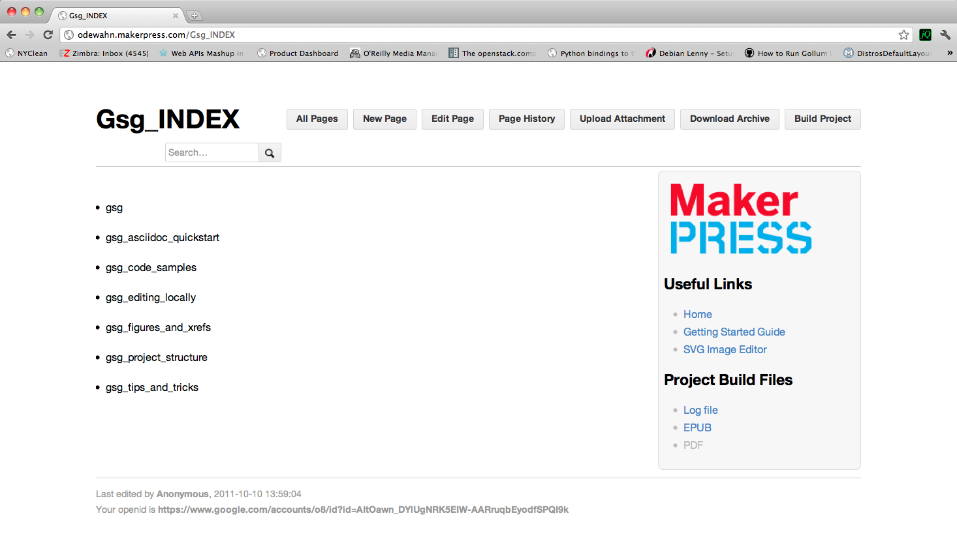
The “Build Project” button appears on pages that end with “_INDEX”

