Slide 2
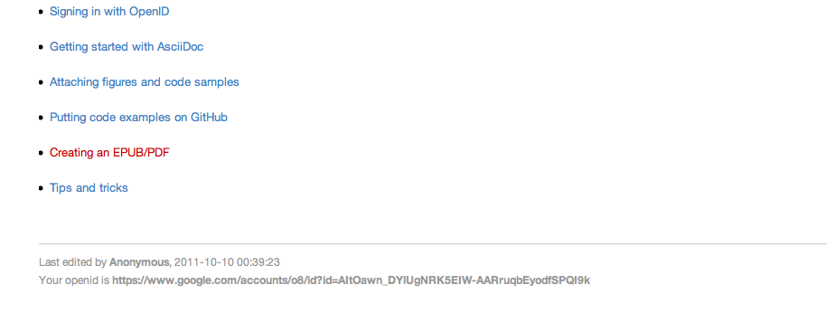
Your OpenID is listed in the footer of each page.

