Slide 1

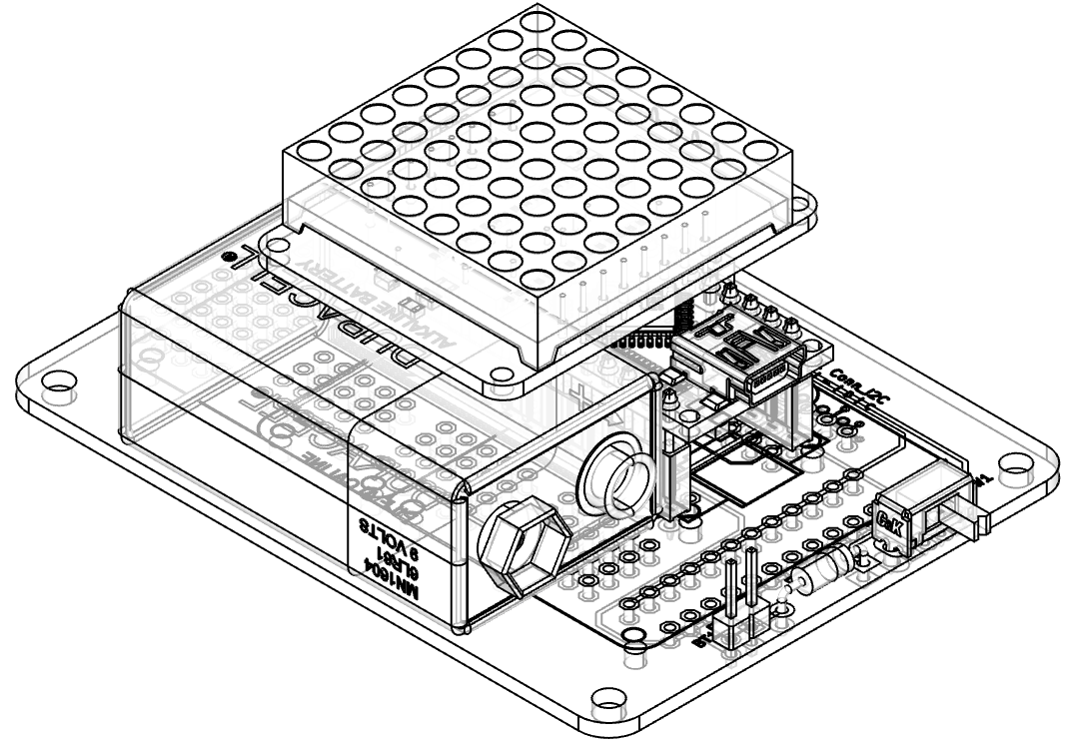
“Bag Tag” v2
Electronics
8x8 LED Matrix
(Proposed project for Innov School Jr)

Slide 2

Requirements
Complexity level - SIMPLE
Must include elements of
  Electronics (soldering)
  Arduino (programming)
  Rapid prototyping (3DP/laser)
BADGE form factor
Powered by 9V battery
Expandable / Hackable
Changes in v2 (v/s v1)
All parts on FRONT side of PCB
Three I²C headers
Can install one or two 8x8 LED display
Parts aligned along vertical axis for balance
Extra 24 prototyping pads (12 each for +5V and GND)

Slide 3
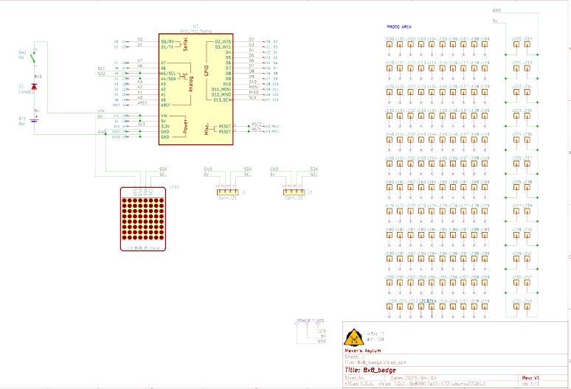
Schematic
Components:
Arduino Nano
Bi-Color 8x8 LED Matrix
Switch
Diode
9V Battery with clip
Header sockets
Header pins
PCB

Slide 4
Options
Optional upgrades
(not included in kit)
2nd Bi-Color 8x8 LED Matrix
Add extra modules
  I²C modules such as accelerometer, IMU, RTC
  Buttons, joystick etc
Hackable via prototyping area with 120 pads+ 24 power rail pads

Slide 5
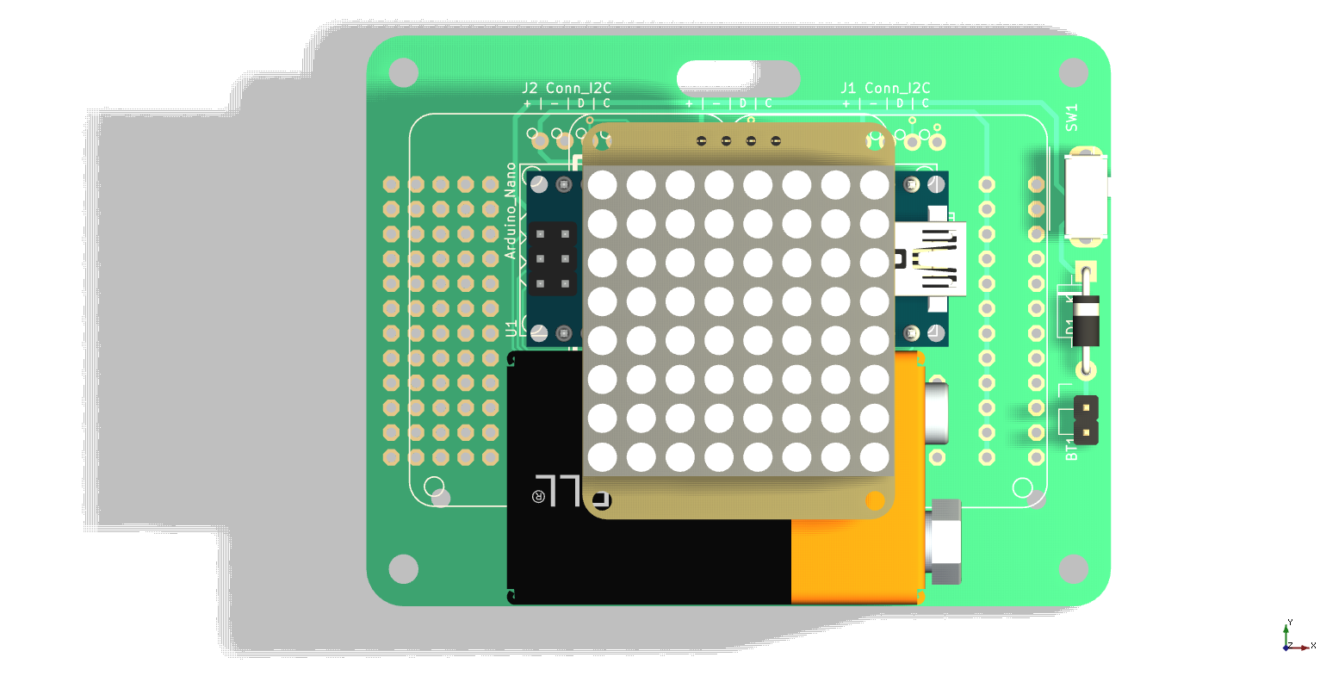
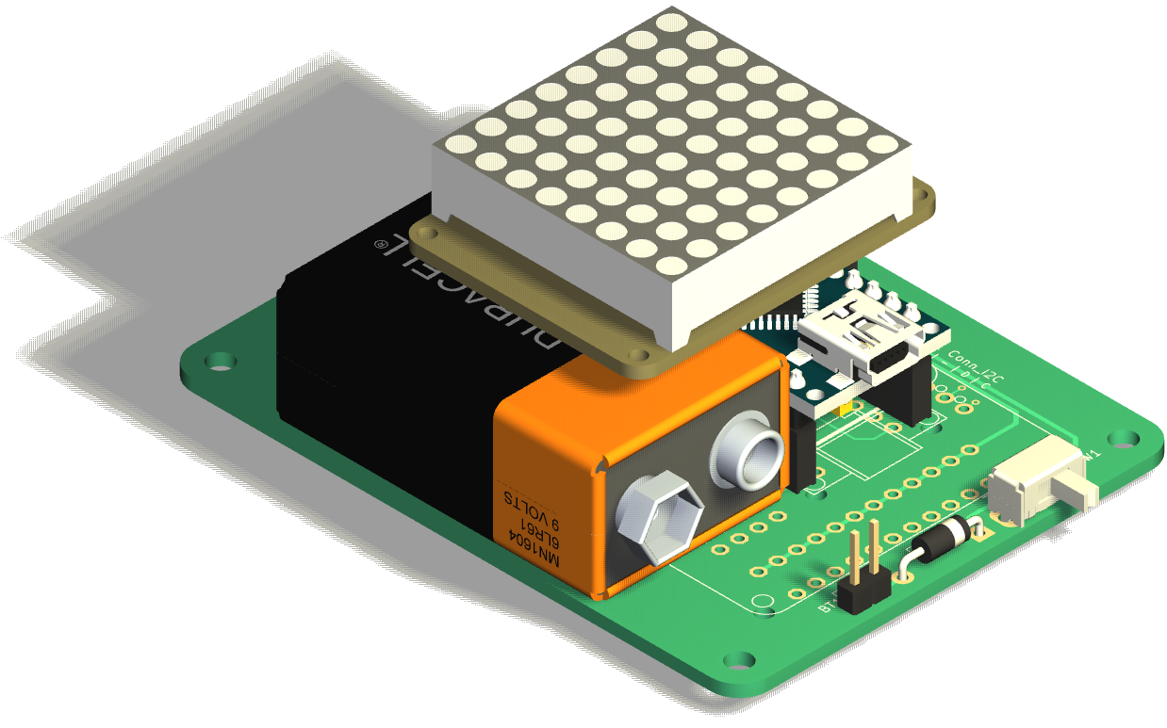
PCB Render
Lanyard slot
Spare I²C, x2
Display
Proto area
Mount holes, x4
Switch

Slide 6
PCB Front view
All components are assembled on Front side.
Components are aligned along vertical axis for weight distribution
There are 120 pads for prototyping + 24 power pads (12 each connected to +5V and GND)
There are 3 I²C headers. For single display, use the center one. For dual display, use the I²C left/right headers.
The blank part of the PCB can be used to stick the 9V battery using adhesive tape.

Slide 7
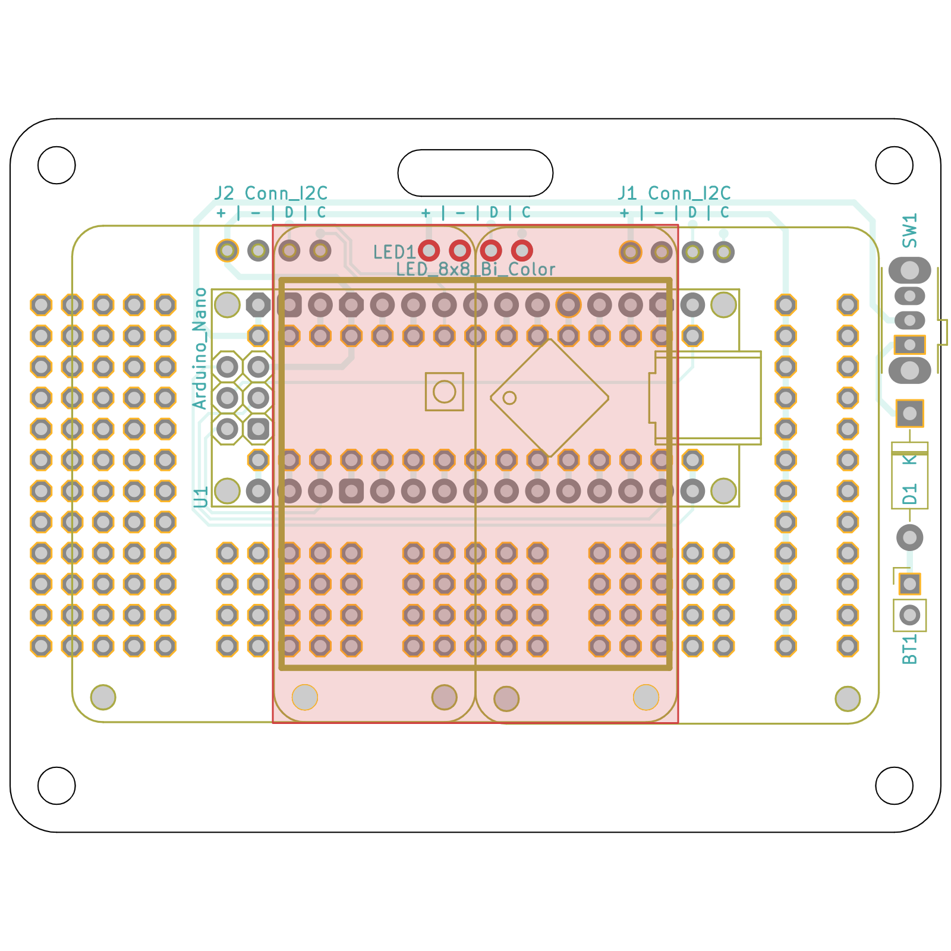
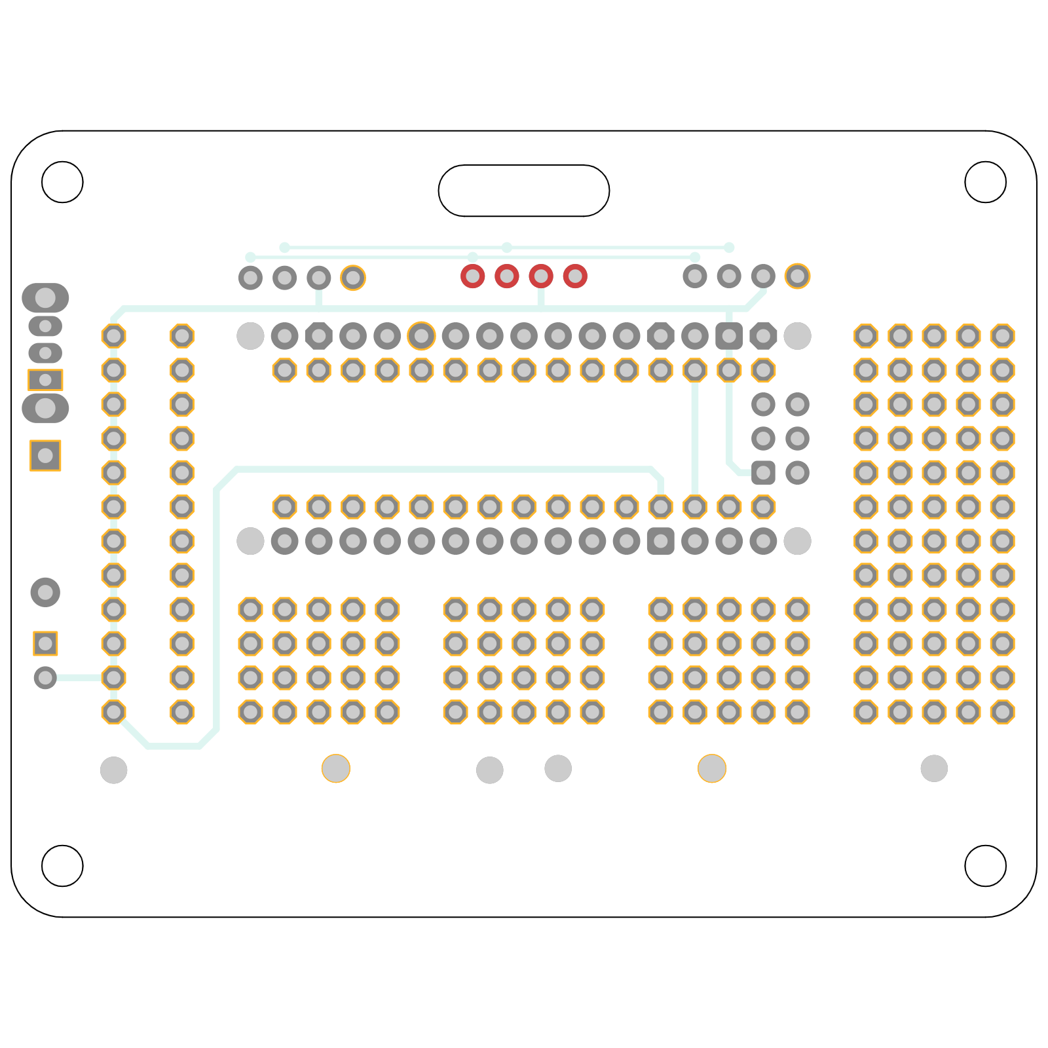
PCB dimensions
3 inches x 2.3 inches
(76.2 mm x 58.4 mm)

Slide 8
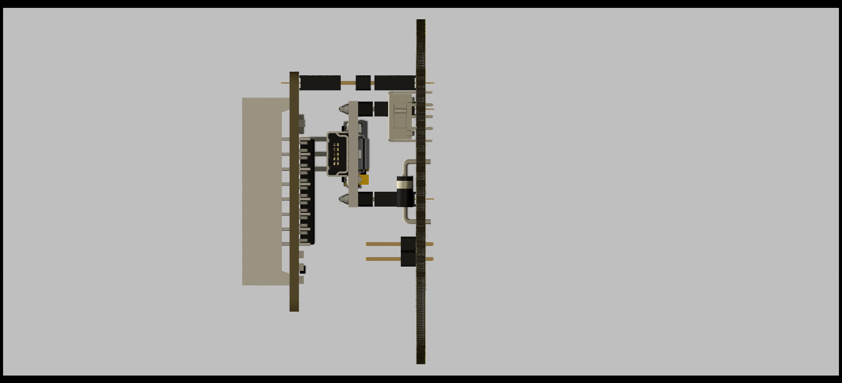
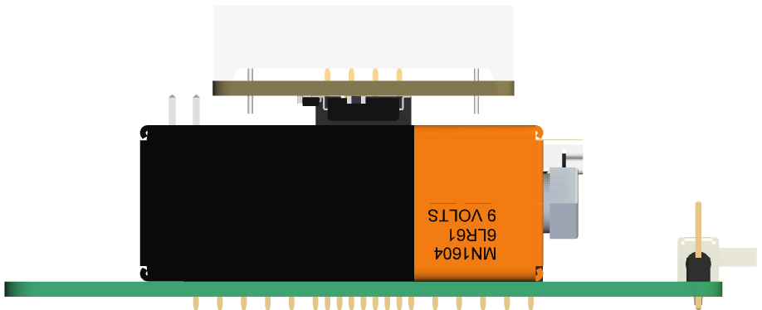
PCB Side view
Side views of the PCB.
8x8 LED matrix display requires extra long header pins, or one pair of sockets and regular header pins.
Some support will be needed under the LED matrix.
Height is 1.3” (33mm). This can be reduced if header sockets are not used and Arduino+LED matrix are directly soldered.

Slide 9
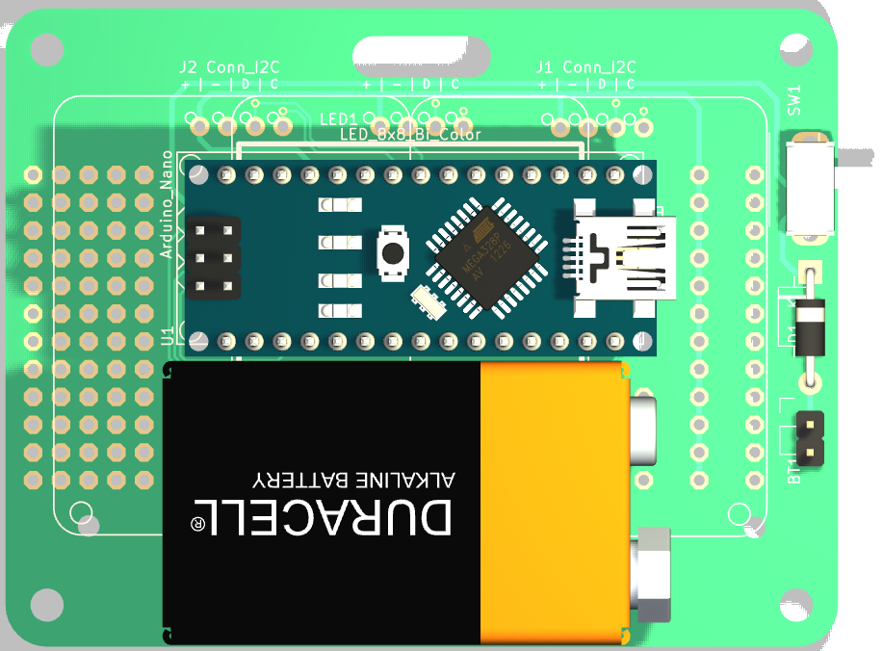
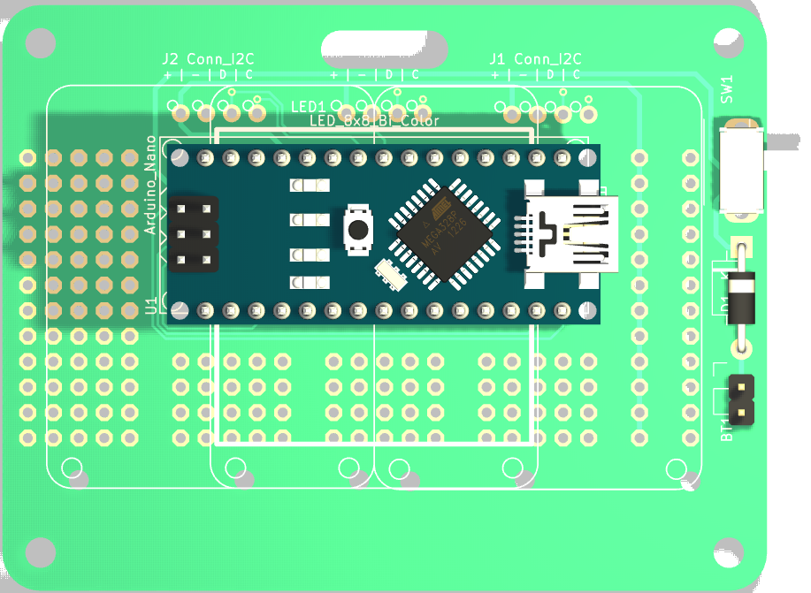
PCB Battery location
Location of 9V battery
(attached using double sided tape)

Slide 10
Hacking
Extra I²C header and 120 copper pads for future hacking
Add a second 8x8 LED matrix, I²C modules (accel, IMU, RTC), buttons etc.
Some hacking ideas:
  Electronic Dice (using accelerometer for shake detection)
  Timer or Clock (using RTC)
  SNAKE game (using 5 buttons)
  PONG game using two joysticks
  Ornament or Wearable
  VU meter (sound decibel display, using microphone module)

