Slide 1

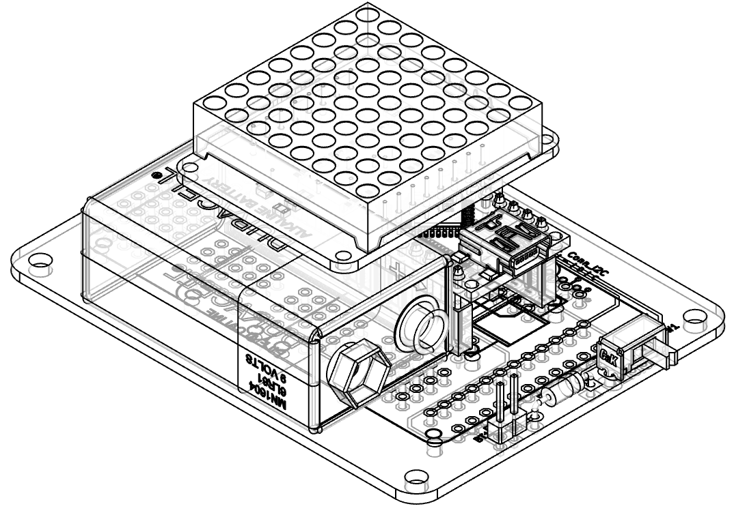
“Bag Tag” v1
Electronics
8x8 LED Matrix
(Proposed project for Innov School Jr)

Slide 2

Requirements
Complexity level - SIMPLE
Must include elements of
  Electronics (soldering)
  Arduino (programming)
  Rapid prototyping (3D printing / laser cutting)
BADGE form factor
Powered by 9V battery
Expandable / Hackable

Slide 3
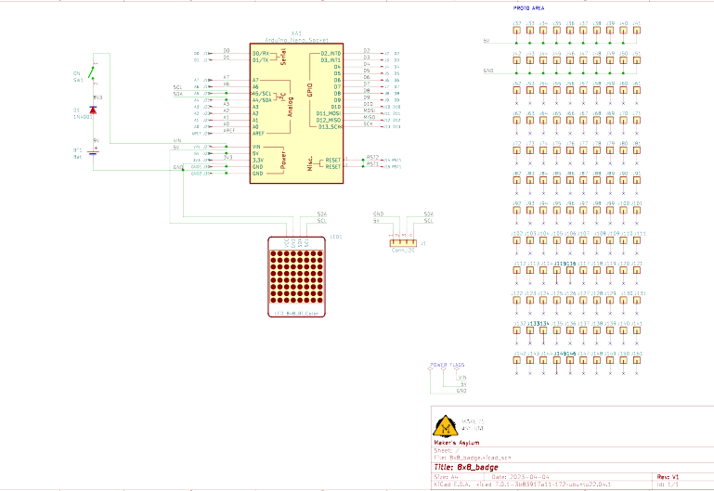
Schematic
Components:
Arduino Nano
Bi-Color 8x8 LED Matrix
Switch
Diode
9V Battery with clip
Header sockets
Header pins
PCB

Slide 4
Options
Optional upgrades
(not included in kit)
2nd Bi-Color 8x8 LED Matrix
Add extra modules
  I²C modules such as accelerometer, IMU, RTC
  Buttons, joystick etc
Hackable via prototyping area with 120 pads

Slide 5
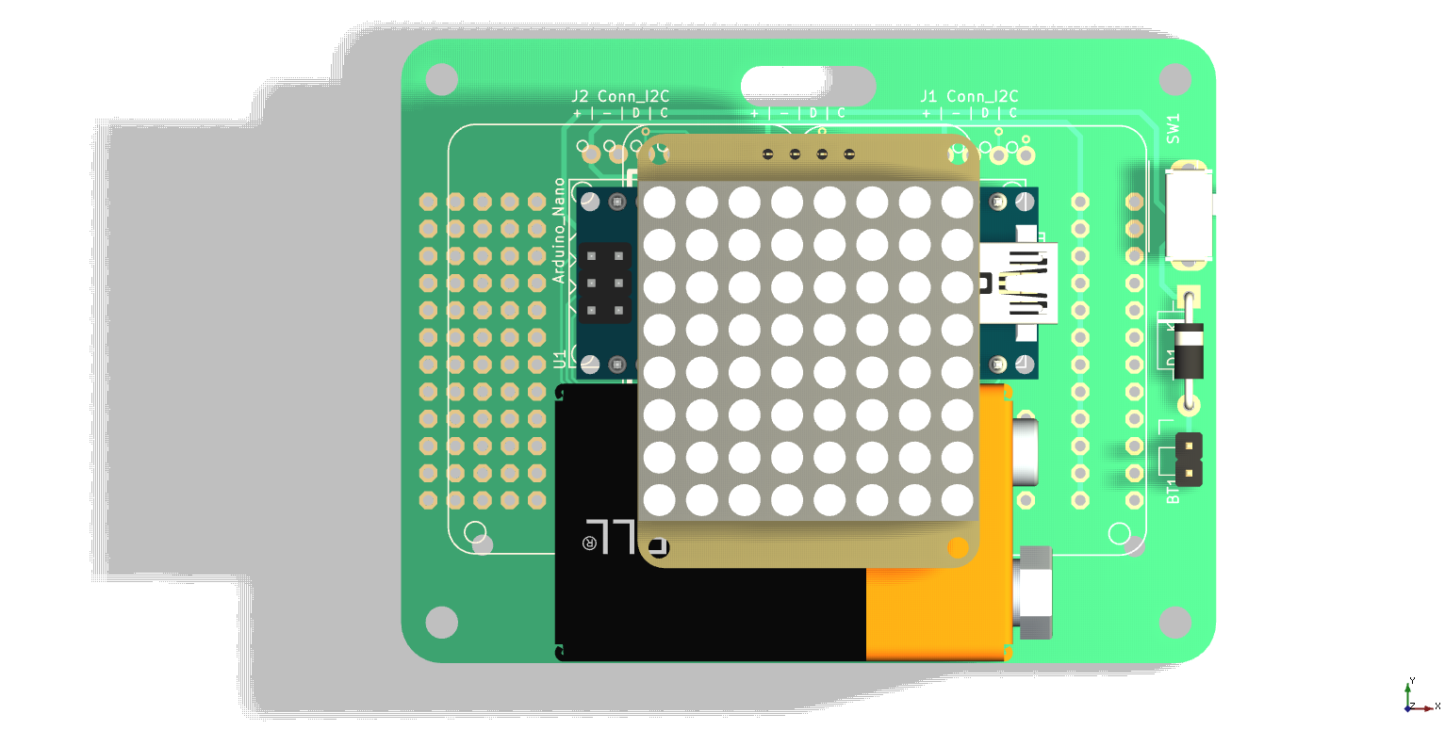
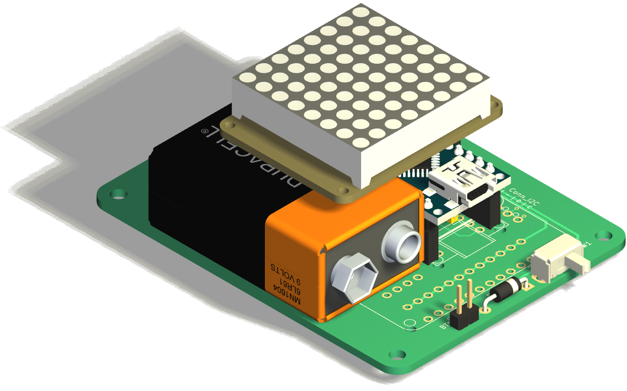
PCB Render
Lanyard slot
Spare I²C
Display
Proto area
Mount hole
Switch

Slide 6
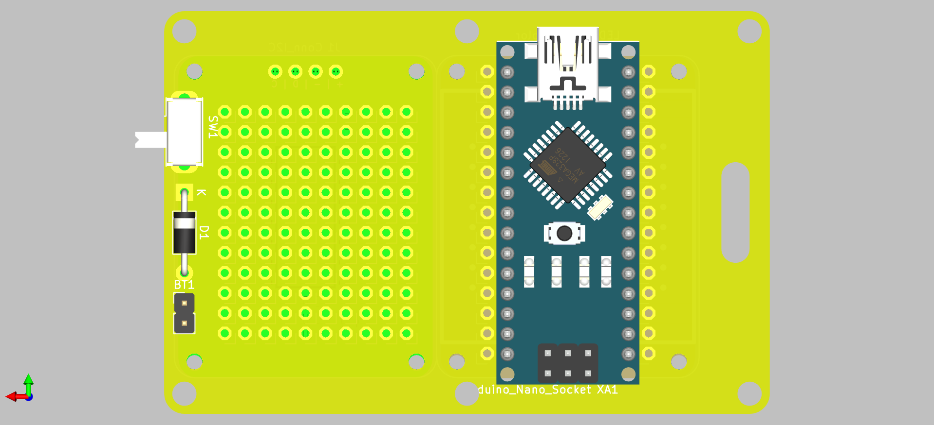
PCB Front / Bottom view
Front side of BAG TAG has ONE 8x8 LED matrix.
The second LED matrix is optional (future hacking)
There are 120 pads for prototyping
Bottom side of BAG TAG has Arduino Nano, slide switch, reverse polarity protection diode, and 2 pin header for battery connection.
The blank part of the PCB can be used to stick the 9V battery using adhesive tape.

Slide 7
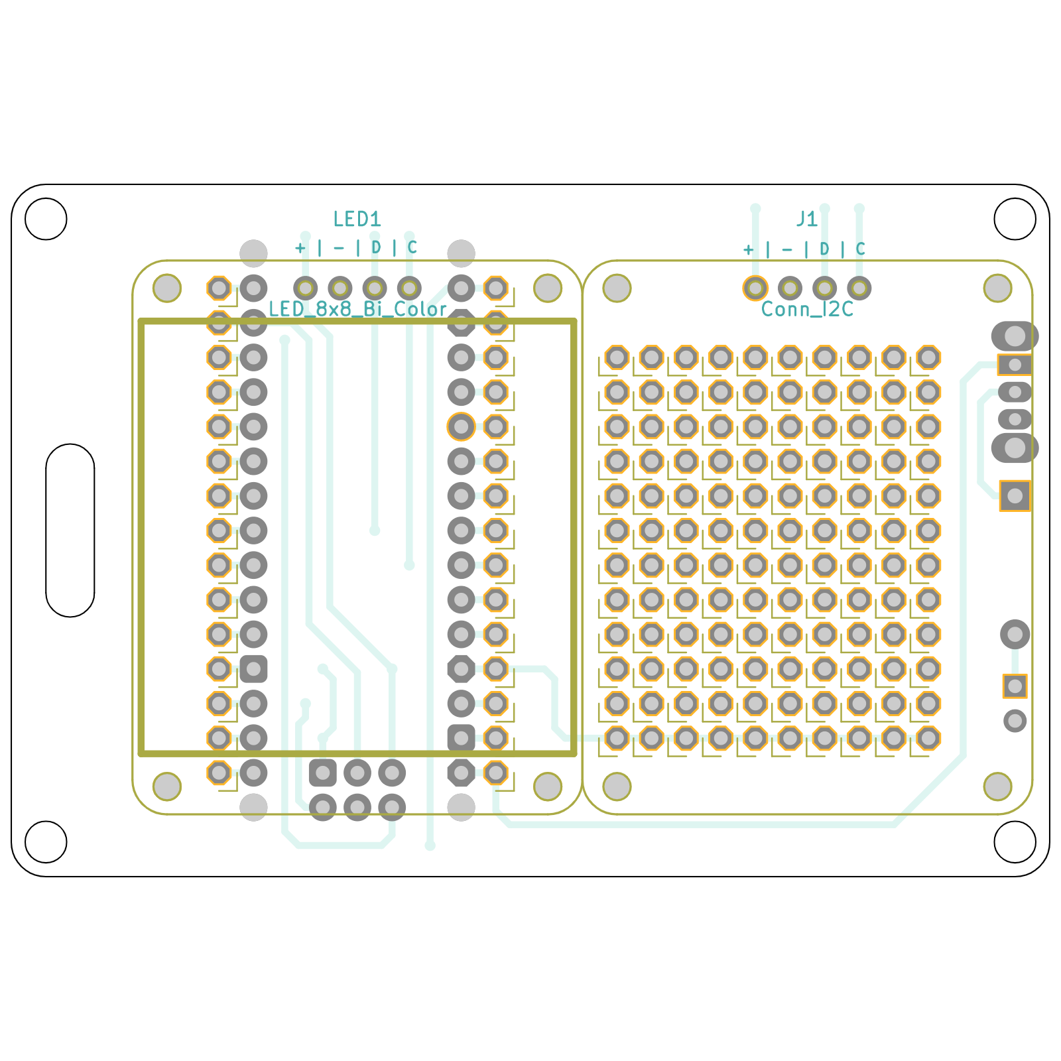
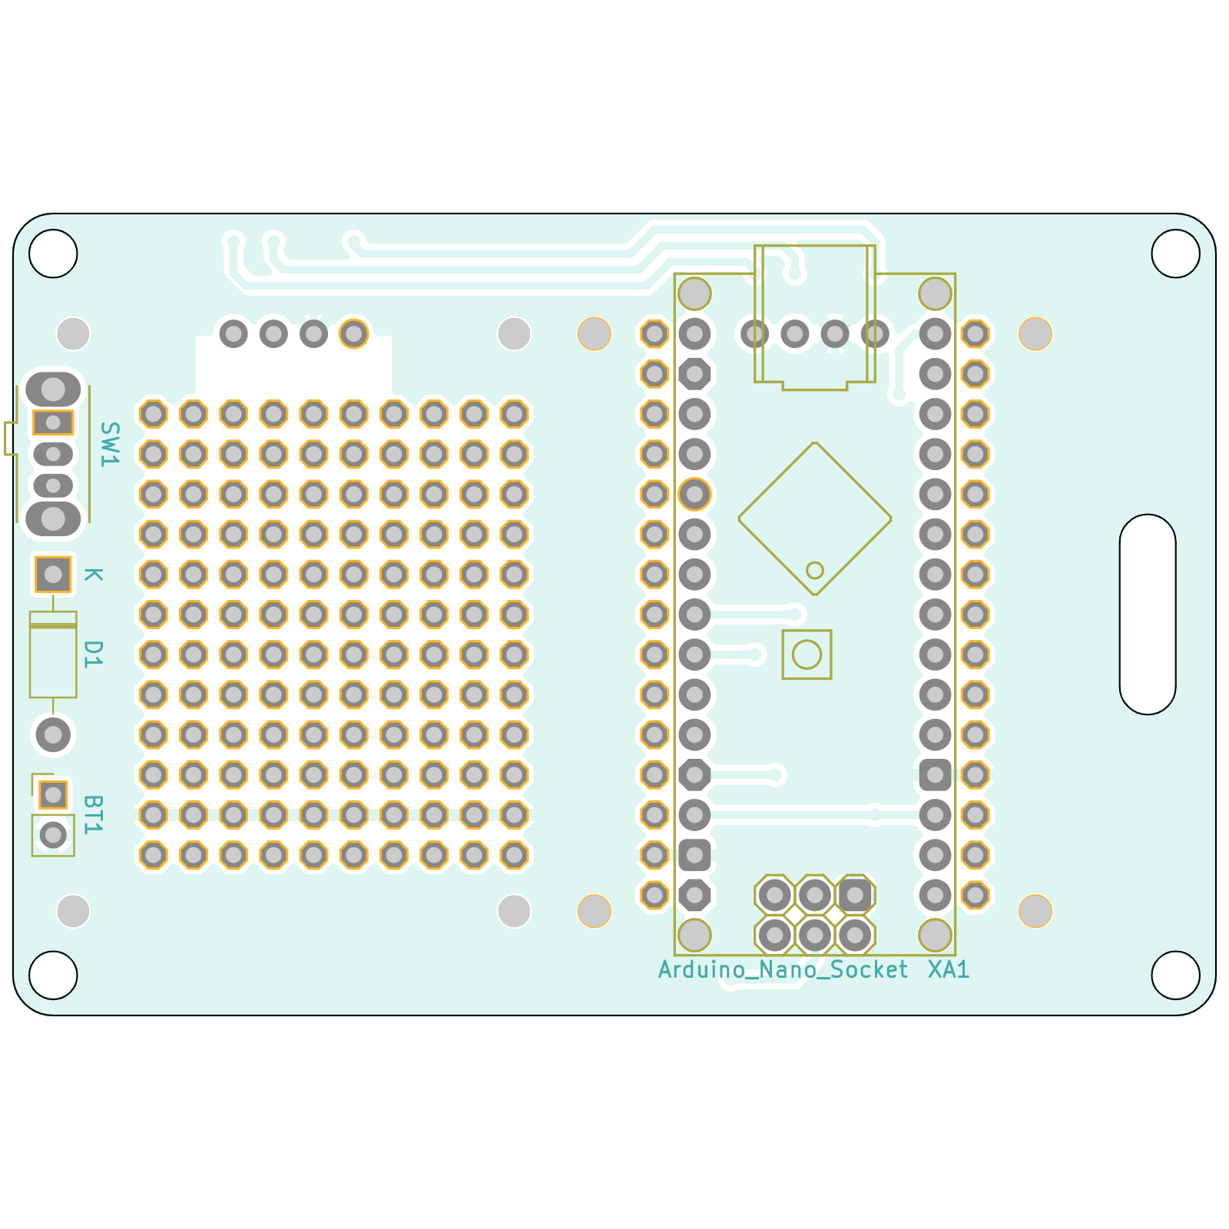
PCB dimensions
Size is smaller than credit card
3 inches x 2 inches
(76.2 mm x 50.8 mm)

Slide 8
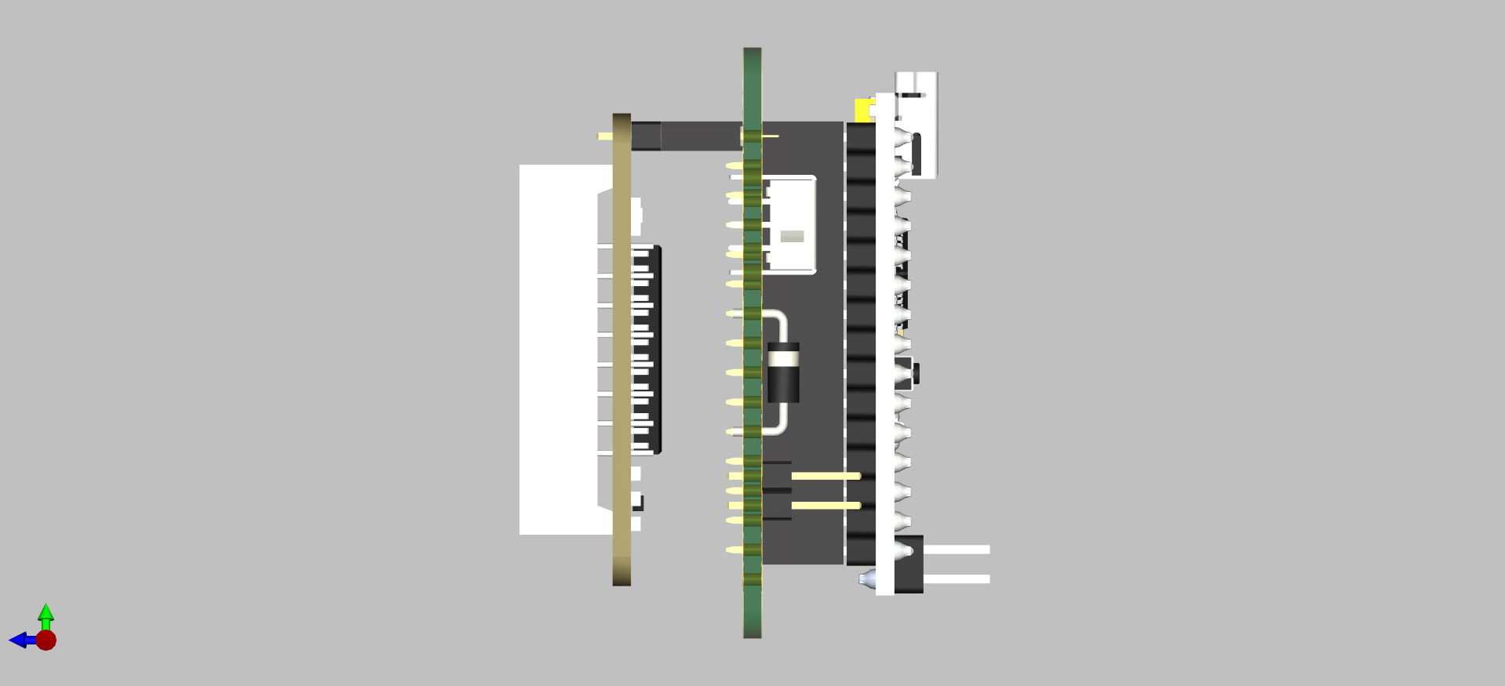
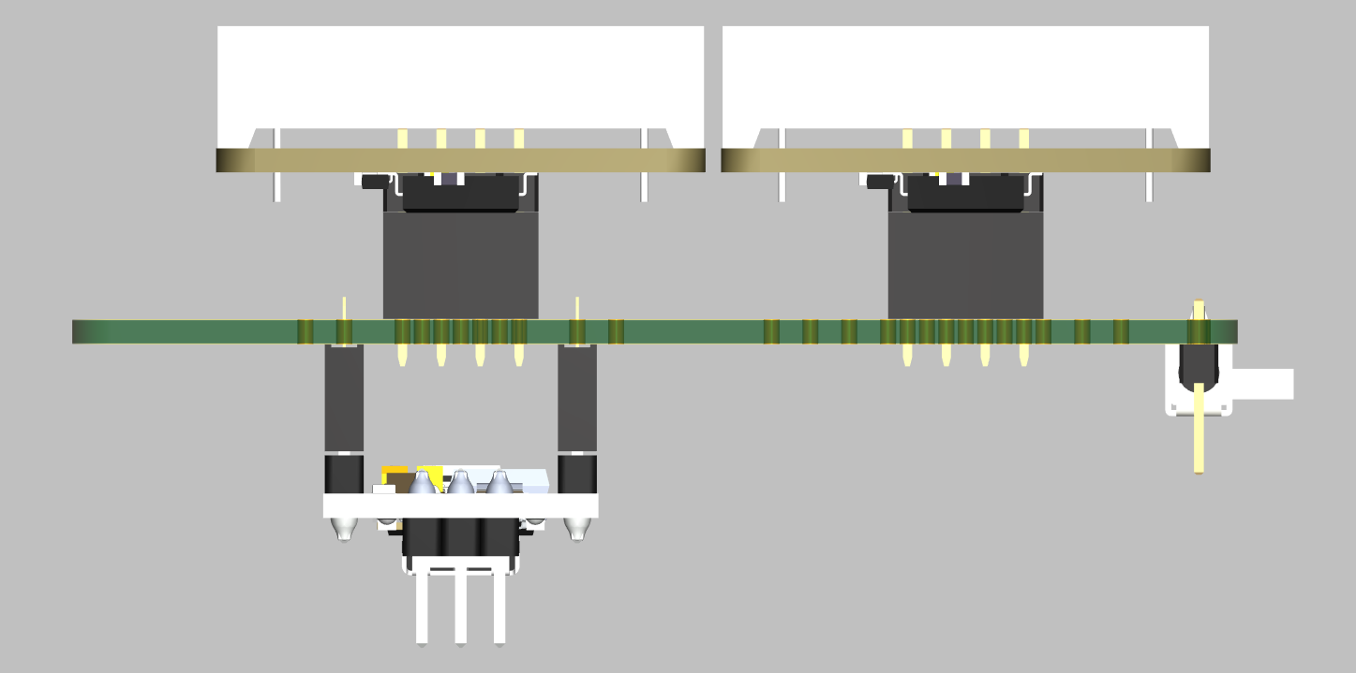
PCB Side view
Side views of the PCB.
Arduino Nano and 8x8 matrix display are mounted using header sockets and header pins.
Some support will be needed under the LED matrix
Height is 1.6” (41mm). This can be reduced if header sockets are not used and Arduino+LED matrix are directly soldered.

Slide 9
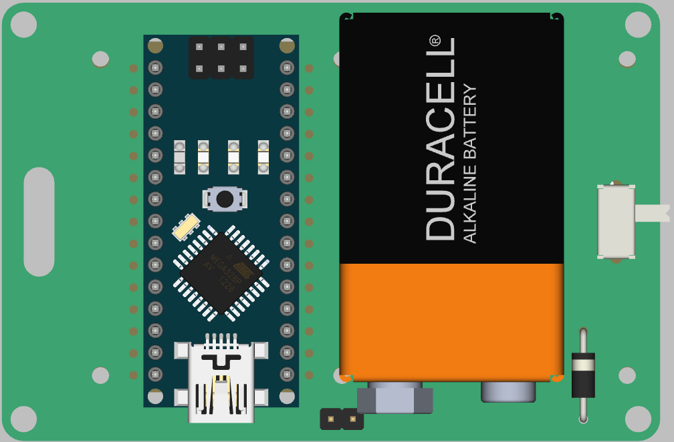
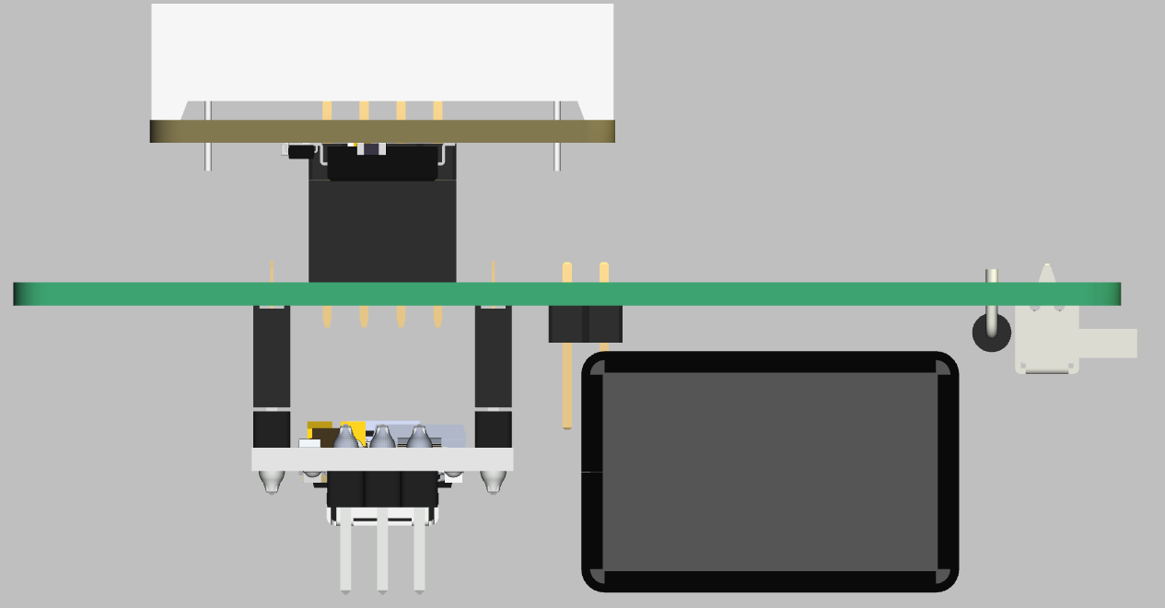
PCB Battery location
Location of 9V battery
(attached using double sided tape)

Slide 10
Hacking
Extra I²C header and 120 copper pads for future hacking
Add a second 8x8 LED matrix, I²C modules (accel, IMU, RTC), buttons etc.
Some hacking ideas:
  Electronic Dice (using accelerometer for shake detection)
  Timer or Clock (using RTC)
  SNAKE game (using 5 buttons)
  PONG game using two joysticks
  Ornament or Wearable
  VU meter (sound decibel display, using microphone module)

