Slide 1

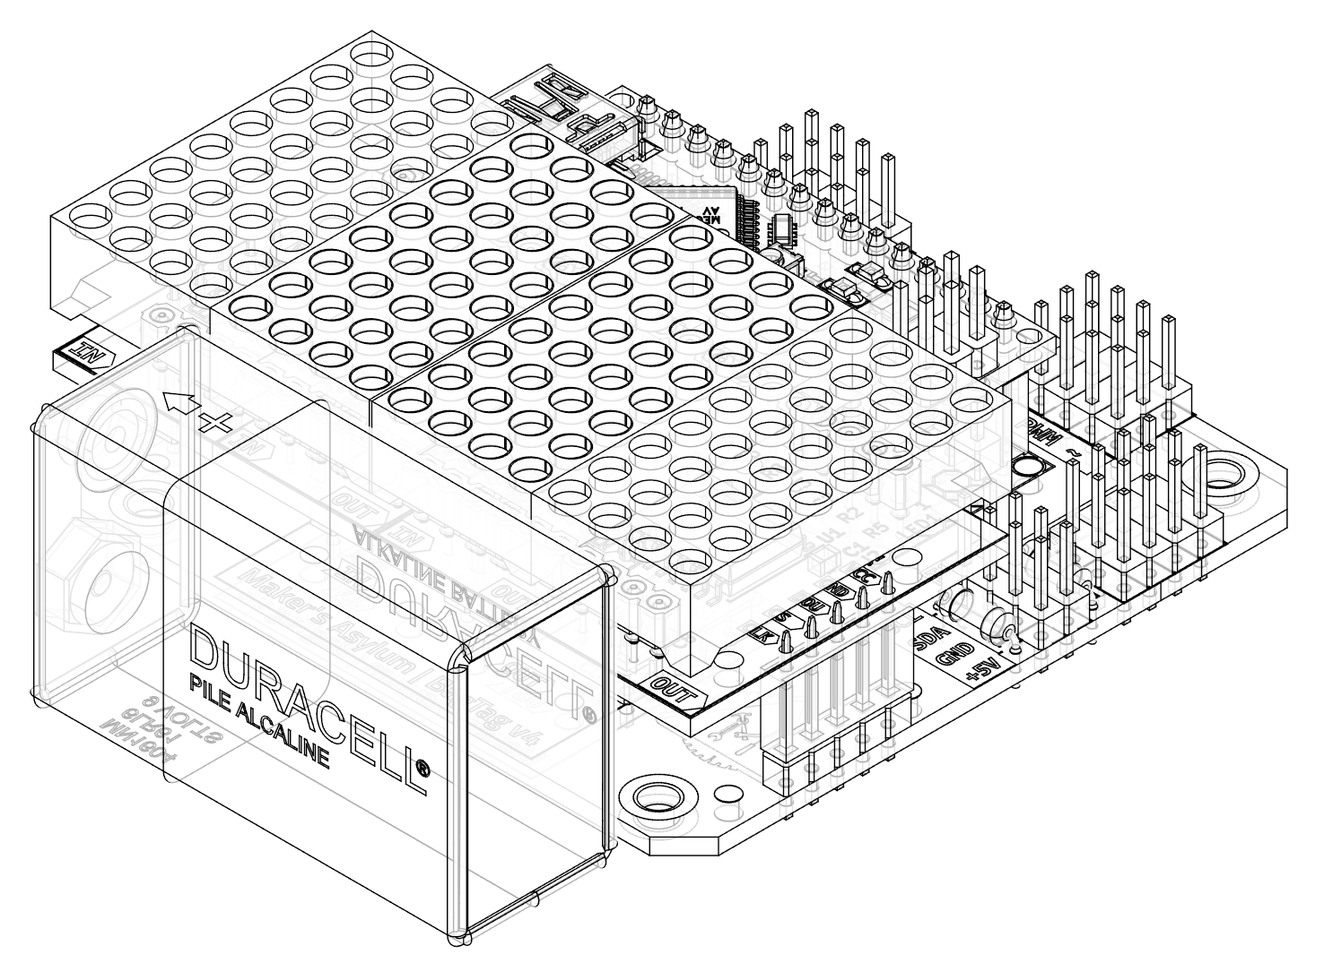
“Bag Tag” v4
Electronics
8x8 LED Matrix
(Proposed project for Innov School Jr)

Slide 2

Requirements
Complexity level - SIMPLE
Must include elements of
  Electronics (soldering)
  Arduino (programming)
  Rapid prototyping (3DP/laser)
BADGE form factor
Powered by 9V battery
Expandable / Hackable
Changes in v4 (v/s v1, v2 & v3)
All parts on FRONT, but battery on side
Two I²C expansion headers
Can install one or two 8x8 SINGLE color LED display based on MAX7219 chip
Parts aligned along vertical axis for balance
3 expansion headers, each with 4 of Digital, PWM & Analog I/’s with +5V and GND
Larger PCB size

Slide 3
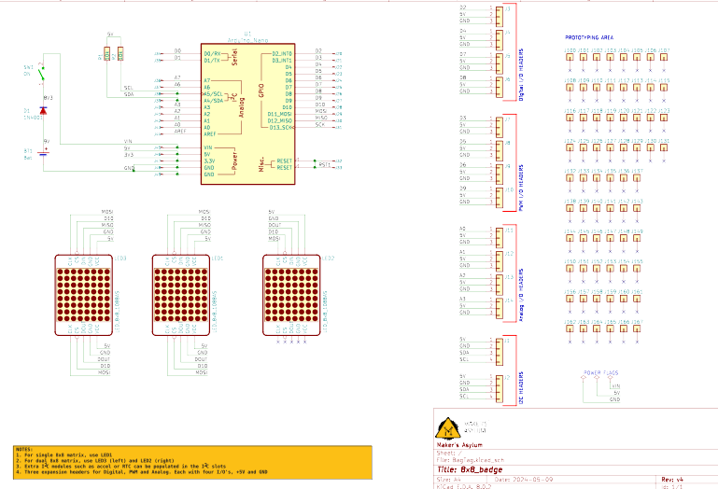
Schematic
Components:
Arduino Nano
Single Color 8x8 LED Matrix based on MAX7219
Switch
Diode
9V Battery with clip
Header sockets
Header pins
PCB

Slide 4

Options
Optional upgrades
(not included in kit)
2nd single color 8x8 LED Matrix
Add extra modules
  I²C modules such as accelerometer, IMU, RTC
  Buttons, joystick etc
Hackable via expansion headers for Digital, PWM, and Analog

Slide 5
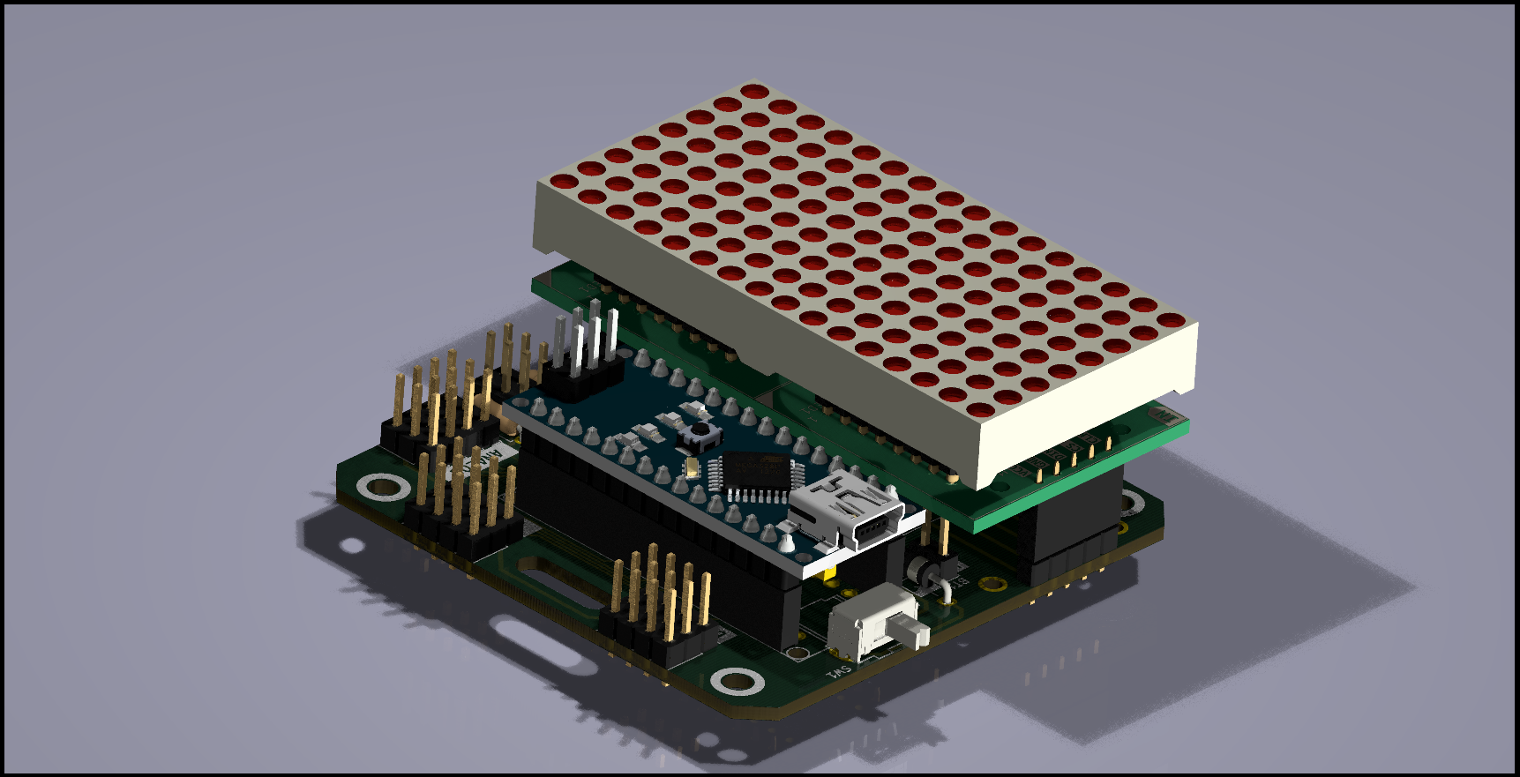
PCB Render

Slide 6
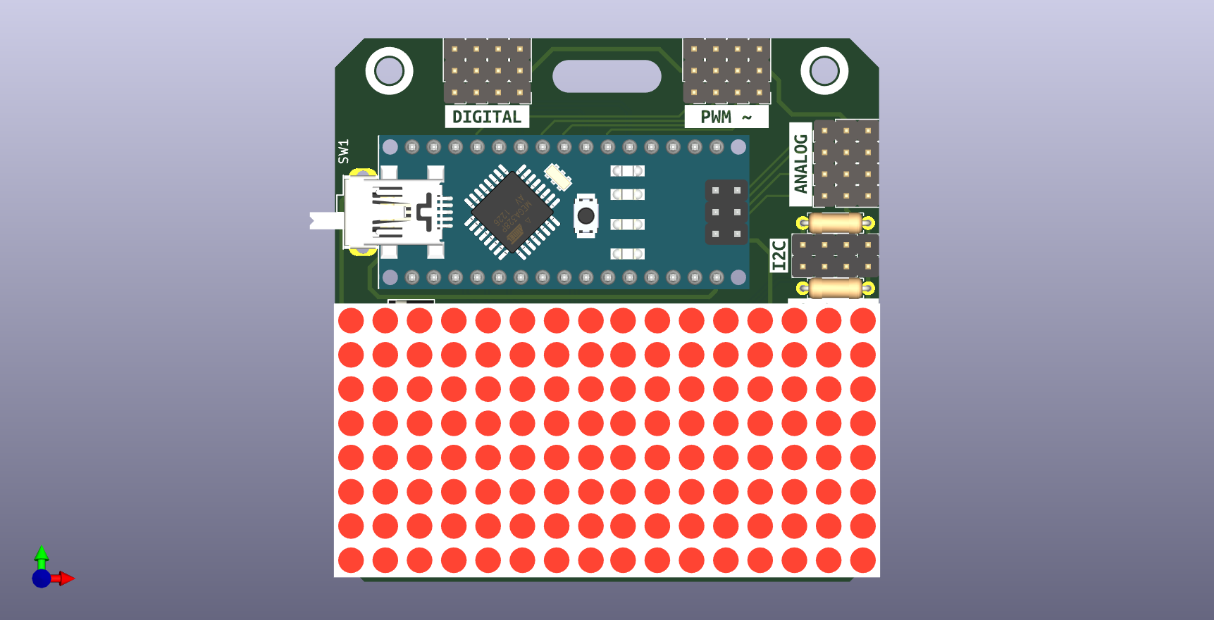
PCB Front view
DIGITAL I/O
Lanyard slot
PWM ~ I/O
Switch
Mount holes, x4
ANALOG I/O
Arduino Nano
Spare I²C, x2
Display
2nd Display

Slide 7
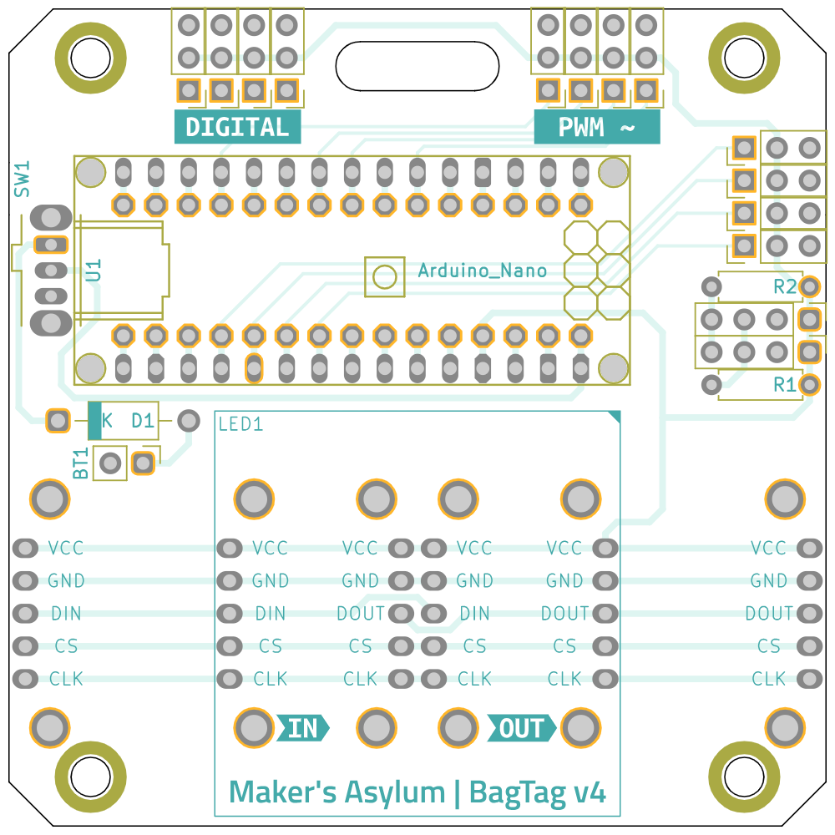
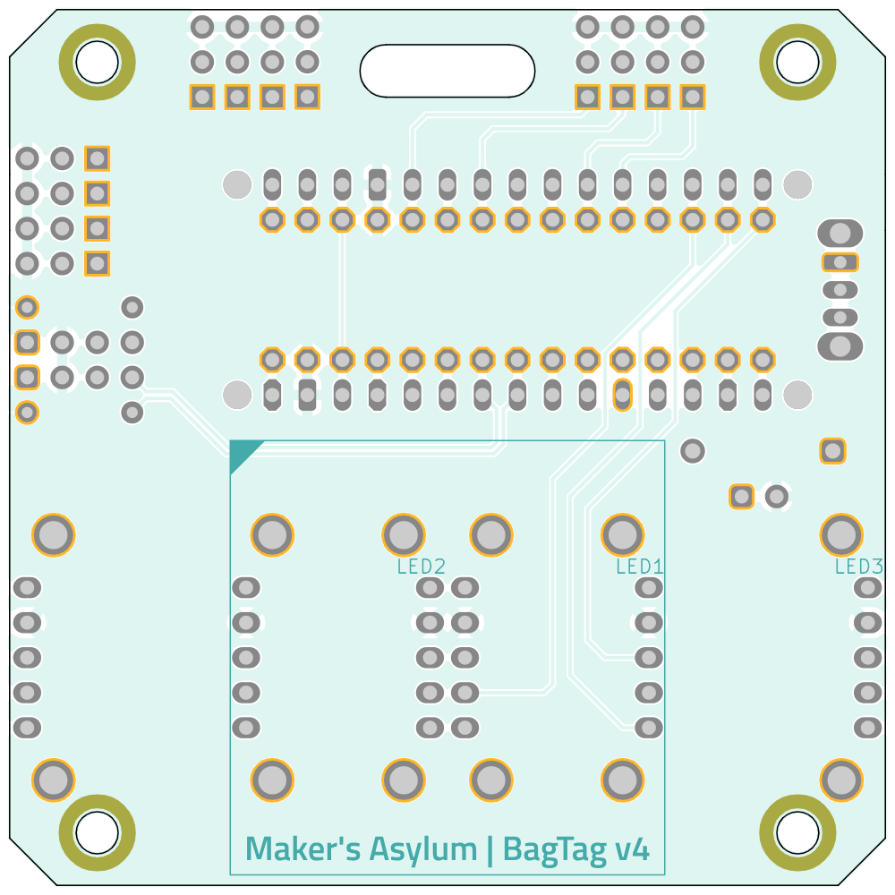
PCB dimensions
PCB = 2.50” x 2.50” (63.5 mm x 63.5 mm)
Mounting = 2.00” x 2.20” (50.8 mm x 55.88 mm)

Slide 8
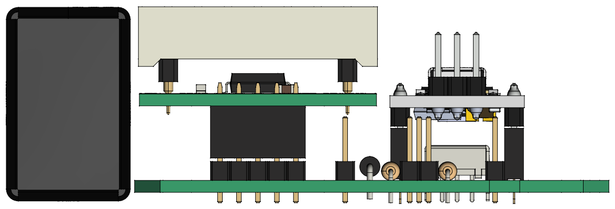
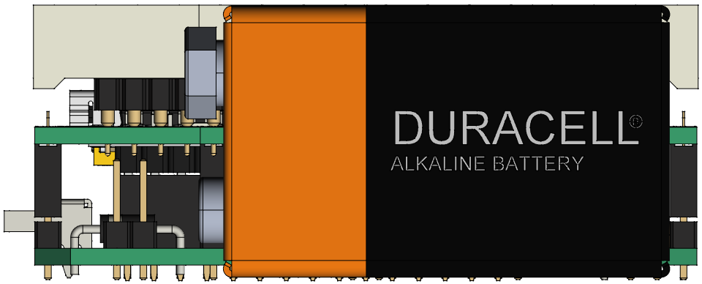
PCB Side views
Side views of the PCB.
8x8 LED matrix display and Arduino Nano require header pins and sockets.
BagTag will fit inside a volume of 82 mm x 65 mm x 28 mm

Slide 9
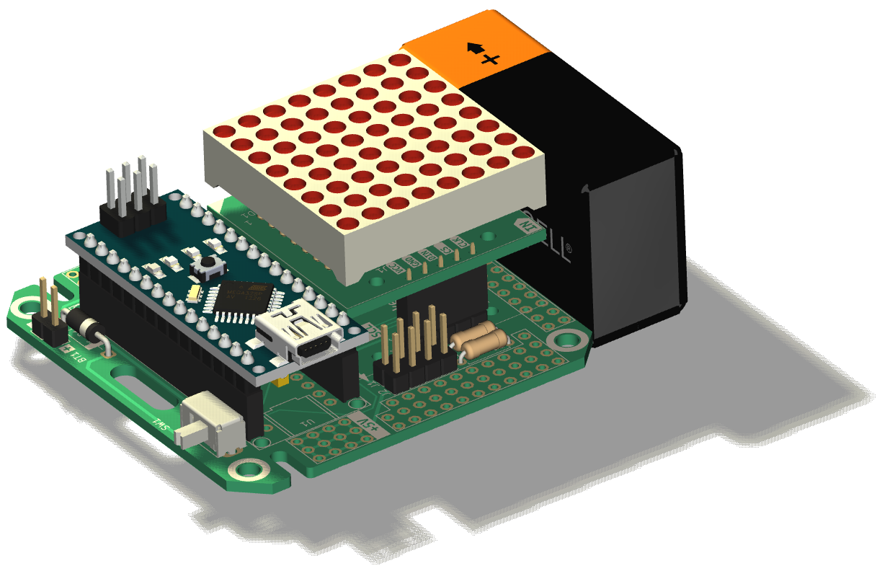
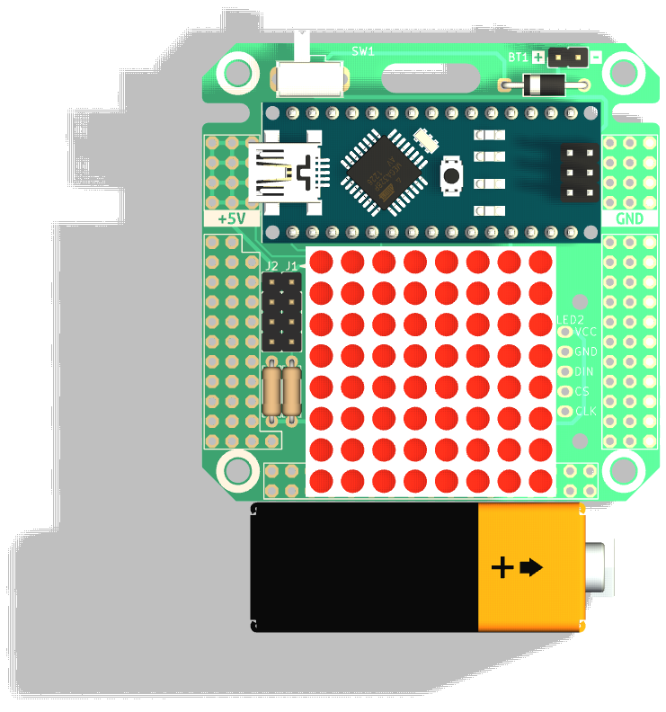
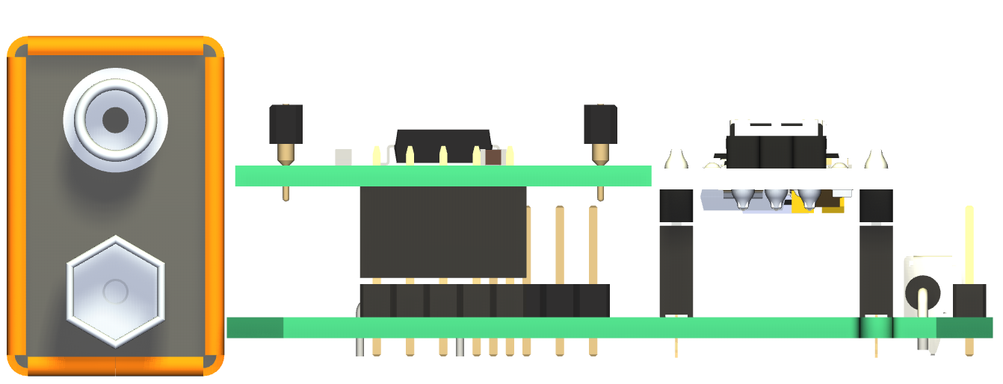
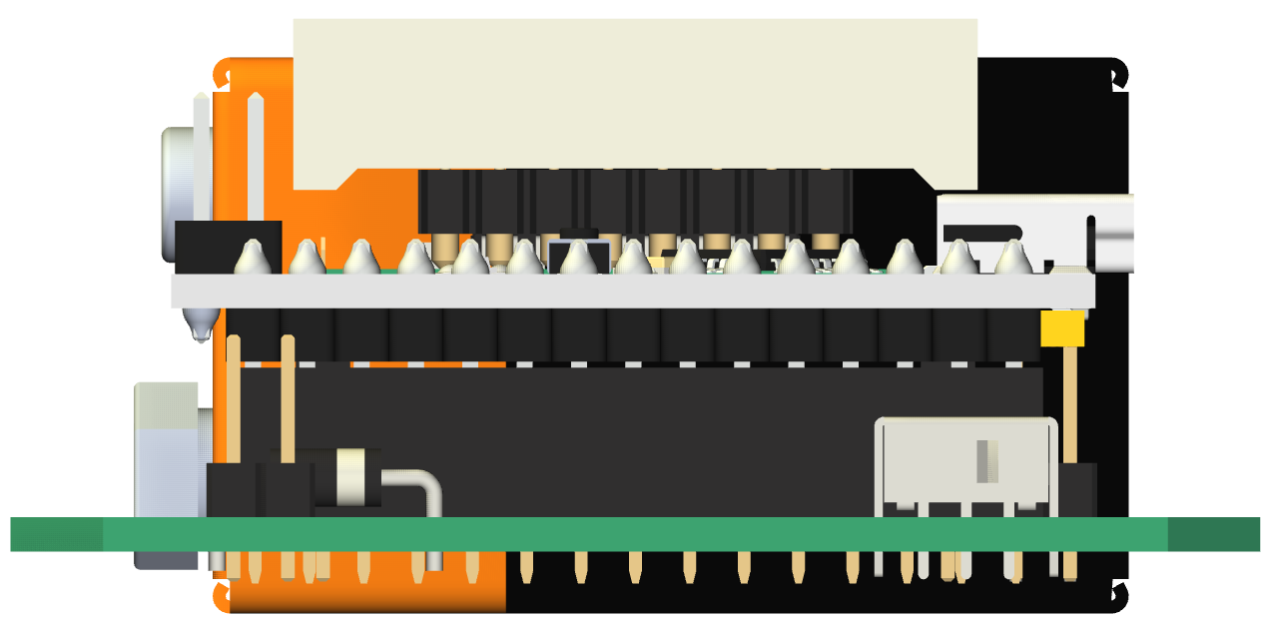
PCB Battery location
Battery is not located on the PCB.
Battery mounting / orientation / location depends on enclosure

Slide 10
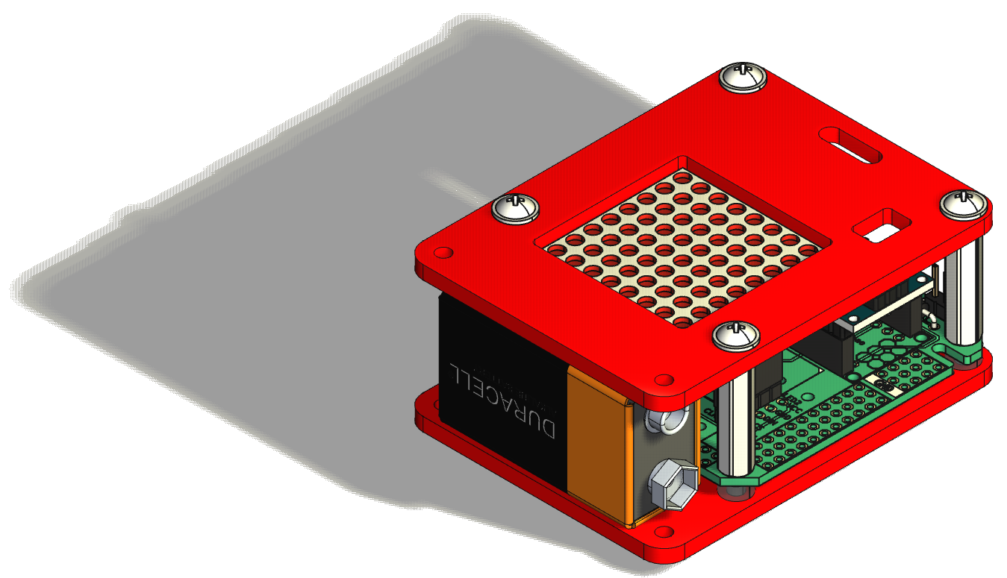
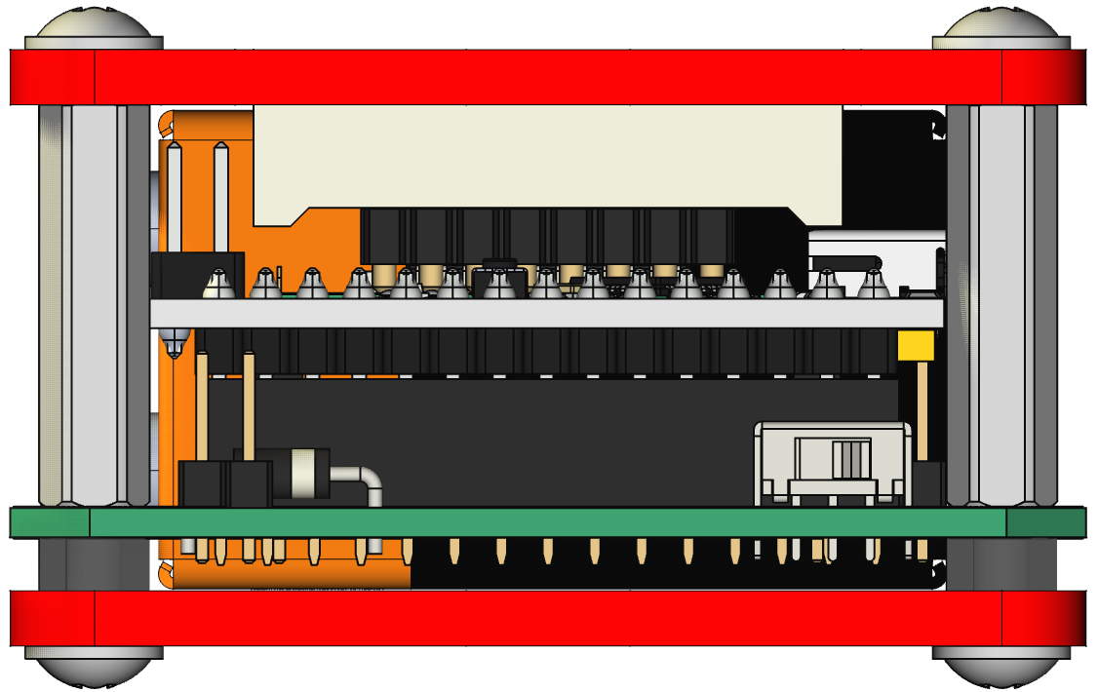
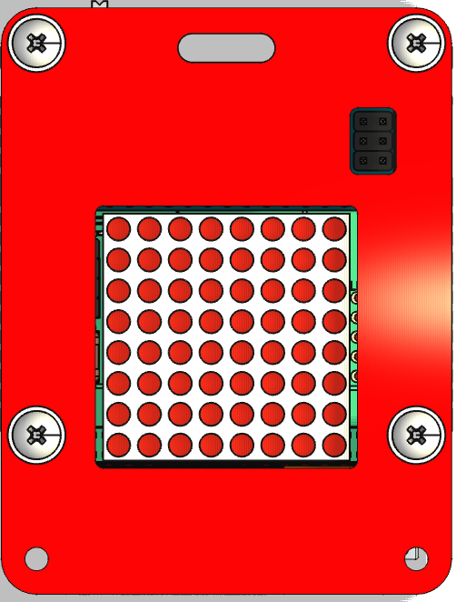
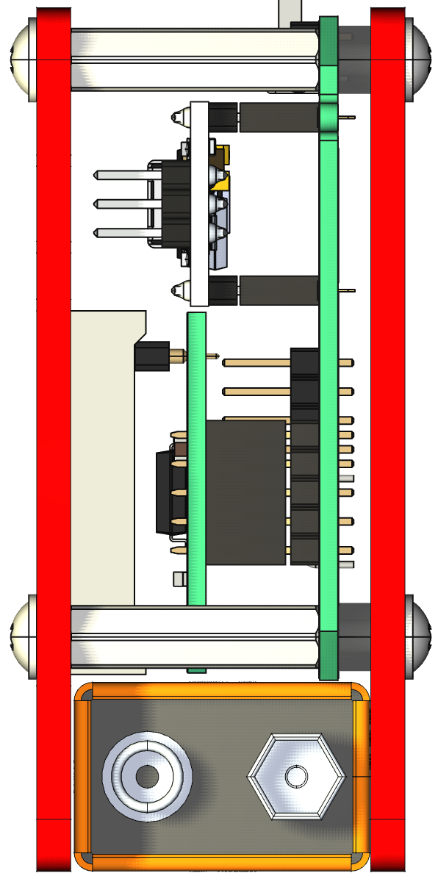
Enclosure suggestion
See exploded view at
~/fabricate/renders/BagTag_v3_exploded_view.mp4

Slide 11
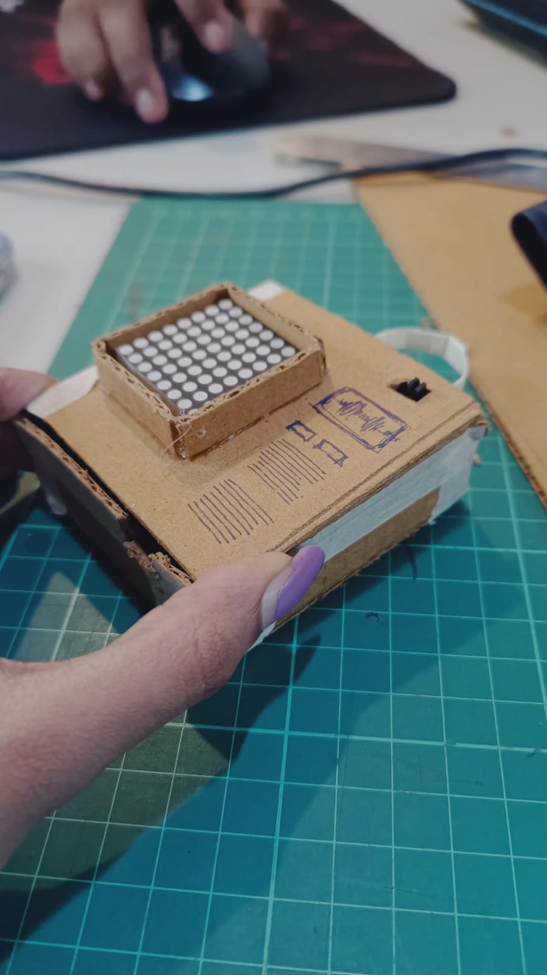
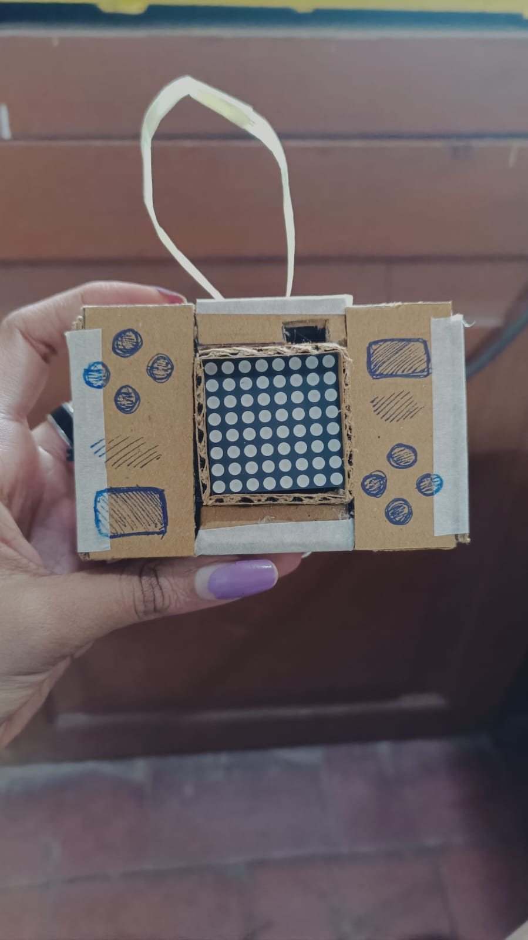
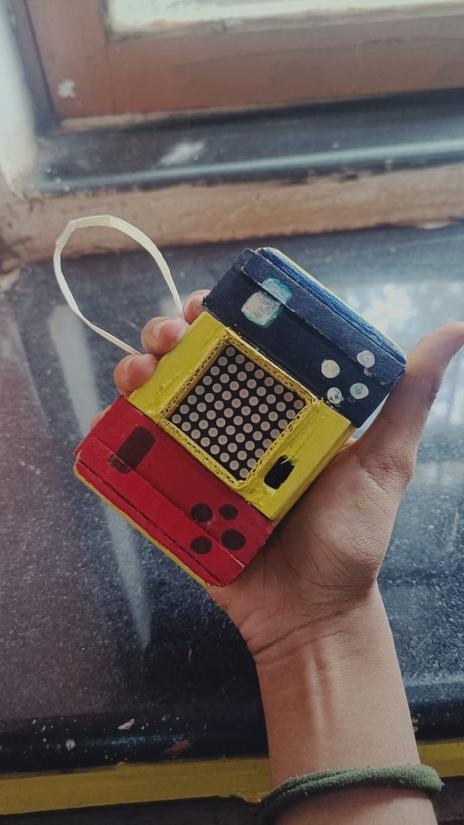
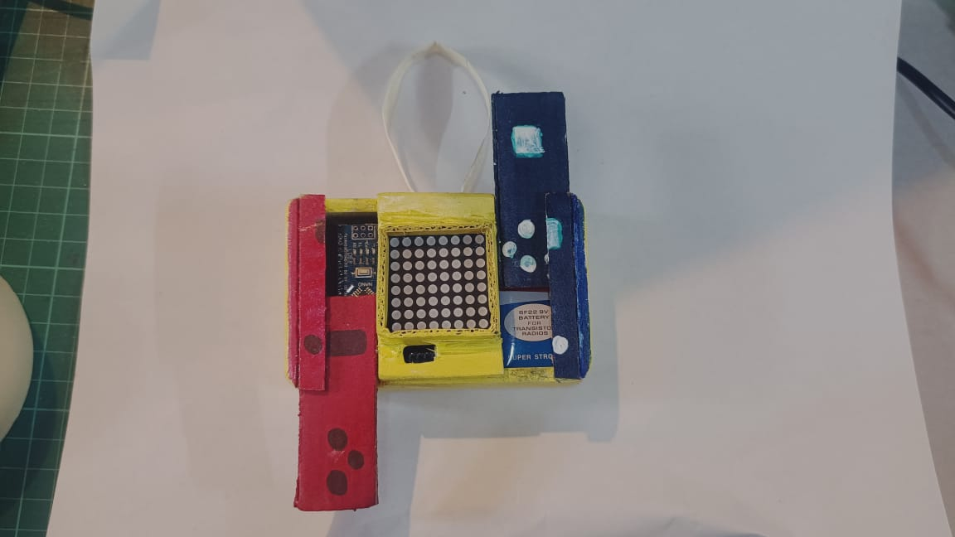
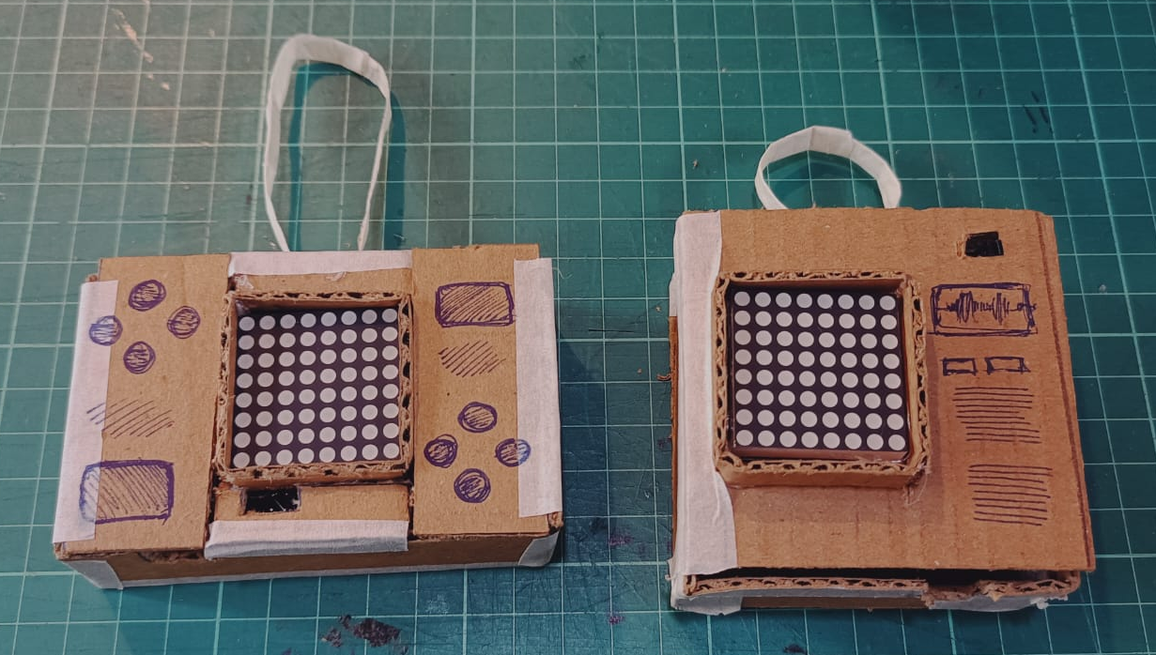
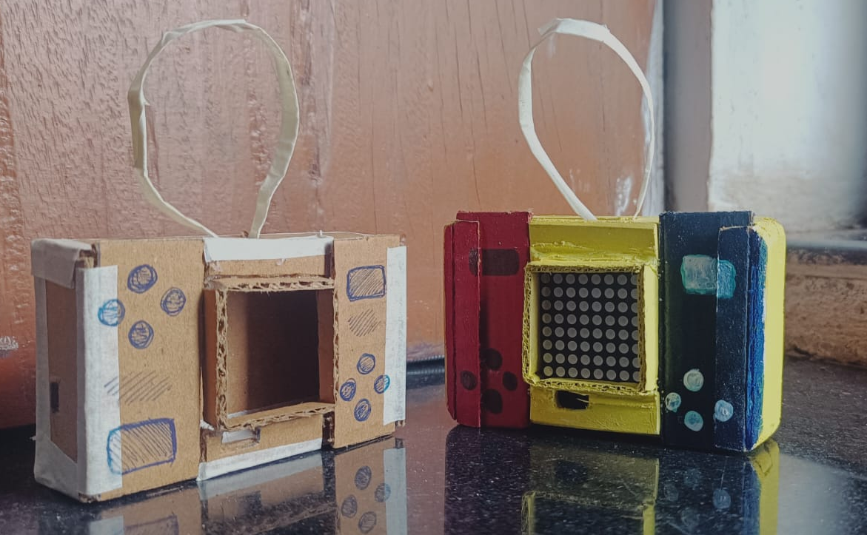
Enclosure suggestions 2

Slide 12
Hacking
Two extra I²C headers and expansion headers for future hacking
Add a second 8x8 LED matrix, I²C modules (accel, IMU, RTC), buttons etc.
Some hacking ideas:
  Electronic Dice (using accelerometer for shake detection)
  Timer or Clock (using RTC)
  SNAKE game (using 5 buttons)
  PONG game using two joysticks
  Ornament or Wearable
  VU meter (sound decibel display, using microphone module)

