Slide 1

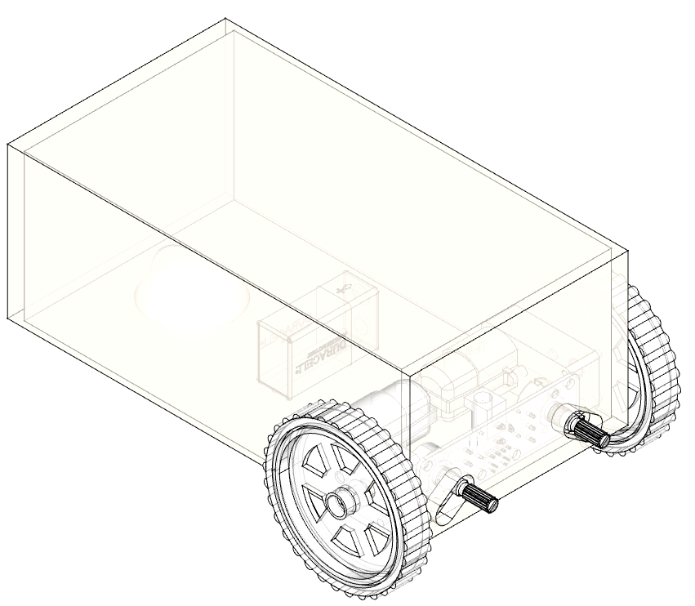
“BoxRobot” v1
Innovation School
Kit Box Robot
(Proposed project for Innov School Jr)

Slide 2

Requirements
Complexity level - SIMPLE
Must include elements of
  Electronics (soldering)
  Up-cycling
  Mechanical assembly
Use innovation school kit box
Powered by 9V battery
Expandable / Hackable

Slide 3
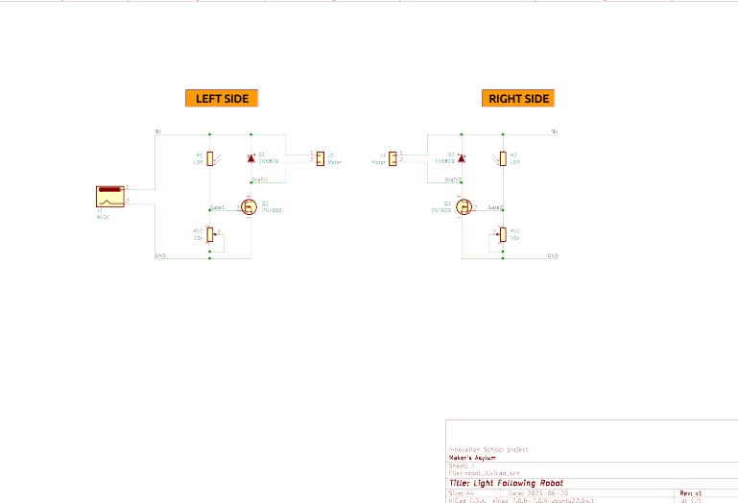
Schematic
Components:
x2 geared BO type motors
x2 BO motor robot wheels
Ping pong ball or steel ball caster wheel
x2 LDR (must be matched pair)
x2 potentiometers
x2 type N MOSFET
x2 Schottky Diode
9V Battery with clip
Header sockets
Header pins
PCB

Slide 4
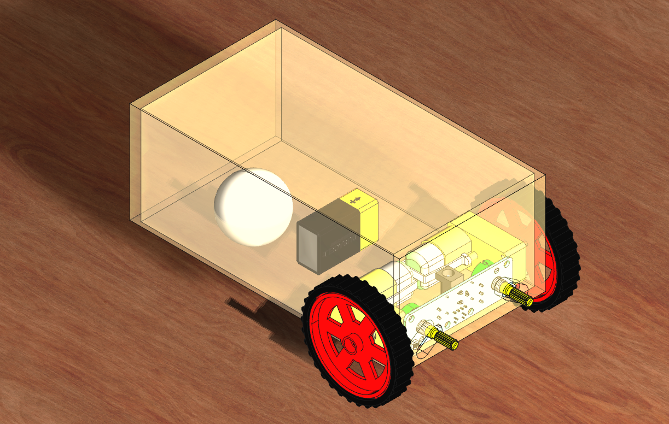
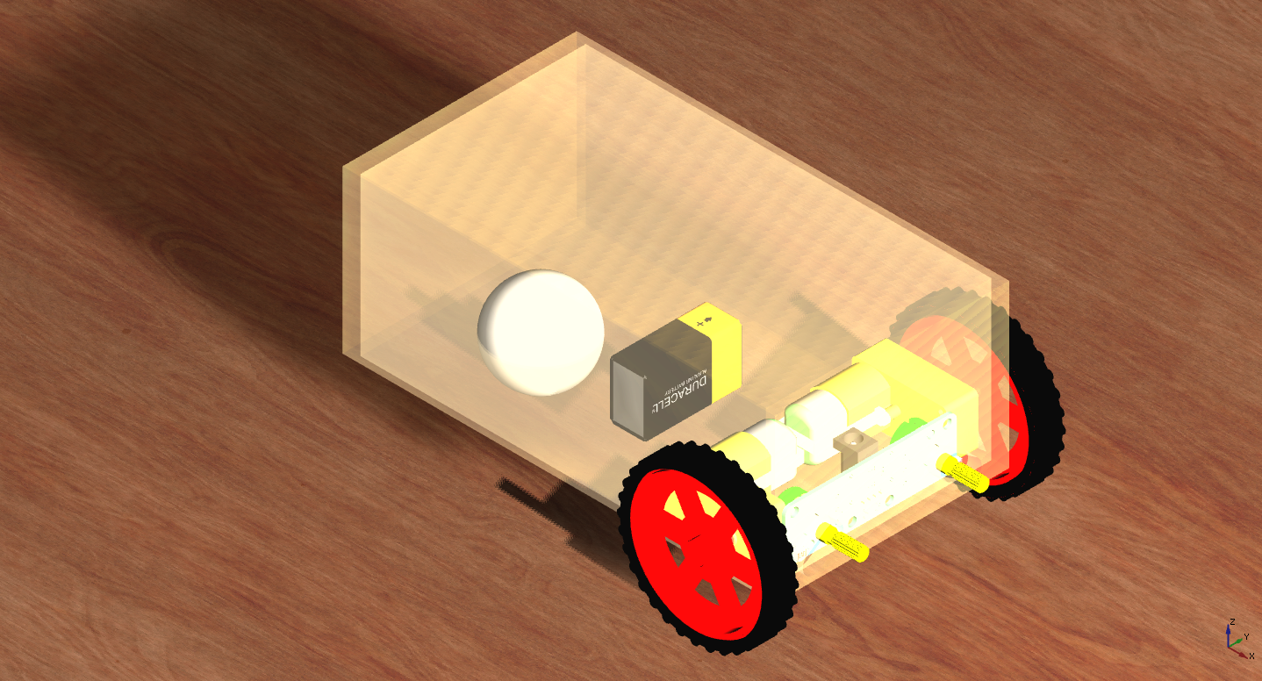
Render

Slide 5
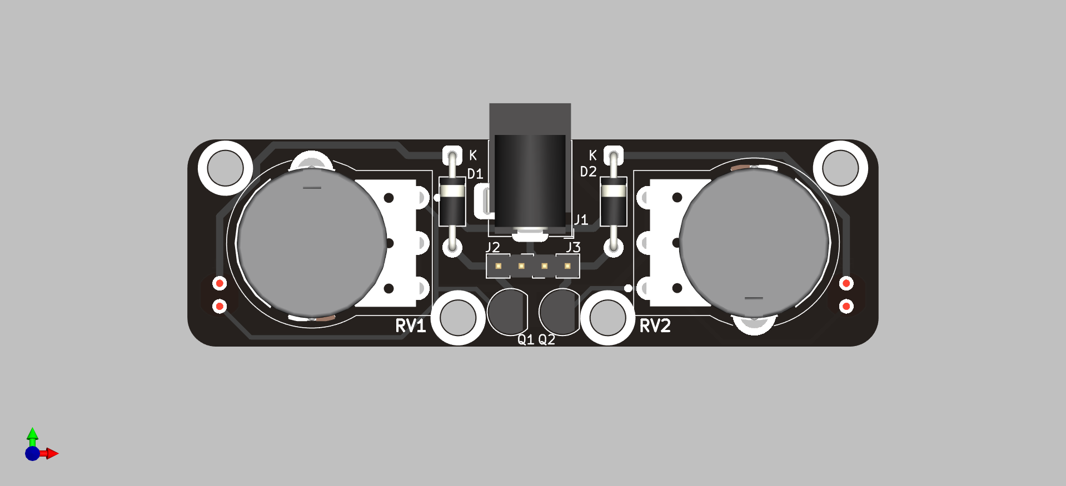
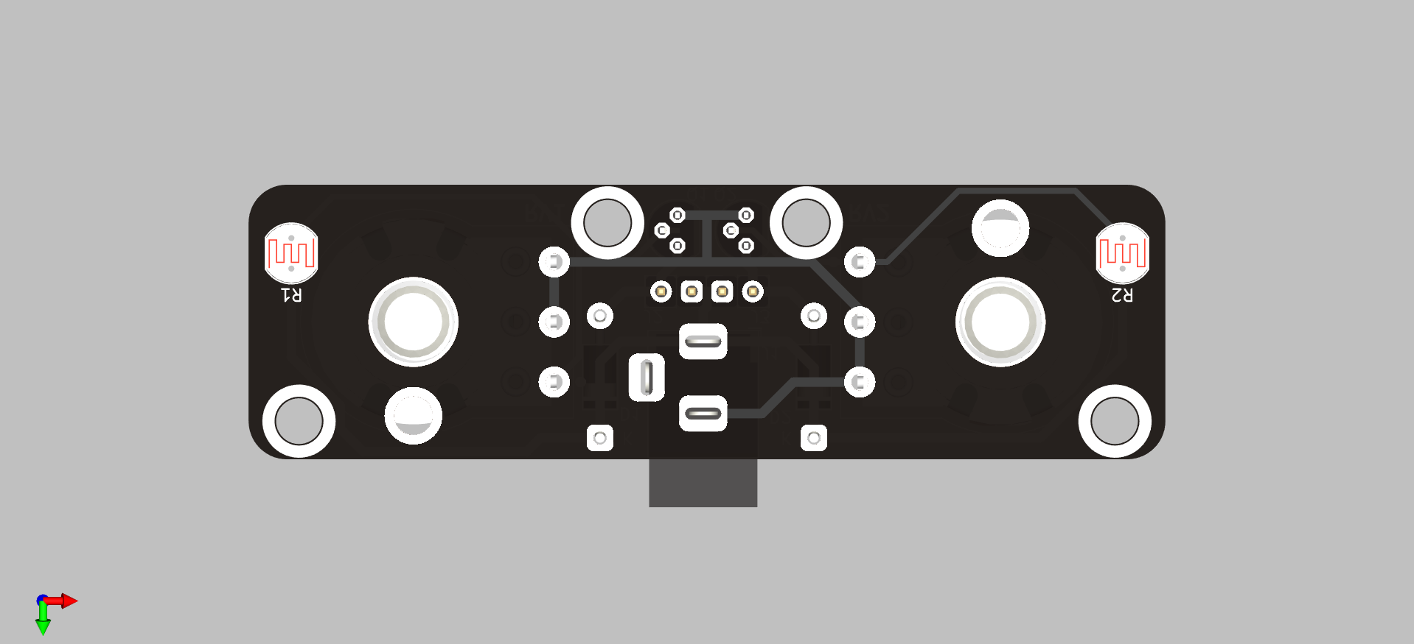
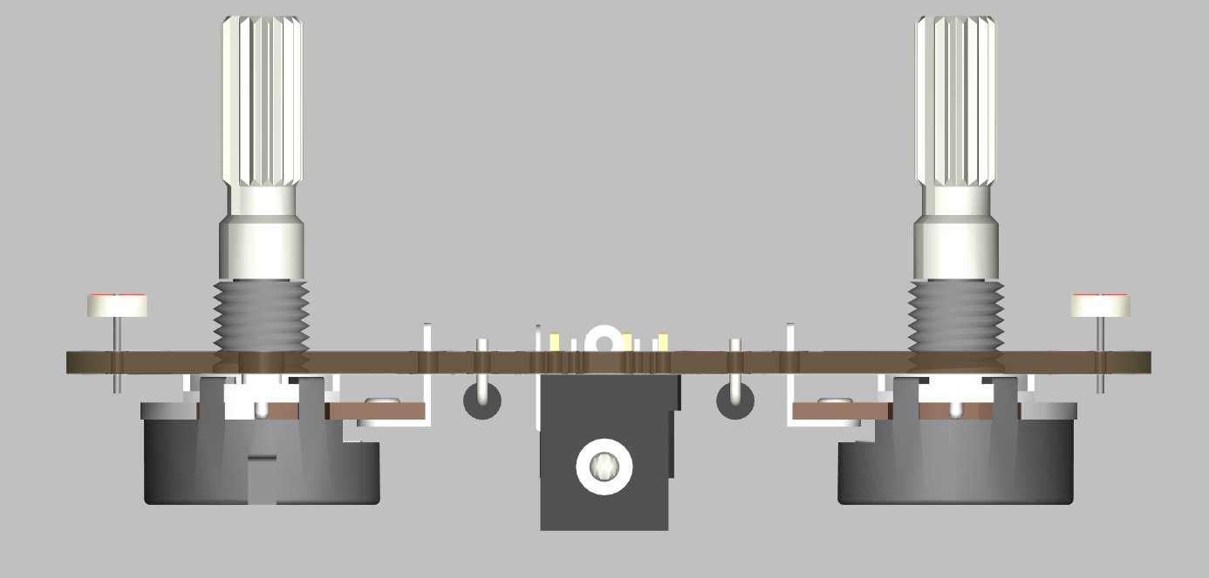
PCB Front / Back view
Socket 9V
Diode
Pot, 10k
Motor header
Mosfet
LDR

Slide 6
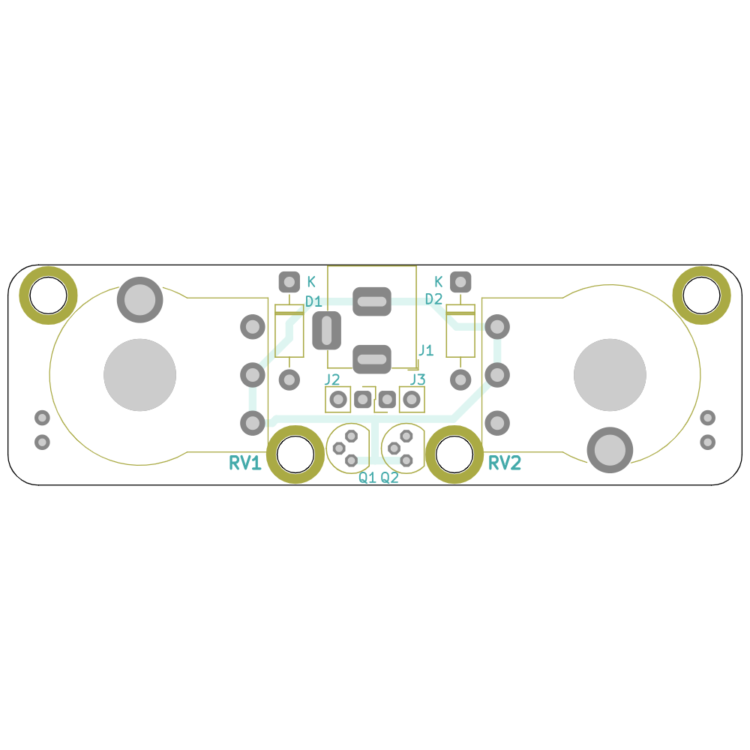
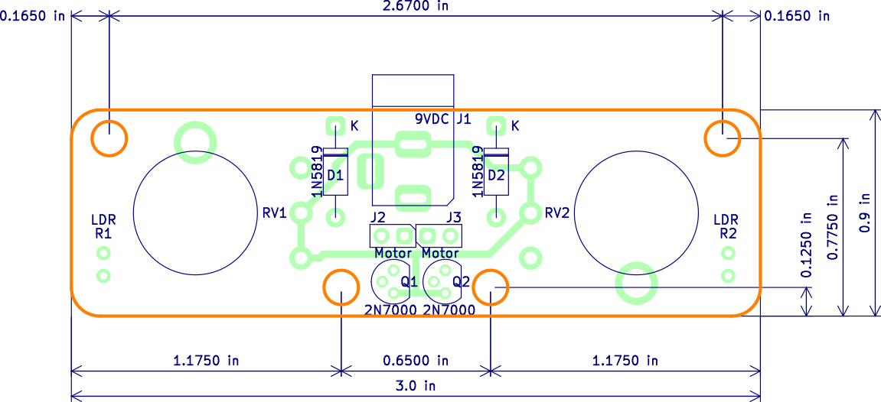
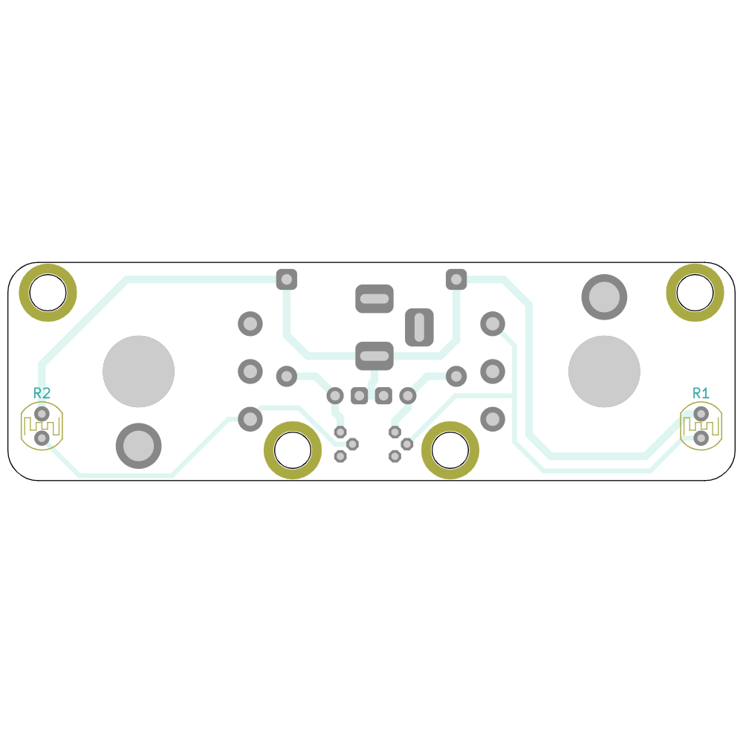
PCB dimensions
PCB =
3.0” x 0.9”
(76.2 mm x 22.9 mm)

Slide 7
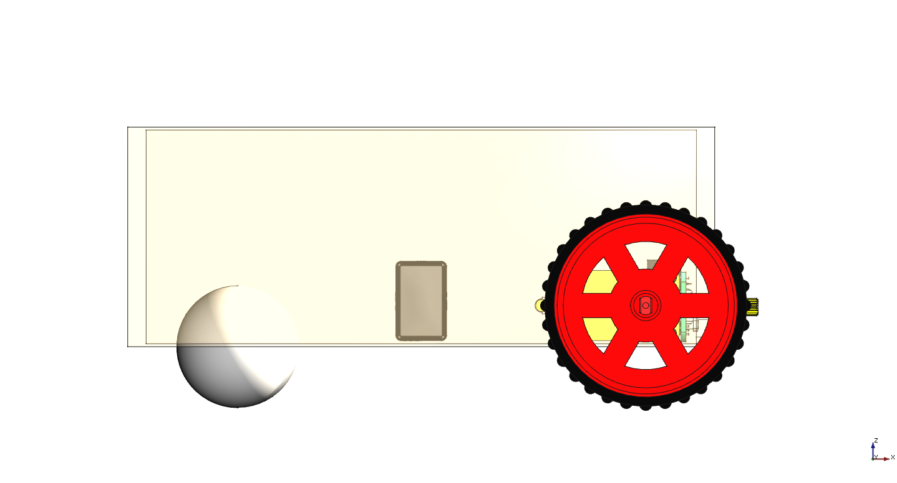
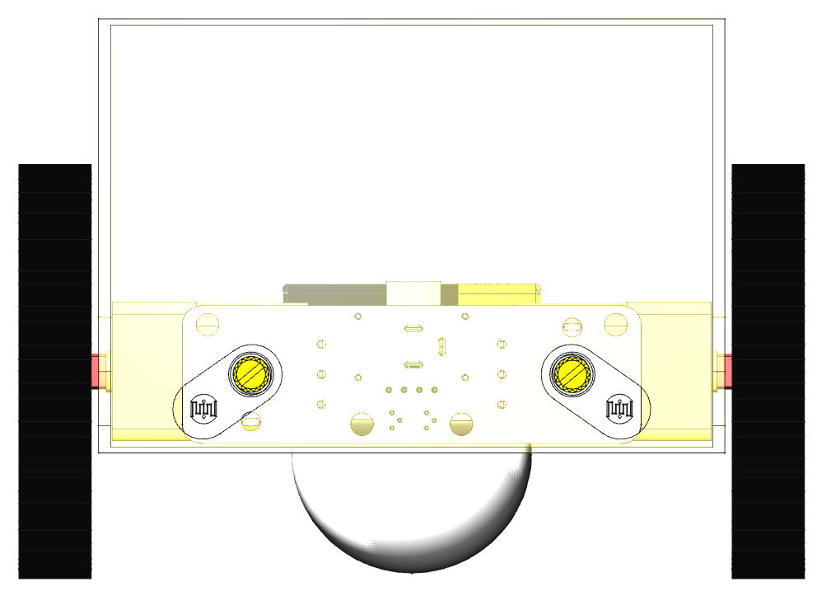
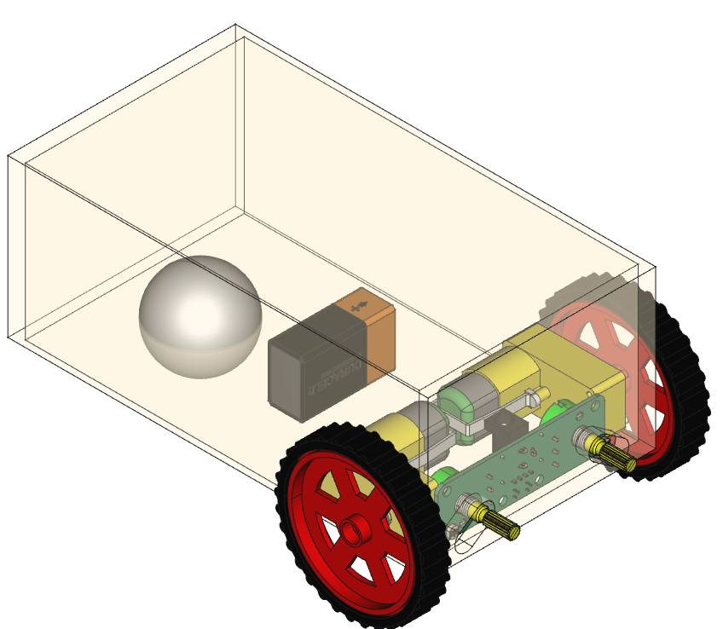
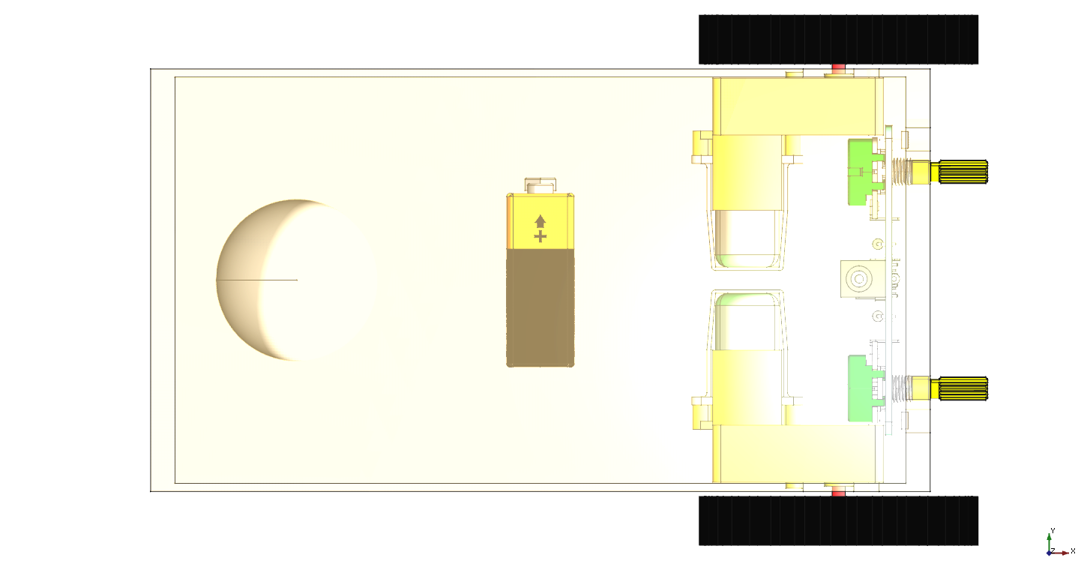
Assembly suggestion
BO Wheels
Ping Pong
9V battery
Motors
PCB
Potentiometer
LDR

Slide 8
Hacking
Reverse the logic so it runs away from light
Add Arduino and sensors
Make it a line follower instead of light follower
Add BagTag to BoxRobot
DERIVED FROM THIS INSTRUCTABLE
  https://www.instructables.com/Simple-Light-Following-Robot/

