Slide 1

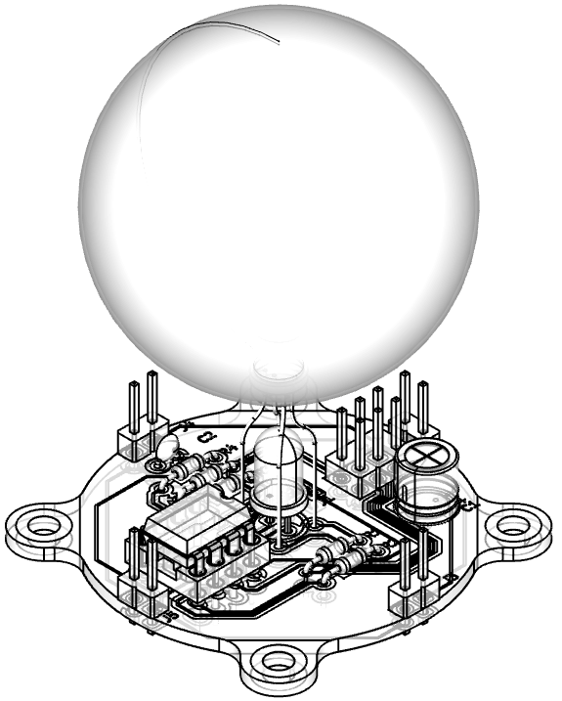
“FireFly” v1
Collaborative Art
Installation
(Proposed project for Innov School Practicum)

Slide 2

Requirements
Complexity level – between MODERATE and SIMPLE
Must include elements of
  Electronics (soldering)
  Arduino (programming)
  Rapid prototyping (3D printing / laser cutting)
  Collaboration
Powered by 5V – power bank, wall adapter, charger etc
Expandable / Hackable

Slide 3
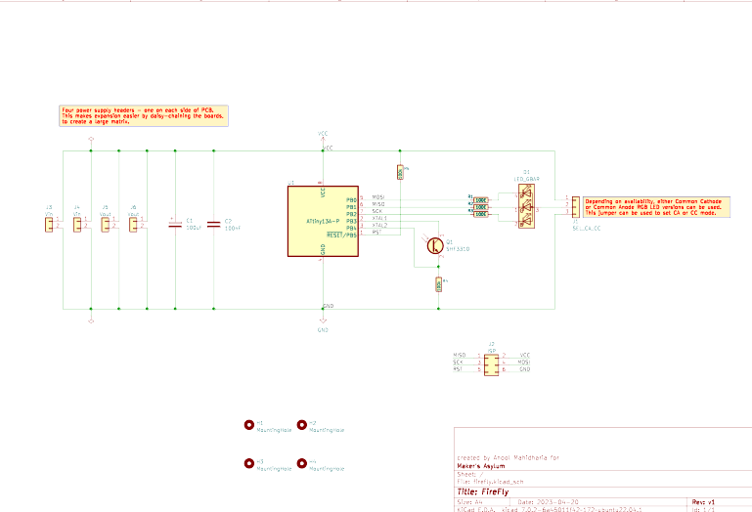
Schematic
Components:
ATtiny13
RGB LED, 5mm, CA/CC
Light Sensor
5 resistors
2 capacitors
Header pins
Header pin shorting links
PCB
Ping-Pong ball

Slide 4
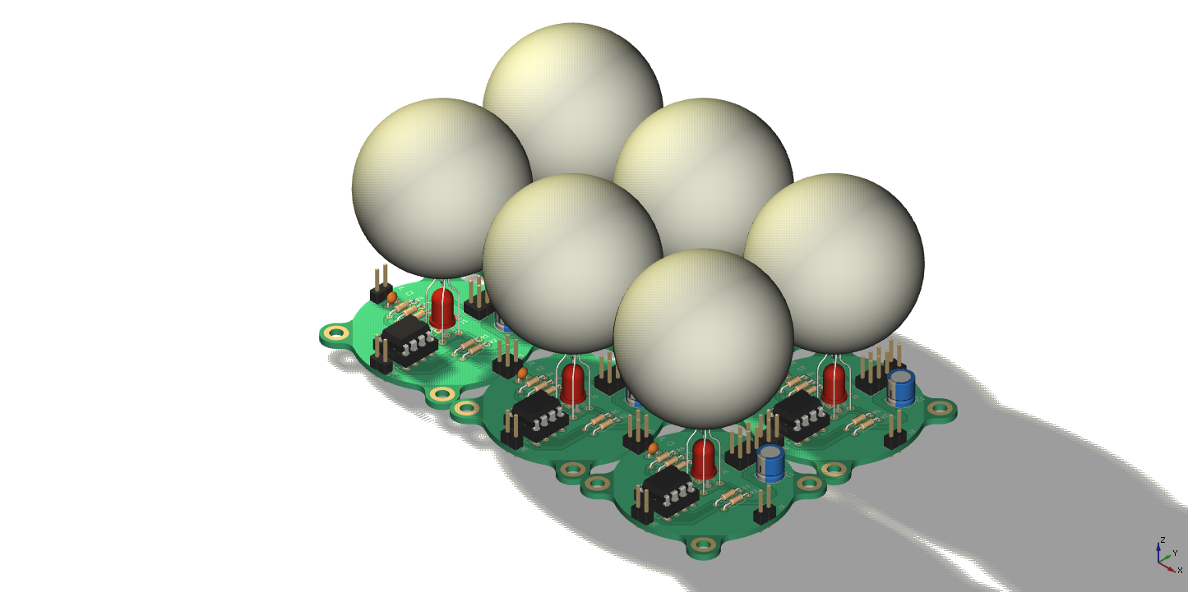
Options
Optional upgrades
(not included in kit)
The circuit is complete by itself, but this is a collaborative project.
Multiple PCB’s are daisy chained together.
Each flashes randomly, but after some time, they start synchronizing their color and flashing rate.
The whole Practicum class can mount all their FireFlies on a MDF or Acrylic board.

Slide 5
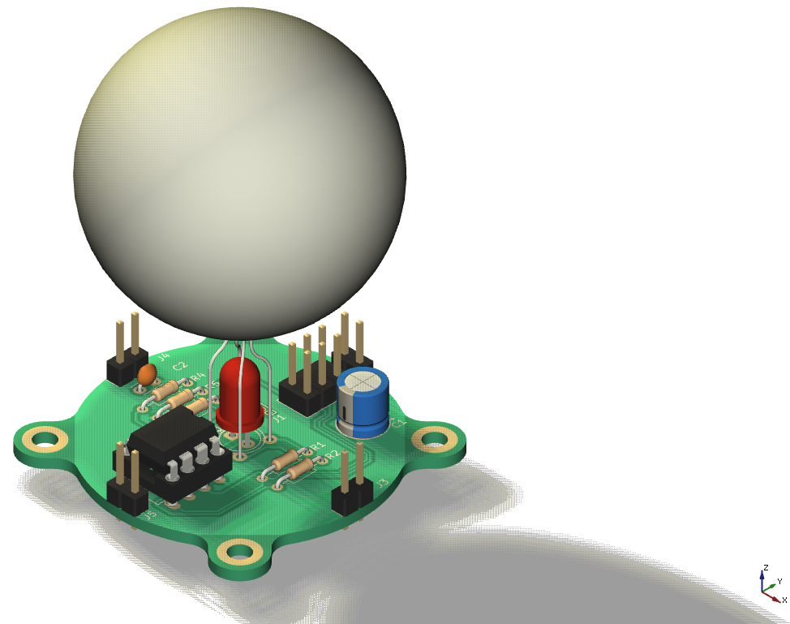
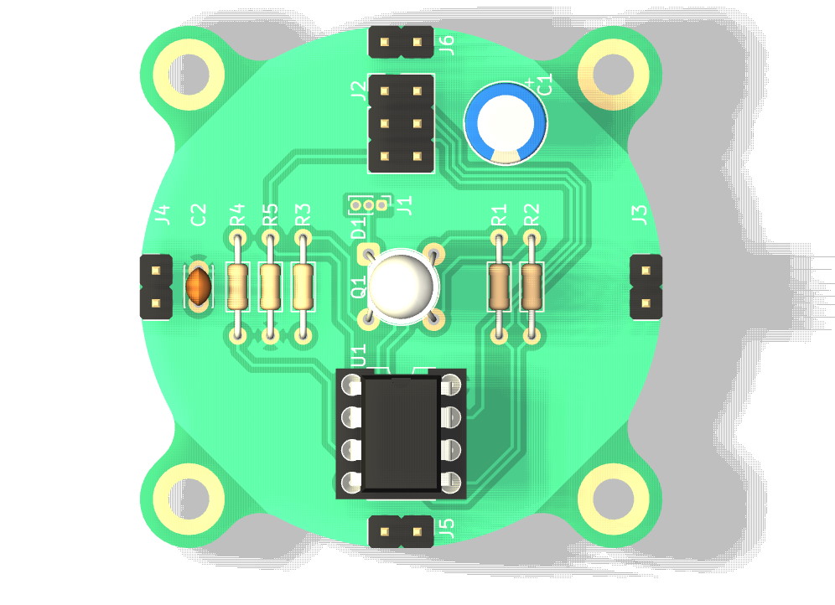
PCB Render
Power headers, x4
SPI header,
programming
RGB LED
Ping-Pong Ball
diffuser
Light Sensor under RGB LED
ATtiny13
Mount holes

Slide 6
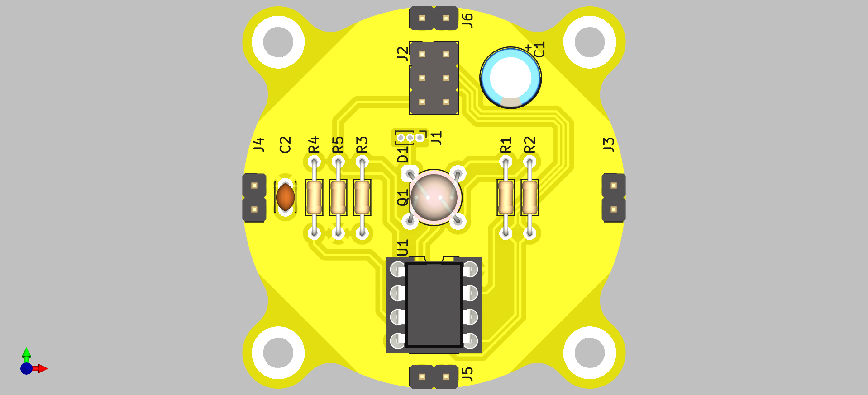
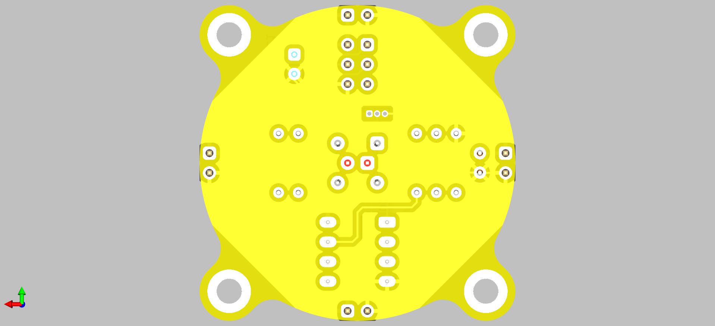
PCB Front / Bottom view
All parts are mounted on front side.
All parts are through hole so soldering is easy
Add some funky text / graphics on bottom

Slide 7
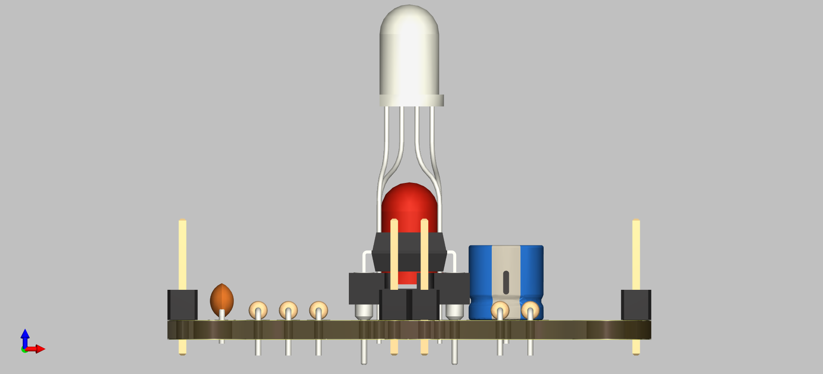
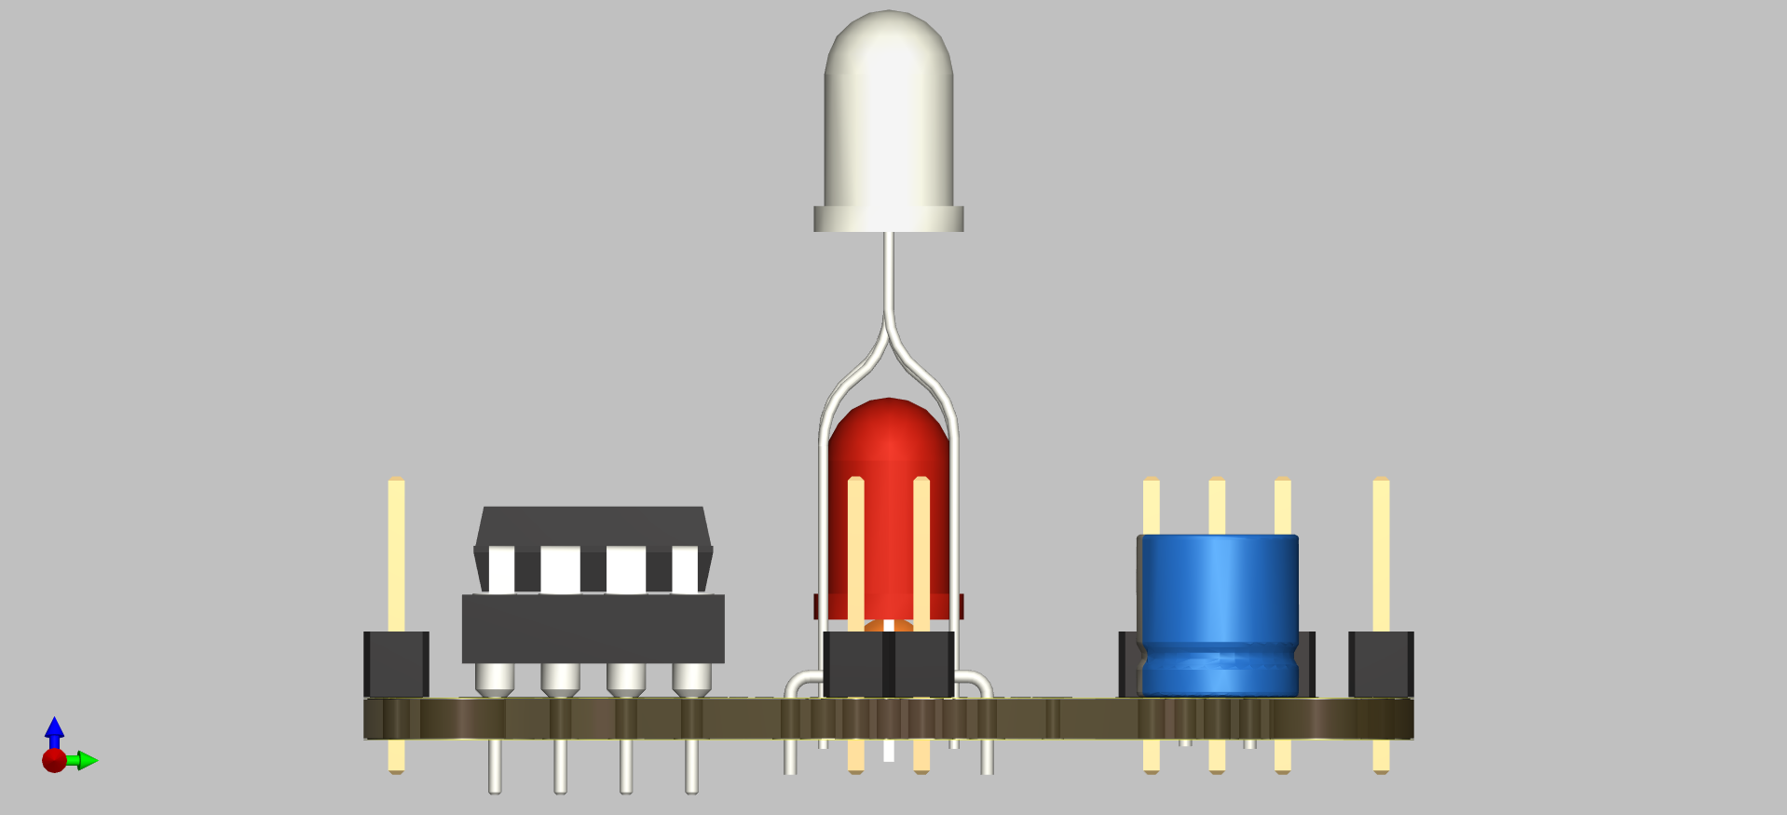
PCB Side view
Side views of the PCB.

Slide 8
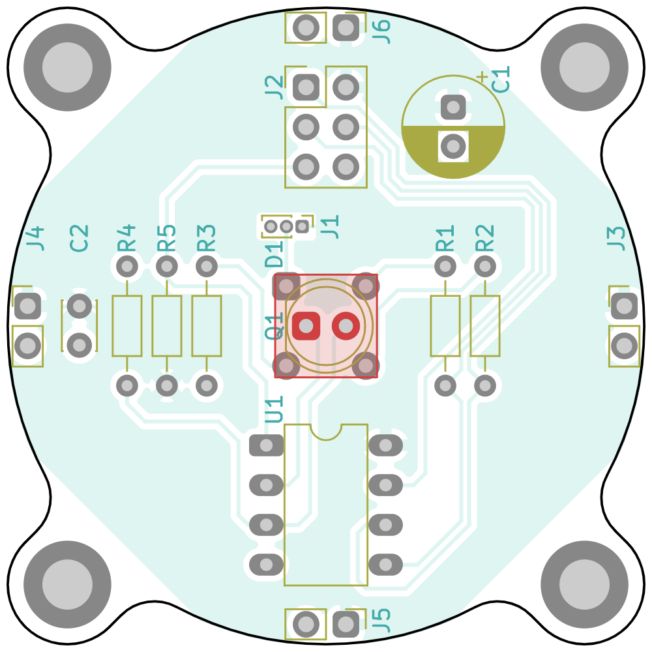
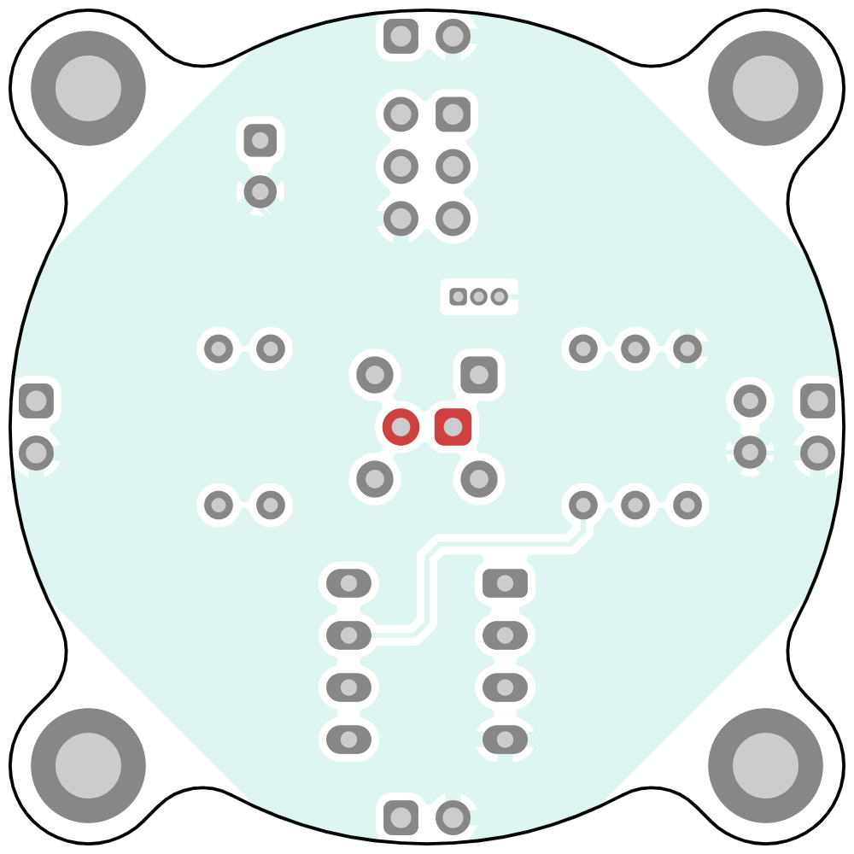
PCB dimensions
1.6 inches x 1.6 inches
(40.6 mm x 40.6 mm)

Slide 9
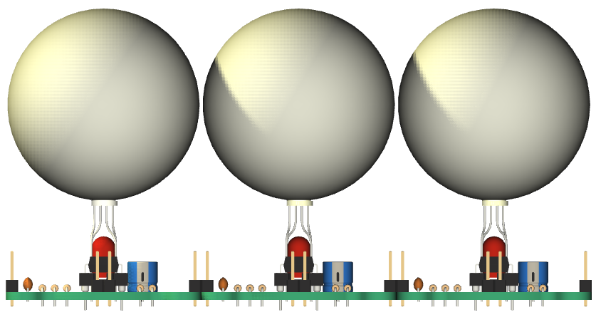
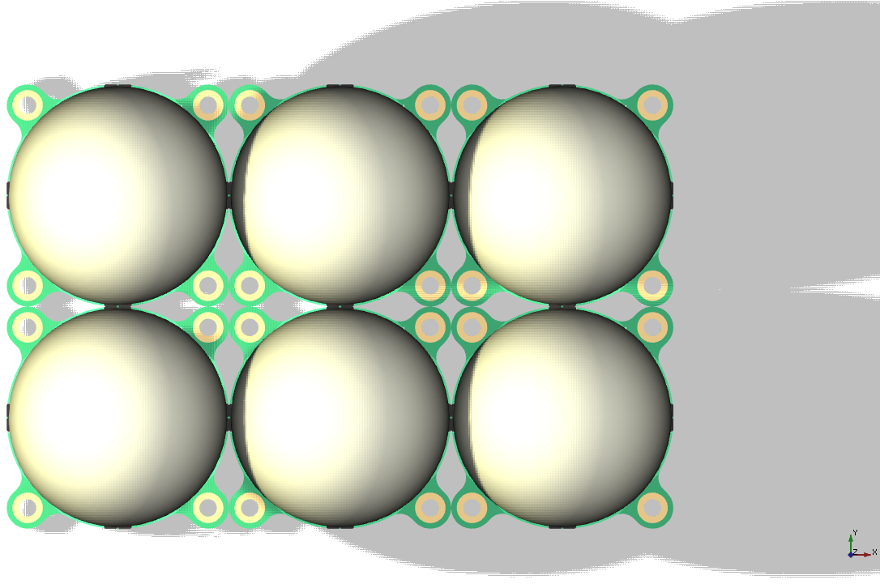
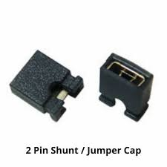
Installation
Individual PCB’s are connected to each other using header pin shorting links. Connections are just for power supply.

Slide 10
NOTES
Derived from:
  https://www.instructables.com/Synchronizing-Fireflies/
  https://tinkerlog.com/howto/synchronizing-firefly-how-to/
  https://github.com/tinkerlog/fireflies
Microcontroller is ATtiny13. Running Arduino on it will take some effort.
Original code is available as a ‘Makefile”. This will have to be reverse engineered to work as Arduino code.
More details on algorithm, code etc on the Instructables page

