Slide 1





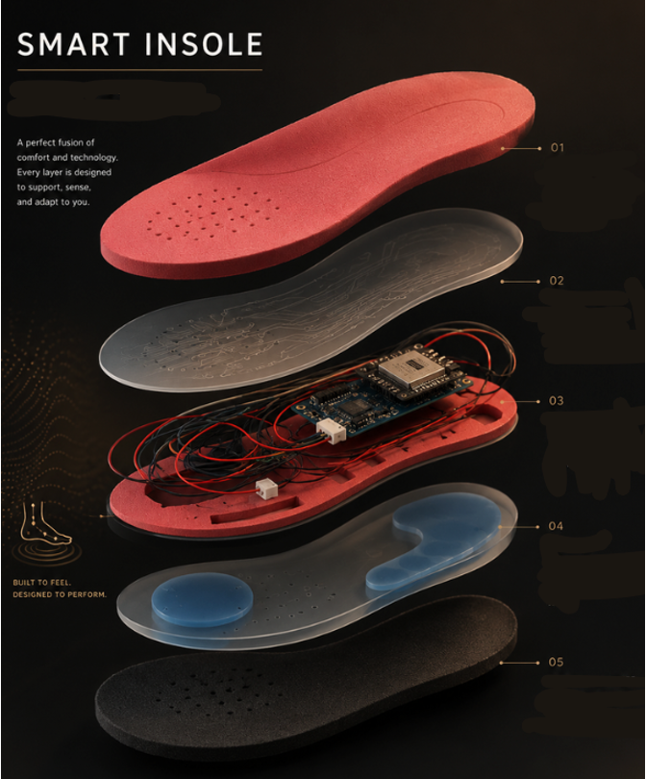
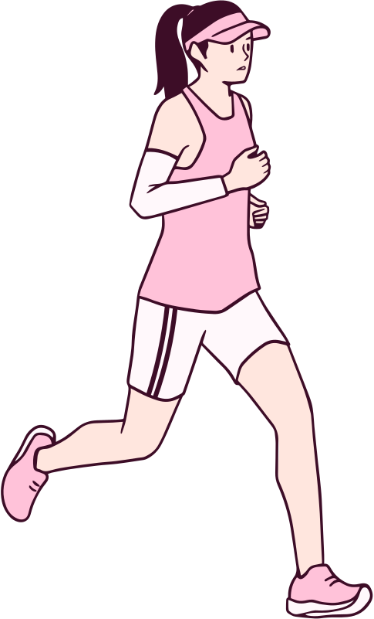
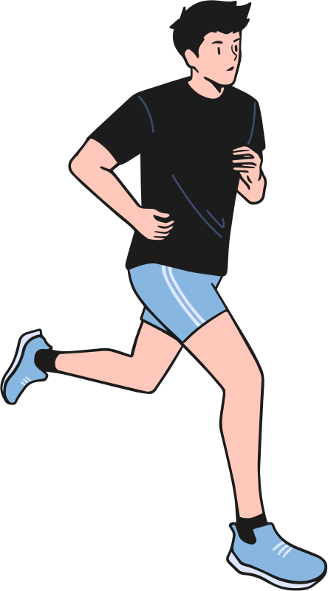

FootSense
smart insole tracker
A 10 crore rupee problem,
solved with a soldering iron
By: Arnav Gupta
Kinjal Mehta
Kiyansh Mahajan

Slide 2

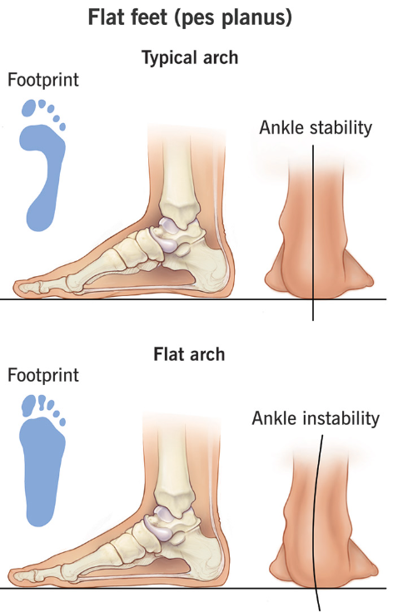



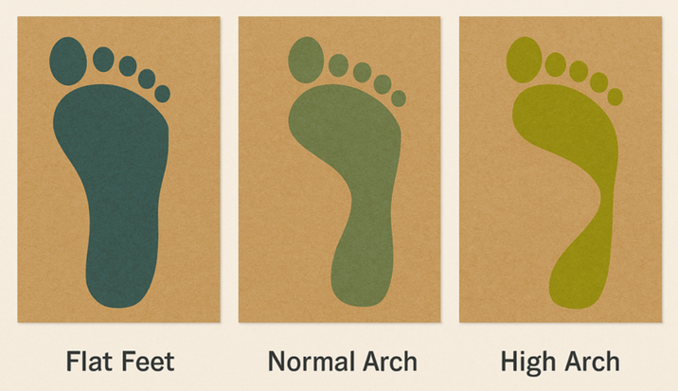
The Problem
9–18% of Indians show flat feet, depending on which clinical test you use
One study of traffic police in Gujarat found flat feet in 33–34% of officers — mostly from standing all day
24.8% prevalence found in a Delhi hospital screening study

Slide 3

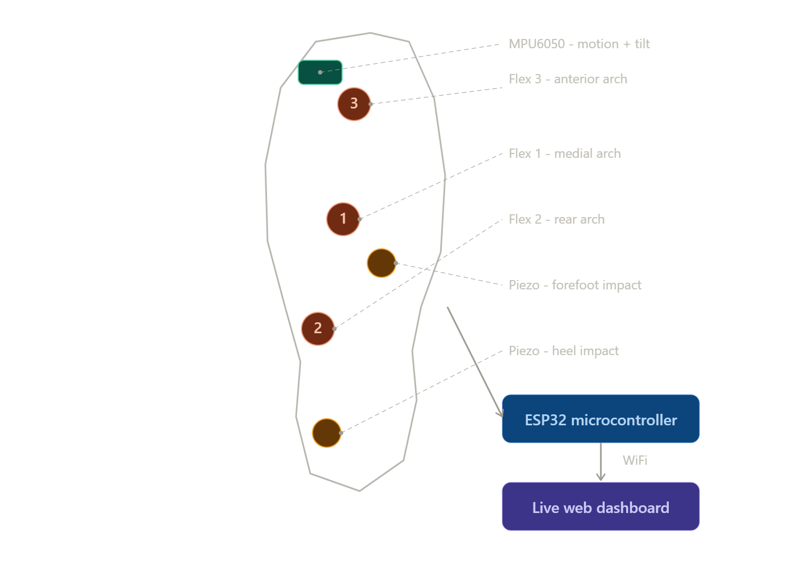

The Expensive Way
Clinical Gait Analysis System
FootSense
3D Gait Analysis System: ₹10,00,000+
FootSense: a few hundred rupees in sensors and a Sunday at Maker's Asylum

Slide 4


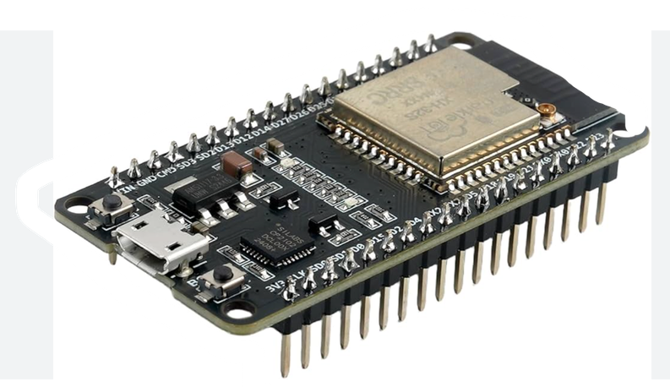

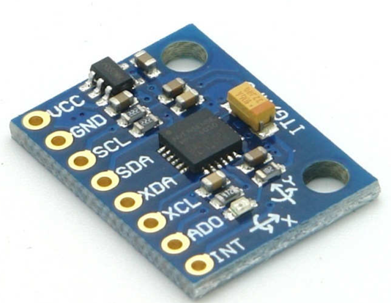
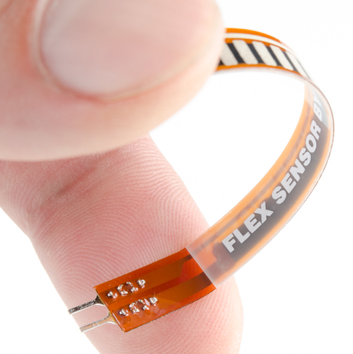
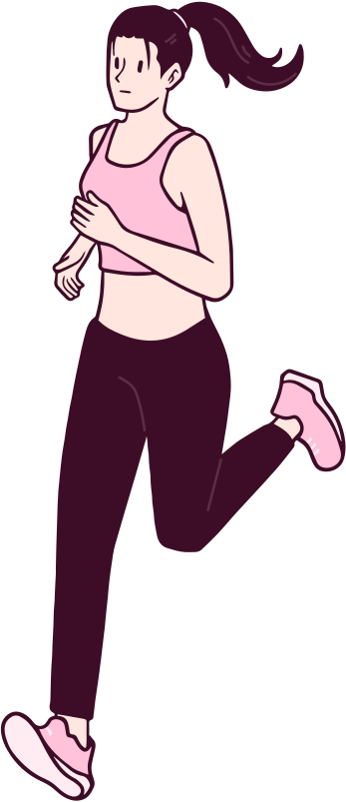
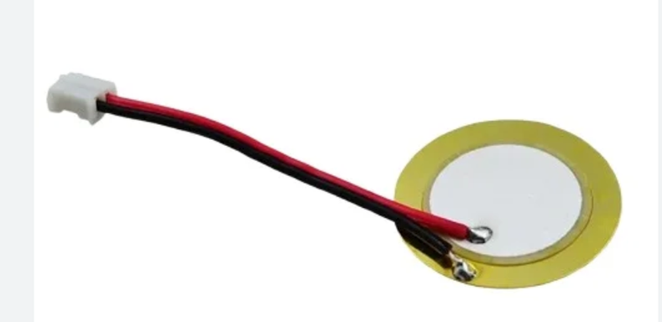
What’s Actually in the Shoe
ESP32
3 flex sensors → arch shape (flat / normal / high)
2 piezo discs → heel & forefoot impact
MPU6050 → step count & impact angle
ESP32 → WiFi → live dashboard
MPU6050
flex sensor
piezo disc

Slide 5

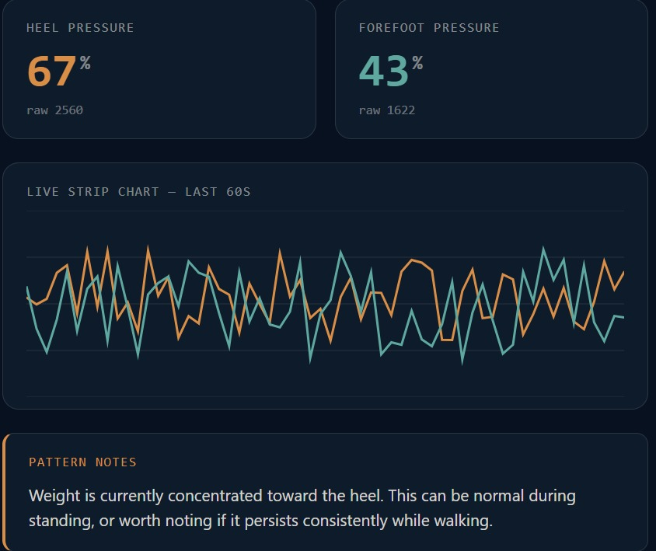

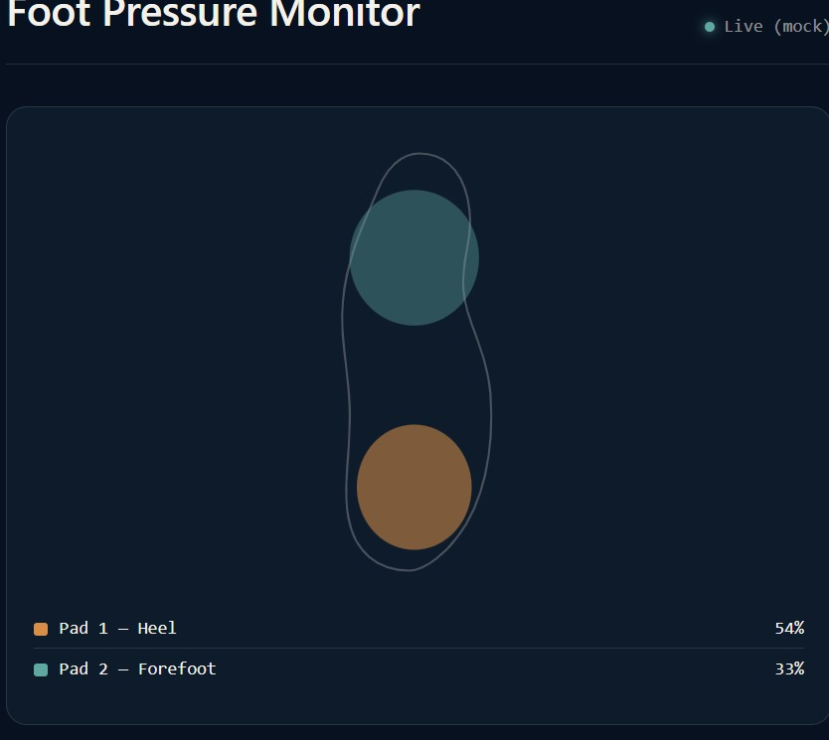
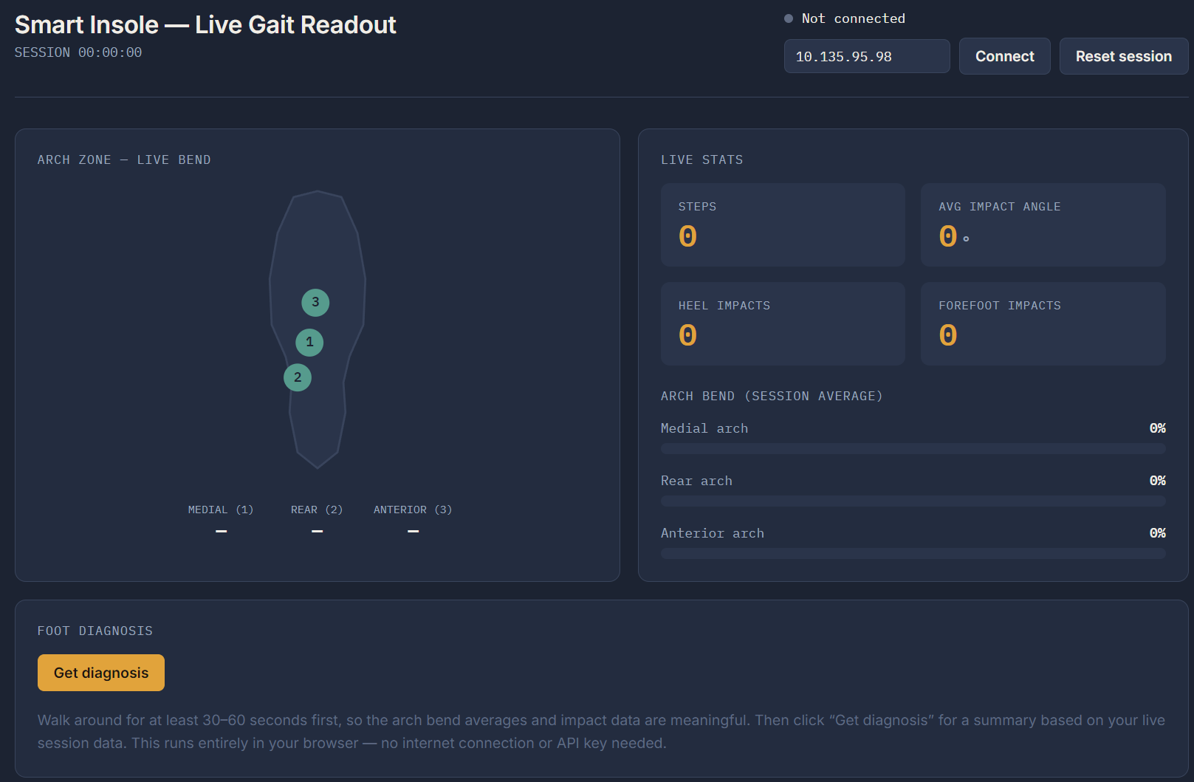
It Talks Back
Live Dashboard
Real Time Arch Bend
Foot Diagnosis
Impact Pressure (Graph and Data)
Step Count + Impact Angle

Slide 7


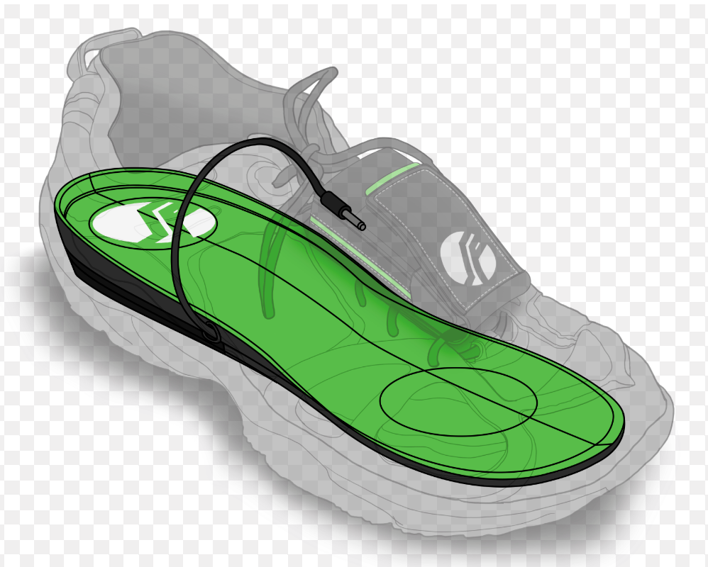
The Truth
Load cell + 4-sensor bridge: didn't work, never fully diagnosed why
Switched to flex sensors + piezo discs/velostat instead
Chased ghost GPIO pins across three different boards
Eventually got a working ESP32 + WiFi + live dashboard pipeline

Slide 8
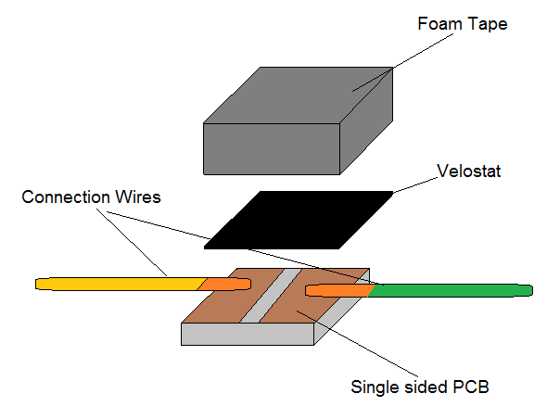
The Velostat Version
Pressure-sensitive sheet, not discrete sensors
Resistance drops the harder you press — wired as a simple voltage divider
Gives a continuous pressure map instead of fixed points
Closer to what ₹10,00,000 clinical mats actually do
Tradeoff: more finicky to calibrate consistently
Built in parallel — not a replacement, a second real path

Slide 9

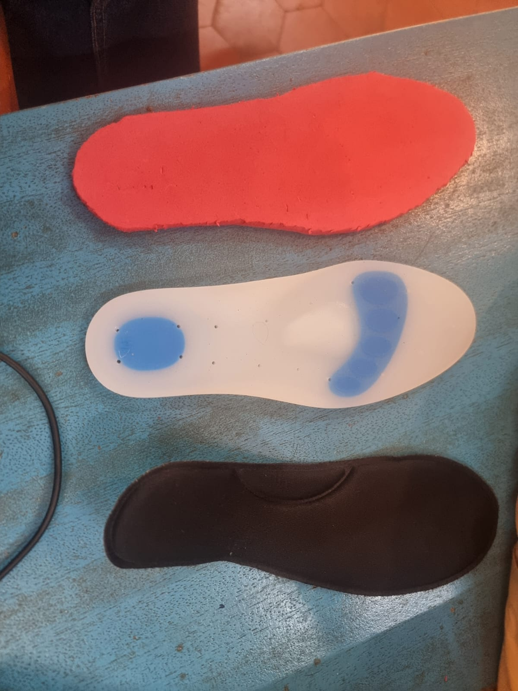
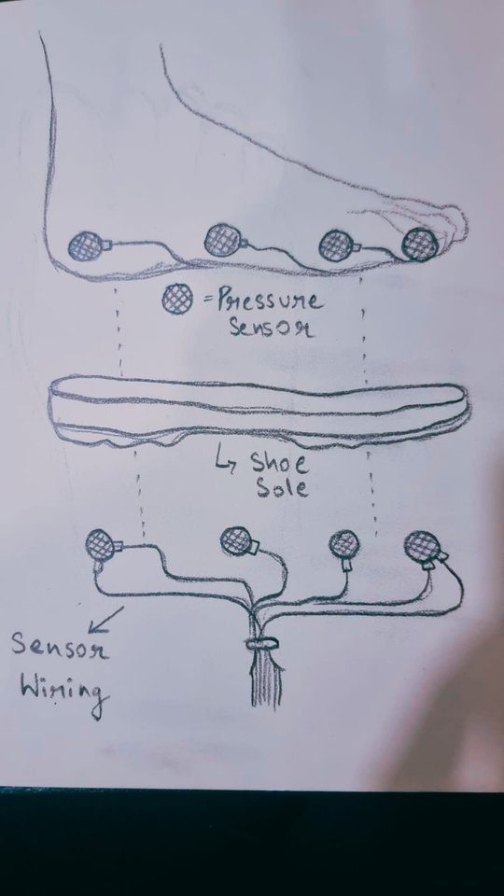
The Truth Again
Honest Limitations
This is a relative signal, not a medical diagnosis
Tested on one person, on one foot.

Slide 10

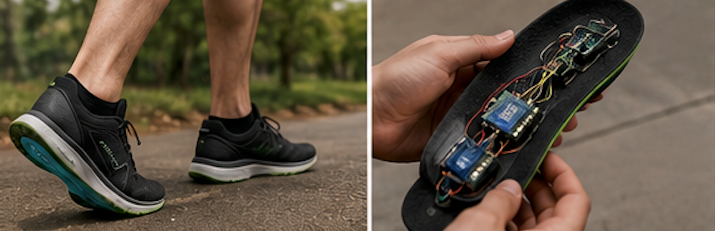
Roadmap
Q1 Development
Q2 Testing
Q3 Awareness
Finalize innovative product design and successfully complete precise sensor calibration process. Design a finalised protected prototupe and apply for a license,
Testing the product and collecting data. Doing further extensive research and training a neural network to develop an AI/ML finished software. Connect with doctors, share the data and use their feedback.
Launch the product on a small scale, connect with shoe/footwear giants and look to expand the product’s functionality and make more iterations.

Slide 11


FootSense
Lab-grade insight. Maker-grade budget. Blood. Sweat. Tears. A LOT of work. Even more help from mentors.
Questions?

Slide 12

People We Want to Thank
The amazing teammates we had here.
The ENTIRE Maker Team:
Dakshat Sir
Anool Sir
Vaibhav Sir
Miss Amber
Miss Sushmita
Sahil Sir
Miss Richa
Sankalp
Kinshuk
Sovam
Gunjan
All Our friends here, and Makers Asylum
Simran
Adishi
Shyam
Bhoomika
Arjun
Jastin / Kalki 01
Sebi
for watching and always supporting us

