Slide 1

TEAM 10
INCLUSIVITY BOT

Slide 2
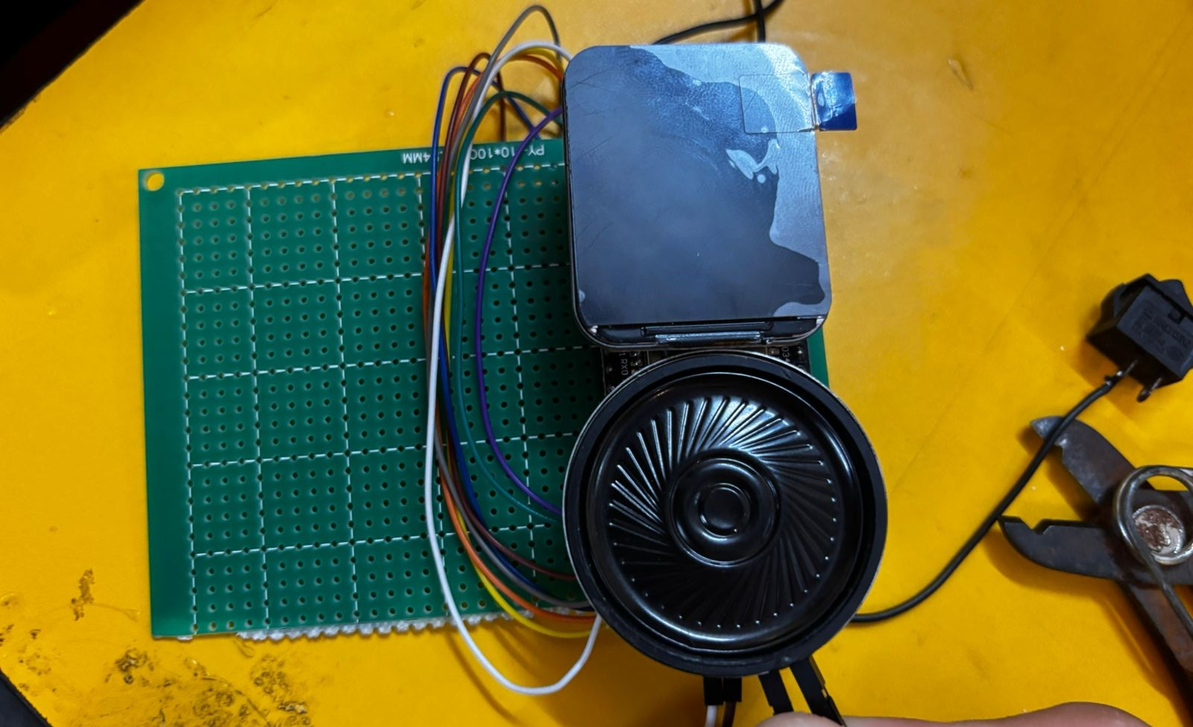
Boot: Bridging Communication Gaps Through Technology
A handheld device empowering neurodivergent individuals to navigate social interactions with confidence and dignity.

Slide 3

MEET THE TEAM “THE LIBERATORS”
Amogh Mathur
Rayana Mazumdar
Stotro Roy
Vidhita Ghadi

Slide 4

The Challenge We're Addressing
Social Communication Barriers
Many neurodivergent individuals experience profound anxiety during social interactions, making it difficult to express themselves clearly or respond to conversations in real-time.
Traditional communication methods often fail to account for the unique processing styles and needs of neurodivergent people.

Slide 5
OUR SOLUTION
Pre-Set Voice Output
Converts pre-written text into speech, ensuring consistent communication and reducing anxiety in real-time interactions.
System Architecture Overview
Input Layer
Physical buttons capture user input.
Processing Core
ESP32 processes signals & coordinates with the user’s device through bluetooth.
Output System
Text-to-speech engine & amplifier deliver voice output, while LCD delivers text output.

Slide 6
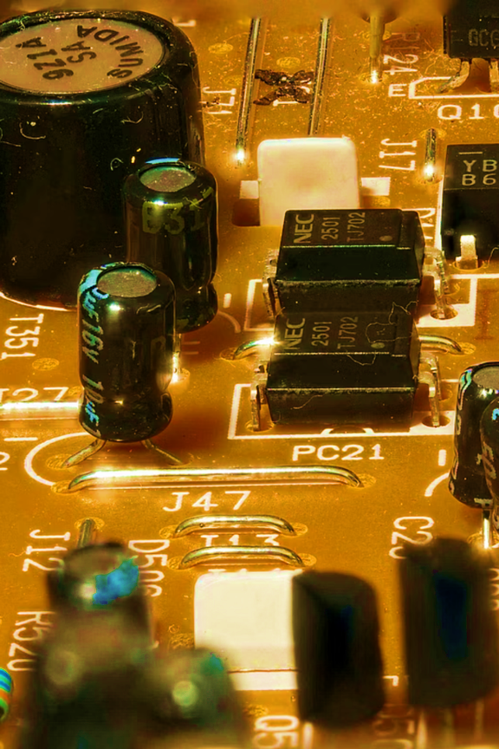
Output System: Clear Communication
Dual Output Capabilities
Boot delivers information through carefully designed output systems that prioritise clarity and user control.
Voice Output: High-quality text-to-speech conversion ensures messages are delivered with natural intonation and appropriate pacing.
Visual Display: Small LCD screen shows current response selection and system status, providing silent confirmation of device state.
Design Priority: All outputs designed for discretion and dignity, ensuring users feel empowered rather than exposed during use.

Slide 7

IMPACT ON SOCIETY
Open-Source Vision
Social Integration
Reduces anxiety and enables fuller participation in social settings, helping neurodivergent individuals build confidence and connections.
Plans to release schematics, code, and 3D-printable enclosures to enable community adaptation and improvement.

Slide 8
THANK YOU!

