Slide 1
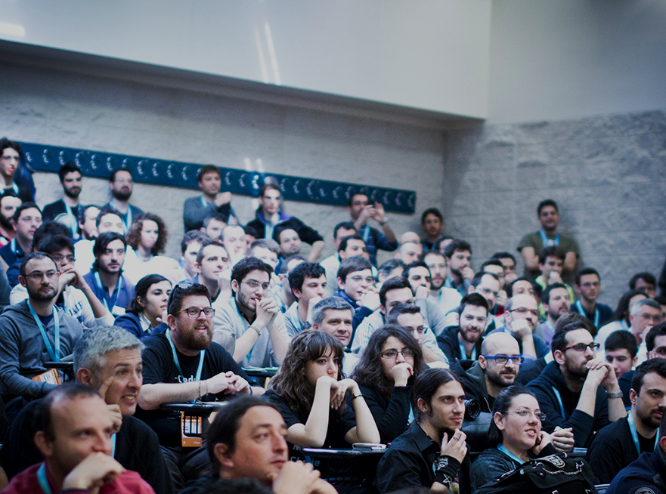



Stop Using Bootstrap PLZ!
MILAN 25-26 NOVEMBER 2016
Davide Di Pumpo

