Slide 1


Slide 2


E-retail factors for customer activation and retention: An empirical study from Indian e-commerce customers :
Customer satisfaction has emerged as one of the most important factors that guarantee the success of online store; it has been posited as a key stimulant of purchase, repurchase intentions and customer loyalty.
Studies show, It is important to Retain customers, since attracting new customers
Is more expensive.
Websites should understand their customers and improve their
Services as per the existing customers feedback in order to retain them
And get new customers through them.

Slide 3
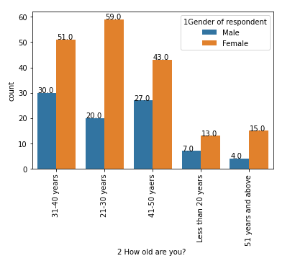
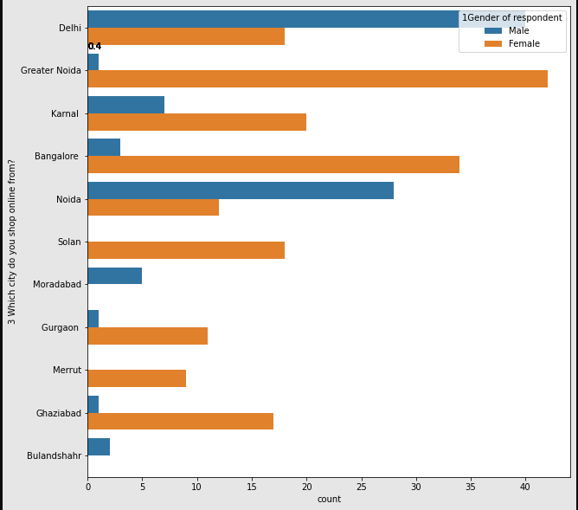
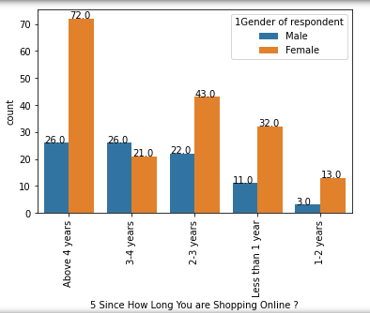
Trends of Users :
Majority of users responded are: Female
Online shopping is preferred by users from cities: Delhi, Noida, Bangalore.
In Delhi major users are male.
We can see the number of users opting online shopping is increasing comparatively.

Slide 4
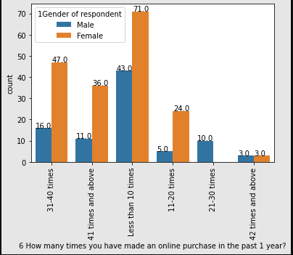
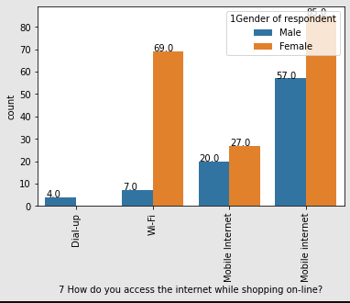
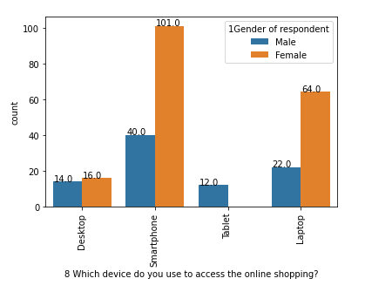
Trends of Users :
58% users are buying more than 10 times a year.
55.8% users using Smart Phones & 32% users using Laptop.
70.6% users accessing website through mobile network.

Slide 5
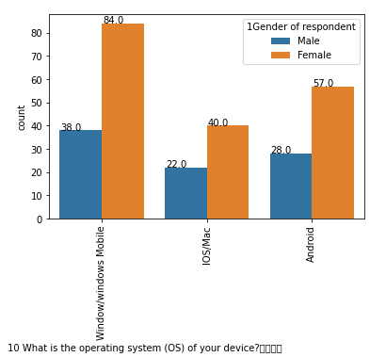
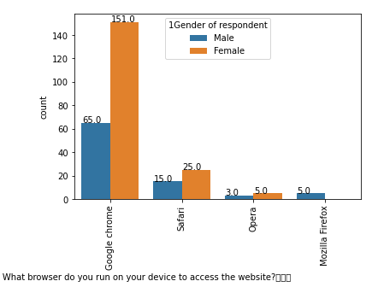
Trends of Users :
OS type : 45% users – Windows & 32% Android
Browser: 80% users are using Chrome.

Slide 6

Key points to Retention of Customers :
Easy and Simple UI of website.
Should offer variety of payment methods.
Provide complete details of product along with seller information.
Display wide range of products in selected category along with relevant products to compare.
Quick delivery & good customer support will make more impact in retention of customer.
Implement different loyalty schemes, provide monetary or other benefits to users.
Maintaining website to respond and load quickly.

Slide 7

Based on Observed Trends:
RANKINGS OF INDIAN WEBSITES:
AMAZON
FLIPKART
MYNTRA
PAYTM
SNAP DEAL

