Slide 1

Financial World Quest
SA Intervarsity Hackathon 2025
Makhavhu MJ, Nemandava Akonaho, Sasebols TB, Musehane R
Your University
September 14, 2025
ls
Financial World Quest

Slide 2
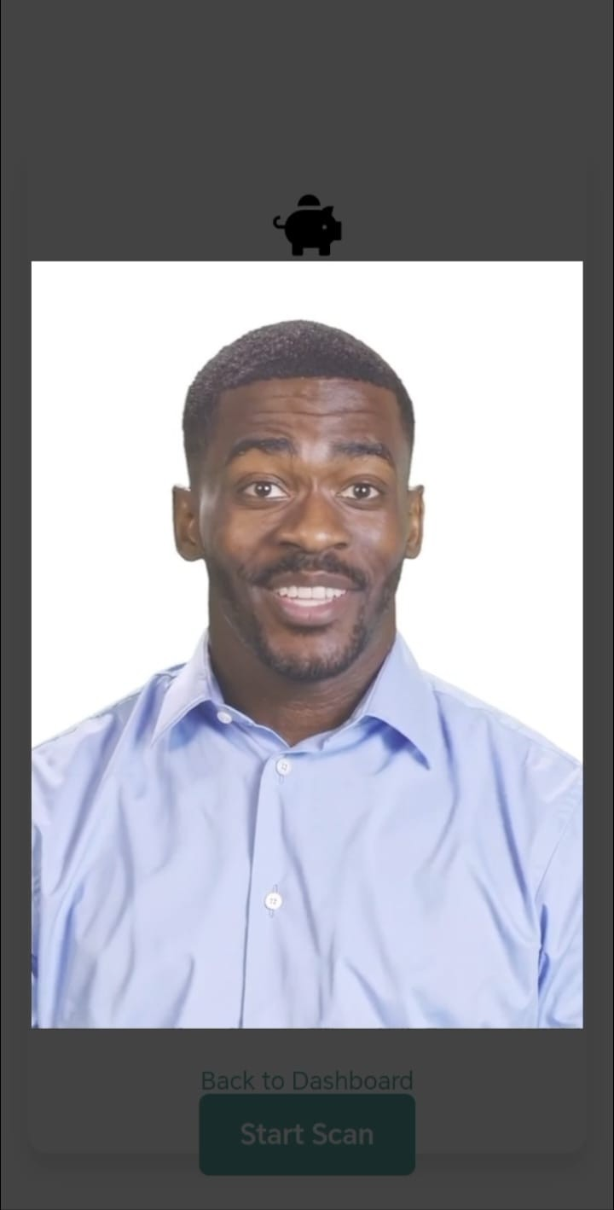
Introducing Financial World Quest, a gamified web app revolutionizing financial literacy in South Africa through Augmented Reality (AR) engagement.
Powered by a machine learning financial advisor, it offers interactive quizzes, personalized budgeting, and SA-specific advice like stokvels.
Join us to explore how AR-driven quests empower users to master their finances!
ls
Financial World Quest

Slide 3
The Challenge
Low Financial Literacy: Many South African youth lack essential financial skills, leading to poor money management.
Engagement Gap: Traditional education methods fail to captivate young learners.
SA Context: Need for culturally relevant solutions like stokvels and SARS tax-free accounts.
ls
Financial World Quest

Slide 4
Our Solution: Financial World Quest
Gamified Web App: Engages users with Augmented Reality (AR)
and interactive challenges.
ML Financial Advisor: Provides personalized, SA-specific advice using a trained logistic regression model.
Accessible: Runs on low-resource devices (e.g., Honor 90) via Docker, or GPU On Runpod.
ls
Financial World Quest

Slide 5
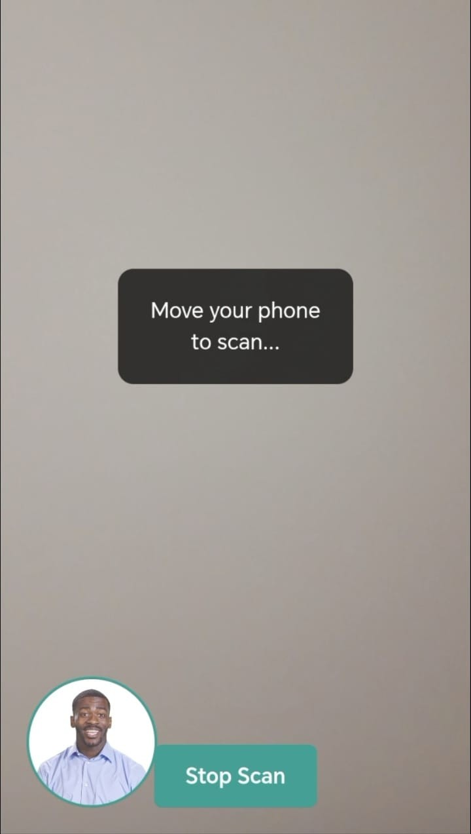
Key Feature: Augmented Reality (AR) Scan
Immersive Start: Users scan their environment with AR to begin financial quests.
Engagement: Visualizes financial goals (e.g., budgeting, savings) in real-world contexts.
Accessible: Works on any modern smartphone (tested on Honor 90).
figureAR Scan in
Action
ls
Financial World Quest

Slide 6
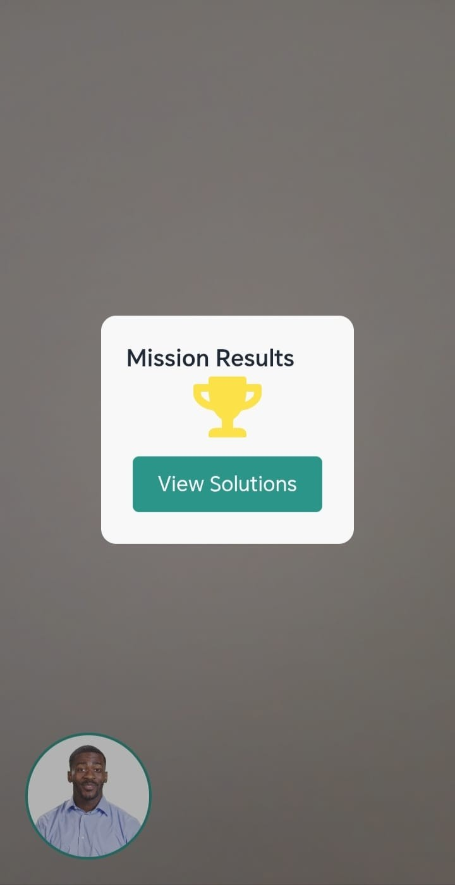
Key Feature: Financial Literacy Quiz
30 Questions: Tests knowledge on budgeting, debt, and investments.
Gamified: Displays score with animated trophy for motivation.
Feedback: Immediate insights to improve financial understanding.
figureQuiz Score
with Trophy
ls
Financial World Quest

Slide 7
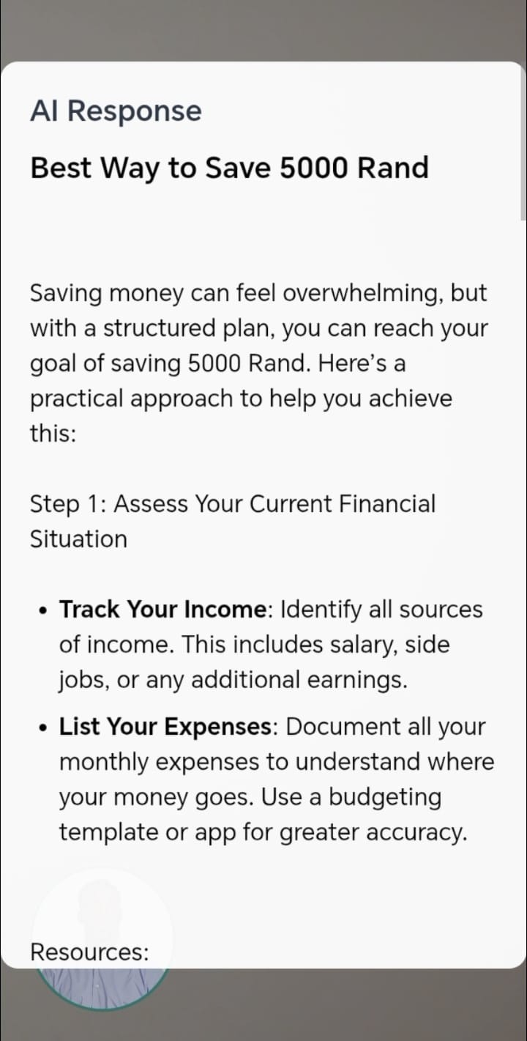
Key Feature: ML Financial Advisor
Logistic Regression: Trained on SA-specific queries.
Personalized Advice: Contextual responses for budgeting, debt, stokvels, etc.
AR Integration: Advice includes tips to visualize goals via AR scan.
Example: Query "budget R5000" yields 50/30/20 plan (R2500 needs, R1500 wants, R1000 savings).
figureResponse to
"budget R5000"
ls
Financial World Quest
7 / 13

Slide 8
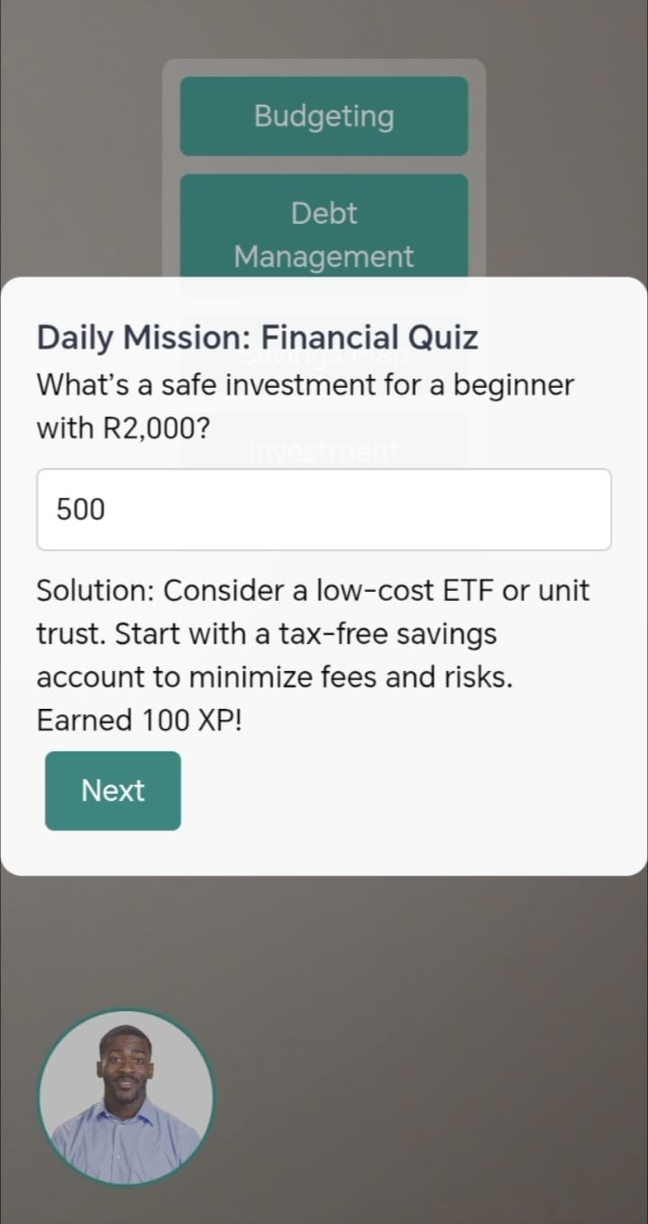
Key Feature: Budget Optimizer
Input: Users enter income/expenses (e.g., R5000/R4000).
Analysis: Provides actionable insights and savings goals.
Gamification: Earns XP and badges for financial milestones.
PDF Export: Downloadable reports for tracking.
figureBudget Analysis (R5000/R4000)
ls
Financial World Quest

Slide 9
Technical Stack
Frontend: HTML, JavaScript, Tailwind CSS, Firebase (Firestore for interactions).
Backend: FastAPI, scikit-learn (logistic regression), Uvicorn.
Deployment: Docker for lightweight, portable execution.
External: jsPDF (PDF export), Font Awesome (icons), Unsplash (background).
ls
Financial World Quest

Slide 10
Website Flow Diagram
Landing Page: Users land on the homepage with a space-themed video intro and a "Start Quest" button.
AR Scan Activation: Clicking "Start Quest" activates the camera; a successful scan triggers a digital human avatar welcome.
Financial Literacy Quiz: A 5-question quiz appears, showing a score and trophy, with immediate feedback.
ML Financial Advisor Interaction: Users input a query (e.g., "budget R5000") for personalized advice with SA-specific tips.
Budget Optimizer Tool: Users enter income/expenses, get analysis, earn XP/badges, and download a PDF report.
Demo and Exploration: A video summarizes the flow, with the digital human offering a recap and future teasers.
ls
Financial World Quest

Slide 11
Demo
Video: Google Drive Demo Folder Click Here
Flow:
1
AR scan to start quest (move phone, visualize environment). Quiz (5/30 questions, score 23/30, trophy).
Custom Challenge ("budget R5000", ML advice, PDF).
Budget Challenge
(R5000/R4000, analysis). Digital human video (toggle full-screen, audio).
2
3
4
5
ls
Financial World Quest

Slide 12
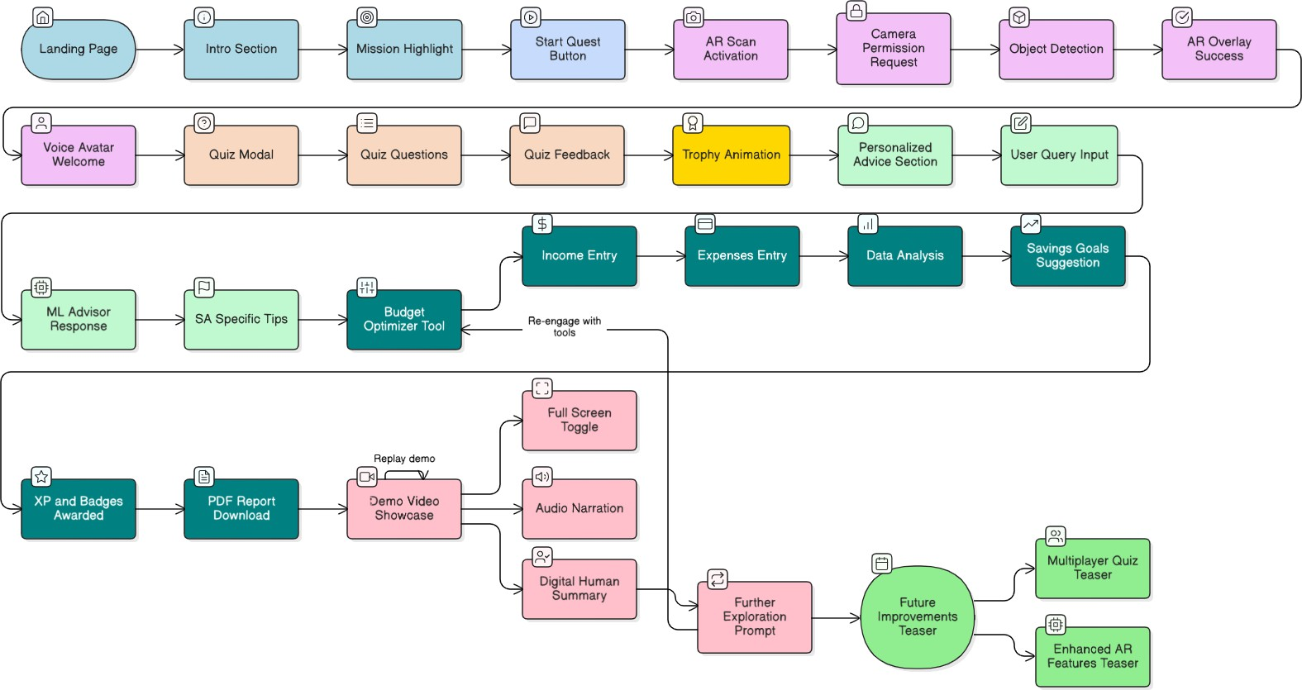
figureDemo Flow Snapshot
ls
Financial World Quest
12 / 13

Slide 13
Future Improvements
Enhanced AR: Add 3D visualizations for financial goals (e.g., savings charts in AR).
Advanced ML: Fine-tune larger LLM on GPU (e.g., via RunPod).
Multiplayer: Enable competitive financial quizzes. PWA: Develop a Progressive Web App for mobile access. Stokvel API: Integrate real-time stokvel management.
ls
Financial World Quest
12 / 13

Slide 14
Team and Thank You
Team Name: Top Dogs
Members: Makhavhu MJ (Lead Developer), Team Member (MUSEHANE R, SASEBOLA TB, NEMANDAVA A)
Institution: University Of Jahannesburg
Contact: GitHub Repo
Thank You! Questions?
Explore Financial World Quest at: https://github.com/Makhavhu7/FINA AI
ls
Financial World Quest
13 / 13

