Slide 1
















FromBlindtoVisionary
Azure-Powered Car Sales Analytics
Transforming raw car sales data into actionable business insights with Azure
Mahdi Makhloufi

Slide 2


























The Challenge:Driving Blind
Driving with a Useless Dashboard
The Data Reality
Making decisions without clear metrics is like driving with a dashboard that has no speedometer.
The data exists, but it'srawandunstructured
Information isscatteredacross multiple systems
Withoutsmart analysis, extracting insights is impossible
dealership managers are left making decisions in the dark
Sales
Inventory
Customers
Vehicles

Slide 3












The Hero Arrives:Azure Pipeline
An end-to-end solution that transforms raw data into strategic business decisions
Blob Storage
Data Factory
Databricks
SQL Database
Power BI
Raw data ingestion
Data orchestration
Advanced processing
Structured storage
Interactive dashboards
The Transformation Process
Raw Data
Processing
Insights
Fromdata filestostrategic decisionsin seconds

Slide 4



















Meet the Customers:Real People, Real Choices
John(35, SUV lover)
Emily(28, premium buyer)
Mike(42, pragmatic)
"I want a strong, safe vehicle for my family, not too expensive."
"I'd rather pay more for a stylish, modern car."
"I just need something simple, reliable, and affordable."
Family-oriented buyer
Young, fashion-conscious buyer
Cost-conscious buyer
Prioritizes safety and reliability
Values style and modern features
Prefers manual transmission
Buys high-volume, mid-priced models
Pays premium prices for desired models
Focuses on entry-level cars
Diamante
Silhouette
Prizm
These aren't just numbers. They're lives, choices, motivations. Our data tells their story.

Slide 5






















The Market Reality:Three Kings Rule
The Big Three Models
The Premium Paradox
Premium Models
Regular Models
Priced above $40,000
Priced below $40,000
Diamante
Silhouette
Prizm
Lower sales volume
Higher sales volume
Top-selling SUV
Popular Hatchback
Best-selling Sedan
Sales Distribution
Key Insight
Despite selling fewer units, premium models generate significantly higher revenue per unit, indicating an opportunity for targeted marketing to premium segments.
Strategic Focus:
Balance inventory between high-volume models and high-margin premium options

Slide 6






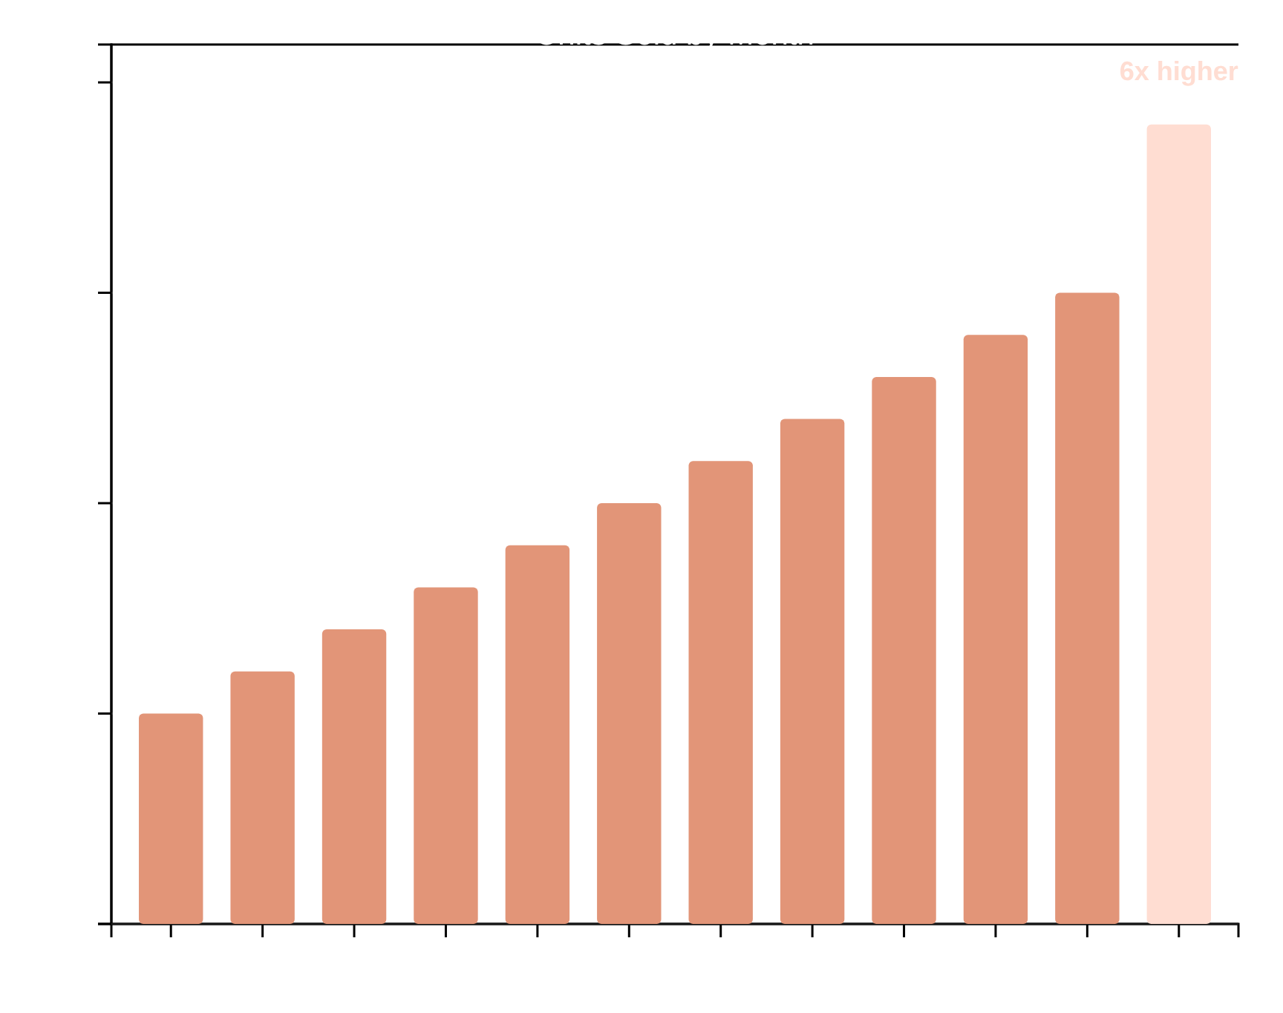








The Twist:December's Sales Explosion
Sales Growth Throughout 2022
The Seasonal Opportunity
Everything changes inNovember— sales begin to skyrocket
Decemberis the dealerships' high season, with sales reaching19,000 units
What if we prepared better for these months?
The Opportunity
Targeted holiday campaigns
Optimized inventory for December
December sales are6x higher
Captureadditional sales
than January 2022

Slide 7
















The Dealers' Race:David vs. Goliath
Goliath: Austin Dealerships
David: Premium Dealers
Austin dominates with41,000sales, yet margins tell a different story.
Small premium dealers generate comparable revenue to giants selling in bulk.
Progressive Shippers Coop
Premium Dealer
13,180 units
VS
Fewer units, higher margin
Rabun Used Car
Regional Specialty
13,130 units
Niche market, high value
Large volume, but at what margin?
Strategic focus on premium segments
Key Insight:In the car market,strategic positioningandtargeted segmentationcan yield significant financial success, even with lower unit sales.

Slide 8
















Insights asSuperpowers: See the Future
With the right data insights, dealerships gain strategic advantages that act as "superpowers" in the competitive automotive market.
Know Which Models to Stock
When to Launch a Promotion
Target the Right Customer
Identify top-selling models: Diamante, Silhouette, and Prizm
Recognize seasonal peaks in November-December
Male buyers (79%) prefer mid-priced models
These three models account for80%of total sales
December sales are6x higherthan January
Female buyers opt for premium, higher-priced vehicles
Optimize inventory allocation for maximum impact
Target marketing during peak buying periods
Leverage personalized marketing strategies
+20% potential revenue
+5,000 additional units sold
Increase average transaction price
Raw Data
Analysis
Actionable Insights

Slide 9






















The Dashboard:Your Decision Cockpit
Car Sales Analytics
Live
Updated:实时
Key Performance Indicators
Top Selling Models
Regional Performance
Total Sales
41,000 Units
Austin: 41,000
Northeast
Southeast
West
Average Price
$28,039
Revenue
$1,149,700
Diamante, Silhouette, and Prizm account for 80% of sales
Filter by:
Model
Region
Dealer
Alerts
Which model works?
Which region booms?
Which promotion to launch?

Slide 10














Business Impact:Real Results, Real Revenue
Focus on Top Models
Prepare for High Season
Target Premium Buyers
Business Transformation
These aren't just numbers. They're real results that transform entire dealerships.

Slide 11







Future Roadmap:The Journey Continues
"And this is just the beginning. Our pipeline isn't an end—it's the start of a continuous journey toward more intelligent, responsive, and profitable car sales operations."
Real-time Predictions
Personalized Recommendations
AI-powered Analytics
Implementing streaming data analytics to provide immediate insights into sales trends and inventory needs, enabling agile adjustments.
Utilizing advanced AI to offer highly tailored vehicle recommendations to individual customers based on their profiles and market trends.
Integrating sophisticated artificial intelligence models for deeper pattern recognition, anomaly detection, and strategic forecasting.
"Our pipeline isn't an end. It's the start of a continuous journey toward more intelligent, responsive, and profitable car sales operations."

Slide 12







Conclusion: FromBlindtoVisionary
Our Transformation Journey
We started with scattered raw data, much like driving with a dashboard that has no speedometer
We told the story of customers, revealing distinct personas and preferences
We revealed the winning models: Diamante, Silhouette, and Prizm collectively account for 80% of sales
We uncovered seasonal peaks: December sales are 6 times higher than at the year's start
Dealerships no longer drive blind. They have a clear dashboard guiding them toward more sales, more satisfaction, and more success
Customer Insights
Market Drivers
Data-Driven Decisions
+20%
5,000+
80%
From models to strategies
Revenue
Units
Market Share
From data to personas
From darkness to dashboard

