Slide 1












Hotel Booking Data Analytics
Turning Data into Actionable Insights
"Imagine it's a sunny August morning: city hotels are fully booked, resorts are preparing for long-stay families, and the hotel team wonders—how can we make every booking count?"
Report Date: 2025-09-19

Slide 2













Introduction – The Problem
Our hotels handle tens of thousands of bookings every year, but where does the revenue really come from? Who are our most valuable guests? And which months need extra attention?
Where does revenue come from?
Who are valuable guests?
Which months need attention?
Identifying high-value customer segments and their booking behaviors
Understanding the distribution channels and their impact on revenue generation
Recognizing seasonal patterns to optimize resource allocation
"The core objective of this analysis is to transform raw booking data into clear, strategic business actions that address these fundamental questions, ultimately optimizing our operations and enhancing guest satisfaction."
Challenge:
87,000 bookings
9.76M revenue

Slide 3


























Data Journey – Our Detective Work
We traced every booking like a detective: inspecting raw data → cleaning → creating a database → analyzing trends.
Inspecting
Cleaning
Creating
Analyzing
Examining booking dates, hotel types, customer countries, meal plans, and more
Removing duplicates, standardizing formats, and correcting inconsistencies
Building structured database with tables for bookings, customers, hotels
Running SQL queries and developing dashboards to uncover insights
Meet Anna
Meet John
Last-minute traveler from Europe
Corporate traveler booking 3 months ahead
"Spontaneous European traveler booking at the last minute. Values freedom and flexibility in her travels."
"Business traveler planning his stay three months in advance. Values location and network connectivity."
Last-minute bookings
European market
Long lead time
Corporate market

Slide 4
















Dashboard – Who Are Our Guests?
City hotels are buzzing with business travelers, while resorts see families and leisure travelers.
87K
$9.76M
79 Days
Bookings this year
87,000 stories of travelers from around the world
Revenue Generated
Average Lead Time
From our loyal guests' stays
Guests plan their trips far ahead
City Hotels
Resort Hotels
Bookings:
61%
Bookings:
39%
ADR:
Lower
ADR:
Higher
Stay:
Shorter
Stay:
Longer
Top Booking Channels:
Room Preference:
TA/TO: 70.68%
Direct: 21.76%
Corporate: 7.56%
Type A rooms dominate (~69K)

Slide 5


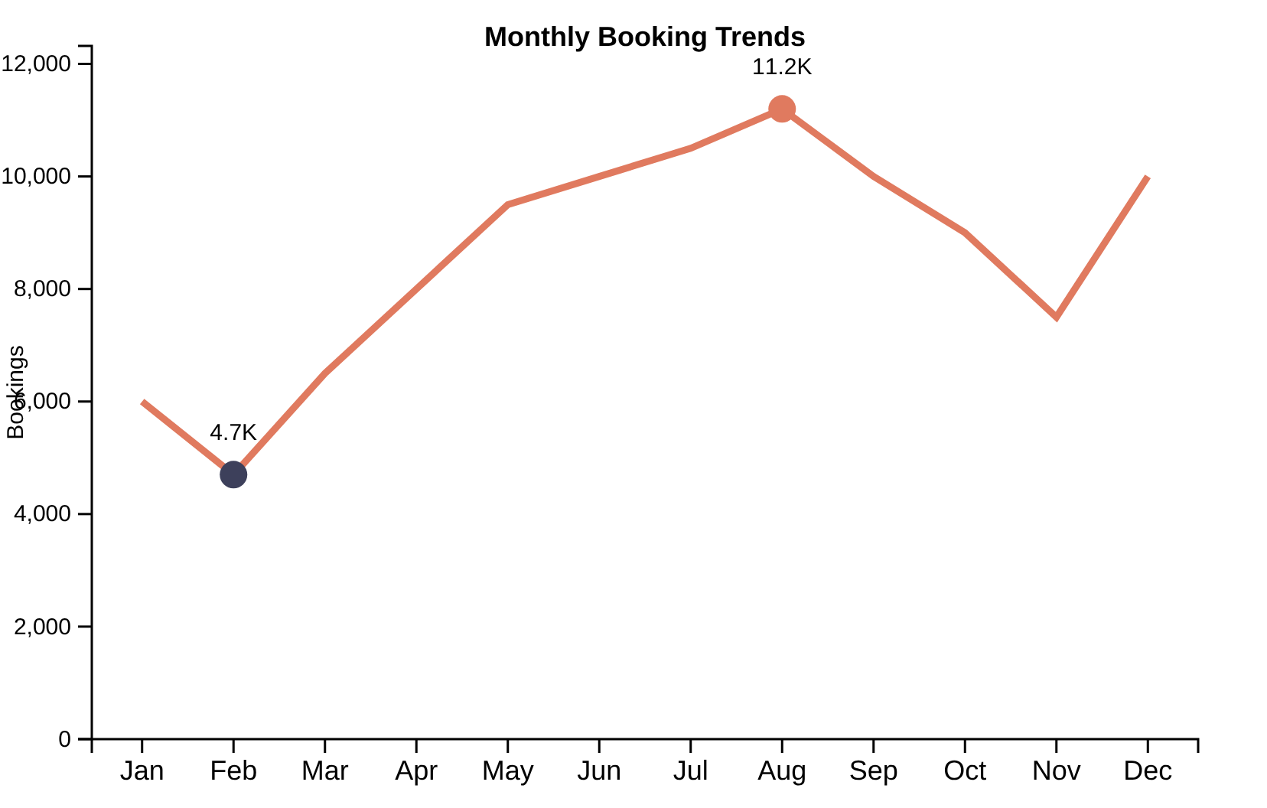









Monthly Trends – A Year in the Life of Our Hotels
"Summer is our stage. August shines, February whispers."
August- Peak Season
11.2K bookings
$2M revenue
12.9K nights
Families and tourists fill our rooms during summer vacation
December- Holiday Season
10K bookings
$1.7M revenue
Holiday travelers make short, high-value bookings
February- Off-season
4.7K bookings
$0.3M revenue
3.9K nights
Opportunity for off-season campaigns and promotions
Key Insight:Strong seasonality in bookings and revenue. Strategic planning for peak periods and targeted off-season campaigns can significantly boost performance during quieter months.

Slide 6











Geographical Analysis – Where Do Guests Come From?
Most of our guests fly from Europe—but some make the long-haul journey from the US, China, or Australia.
Europe
North America
Asia-Pacific
Africa & SE Asia
Our core market
Secondary market
Secondary market
Emerging markets
Dense booking activity
Significant but smaller volume
Emerging opportunities
Growth potential
The Opportunity
While Europe fills our rooms in summer, targeting long-haul markets could bring higher-value bookings all year.
"Focusing marketing on the US, China, and Australia could diversify our customer base and reduce European seasonality."

Slide 7



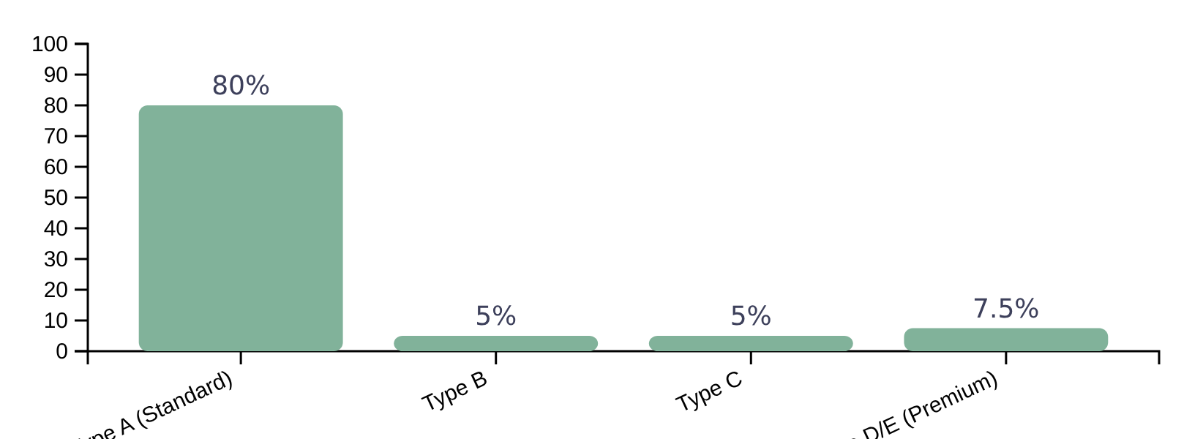











Room & Meal Choices – Understanding Guest Preferences
Type A rooms dominate
Standard rooms account for ~80% of bookings, indicating a weak upselling strategy
Room Type Distribution
Meal Plan Preferences
BB
HB
FB
Most Popular
Underutilized
Opportunity
"Guests prefer BB for flexibility—upsell HB/FB to increase revenue"
"Luxury seekers are a niche we can capture with targeted promotions for Types D/E"
Upselling Opportunity:
"What if we made Type D irresistible? Targeted promotions could convert standard bookings to premium rooms, increasing ADR and revenue."
Premium rooms (D/E) account for only 5-15% of bookings

Slide 8













Predictive Modeling – Seeing the Future
"Imagine knowing which booking will cancel before it happens."
Historical Data
ML Model
Predictions
Business Impact
Booking history & outcomes
Logistic Regression, Decision Trees
Cancellation risk, demand forecast
Strategic decisions, revenue protection
Identify High-Risk Cancellations
Forecast Seasonal Demand
Predict which bookings are most likely to cancel, enabling proactive interventions like personalized re-engagement offers or flexible booking options to reduce cancellation rates.
Forecast seasonal demand fluctuations to optimize staffing levels, adjust pricing strategies dynamically, and manage inventory more effectively during peak and off-peak periods.
"This predictive power is crucial for maintaining a competitive edge and ensuring every booking contributes optimally to our hotel's success."

Slide 9









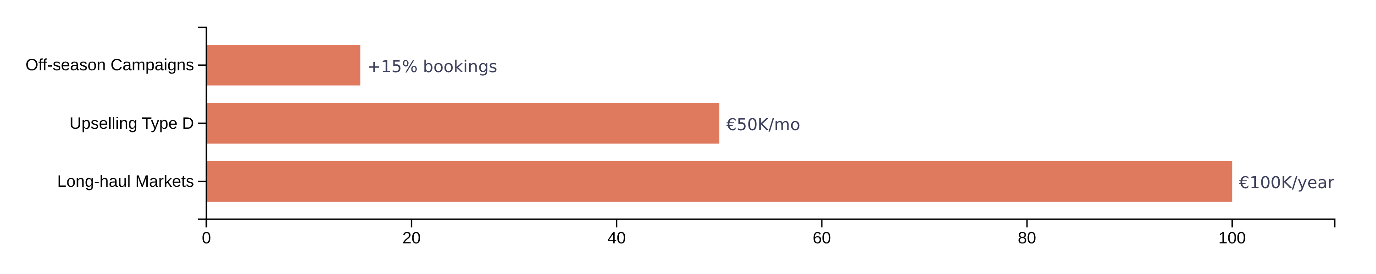
Business Impact – Turning Insights into Action
"These numbers are not just metrics—they're opportunities to delight guests and increase revenue."
Off-season Campaigns
Upselling Type D Rooms
Target Long-haul Markets
Targeted promotions in February can increase bookings by15%
Promoting premium rooms can bring€50Kadditional revenue monthly
Focus on US, China, and Australia for€100Krevenue annually
Type D/E rooms account for only 5-15% of bookings
Diversify customer base beyond European seasonality
February currently has only 4.7K bookings

Slide 10















Conclusion – The Story We've Told
"From raw data to insights to action, we now know our guests, understand the peaks and valleys, and have a roadmap to grow revenue and loyalty."
Raw Data
Insights
Action
87K bookings, 9.76M revenue
Guest personas, seasonal patterns
Strategic recommendations
Know Your Guests
Understand Seasons
City hotels: business travelers, short staysResorts: families, leisure travelers
August/December: peaksFebruary: opportunity for campaigns
Target Markets
Roadmap for Growth
Europe: core marketNorth America, Asia-Pacific: growth potential
Off-season campaigns, upselling, market expansion

Slide 11











Q&A – Join the Story
I'm excited to hear your questions or thoughts on how we can make each guest experience even better.
Your insights could help shape our future strategies and drive meaningful improvements in our hotel operations.
Which strategy excites you most?
Off-season Campaigns
Upselling Rooms
Long-haul Markets
Targeting February with special promotions to increase bookings by 15%
Promoting premium Type D rooms for an additional €50K monthly revenue
Targeting US, China, and Australia for €100K additional annual revenue
Share your ideas and help shape our data-driven future!

