Slide 1


Investigating feeding tolerance in wild vervet monkeys during a cooperative task
Michael Aung Kyaw
University of Neuchâtel Master Thesis Presentation 7th of February 2025

Slide 2
Plan
Male-Female cooperation
What influences tolerance
Female dominant system
Vervet monkeys
Research question & hypothesis
Method & experimental design
Results : Rank differences
Results : Ecological seasons
Conclusions of the experiment (results + gaps addressed)
Limitations and future direction
Future research and take-home message

Slide 3
Intoroduction
Importance of research area
Main theories and empirical findings
Lead into why your study was needed
Your specific research question(s)
Your specific hypotheses

Slide 4
Silk, J. B. (2007) – frequently referenced for intergroup tolerance and primate cooperation​.
Jaeggi et al. (2016) – discusses obstacles and catalysts of cooperation in primates​.
Lewis (2002, 2018, 2023) – focuses on intersexual power and dominance​.
Ostner & Schülke (2018) – examines resource monopolization and dominance structures​.
Most Important Sources:
Borgeaud & Bshary (2015) – highlights how grooming influences social bonds and tolerance​.
Cheney et al. (2016) – provides a theoretical framework for social bonds and tolerance​.
Hare et al. (2007) – compares cooperative behaviors in primates, particularly bonobos​.
Díaz-Muñoz et al. (2014) – explores male-female reproductive cooperation​.

Slide 5
Vervets / Population
Groups
Males /Females
Rank
Time p/week
Frequency
Amount trials
..

Slide 6
Tolerance
What behaviours
Forms of tolerance
Definition of tolerance
Definition for experiment: eating at the box without engaging in agonistic (stare attack, hit, head bop) with it’s partner

Slide 7
Why (tolerance?)
Fitness
Male dispersal
What influences it?
Why in vervets : -Lack studies in monkeys and in experimental conditions
-…

Slide 8
Hypothesis

Slide 9

Data collection & Methods
3 minutes
Introduce research design
Explain how you recruited subjects (humans, mosquitoes, plants, etc)
Explain how variables were operationally defined
Methods
Ab libitum
Scans
Focal
Data (before/after)
Grooming intra dyad
Proximity with partner
Social network
Rank
Audience

Slide 10
Method
Habituation to boxes
Learning patterns
Dyadic tolerance experiment
Rules* Tablet screenshots
Distances, more/less distance, 30sec rule, agression vs tolerance vs ignore…, 15 trials

Slide 11
Analysis

Slide 12
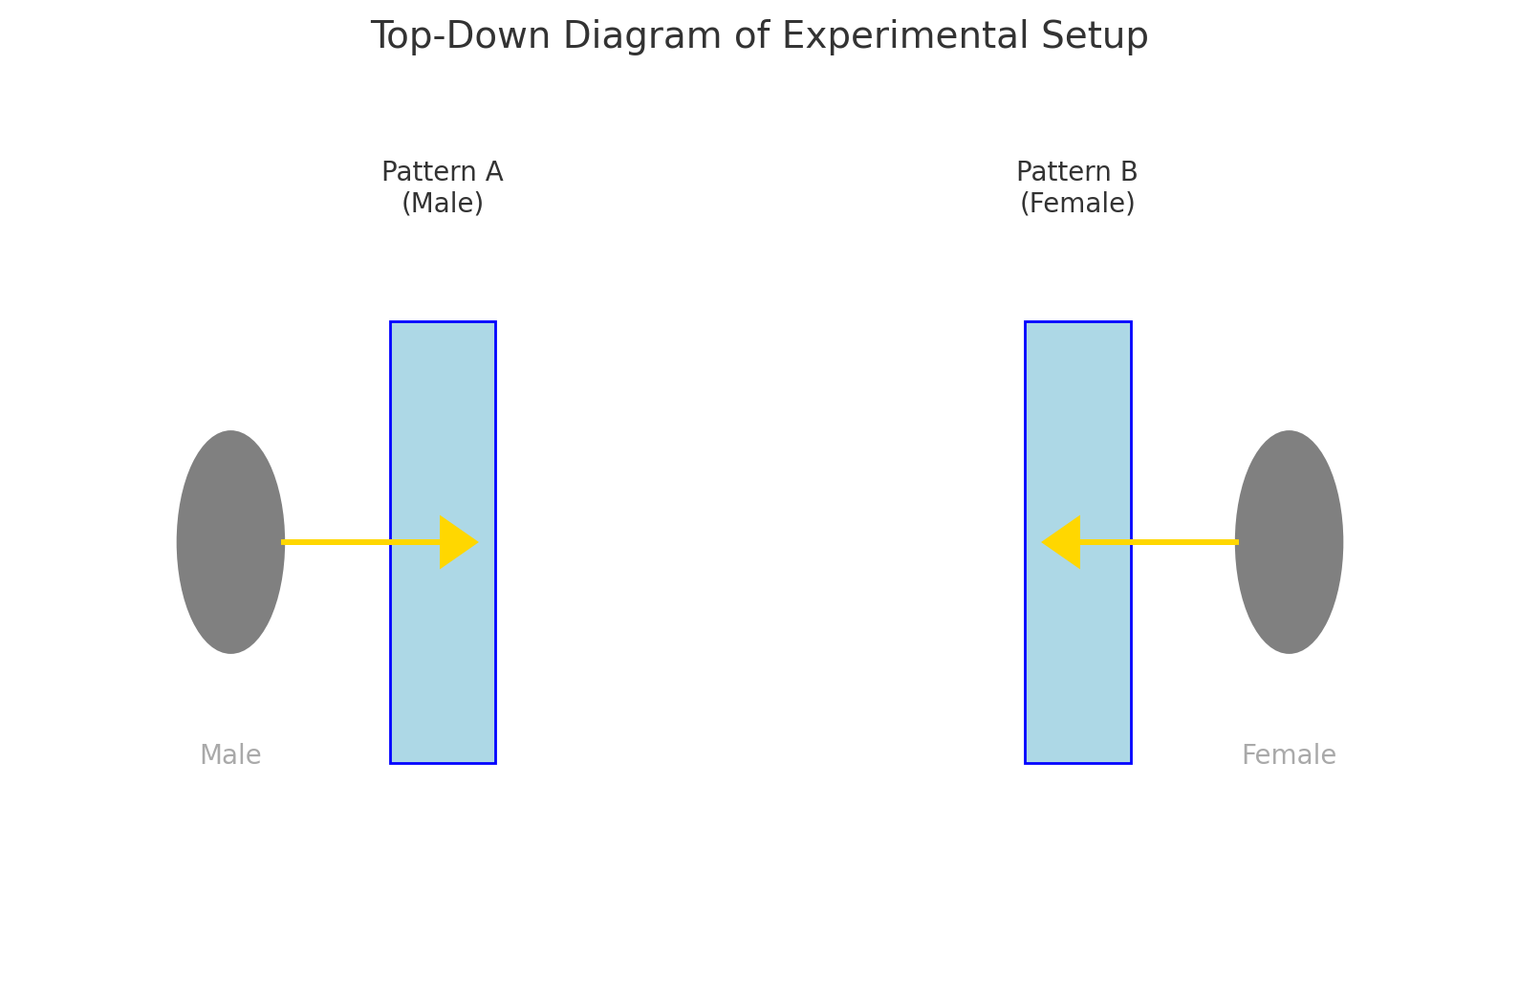
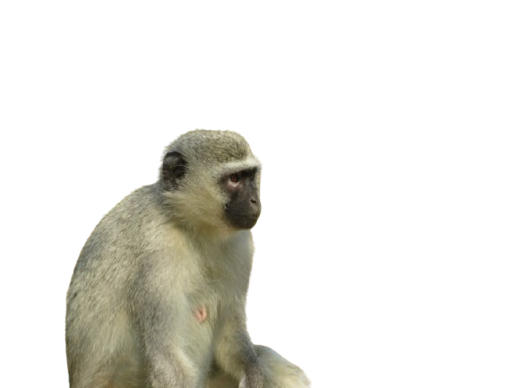
Questions
3 pieces of corn in each boxes
Distance from 0m (min) to 10m (max) between boxes

Slide 13
Field assistant with camera
Experimenters
Distance ( 0 to 10m)
Dyad
Box apparatus (with pattern and corn inside)

Slide 14
Diagram of the Experimental Setup of a Trial
Box A
Box B
Monkey A
Monkey B
Distance from 0m to 10m
Remote controlled Plexiglas window
Manipulation of the distance between the boxes Tolerance twice in a row: +1m
Aggression and not approaching: -1m
Intrusion: = distance

Slide 15


Unique coloured pattern
Remote controlled Plexiglas window
Female
Male
Distance from 0m (min) to 10m (max) between boxes
Box w. 3 piece of corn
Manipulation of the distance between the boxes Tolerance twice in a row: +1m
Aggression and not approaching: -1m
Intrusion: = distance

Slide 16
Results
Clearly state if your results did/did not support your original predictions.
Show summarized descriptive statistics in appropriate table or figure
Discuss test conducted and its results (e.g. F, dependent-t…).
4 minutes

Slide 17
Effect of Rank on Tolerance
Rank Differences and Tolerance
The study found that dyads with smaller rank disparities exhibited higher tolerance. This means that male-female pairs in which both individuals were closer in rank (e.g., one quartile apart) were more likely to cooperate than pairs with larger rank gaps (e.g., two or three quartiles apart).
Why Does This Happen?
Hierarchical Segregation: High-ranking individuals tend to monopolize resources and reject lower-ranking partners, forcing lower-ranking individuals to avoid competition altogether.
Risk Aversion: Low-ranking individuals may avoid interactions with dominants to reduce the risk of aggression, leading to lower tolerance between unequally ranked partners.
Social Bonding within Rank Proximity: Studies on primates, including baboons and macaques, show that individuals of similar rank are more likely to share resources and groom each other, reinforcing cooperative behaviors (Dubuc et al., 2012; Jaeggi et al., 2016)
Support in other primates
Macaques (Matsumura & Okamoto, 1997): High-ranking individuals avoid co-feeding with lower ranks, reinforcing the idea that rank determines social inclusion. Chimpanzees (Murray et al., 2006): Subordinates adjust foraging strategies to avoid aggression from dominants, mirroring vervet monkey avoidance of lower-ranked individuals in cooperative tasks. Bonobos (Paoli et al., 2006): Rank differences are mitigated through female coalitions, allowing more equitable food-sharing, unlike in vervets, where male-female rank disparities limit tolerance.

Slide 18
Effect of Ecological Seasons on Tolerance
Tolerance was highest in winter and lowest in summer, suggesting that seasonal resource availability influences social interactions. Why…?
Winter = Scarcity = Increased Cooperation
Food shortages force individuals to cooperate to maximize their access to limited resources (Pansini, 2011).
Higher interdependence reduces aggression, as individuals need social partners to increase their chances of obtaining food.
Similar findings in baboons and lemurs show that during food scarcity, social bonds strengthen, with more grooming and alliance formation (Silk, 2007).
Summer = Abundance = Reduced Need for Tolerance
Resource competition decreases, so individuals do not need to rely on cooperative strategies to gain food.
Dominance hierarchies become more evident as high-ranking individuals monopolize resources without social repercussions.
For example, in ring-tailed lemurs (Sauther, 1993), female competition for resources increases when food is scarce, leading to dominance shifts, similar to vervet winter tolerance changes.
Examples in other species Bonobos vs. Chimpanzees (Hare et al., 2007): Bonobos, who live in food-abundant environments, display more tolerance in cooperative tasks, whereas chimpanzees, who experience periodic scarcity, show more dominance-based food monopolization. Mountain Gorillas (Pisor & Surbeck, 2019): Seasonal resource shifts influence tolerance—high-ranking individuals share more food in harsh conditions but become more exclusive when resources are abundant.

Slide 19
Discussion
5 minutes
Place your findings back into the general literature
Briefly discuss any major problems with your methodology
Discuss further directions for research
Answer questions

Slide 20
Our findings: In short
The study highlights that male-female tolerance is not just a function of individual personalities but is shaped by ecological and hierarchical constraints.
Key Takeaways
Hierarchy affects social bonds: Unlike species where male-female friendships are strong (e.g., bonobos), vervets prioritize dominance over social affiliation in food contexts.
Male strategies may be context-dependent: In mating seasons, males show more tolerance, possibly to gain reproductive advantages. In contrast, in non-mating periods, rank-based avoidance dominates.
Baboon “Friendships” (Smuts, 1985): Males form bonds with females to gain future reproductive benefits. In vervets, however, rank disparities override these affiliations in food competition settings
Supporting Seasonal Adaptability Theory
The study reinforces the idea that cooperation increases under environmental stress, aligning with broader ecological theories of sociality.
Key Takeaways
Survival Pressures Influence Tolerance: When resources are scarce, primates become more cooperative to increase survival chances.
Seasonality Shapes Social Organization: Tolerance fluctuates not just due to individual traits but in response to ecological conditions.
Example
Chimpanzee Seasonal Fission-Fusion Dynamics (Houle & Wrangham, 2021): Chimpanzees adjust their grouping patterns based on seasonal resource availability, showing similar social flexibility as vervets in this study.

Slide 21
Limitations & Future Directions
Small Sample Size: Limits statistical power and generalizability​.
No Audience Effects Considered: Lack of control for third-party influences on dyadic interactions​.
Resource Availability Not Measured: Seasonal differences were inferred rather than directly tested​.
Short Study Duration: Limited ability to assess long-term social dynamics​.
Longitudinal Studies: Investigate tolerance evolution over extended periods​.
Audience Effects: Include observational controls for third-party influences​.
Demographic Variables: Examine the impact of sex ratios and group composition on tolerance​.

Slide 22
Social bonds do not predict tolerance?
One unexpected finding is that pre-existing social bonds did not significantly predict tolerance levels.
Why is this important?
Social Bonds Are Not Always Stable Predictors: In vervets, hierarchy overrides pre-existing relationships in food competition contexts.
Social Learning May Play a Role: Dyads with weaker initial bonds increased their tolerance over time, suggesting that forced proximity can induce social familiarity.
Example
Grooming-for-Tolerance Trade-offs (Borgeaud & Bshary, 2015): Grooming can act as a form of currency, but in vervets, forced proximity alone may be enough to foster tolerance, even without grooming reinforcement.

Slide 23
What to keep
Main Message:
Male-female tolerance in vervet monkeys is not driven primarily by social bonds but rather by hierarchical structures and ecological conditions.
What Should We Keep in Mind?
Hierarchy Matters More Than Friendships
Unlike in bonobos or baboons, where male-female “friendships” provide stability, vervets prioritize rank in cooperative tasks.
Context Shapes Behavior
Tolerance fluctuates with seasons, showing that behavioral flexibility is crucial in understanding primate sociality.
Social Proximity Can Replace Social Bonds
Even individuals with weak social bonds became more tolerant over time, suggesting that interaction frequency can shape cooperation, even in the absence of grooming or affiliative behaviors.
Why This Matters in a Broader Context?
Evolutionary Perspective: Supports the idea that hierarchical primates adjust cooperation strategies dynamically, rather than being bound by pre-existing relationships.
Comparative Primate Studies: This challenges the assumption that male-female tolerance follows a universal rule across primate species—instead, ecological and dominance-based factors play a stronger role in vervets.
Application to Conservation & Animal Behavior: Understanding how ecological constraints influence cooperation can help predict how primates may respond to environmental changes such as habitat loss.

Slide 24
Take home message
This study challenges existing paradigms and highlights that tolerance is not universal across species but an adaptive response to social and ecological realities. Future research should focus on how these factors interact across different primate societies and other social animals.

Slide 25

Acknowledgements
Collaborators
Funding agencies
Group affiliations

Slide 26
Question time
5 minutes
Prepare for & know your audience

Slide 27
References

Slide 28
Question time

Slide 29
Additional content
Evoltuin nof tolerance per dyad
Non significant graphs
Tabel expliaing variables
16 model comparaison

Slide 30
Font size
Size 20 (citations and statistics)
Size 25 (minimum font size)
Size 32 (better)
Size 35 (even better)
Size 40 (titles)

