Slide 1

Cultural Assessment Leadership Team Review
August 3, 2022

Slide 2
Engagement Scope

Slide 3
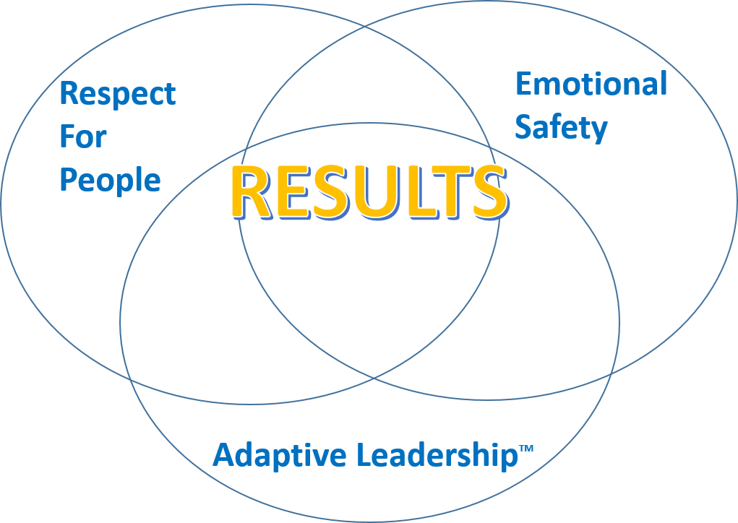
The Paradox of High Performance
Leaders believe they are responsible for the results…
In reality, Leaders are responsible for the people who generate the results
Notes:
standar slide

Slide 4
Assessment Surprises
Notes:
anth

Slide 5
Overarching Themes-Positives to Build on
Positive Themes
Improvement Themes

Slide 6
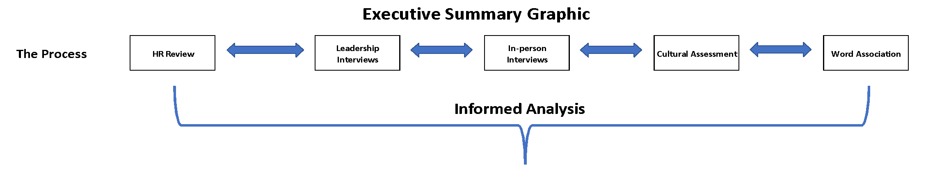
Executive Summary
Notes:
three levels of assessment - one is here (full blown) – w/ team members —-- others have less
Making it more like instrument - speedometer - red yellow green different dials for each gauge - car instrument panel - make it “sexier”

Slide 7
Executive Summary
Notes:
dials instead - positive atrt and improvement opp generated from sub cats that stand out over all sections with large impact to the score are the primary concentration areas - some came from employee interview and other sections anth

Slide 8
Business Outcomes Assessment
Morale –
Turnover –
Engagement –
Change Mgmt/Resilience –
Notes:
anth same thing as prev

Slide 9
Business Outcomes Assessment
Loyalty –
Unionization –
Notes:
same as above

Slide 10
Assessment Details Discussion

Slide 11
Participation
Potential Participation Drivers
Notes:
generate chart - anth left - in excel- manually with cells - do it horizontal , statistical validity chart number of respondents to the total Determine a Statistically Valid Sample Size

Slide 12
Respect For People Details
Notes:
dial

Slide 13
Respect For People Positive Attributes
Attribute | Statement | Yes %
Performance Management
Support / Flexibility
Notes:
generated from questions - can be shorter - percentage from overall - not weighted - attribute - are sub cat
–bottom are pulled from

Slide 14
Respect For People Improvements
Attribute | Statement | Yes %
Trust in HR
Values
Personal Development
Workload / Burnout
Notes:
cont from above – look to quantifiable results “questions” – major themes from in person and word association – could also use cluster info

Slide 15
RFP Departmental Analysis
Notes:
generate as a graph - can keep dial top right – keep is easy to read - add sub categories from questions that had the most impact - focus on the “bad” attributes - largest deviations from dep/pos when cmprd to cmpny - add more sub cat to questions to be more specific —---start general “trust” -> “hr trust, sprvsr trust, ldr trust” -can change gray - any color - nutral dark

Slide 16
RFP Departmental Breakout
Notes:
outside bounds by negative stdrd dev -> red highlight - further reviews / tweaks

Slide 17
Emotional Safety Details

Slide 18
Emotional Safety Positive Attributes
Attribute | Statement | Yes %
Benefits
Vulnerability / Open Culture / Supervisor Trust

Slide 19
Change Management Details

Slide 20
Change Management Positive Attributes
Attribute | Statement | Yes %
Purpose
Celebrating

Slide 21
Change Management Improvements
Attribute | Statement | Yes %
Lack of Process
Communication
Support

Slide 22
Change Mgmt Departmental Analysis

Slide 23
Change Mgmt Departmental Breakout

Slide 24
Supervisor Leadership Details

Slide 25
Supervisor Leadership Positive Attributes
Attribute | Statement | Yes %
Courage Compassion Competence Trust
KBC’s frontline leaders are a true asset that can be leveraged… treat them like leaders not like employees

Slide 26
Senior Leadership Details

Slide 27
Senior Leadership Positive Attributes
Attribute | Statement | Yes %
Approachable
Notes:
leave a space to add notes

Slide 28
Senior Leadership Improvements
Attribute | Statement | Yes %
Values
Trust
Servant Leadership

Slide 29
Senior Leadership Departmental Analysis

Slide 30
Senior Leadership Departmental Analysis

Slide 31
Executive Summary

Slide 32
Word Association Details Discussion

Slide 33
Word Association Surprises / Themes
Notes:
anth

Slide 34
Word Association High Level Summary
Notes:
generate circles - same colors

Slide 35
Word Association High Level Summary
Notes:
personal notes

Slide 36
Word Association Departmental Analysis
Notes:
%100 generate - < > signs when compared to kbc avg - words that drive the score - based on stdv per word that flag words with most impact - those show up on graph positive or negative (if score is positive only do 4 pos 4 neg) more if department is sqd to more ngtv prctg pnt variance. another

Slide 37
Troubling Word Analysis-Toxic Environment

Slide 38
Troubling Word Analysis-Burnout
Notes:
keep percentages

Slide 39
Hi-Pots View KBC Significantly Less Positive
Notes:
break out positions and departments - can delete if not ness

Slide 40
Hi-Pots Are At Risk

Slide 41
Next Steps -Overall
The recommended next steps that follow will positively impact retention and productivity metrics as well as increasing engagement, morale, and loyalty
Improvement Area | Recommendation | Responsible

Slide 42
Next Steps - Trust
Improvement Area | Recommendation | Responsible

Slide 43
Next Steps – Change Management
Improvement Area | Recommendation | Responsible

Slide 44
Next Steps – Burnout/Development
Improvement Area | Recommendation | Responsible

Slide 45
Next Steps – Other Areas
Improvement Area | Recommendation | Responsible

Slide 46
Backup

