Slide 1
Storyboards
Matt Voorhies
Seth Mason
Tyler Bullock
Ashley Dodson
Jacob O’Connor

Slide 2
Splash Page and Directions
All along the Jordans’
Help guy get his Jordans’ back from the dark lord! Fight all the bosses on each level to proceed to the next level!
Click the left and right arrow keys to move forward and backward, the up and down arrow keys to move up or down(they are located on the screen).
When fights are initiated, watch your Hitpoint bar at the top of the screen and fight each boss with your attack and specials buffs you get upon leveling.
Click the Scroll right above the directional buttons. This brings you to the help page.
Clear zones 1 and 2 to confront the dark lord.
During cut scenes, click the next button to move onto the next scene. If you want to skip the dialogue click the skip button.
The max Level guy can reach is 5.

Slide 3

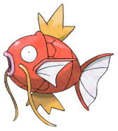

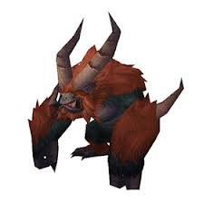
Enemies Page 1
Plue:
Fish:
Moleman:
Gorlak:

Slide 4
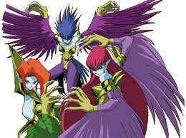
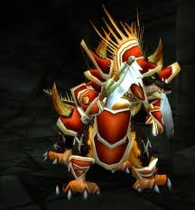

Enemies Page 2
Harpies Nest:
Dragon Knights:
Dark Lord:

Slide 5
Characters in scene: Guy, Plue, Fish, Moleman
Background Items:
Goal: Kill Plue, Fish, and the Moleman
Lose: Dying to Plue, Fish, or the Moleman
Move to the next level : walk to the cave after beating Moleman.
Guy moves by: Click the left and right arrow keys to move forward and backward, the up and down arrow keys to move up or down(they are located on the screen).
Attack: select attack or heal from fight scene menu
Level 1

Slide 6
Level 2
Characters in scene: Guy, Gorlak, Harpies nest, Dragon knights .
Static background Items: None.
Goal: kill the Gorlak, Harpies nest, and Dragon knights to proceed.
Lose : Dying to Gorlak, Harpies nest, or the Dragon Knights.
Move to the next level : Walk to the bridge after defeating the Dragon Knights
Guy moves by: Click the left and right arrow keys to move forward and backward, the up and down arrow keys to move up or down(they are located on the screen).
Attack: select attack or heal from fight scene menu

Slide 7
Level 3
Characters in scene: Guy, Dark Lord
Static background Items: None.
Goal: Defeat the Dark Lord to beat the game!
Lose : Dying to the Dark Lord
Move to the next level : Defeating the Dark Lord to beat the game.
Guy moves by: Click the left and right arrow keys to move forward and backward, the up and down arrow keys to move up or down(they are located on the screen).
Attack: select attack or heal from fight scene menu.

Slide 8
“You Beat the game!” Page!

