Slide 1
HYBRID WHEELCHAIR
GROUP MEMBERS
MIRZA TAIMOOR BAIG
FAREEHA SIDDIQUI
MUHAMMAD USMAN NIZAMI
SAADAT HUSSAIN
SUPERVISOR:
Dr. rizwan Iqbal

Slide 2
Table of contents
Introduction
Project Architecture And Design
Block Diagrams
Hardware Connections
Comparison
Practical Demonstration

Slide 3
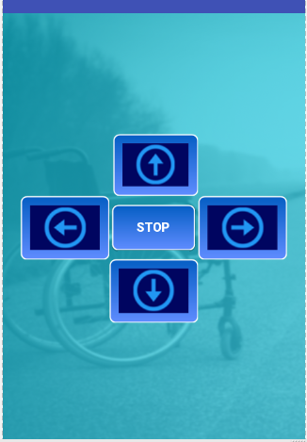

introduction

Slide 4
Components that are used in our project
Android supportive Mobile phones (1 unit)
Wheel Chair (1 unit)
Arduino mega Microcontroller (1 unit)
Bluetooth Module (HC-05)
Wiper motors / dc gear motors (2 unit)
Batteries 12v (2 Unit)
Arduino l293d motor shield (1 unit)

Slide 5
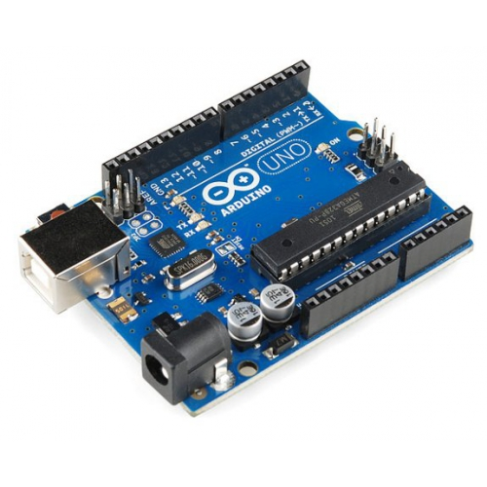
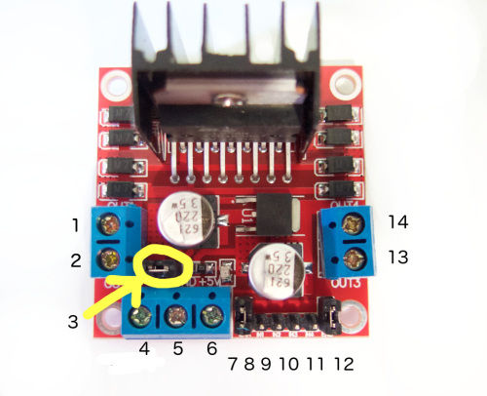
Components
Arduino mega Microcontroller
Motor Controller

Slide 6
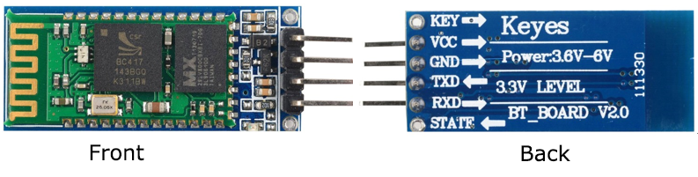
Components
Bluetooth Module

Slide 7
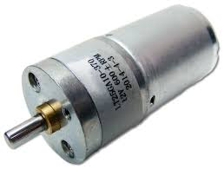
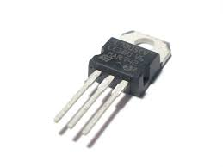
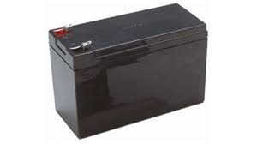
Components
DC gear motors
Regulators
Battery

Slide 8
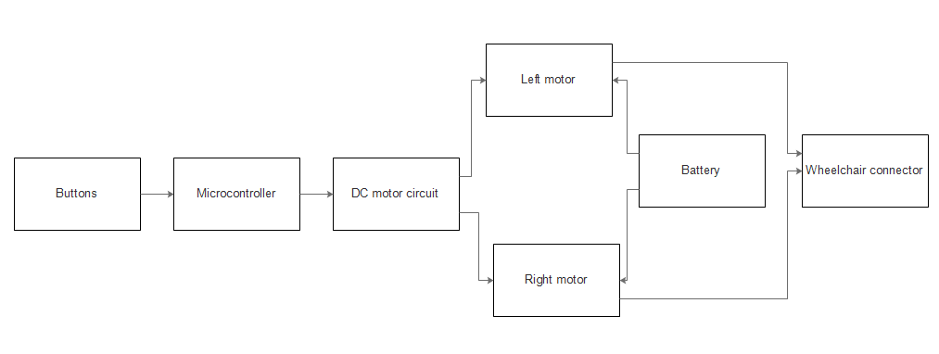
Block diagram (Buttons)

Slide 9
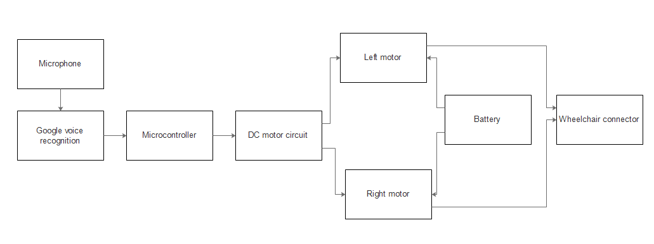
Block diagram (Voice Input)

Slide 10
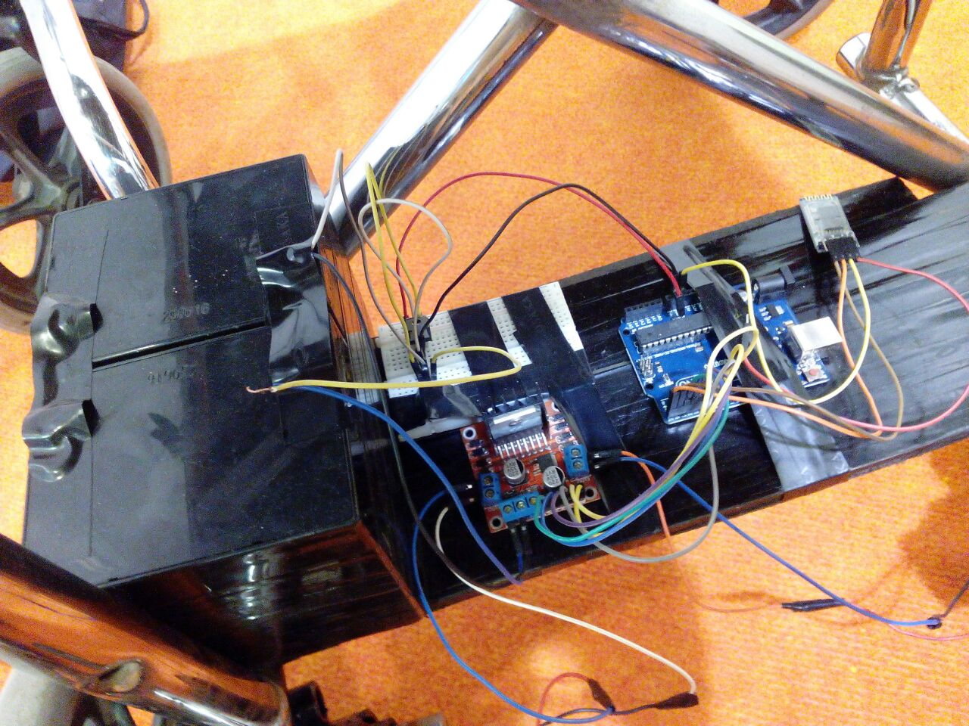
Project architecture and design

Slide 11
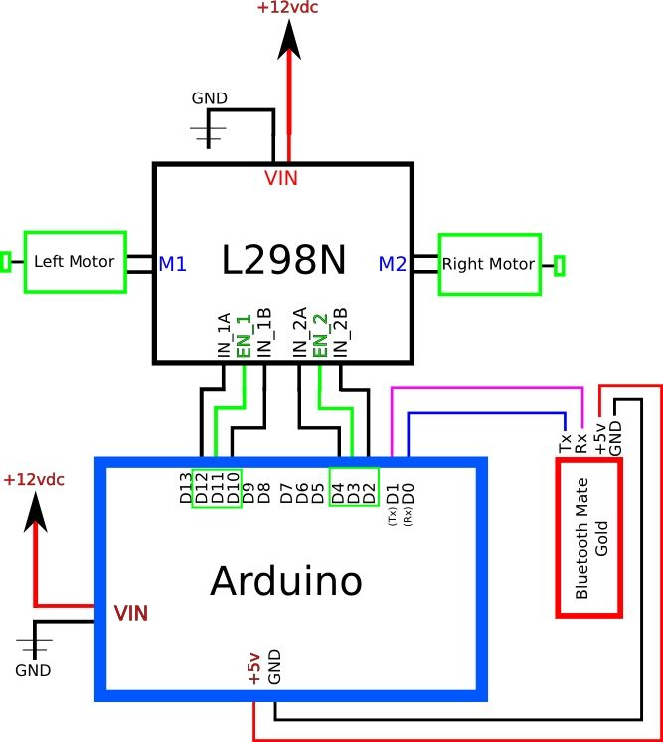
Hardware connections

Slide 12
comparison
Our Hardware
No hardware complexity.
Smaller size of hardware.
Three hardware components.
very easier hardware program.
Our Software
Very easier software program.
Smaller size of software program.
Software installation and downloading is easier.
Voice recognition based software program.
Hardware
Higher hardware complexity.
Larger size of hardware.
More hardware components.
More complex hardware program.
Software
More complex software program.
Larger size of software program.
Software installation and downloading is complex.

Slide 13
comparison
Our Mechanical
Easier way to insert motors in wheelchair.
No chain mechanism.
No gear box mechanism.
Our Another Advantages
Lighter weight.
Cost is very low
Mechanical
Complex way to insert motors in wheelchair.
Yes chain mechanism.
Yes gear box mechanism.
Another Advantages
Cost is very high.
Heavier weight.

Slide 14
Project Summary
Research based.
Scientific Calculation successfully with results.
Wheelchair can be operated by Urdu language.
Future work
Obstacle avoidance(distance sensor).
Brain Computer Interface(Brain sensor).

Slide 15
Practical demonstration

