Slide 1
HYBRID WHEELCHAIR
GROUP MEMBERS
MIRZA TAIMOOR BAIG
FAREEHA SIDDIQUI
MUHAMMAD USMAN NIZAMI
SAADAT HUSSAIN
SUPERVISOR
Dr.rizwan iqbal

Slide 2
Table of contents
Introduction
Project Architecture And Design
Hardware Connections
Comparison
Practical Demonstration

Slide 3
introduction
Problem Definition
Project Summary

Slide 4
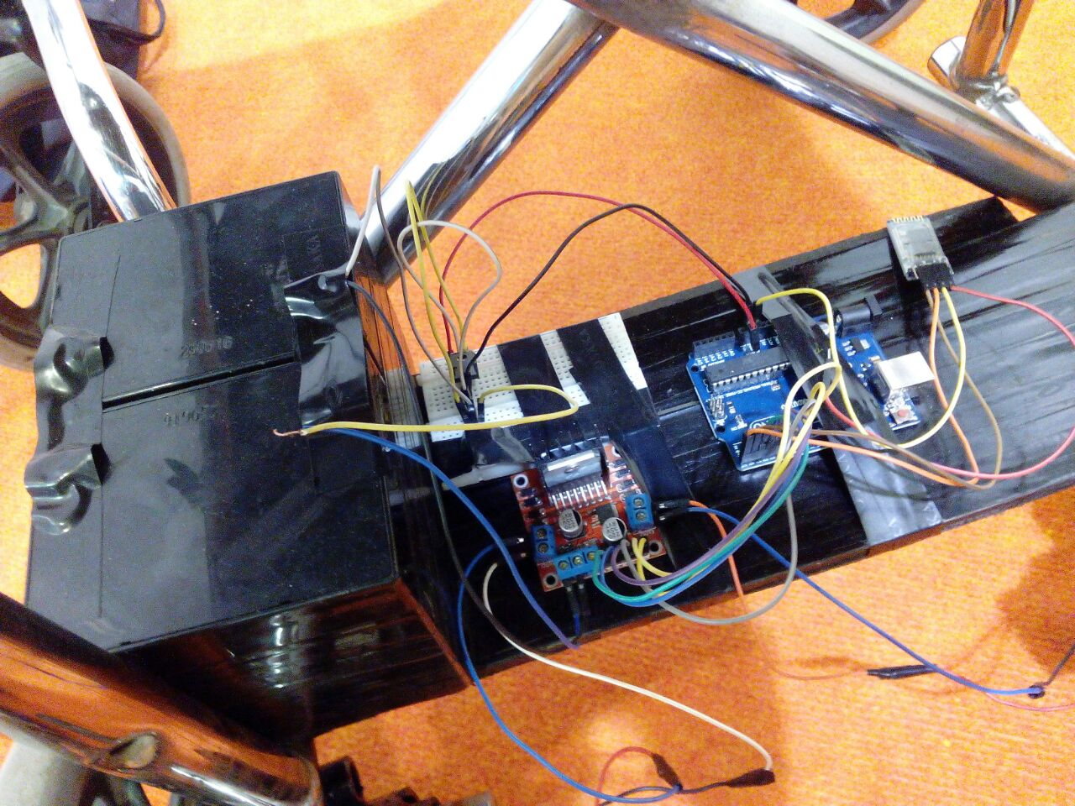
Project architecture and design

Slide 5
Components that are used in our project
Android supportive Mobile phones (1 unit)
Wheel Chair (1 unit)
Arduino mega Microcontroller (1 unit)
Wiper motors / dc gear motors (2 unit)
Batteries 12v (2 Unit)
Arduino l293d motor shield (1 unit)

Slide 6
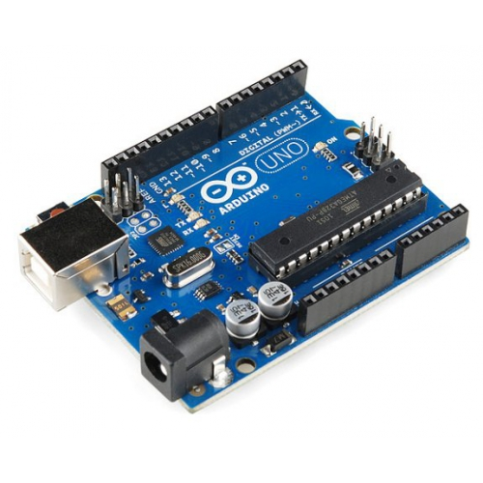
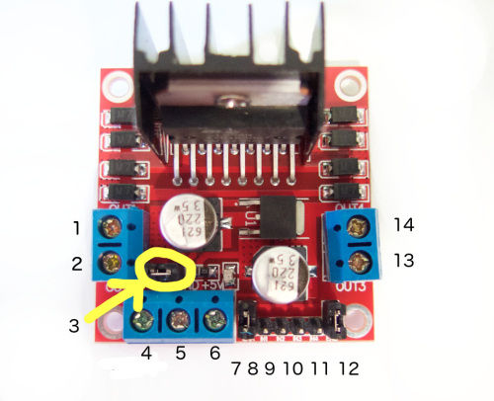

Slide 7
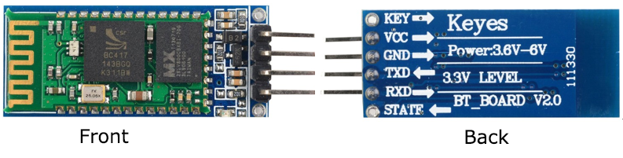

Slide 8
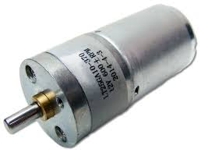
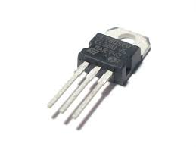
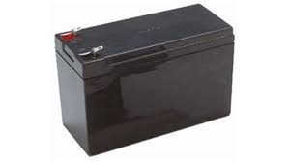

Slide 9
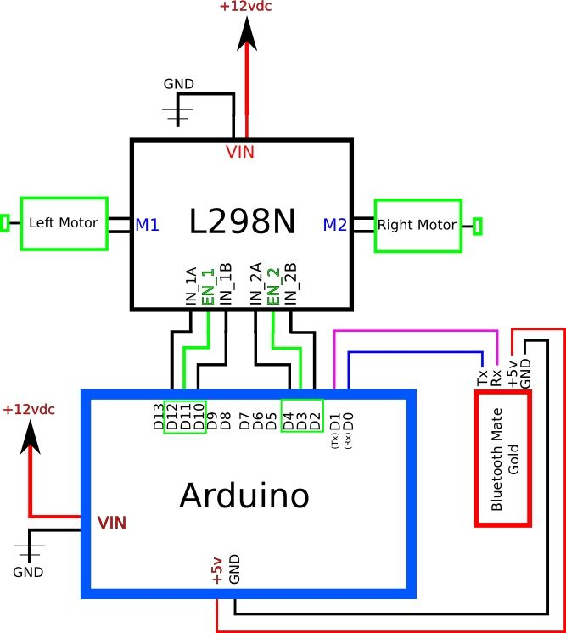
Hardware connections

Slide 10
comparison
Our Hardware
No hardware complexity.
Smaller size of hardware.
Three hardware components.
very easier hardware program.
Our Software
Very easier software program.
Smaller size of software program.
Software installation and downloading is easier.
Voice recognition based software program.
Hardware
Higher hardware complexity.
Larger size of hardware.
More hardware components.
More complex hardware program.
Software
More complex software program.
Larger size of software program.
Software installation and downloading is complex.

Slide 11
comparison
Our Mechanical
Easier way to insert motors in wheelchair.
No chain mechanism.
No gear box mechanism.
Our Another Advantages
Lighter weight.
Cost is very low
Mechanical
Complex way to insert motors in wheelchair.
Yes chain mechanism.
Yes gear box mechanism.
Another Advantages
Cost is very high.
Heavier weight.

Slide 12
Project Summary
Research based.
Scientific Calculation successfully with results.
Wheelchair can be operated by Urdu language.
Future work
Obstacle avoidance(distance sensor).
Brain Computer Interface(Brain sensor).

Slide 13
Practical demonstration

