Slide 1

PROOF READING BOT
Aayush Grover Komal Makkar Shubham Singhal
500045032 500046239 500048442
Under the guidance of
Ms. Ruchika Saini

Slide 2
ABSTRACT
The growth of the Information Technology and Digitization over the past decade has given unprecedented access to information from a variety of resources. Unfortunately, one of its major side effects is Plagiarism and its significant increase.
It has never been easier to copy and paste someone else’s content and pass it off as one’s own writing. However, distribution of assessment work leads to problems when student’s answers need to be checked for plagiarism and therefore has become one of the challenges for educational institutions. This project exhibits and demonstrates a computer assisted plagiarism detection application of text based submissions.

Slide 3
INTRODUCTION
As people are free to find and retrace plenty of information from their fellow mates, in many of the cases, they are tempted to adopt plagiarism through copy-and-paste. A special issue is published by IEEE transaction on plagiarism. It is confirmed that, “Plagiarism seriously damages the education process in a number of ways, where it prevents students from developing the skills of creative thinking and critical analysis and it undermines the trust between lecturers and students. Furthermore, if plagiarism is undetected, it can impact the reputation of the academic institution and devalue its degrees.”
Proof Reading Bot is a project that intends to observe and detect Plagiarism in regards to student submitted assignments in educational institutions. Considering the same, it’s being observed that students copy contents without prior permission and acknowledgement.
So, we have used socket programming concepts in order to scrape together assignments given to students and afterwards, use well defined algorithms to recognize plagiarism among assignments. At the same time, provide a detailed graph to determine the extent of plagiarism.

Slide 4
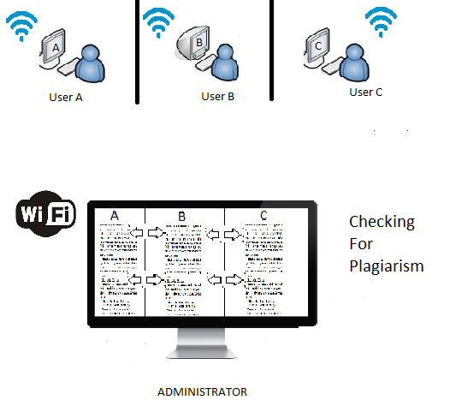
Problem Statement
Plagiarism or copy pasting is
difficult to notice in a large
volume of documents, the
demonstrated Project focuses
on computer-assisted plagiarism
detection in medium to large
volumes of text-based
submissions.

Slide 5
OBJECTIVE
The core objective of this project is to develop a platform where computer aided text-based assignments or exams submitted by students can be easily accessible on the administrator’s (here it will be Professor) system and afterwards, administrator (Professor) would be able to observe the plagiarism among the assignment submissions and also, would be able to notice the extent of copy-paste with the help of graphs.

Slide 6
METHODOLOGY
MODULE DESIGN:
MODULE 1: Input data from client using Graphical User Interface
MODULE 2: Data transfer from client (student) to server (professor) via Socket Programming
MODULE 3: Server receives Data & Data Storage in files for each client separately
MODULE 4: Data fetching, tokenizing and Stop word Removal
MODULE 5: Hashing calculations & saving
MODULE 6: Hash Arrays Fetch and Comparison
MODULE 7: Plagiarism Analysis between files collected

Slide 7
ALGORITHM FOR TRANSFERRING DOCUMENTS FROM CLIENT’S SIDE TO SERVER’S SIDE
The steps involved in establishing a socket on the client side are as follows:
1. Create a socket
2. Connect the socket to the address of the server
3. Send and receive data. There are a number of ways to do this, but the simplest is to use the read() and write() system calls.
The steps involved in establishing a socket on the server side are as follows:
1. Create a socket
2. Bind the socket to an address using the bind() system call. For a server socket on the Internet, an address consists of a port number on the host machine.
3.Listen for connections
4. Accept a connection with the accept() system call.
5. Send and receive data

Slide 8
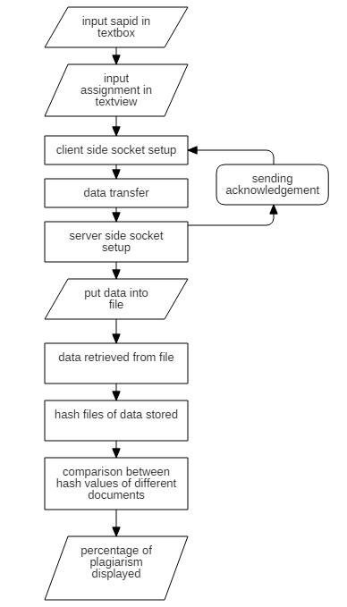
FLOWCHART FOR DOCUMENT TRANSFER

Slide 9
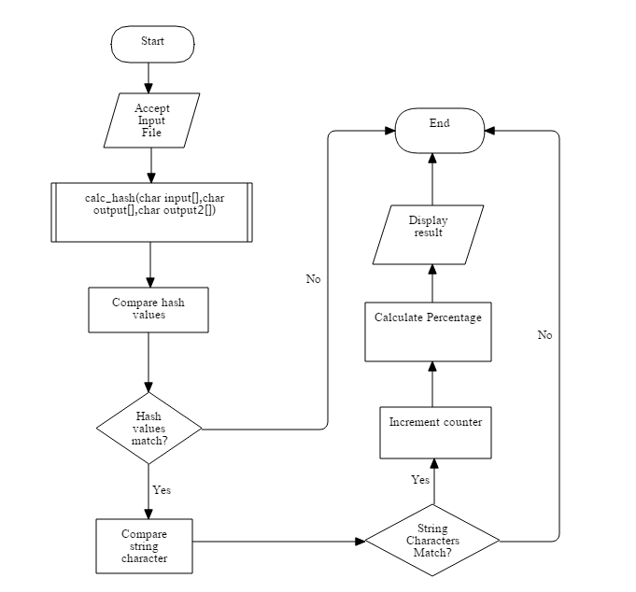
FLOWCHART FOR STRING COMPARISON (main)

Slide 10
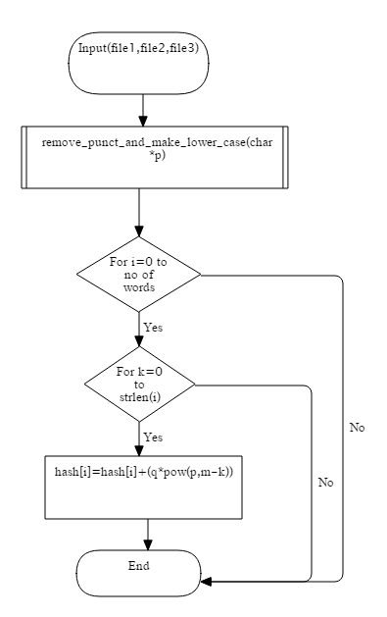
FLOWCHART: calc_hash(char input[],char output[],char output2[])

Slide 11
ALGORITHM FOR DOCUMENTS COMPARISON
1. Users submit the assignment.
2. Document fetched and words stored in an array
3. Punctuation marks are removed and words converted to lower case.
4. Stop words (like is, a, the, etc) are removed.
4.1 For i←0 to nowords
4.1.1 For k←0 to no of stop words
4.1.1.1 if(strcmp(words[i],stopword[k])==0)
4.1.1.1.1 remove words[i]
5. Assign hash values to remaining words using hash function.
5.1 For i←0 to no of words
5.1.1 m=strlen(word)
5.1.2 For k←1 to m
5.1.2.1 hash[i]=hash[i]+(q*pow(p,m-k))
where q= Ascii code of the character
p=large prime number
m= length of the word
k= characters
6. Store the values in a file.
7. Repeat 2-6 for every submission.
8. Percentage of similarity between documents is calculated and displayed.

Slide 12
DATA FLOW DIAGRAM
LEVEL 0

Slide 13
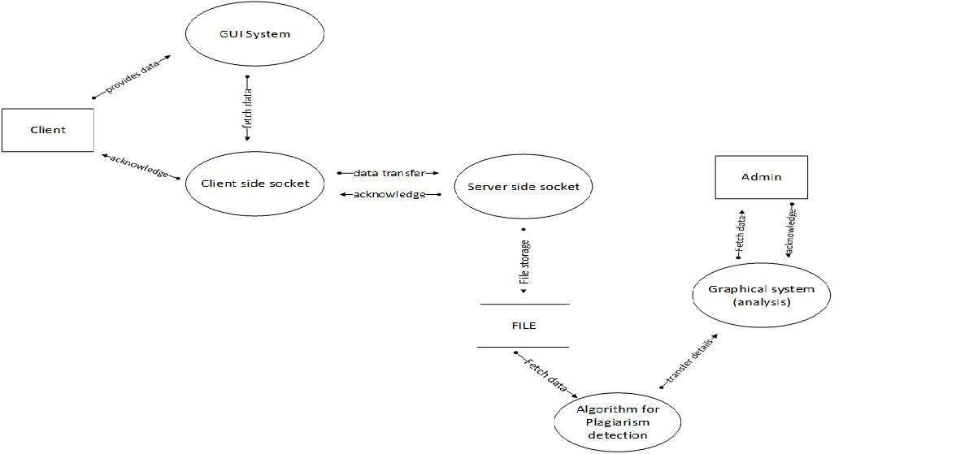
LEVEL 1

Slide 14
RESULTS AND DISCUSSION
Different modules have been discussed in this project.
These modules are Connection Establishment, Data Transfer, Storage and Fetching, Tokenizing and Stop word removal, Data Comparison, and Plagiarism Analysis
In Connection Establishment module, connection between client (user) and server (teacher) is established.
In Data Transfer module, submission of assignment takes place.
In Storage and Fetching module, assignment file is stored on server’s system and later fetched for plagiarism check.
In Tokenizing and Stop word removal module, documents are checked and stop words are removed
In Data Comparison module, strings of the document are assigned a hash value using a hash function and are compared.
In Plagiarism Analysis module, similarity between the two documents is seen using percentage calculation.

Slide 15
CONCLUSION
The user (student) will be able to submit the assignment and they will be directed to Administrator ’s (professor) system. Multiple client and server communication is possible. Plagiarism between multiple documents can be checked and displayed.

Slide 16
TEST CASES
TEST CASE ID | TEST OBJECTIVE | TEST DATA | EXPECTED OUTPUT | ACTUAL OUTPUT | STATUS
TC_01 | establishing connection | valid port number and ip address | connection established | connection established | Success
 |  | invalid port number | connection not established | connection not established | Success
 |  | invalid ip address | connection not established | connection not established | Success
TC_02 | send data from client to server | textbox input length = 9 | data accepted and acknowledment received | data accepted and acknowledment received | Success
 |  | textbox input empty | data not accepted | data not accepted | Success
 |  | textarea input empty | data not accepted | data not accepted | Success
 |  | textbox input length > 9 | data not accepted | data not accepted | Success
 |  | textbox input length < 9 | data not accepted | data not accepted | Success
TC_03 | calculate hash values | valid file name | hash values calculated | hash values calculated | Success
 |  | invalid file name | cannot open file and hash values not calculated | cannot open file and hash values not calculated | Success
 |  | invalid path | cannot open file and hash values not calculated | cannot open file and hash values not calculated | Success
TC_04 | punctuation remove function | data from the file received | punctuation removed from data and converted the text in lower case | punctuation removed from data and converted the text in lower case | Success
TC_05 | comparison of two documents | two valid file name | percentage of plagiarism detected | percentage of plagiarism detected | Success
 |  | invalid file name | cannot open file | cannot open file | Success

Slide 17
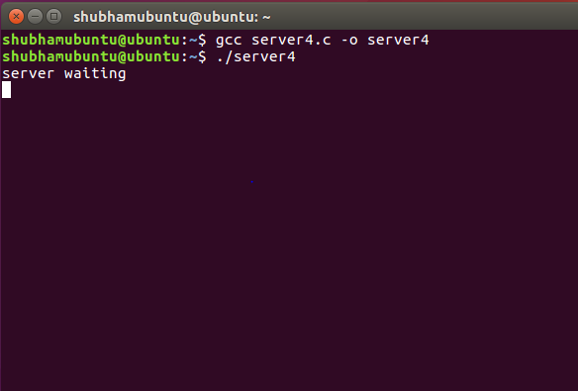
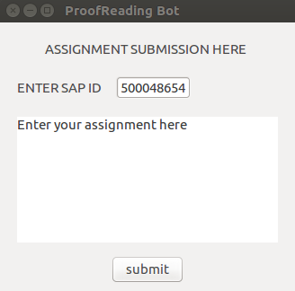
ANNEXURES

Slide 18
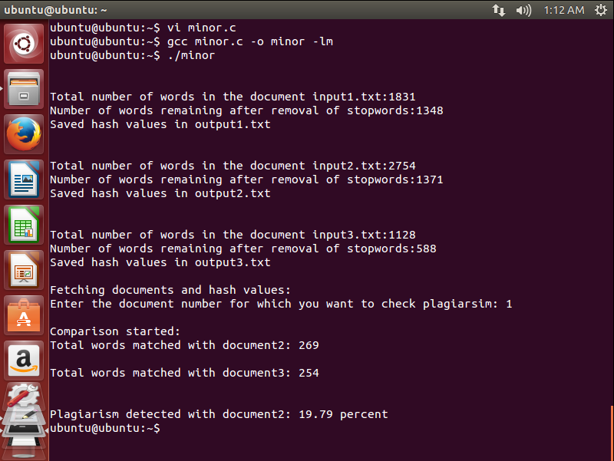

Slide 19
REFERENCES
[1] Dr Jeremy B. Williams, “Plagiarism: Deterrence, Detection and Prevention, "The Handbook for Economic Lecturers,” Universitas 21 Global
[2] Petri Sirkkala and Sami Puonti, “Nalkki-project – Tool for Plagiarism Detection Using the Web,” Institute of Software Systems Tampere University of Technology,Tampere, Finland
[3] A.P. Gope and R.N. Behera, “A Novel Pattern Matching Algorithm in Genome Sequence Analysis,” International Journal of Computer Science and Information Technologies, Vol. 5 (4), pp- 5450-5457, 2014
[4] Limi Kalita, “Socket Programming,” International Journal of Computer Science and Information Technologies, Vol. 5 (3), 4802-4807, 2014
[5] Ranti Eka Putri and A.P.U. Siahaa, “Examination of Document Similarity using Rabin-Karp,” International Journal o f Recent Trends in Engineering and Research, Volume 03, Issue 08, (ISSN:2455-1457)
[6] S.K. Shivaji and P.S., “Plagiarism Detection by using Karp-Rabin and String Matching Algorithm Together,” International Journal of Computer Applications (0975 – 8887) Volume 116 – No. 23, April 2015
[7] S. Popov, “Algorithm of the Week: Rabin-Karp String Searching,” DZone / Java Zone, 3 April 2012

