Slide 1
Supply Chain Supplier Recommendation
Using Graph Neural Networks
Finding the Right Business Partners with AI
Michael Axel
Reshma Chandran
Srishwan Beecharaju
GNN Course Project • SUNY POLYTECHNIC INSTITUTE

Slide 2
The Problem: Finding Good Suppliers is Hard
Current Challenges
Our Solution
Companies search for suppliers manually
Use Graph Neural Networks (GNN)
They only look at basic info like location
Learn from existing successful partnerships
They miss hidden patterns in networks
Find hidden connections in the network
Bad matches means wasted time and money
Recommend the best supplier matches

Slide 3
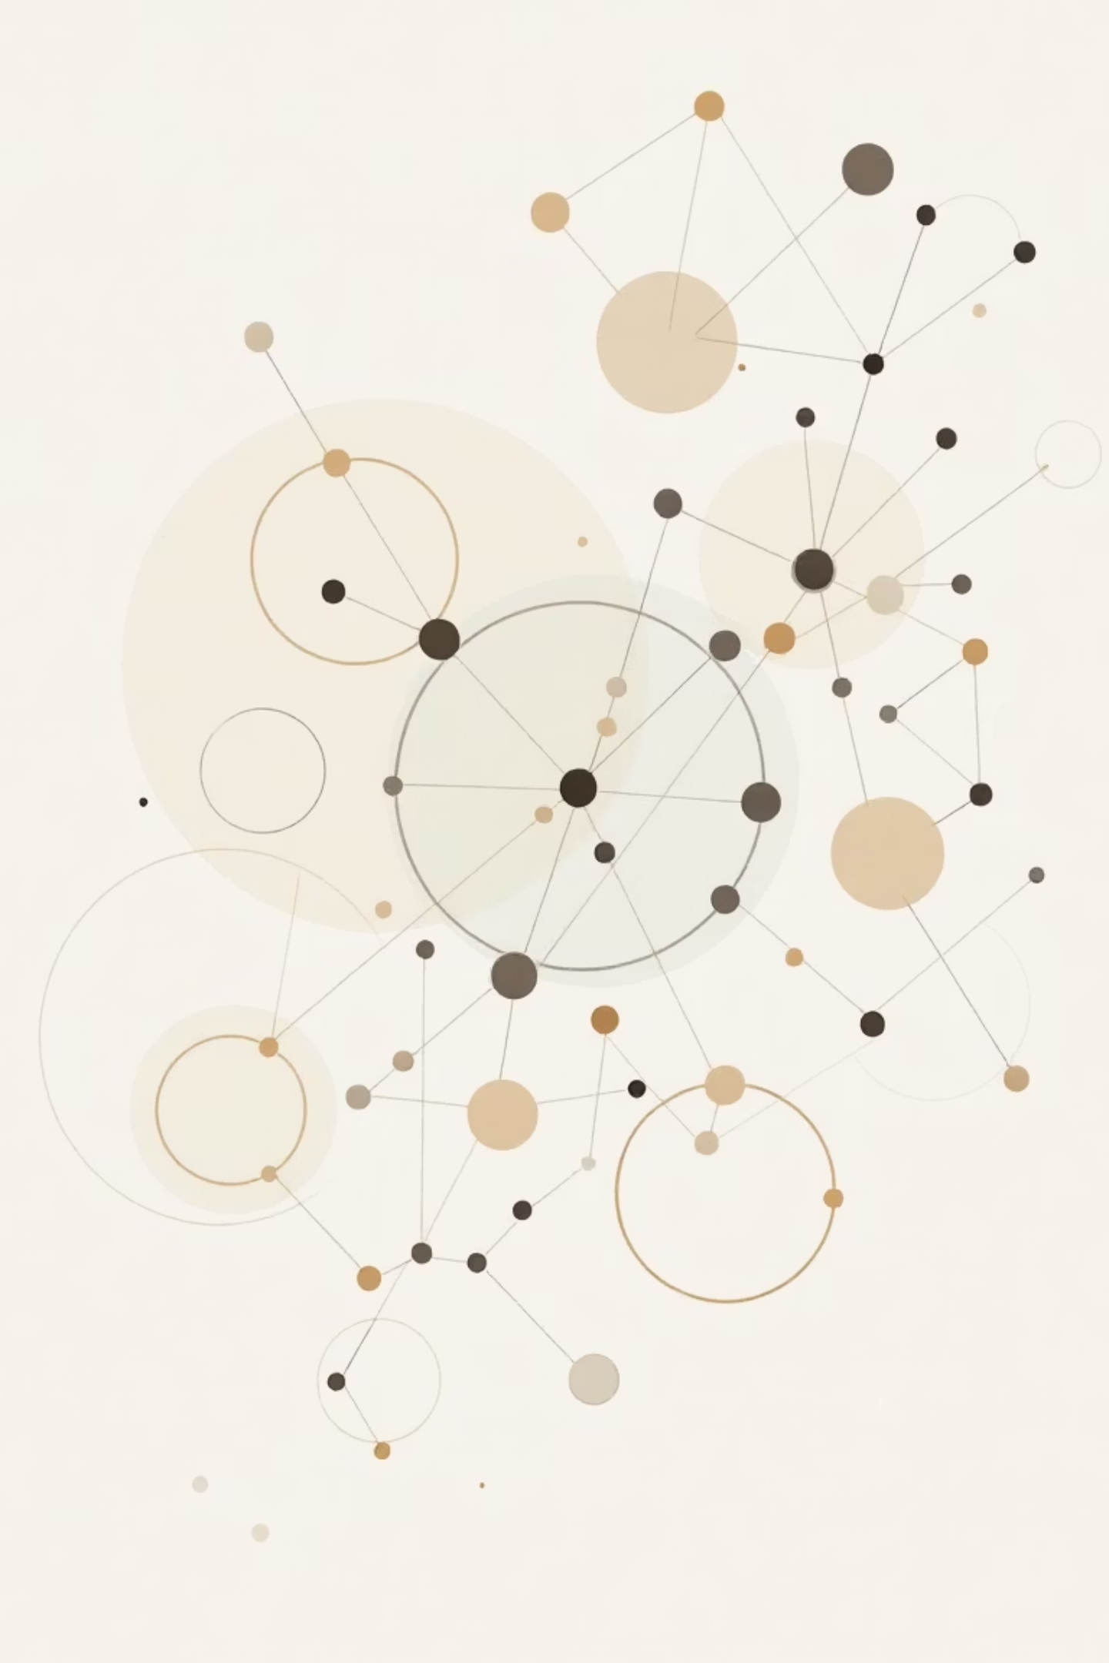


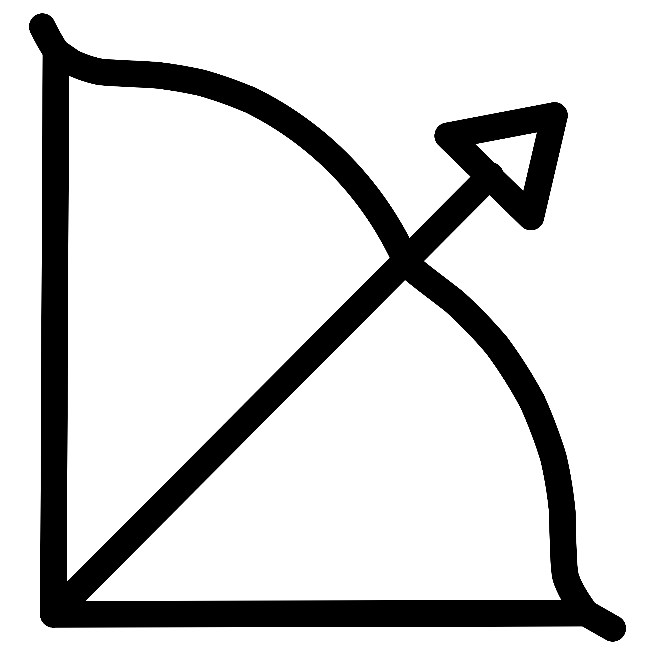
What is a Graph?
Supply Chain as a Graph
Nodes = Companies
Edges = Relationships
Each company is a circle (node) in our graph, representing a distinct entity in the supply chain.
Lines connecting nodes show business partnerships or transactions between companies.
Our Goal
Predict NEW edges – which companies should work together for optimal outcomes.

Slide 4

Our Dataset: SupplyGraph
Real supply chain data from Bangladesh, openly available at github.com/ciol-researchlab/SupplyGraph
40
806
Nodes (Companies)
Edges (Relationships)
Each node represents a distinct company within the supply chain network.
These represent the connections and interactions between companies.
What is in the Data?
Node Features: 8 descriptive features per company, detailing various attributes.
Product Groups: Links between companies dealing with similar product categories.
Plant Edges: Connections indicating factory-to-factory relationships.
Storage Links: Connections highlighting warehouse or storage facility relationships.

Slide 5
How GNN Works
The GNN transforms complex network data into actionable insights for supplier recommendations.
01
02
Look at Each Company
Talk to Neighbors
Each company has features like a profile, such as location, industry, and capacity. The GNN reads these features as its initial input.
Each company's representation is updated by aggregating information from its directly connected partners, learning from their attributes and relationships.
03
04
Create Fingerprint
Compare and Recommend
Through multiple layers of aggregation and transformation, each company gets a unique "embedding" or fingerprint that captures its network position and characteristics.
We then compare these embeddings to find companies with similar profiles or those that would form strong, complementary partnerships, recommending the best matches.
Input: 8 features → GNN Processing → Output: 16-dim embedding → Link Prediction Score

Slide 6
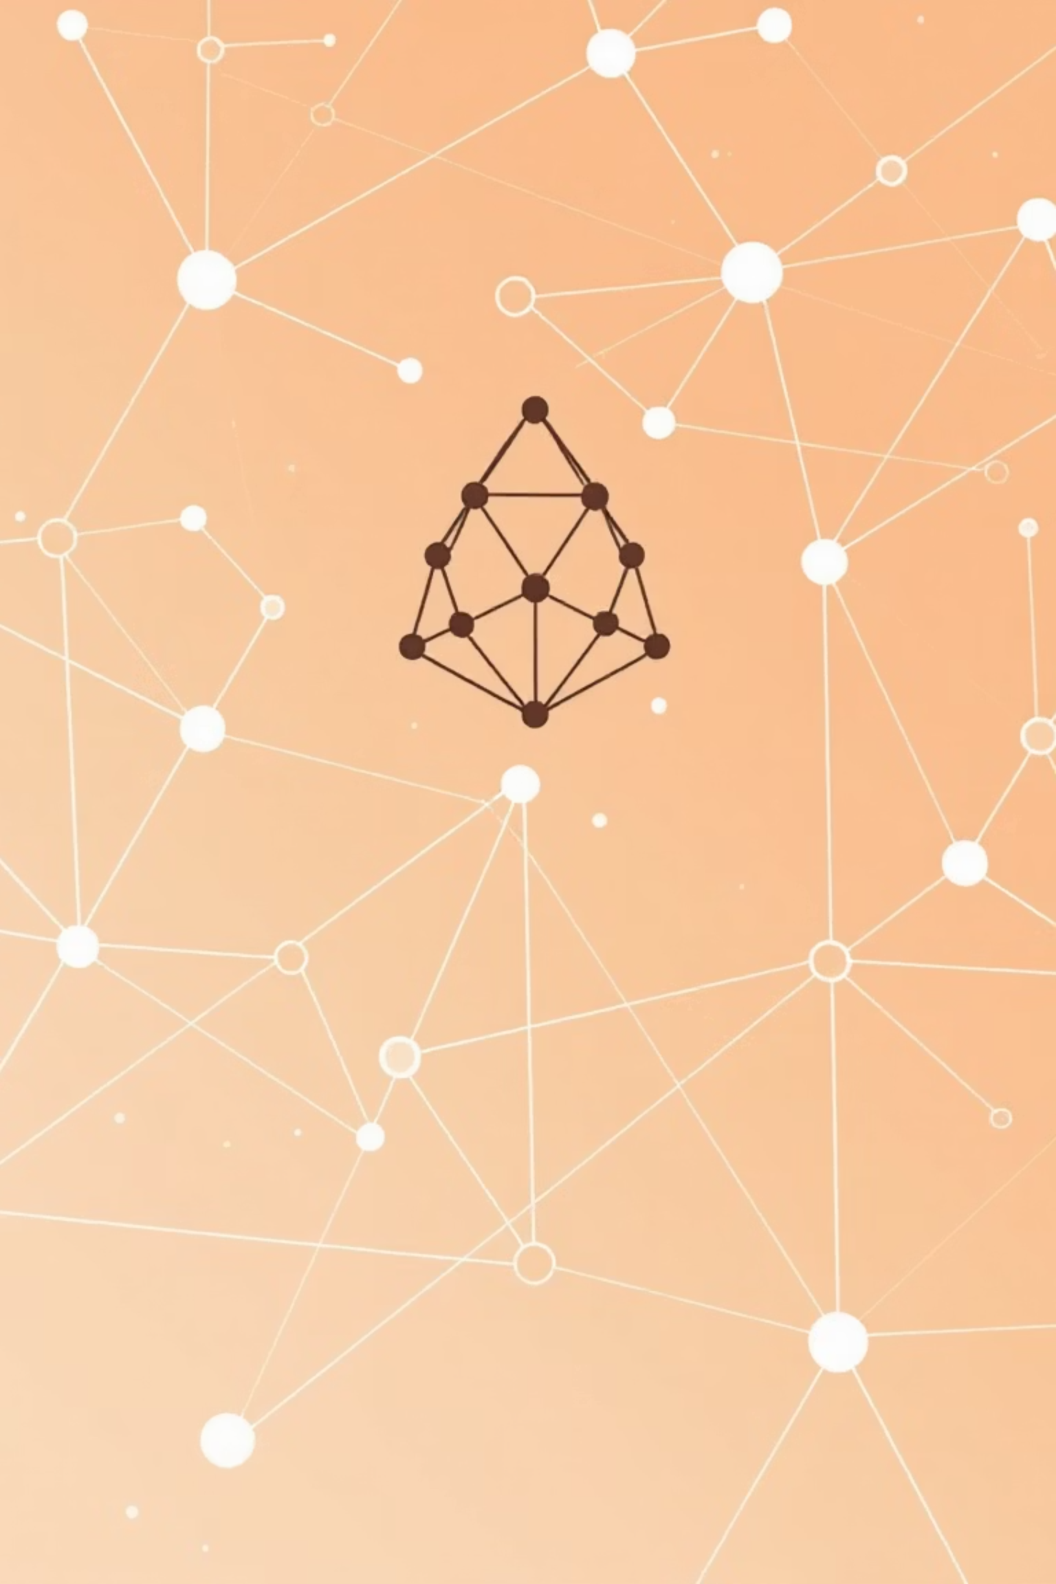

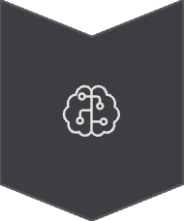
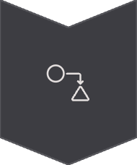
Our Model: 2-Layer GCN
Model Architecture Flow
8 Input Features
GCN Layer 1 (8→32)
GCN Layer 2 (32→16)
16 Output Embedding
Model Details
Training Setup
Type: Graph Convolutional Network (GCN)
Epochs: 100 iterations for training convergence.
Layers: Two GCN layers for hierarchical feature extraction.
Data Split: 70% Train / 5% Validation / 10% Test (remaining 15% used for other tasks).
Dropout: 0.2, applied to prevent overfitting and improve generalization.
Task: Link Prediction, identifying potential new connections.
Activation: ReLU (Rectified Linear Unit) for non-linearity.
Framework: PyTorch Geometric, leveraging its optimized GNN implementations.

Slide 7

Results: It Works!
Model Performance
80.2%
Average Precision
86.7%
Test AUC Score
What Does This Mean?
86.7% AUC: Our model correctly identifies good matches 87% of the time, significantly outperforming random chance (50%).
80.2% AP: When the system recommends a potential supplier, we are confident it's a valid match approximately 8 out of 10 times.
This indicates a robust and reliable system for supplier recommendations, far better than traditional, manual approaches.

Slide 8
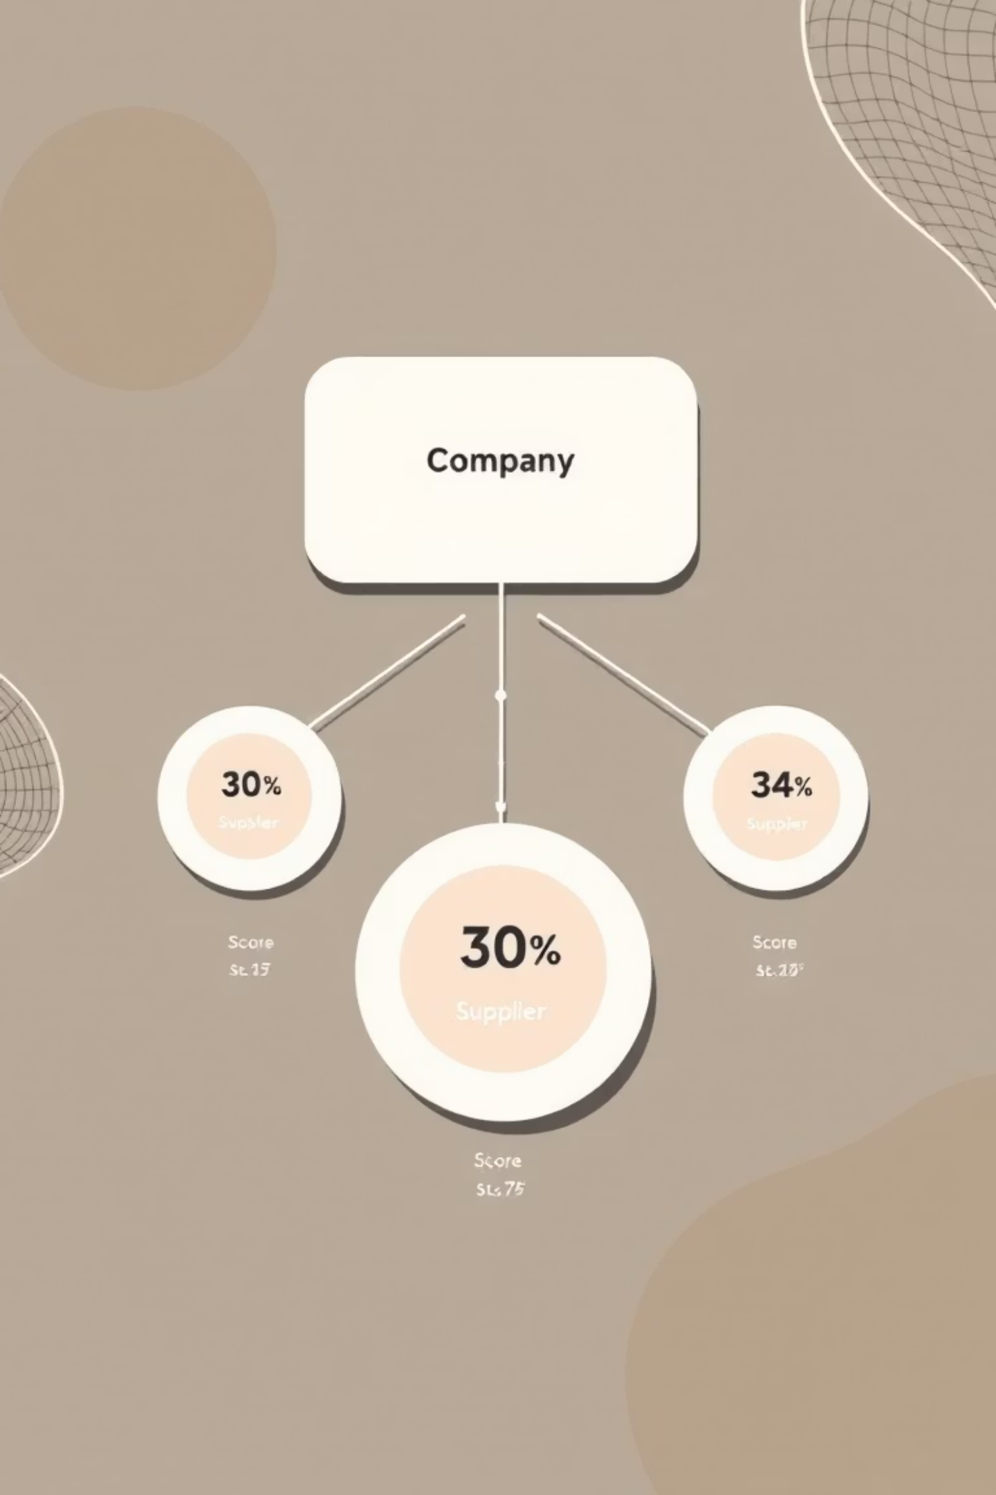

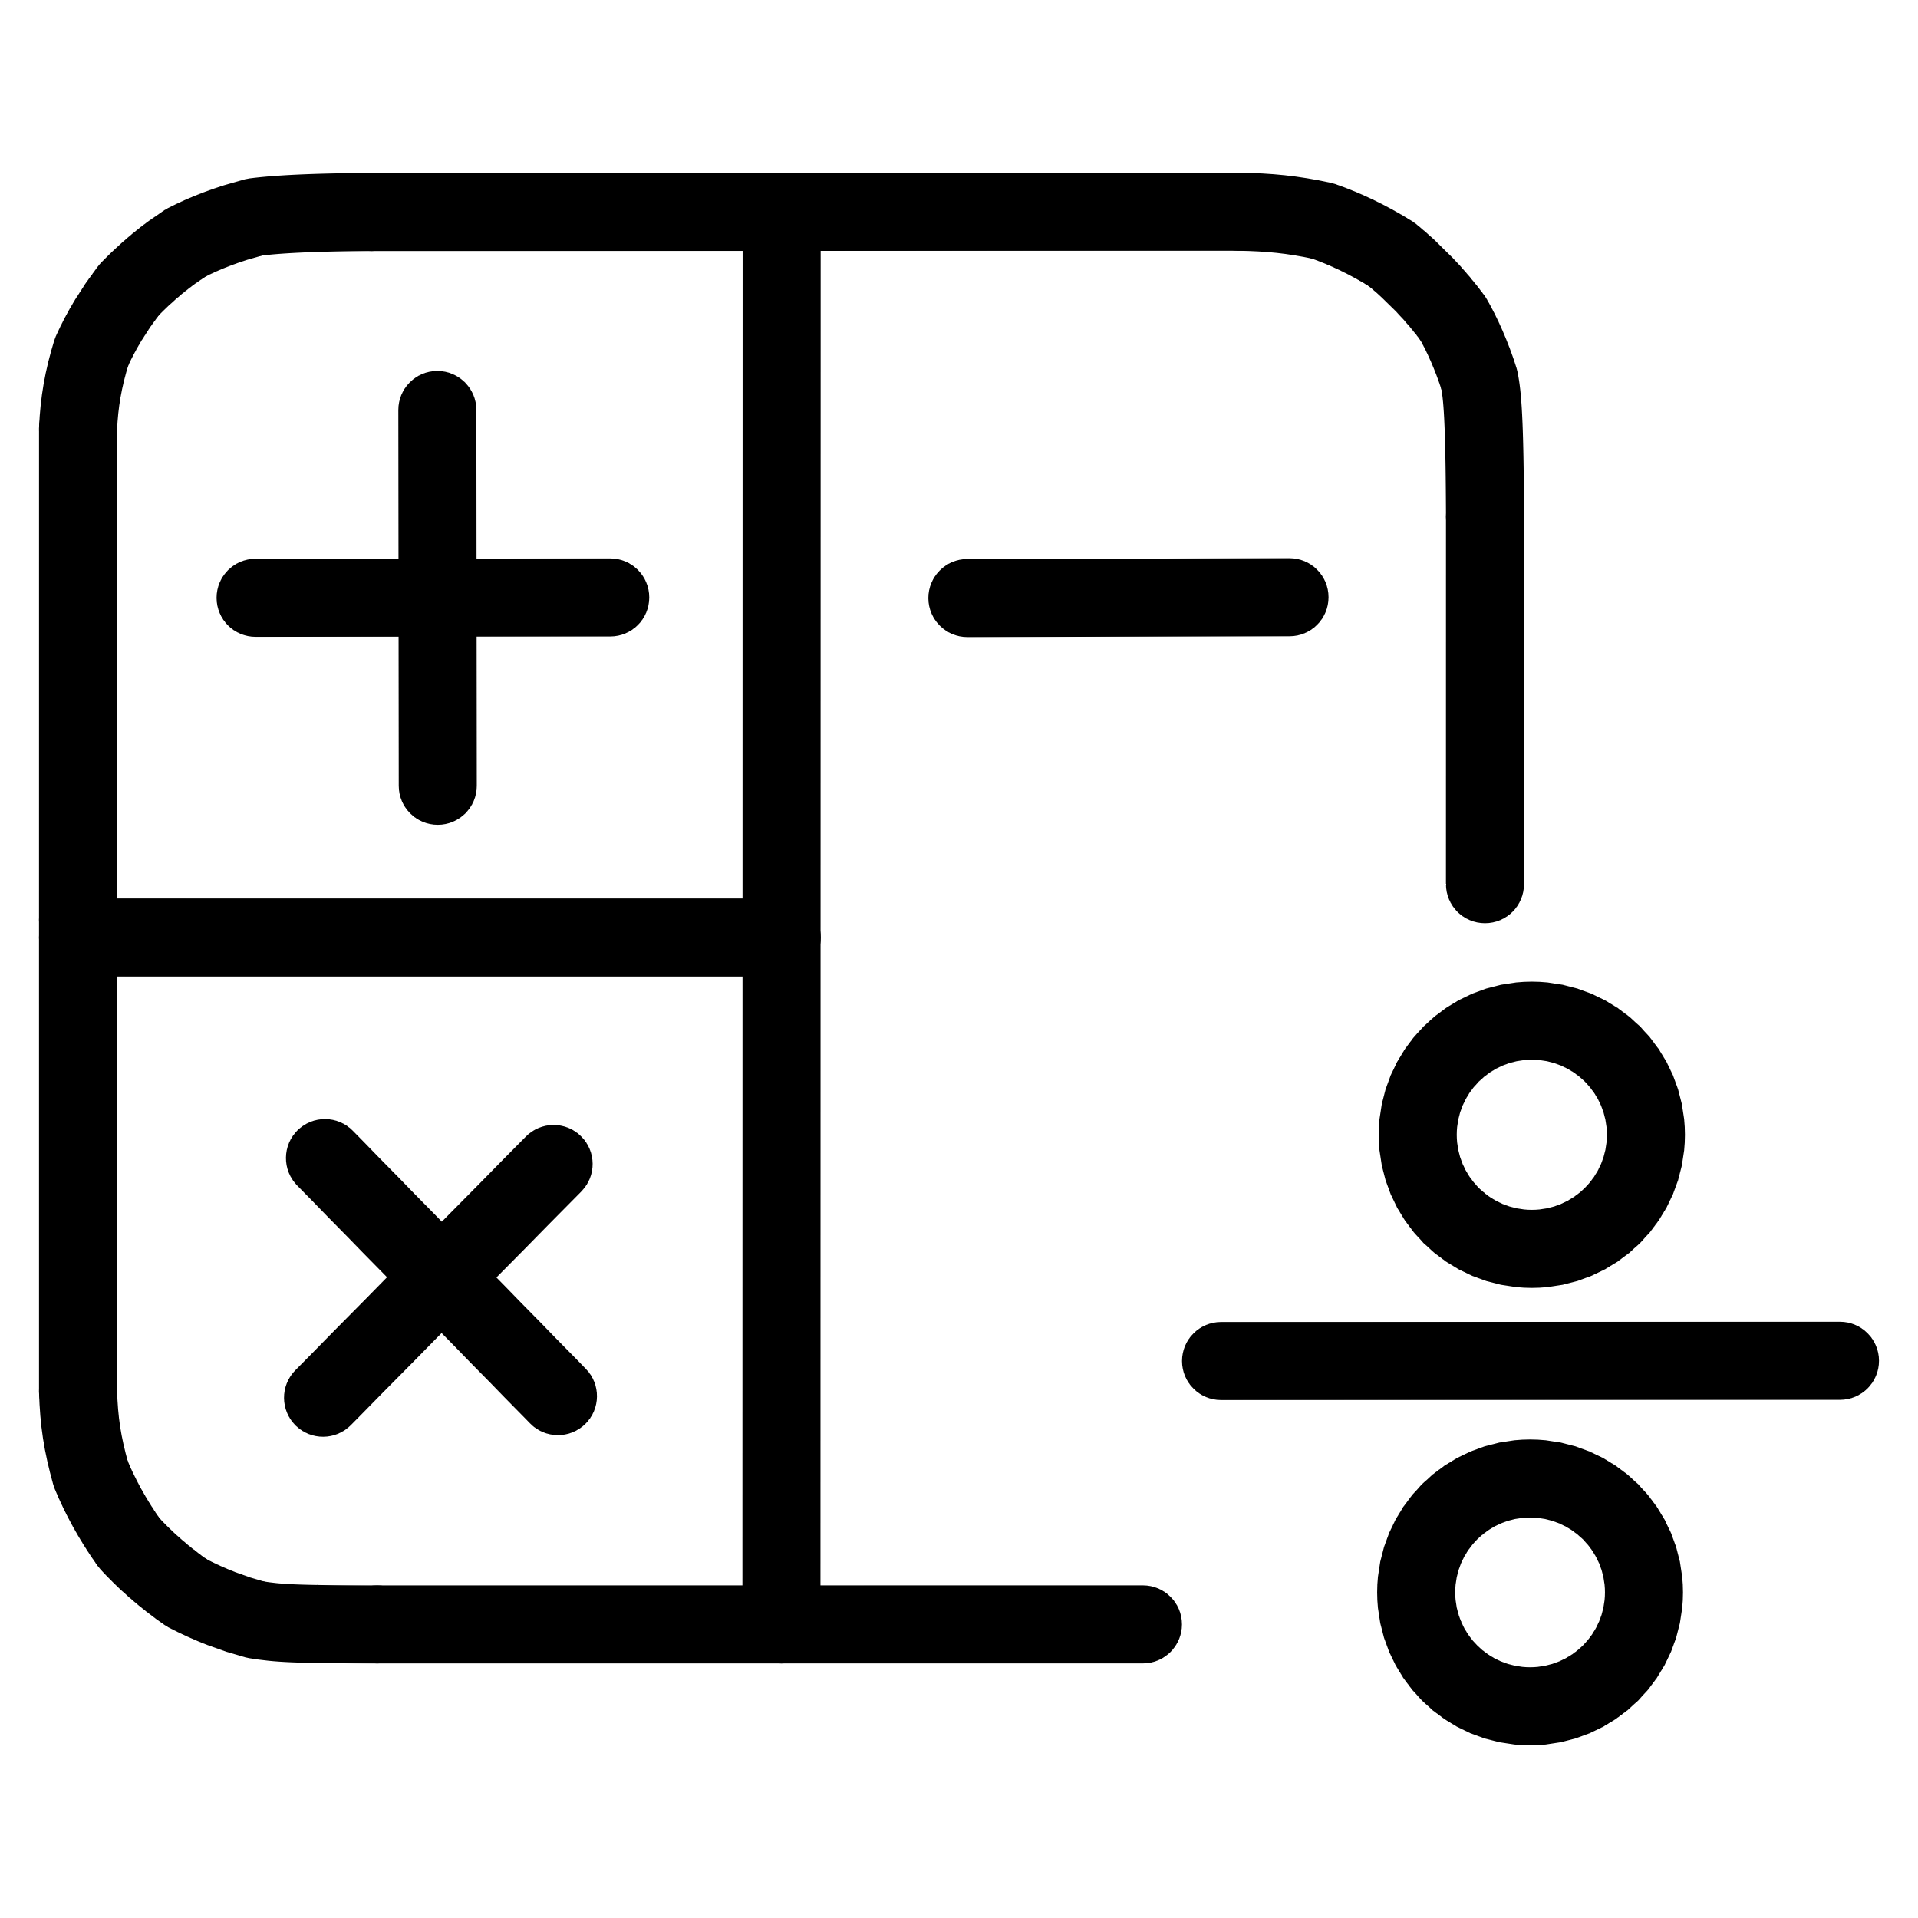
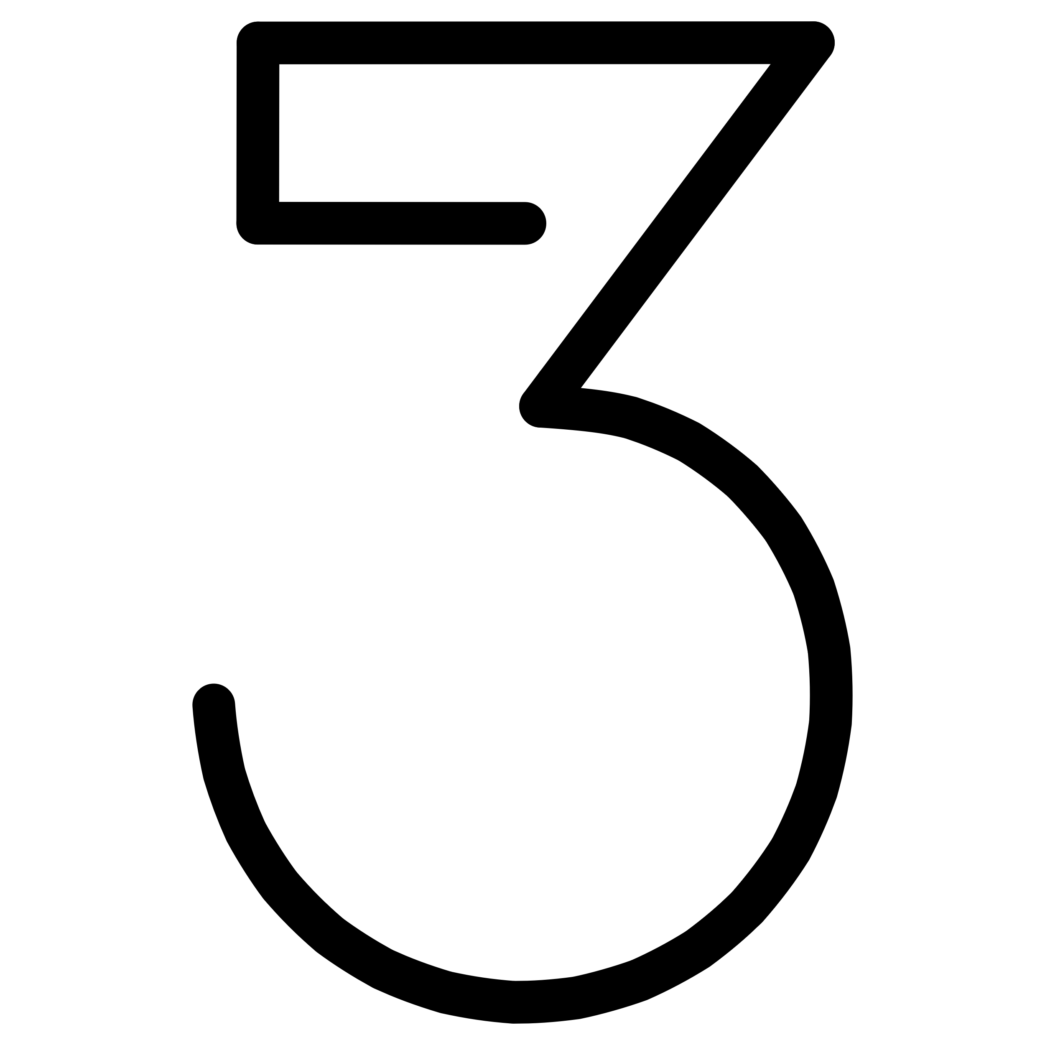
Sample Recommendations
Here is what our system recommends for company AT5X5K, based on its network patterns and features:
#1 ATN02K12P
#2 MAR01K24P
Score: 2.70
Score: 2.67
This recommendation indicates the strongest potential partnership based on GNN analysis.
A highly promising match, showing strong compatibility with AT5X5K.
#3 MASR025K
Score: 2.30
Another strong candidate, suggesting a valuable potential collaboration.
Higher scores indicate a better match. These companies share similar network patterns and characteristics with AT5X5K's existing successful partners.

Slide 9

Conclusion
Key Takeaway
Graph Neural Networks can learn intricate patterns from existing business relationships to predict new, high-potential partnerships that traditional, rule-based methods would often miss, revolutionizing supplier discovery.
What We Did
Future Work
Developed a GNN-based supplier recommendation system.
Integrate more diverse company features (e.g., financial health, sustainability metrics).
Utilized real-world supply chain data from the SupplyGraph dataset.
Test the model on significantly larger and more complex datasets for scalability.
Achieved a high performance of 86.7% AUC on test data, demonstrating effectiveness.
Incorporate time-based patterns and dynamic network changes for evolving recommendations.
Created an automated system capable of recommending new suppliers efficiently.

Slide 10



Thank You!
Questions?
Project Summary
40
806
86.7%
Nodes (Companies)
Edges (Relationships)
AUC Score

