Slide 1
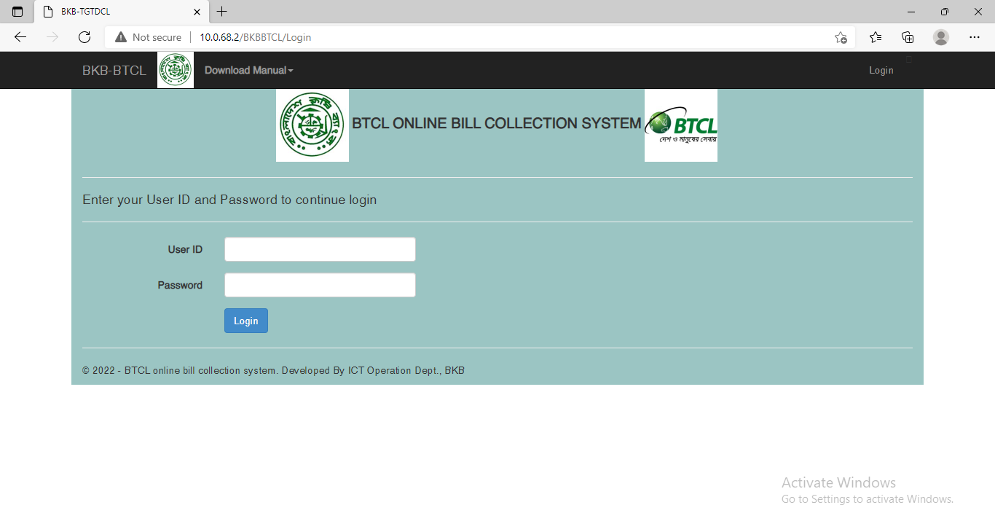
BTCL Online Bill Collection Manual
Login into the system using URL http://10.0.68.2/BKBUtility/
with your user id and password (at slide 10)

Slide 2
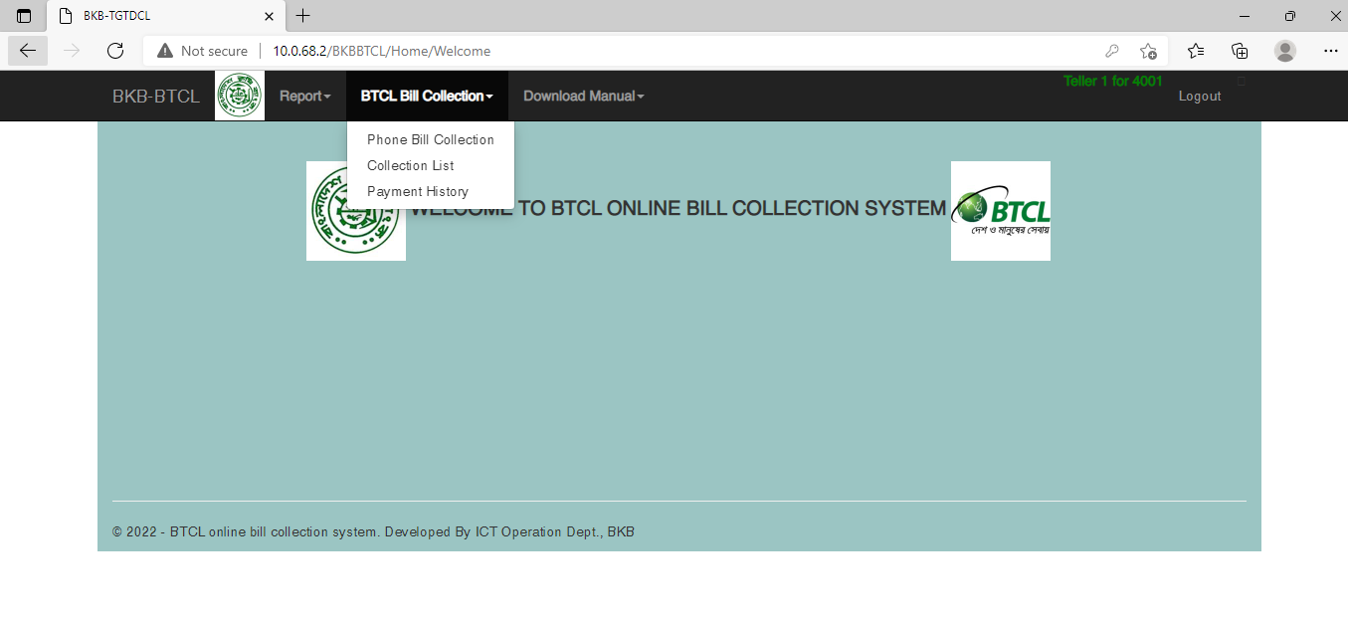
2. After successful login you get all the menu related To BTCL Bill collection, Reports and user management.
Select from BTCL Bill Collection Menu-> Phone Bill Collection

Slide 3
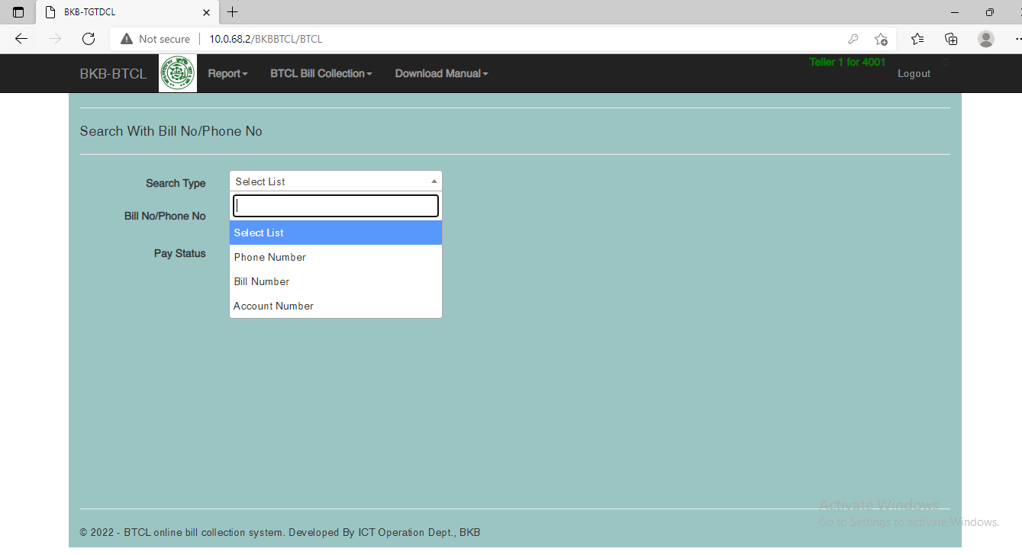
After Selecting menu press on Phone Bill Collection to collect Bill Select Search Type

Slide 4
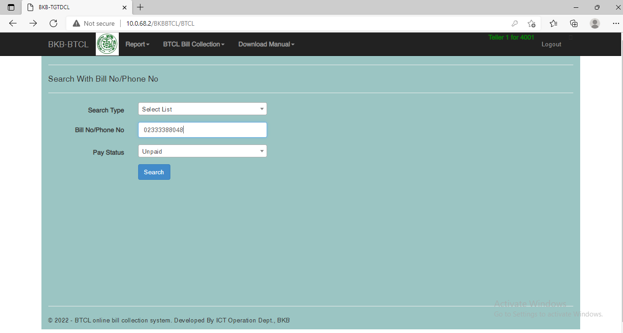
After Selecting Search Type Phone Number, giving Phone Number and selecting Pay Status Unpaid Press on Search Button

Slide 5
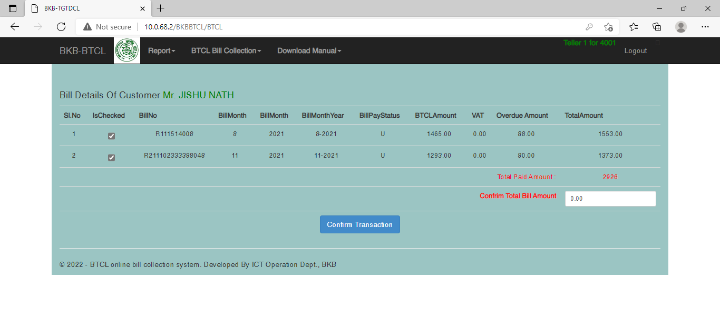
Check mark the IsChecked field which BillNumber the customer wants to give TotalAmount will be automatically displayed on Total paid Amount field
Confirm Total Bill Amount paid by customer at branch

Slide 6
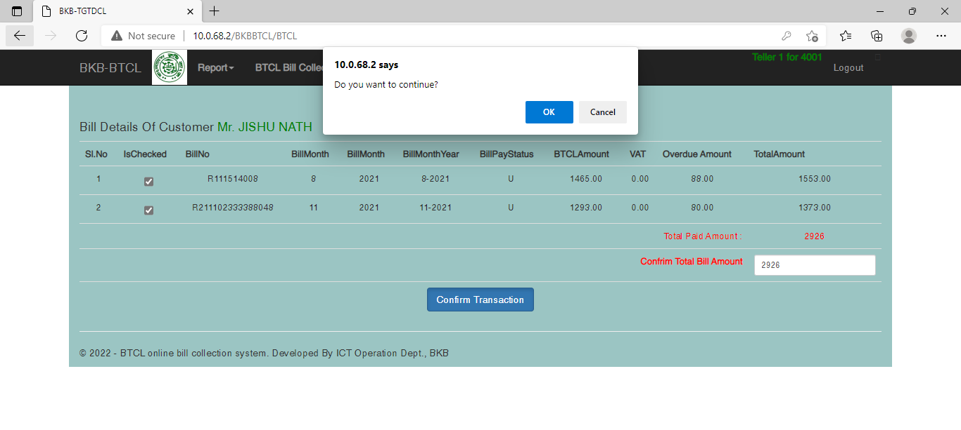

Slide 7
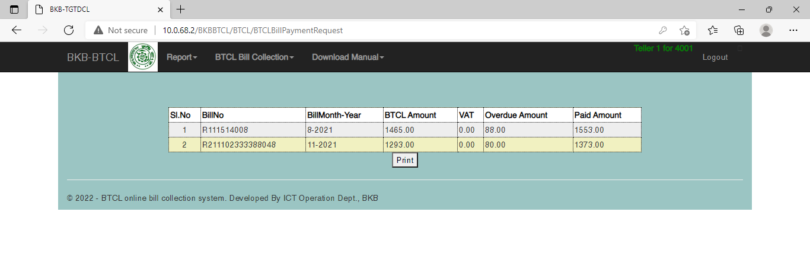
After successful payment you will receive this receipt with BillNo and Paid Amount which can be printed by clicking Print Button

Slide 8
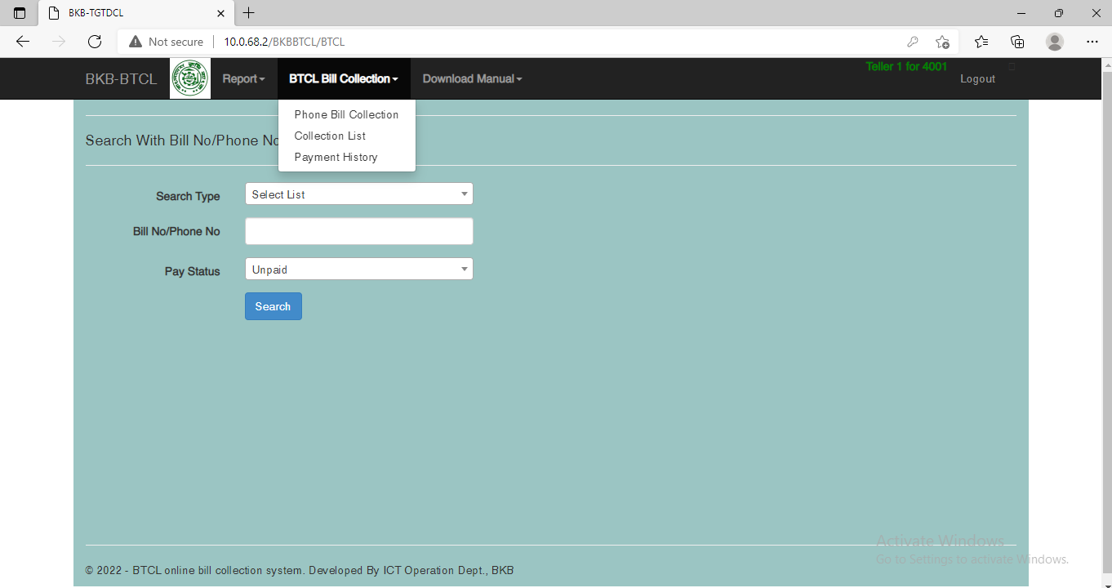
In order to view Collection List transaction Report select Collection List from here you also can cancel Payment

Slide 9
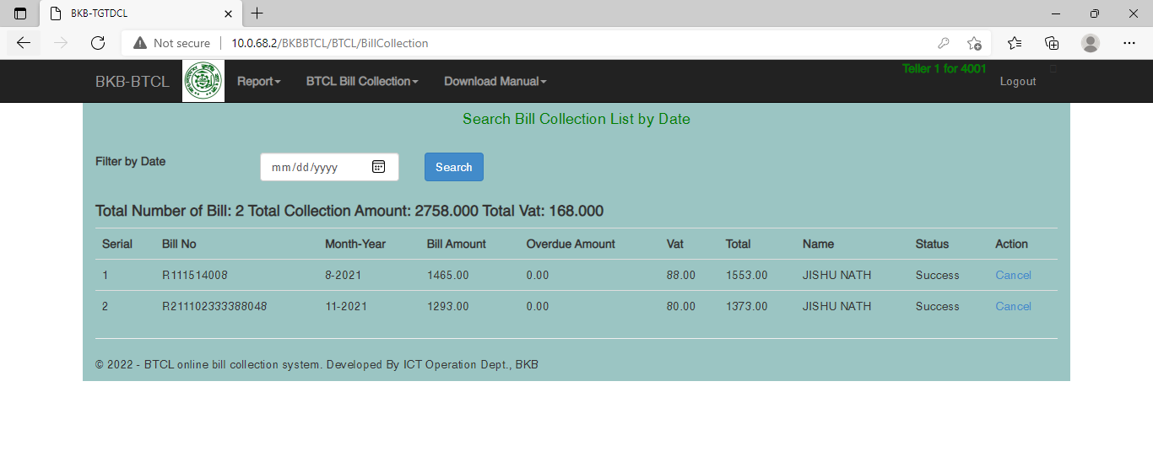

Slide 10
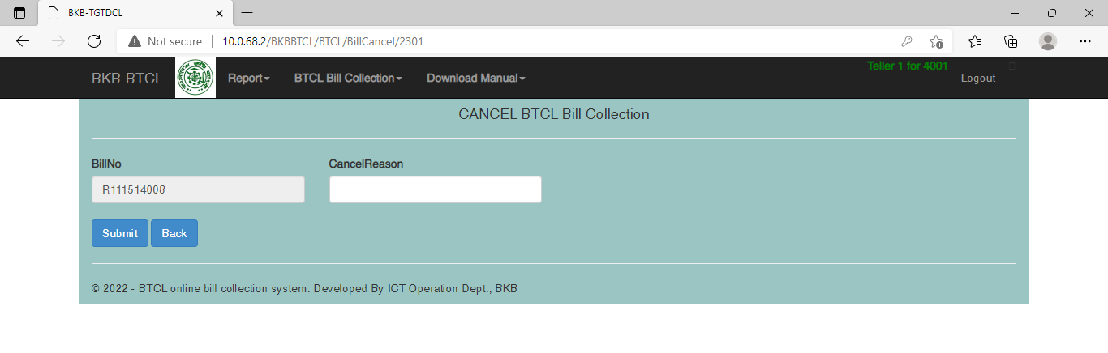

Slide 11
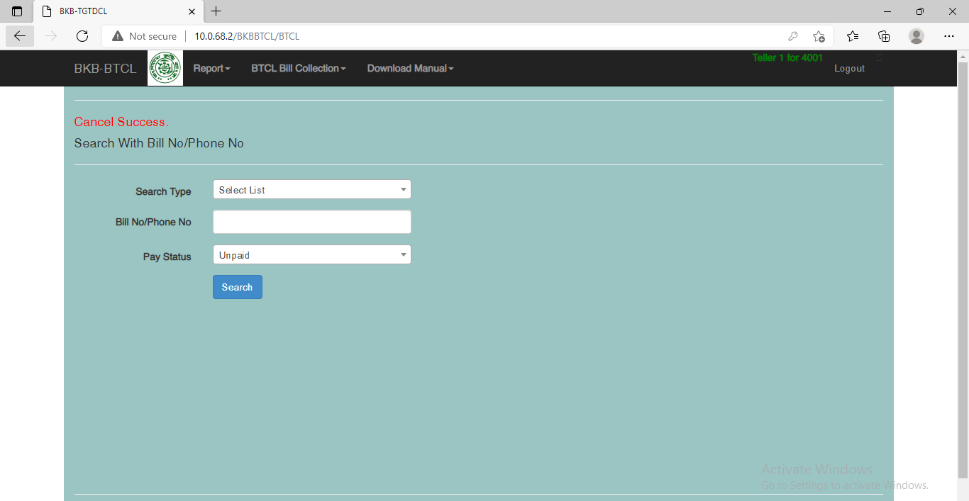

Slide 12
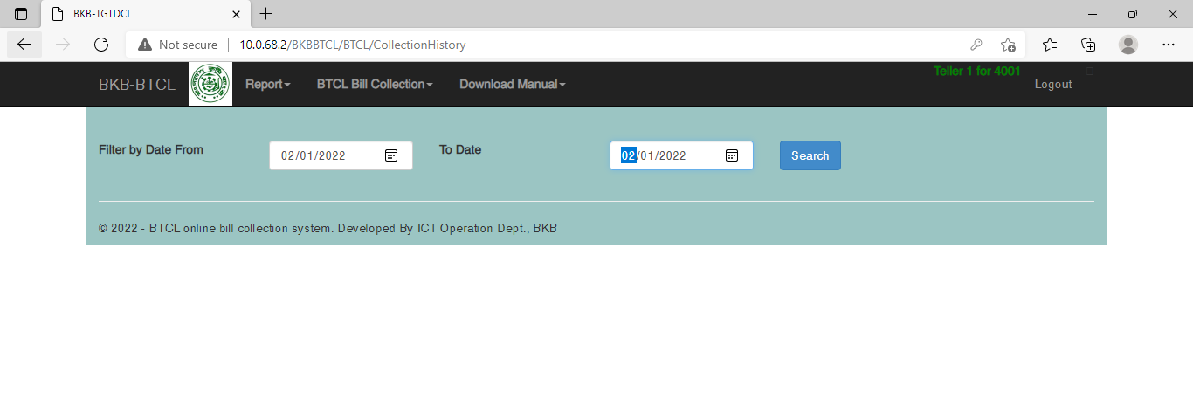
In order to view Payment History transaction Report select Payment History

Slide 13
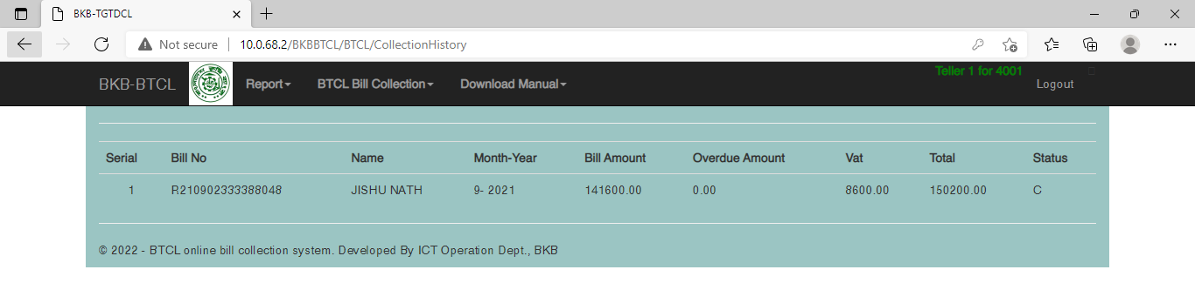

Slide 14
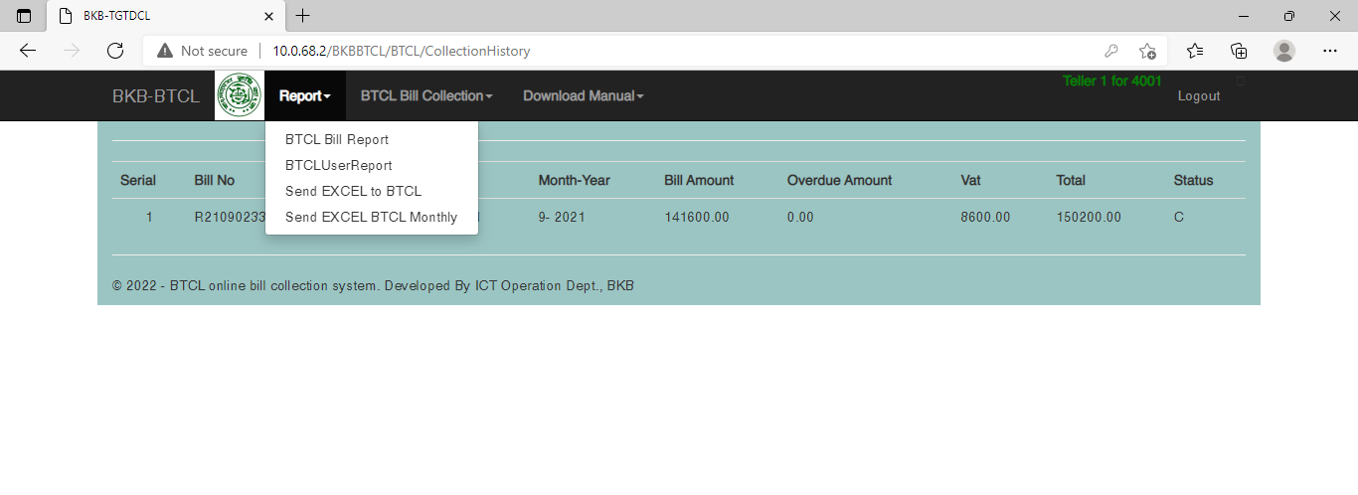
All the report listed here.

Slide 15
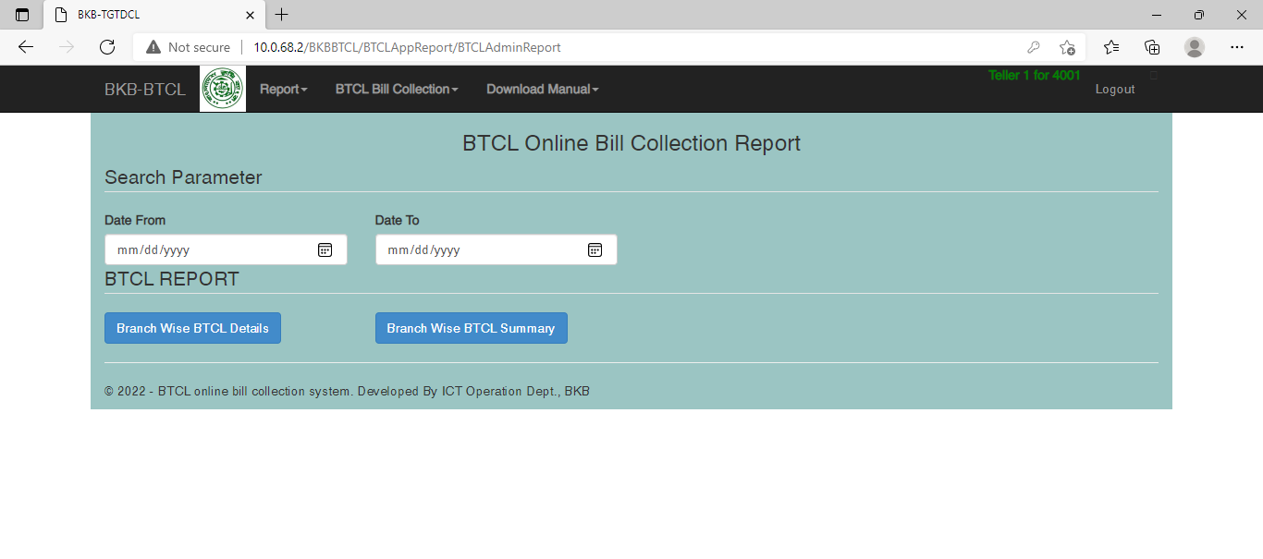
All the report listed here. Select report you want to view within the date range

Slide 16
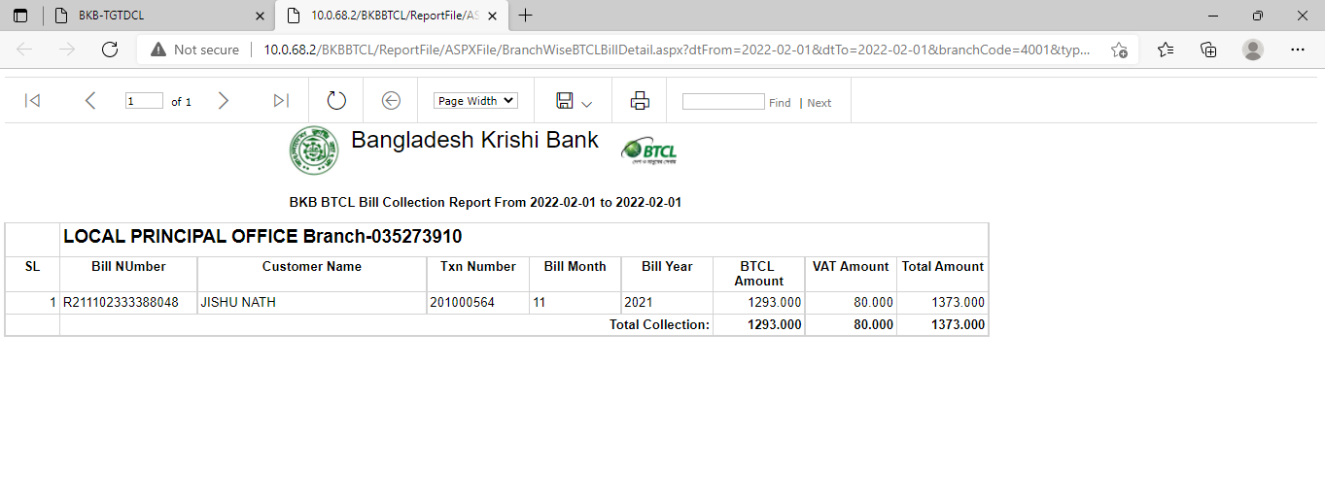

Slide 17
Dear Sir,
Please be informed that Bangladesh Krishi Bank has introduced online bill collection system for BTCL. All the branch of Dhaka and division/districts of BKB will collect BTCL telephone bill from the system.
All the branches are instructed to follow the manual attached herewith in order to collect bill. After successful collection of bill branch are requested to deposit the collected amount to BTCL SND account and VAT account managing at Local Principle Branch.
Account Details:
Serial | Account No | Account Name
1 | 4001-0210042284 | BTCL Bill Collection Account
2 | 4001-0210042293 | BTCL VAT Account
User ID: bkbmgxxxx (xxxx is four digit branch code. Ex: bkbmg0201, bkbmg0202)
Password: 123456 (User must need to change their password at first login)

Slide 18
Support
Md. Ahsan Habib, Programmer(01777-743207)
Maklina Khatun, Asst. Programmer (01516-134435)

