Slide 1
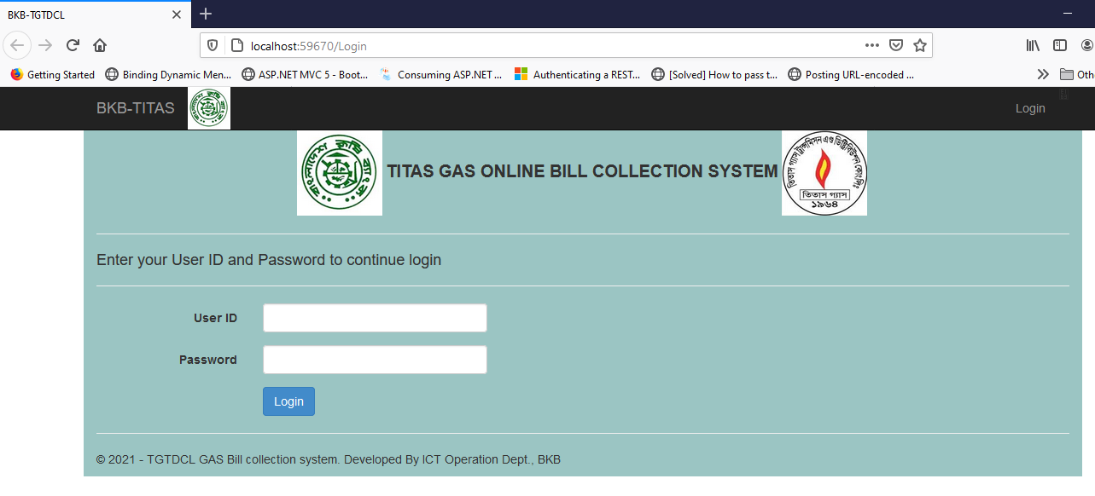
TITAS Online Bill Collection Manual
Login into the system using URL http://10.0.68.2/bkbtitas
with your user id and password (at slide 10)

Slide 2
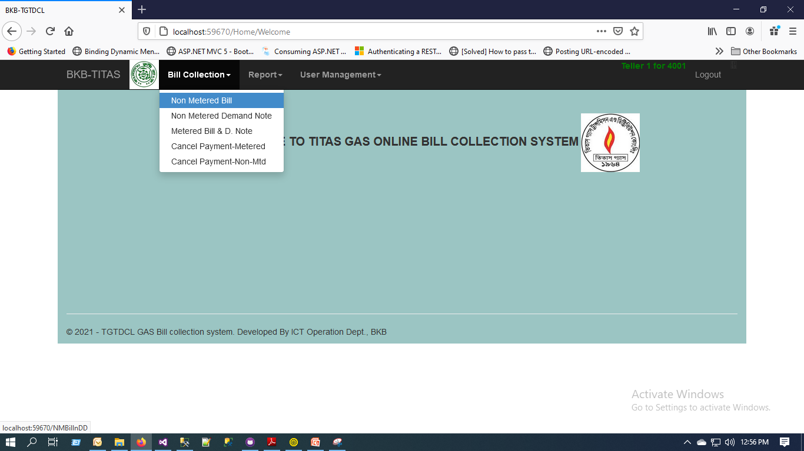
2. After successful login you get all the menu related To bill collection, Reports and user management.

Slide 3
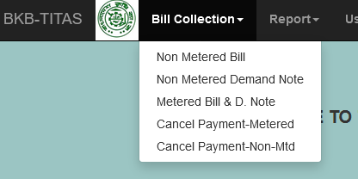
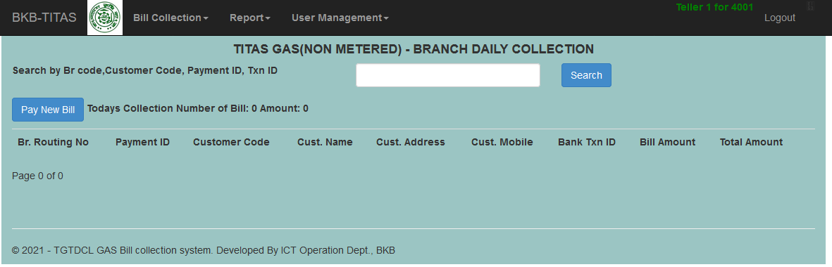
Select collection type from
Bill Collection Menu-> Non-metered Bill
After Select menu press on Pay New Bill to collect Bill
You can search Specific bill inputting value and press search
If you have any bill paid today for non-metered you will see the list here

Slide 4
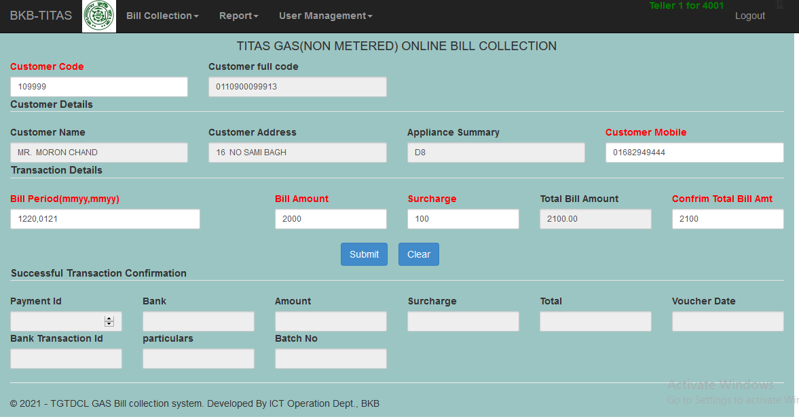
Input Customer ID
Press Tab or Move Cursor customer Information will automatically display
Check customer data and provide Bill information and then press submit
*Red colors are mandatory field

Slide 5
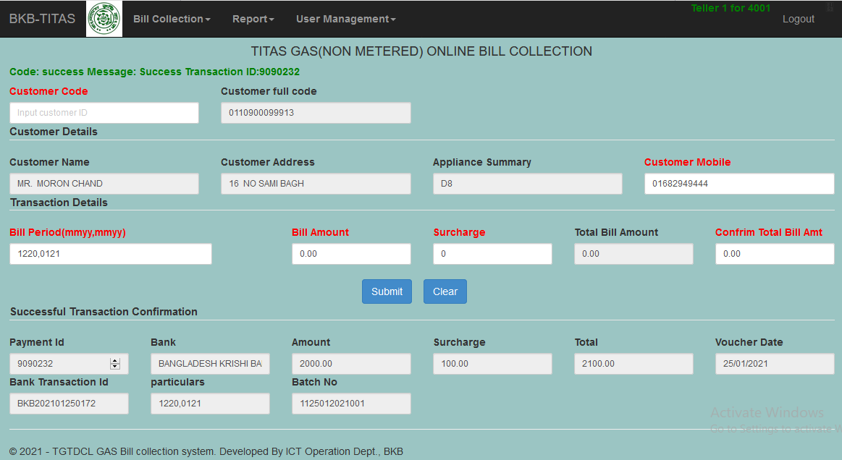
If your Bill paid successfully you will get the message with transaction ID
In addition you will receive the below response for Non-Metered Bill. To collect new bill press Clear

Slide 6
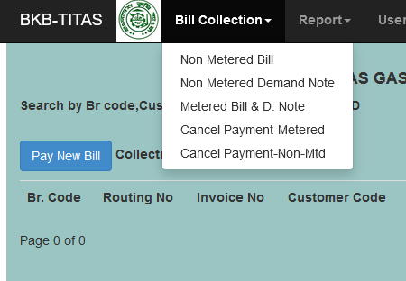
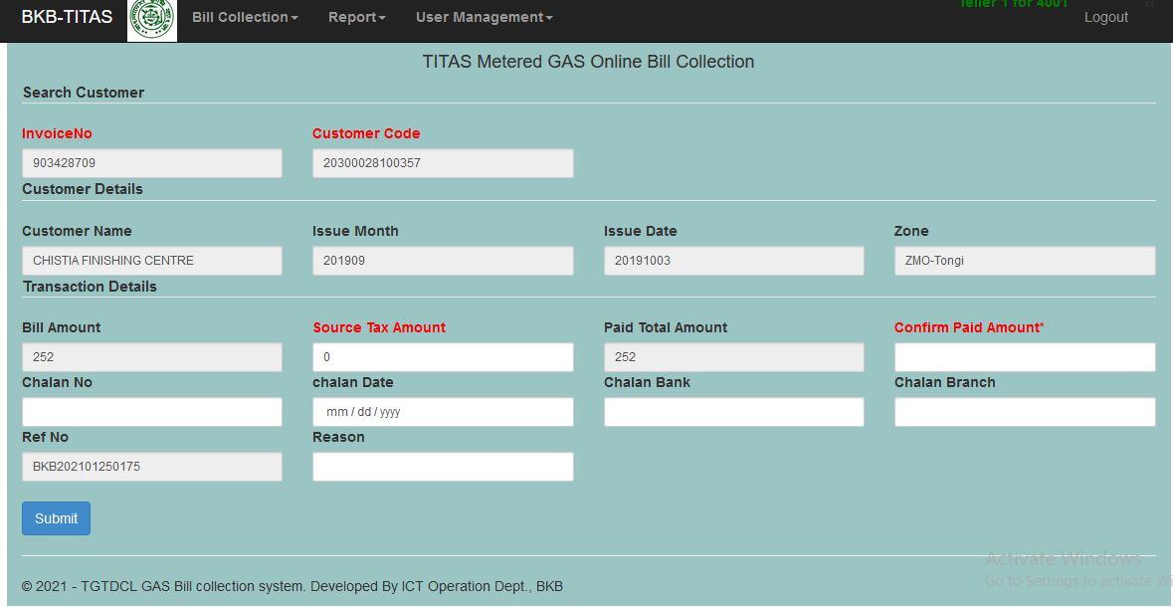
In order to collect Metered bill Select Bill Collection-> Metered Bill
Bill list page will load press Pay New Bill
Input Invoice No first and then input customer code for metered customer move cursor. Bill information will populate display
Confirm total amount paid by customer at branch
If any Source tax(AIT) paid by customer Input chalan information
Press Submit after completing input

Slide 7
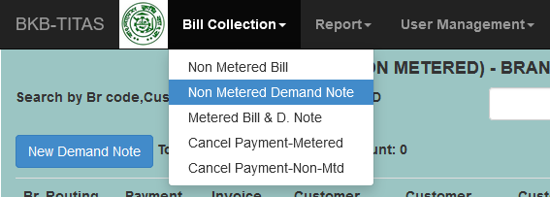
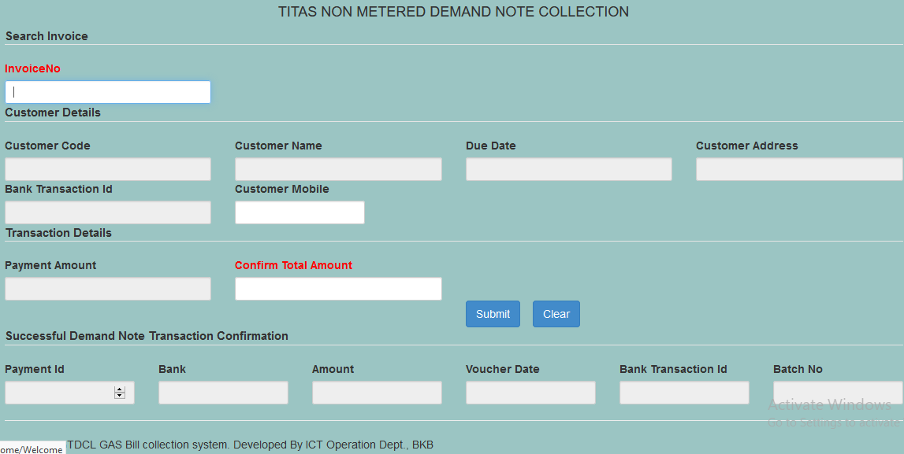
To collect Non-Metered Demand Note select from menu and press New Demand Note
Input Non-metered Demand note Invoice No you will get all information Press submit successful response will show as before. Press clear to collect new bill

Slide 8
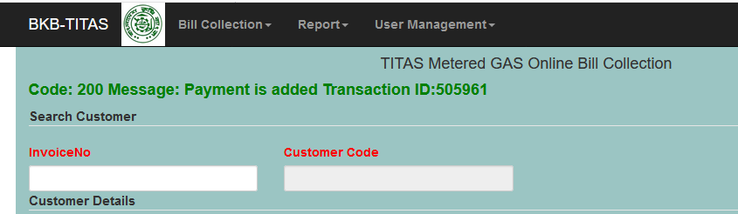
After successful payment you will receive Transaction ID

Slide 9
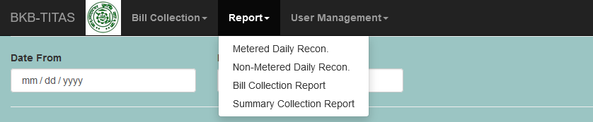
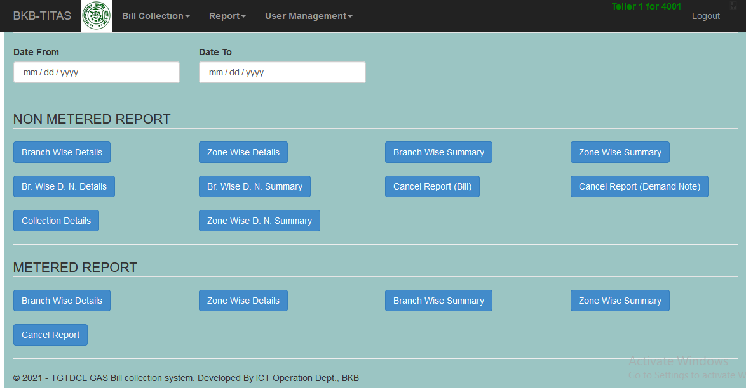
In order to view daily and historical transaction Report select Bill Collection Report
All the report listed here. Select report you want to view within the date range

Slide 10
Dear Sir,
Please be informed that Bangladesh Krishi Bank has introduced online bill collection system for TITAS. All the branch of Dhaka and Mymenshing division of BKB will Titas GAS bill from the system.
All the branches are instructed to follow the manual attached herewith in order to collect gas bill. After successful collection of GAS bill branch are requested to deposit the collected amount to Titas SND account at Kawranbazar Branch.
Account Details:
Serial | Account No | Account Name
1 | 4101-032000092 | Titas Gas Transmission and Distribution Company Limited(Metered)
2 | 4101-032000093 | Titas Gas Transmission and Distribution Company Limited(Non-Metered)
User ID: bkbmgxxxx (xxxx is four digit branch code. Ex: bkbmg0201, bkbmg0202)
Password: 123456 (User must need to change their password at first login)

Slide 11
Support
Md. Ahsan Habib, Programmer(01777-743207)
Al-Uddin, Senior Officer-IT(01829-370289)
SM Samiul Haque Rubel, Senior Officer-IT(01732-218813)

