Slide 1
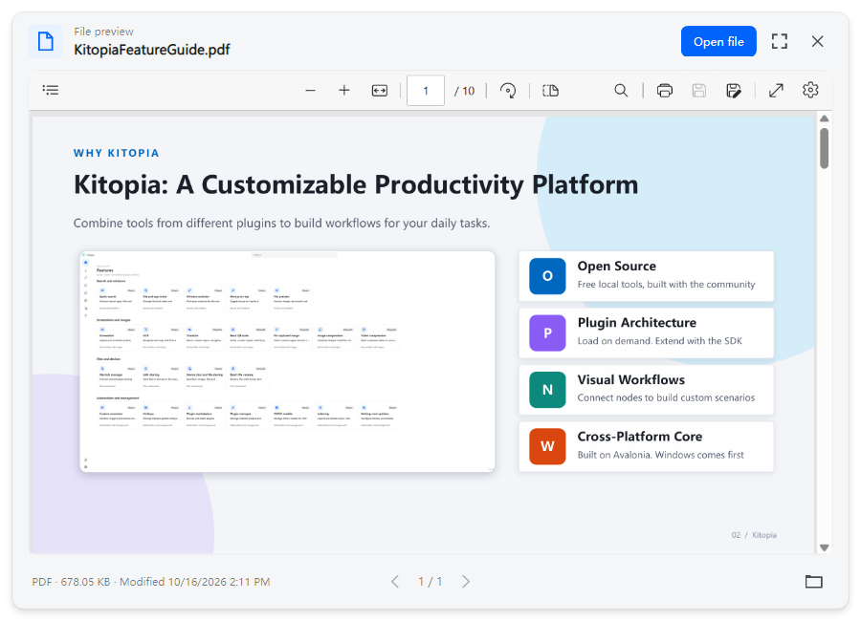
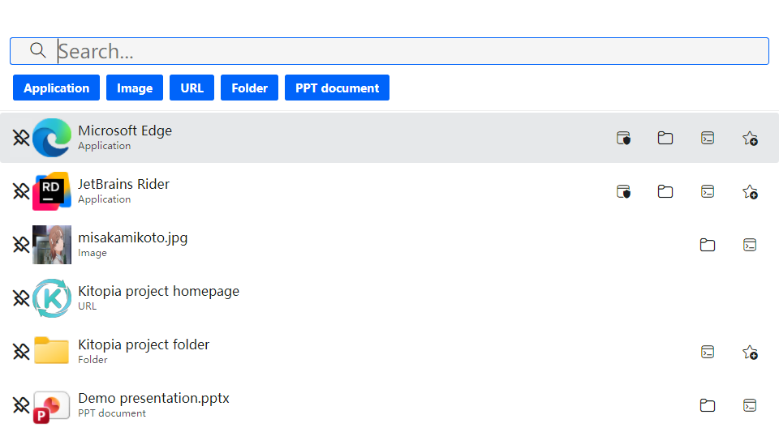
OPEN SOURCE · FREE · PLUGINS · NODES
Kitopia
Your desktop productivity toolkit
Open source tools with plugins and visual workflows
Version 1.0.0 released
github.com/Maklith/Kitopia
Notes:
Preview image source: Misaka Mikoto, A Certain Scientific Railgun T official character page. https://toaru-project.com/railgun_t/chara/mikoto.html
Image: https://toaru-project.com/railgun_t/core_sys/images/contents/00000008/block/00000001/00000242.jpg
Product screenshots: docs/tools/render. Image material: https://toaru-project.com/railgun_t/chara/mikoto.html

Slide 2
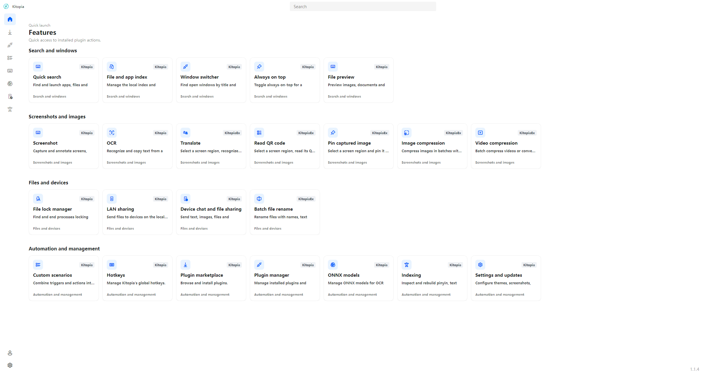
WHY KITOPIA
Kitopia: A Customizable Productivity Platform
Combine tools from different plugins to build workflows for your daily tasks.
O
Open Source
Free local tools, built with the community
P
Plugin Architecture
Load on demand. Extend with the SDK
N
Visual Workflows
Connect nodes to build custom scenarios
W
Cross-Platform Core
Built on Avalonia. Windows comes first
02 / Kitopia
Notes:
Product screenshots: docs/tools/render. Image material: https://toaru-project.com/railgun_t/chara/mikoto.html

Slide 3
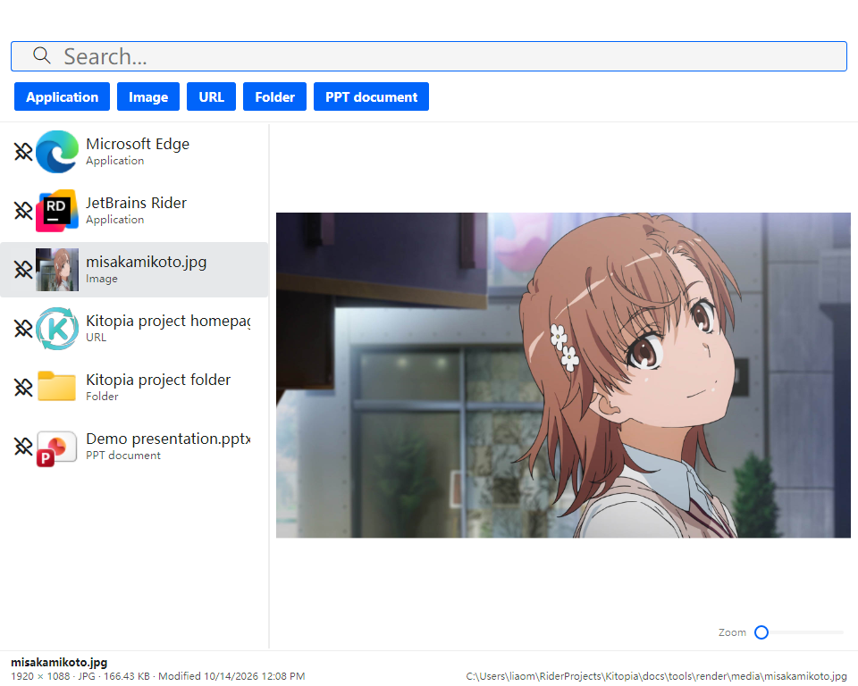
LAUNCHER · Alt + Space
Search, Launch and Preview
Quick Launch
Launch apps, files and folders. Run as admin
Everything Search
Search files across your drives
Clipboard Actions
Recognize paths in the clipboard and open them
Web and Commands
Open websites, search the web or run shell commands
Everyday Tools
Calculations, clipboard image saving and translation
03 / Kitopia
Notes:
Preview image source: Misaka Mikoto, A Certain Scientific Railgun T official character page. https://toaru-project.com/railgun_t/chara/mikoto.html
Image: https://toaru-project.com/railgun_t/core_sys/images/contents/00000008/block/00000001/00000242.jpg
Product screenshots: docs/tools/render. Image material: https://toaru-project.com/railgun_t/chara/mikoto.html

Slide 4
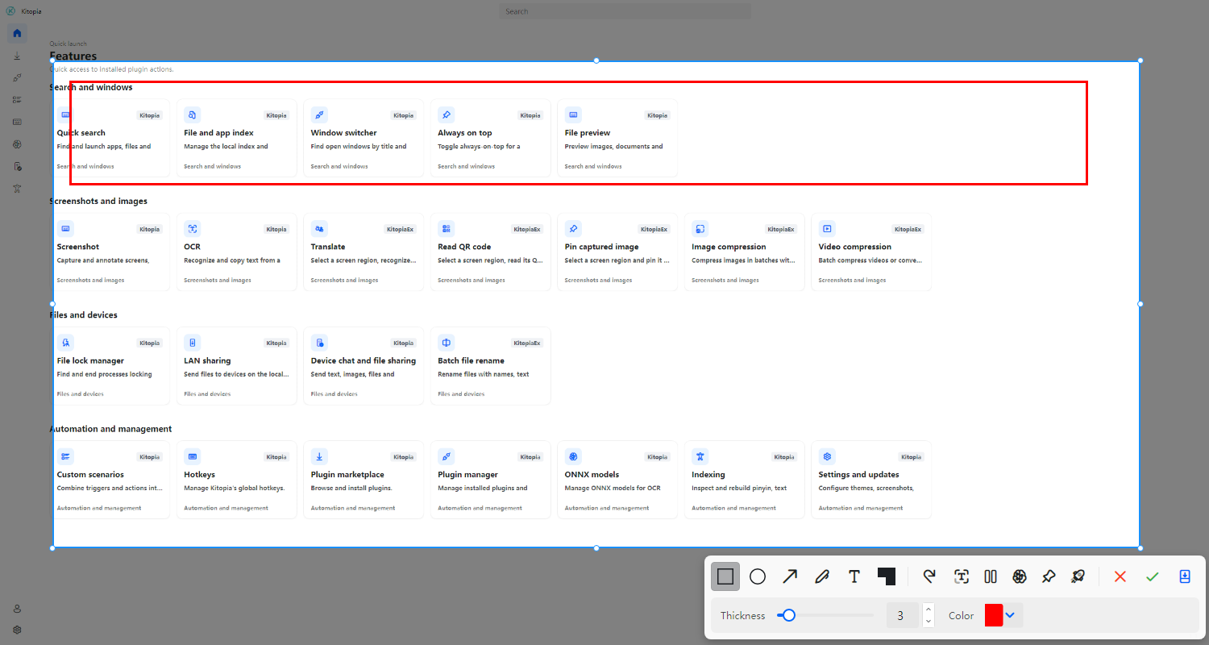
SCREENSHOT · Ctrl + Alt + Q
Screenshots, HDR and Scrolling Capture
H
HDR
L
Scroll
Capture high dynamic range color
Scroll to capture long pages
A
Annotate
O
OCR
Shapes, arrows, pens, text and mosaic
Extract text from screenshots
Q
QR Codes
T
Translate
Read QR codes in images
Translate captured text
Pin Image
Keep a screenshot on top for reference
Quick Look: select a file in Explorer and press Space
04 / Kitopia
Notes:
Product screenshots: docs/tools/render. Image material: https://toaru-project.com/railgun_t/chara/mikoto.html

Slide 5
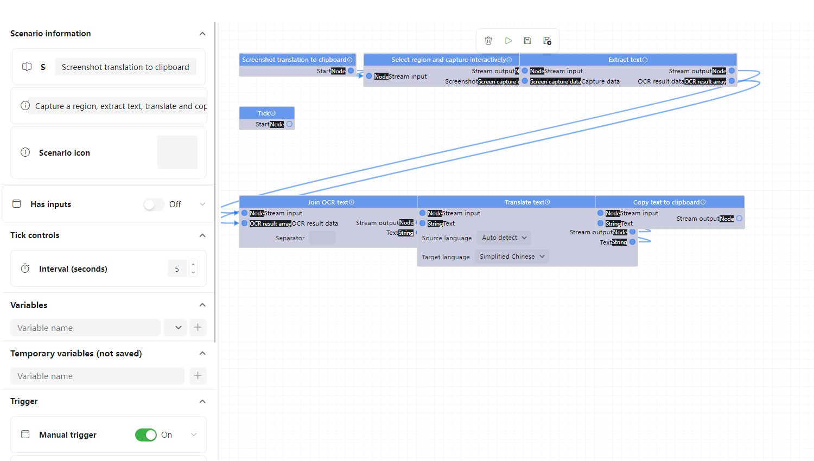
SCENARIOS
Build Workflows with Visual Nodes
Connect built-in and plugin tools in a visual editor inspired by Unreal Engine Blueprints.
Visual Editor
Arrange logic on a canvas
Plugin Tools
Combine capabilities
Market
Upload, download and import scenarios
05 / Kitopia
Notes:
Product screenshots: docs/tools/render. Image material: https://toaru-project.com/railgun_t/chara/mikoto.html

Slide 6
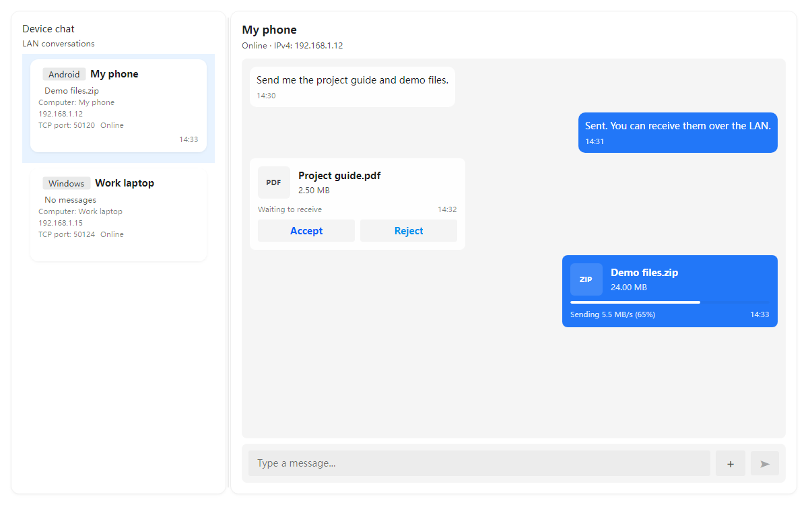
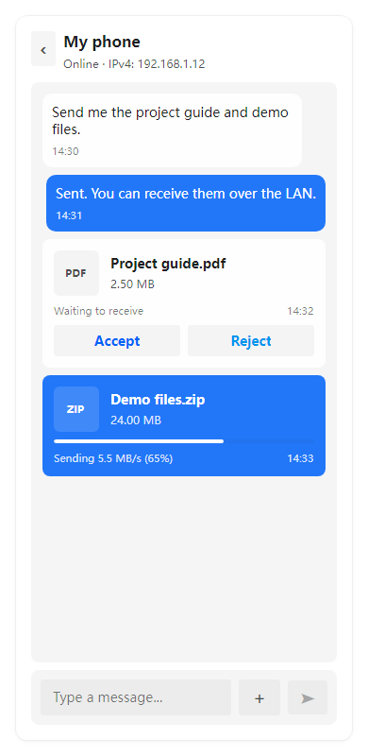
DEVICE LINK
Chat and Share Files Across Devices
Automatic Discovery
Find Windows and Android devices on your LAN
Device Chat
Send and receive messages between devices
File Transfers
Share files with progress and speed indicators
Receive Confirmation
Accept or reject incoming files
Android Companion
Chat and exchange files from your phone
06 / Kitopia
Notes:
Product screenshots: docs/tools/render. Image material: https://toaru-project.com/railgun_t/chara/mikoto.html

Slide 7
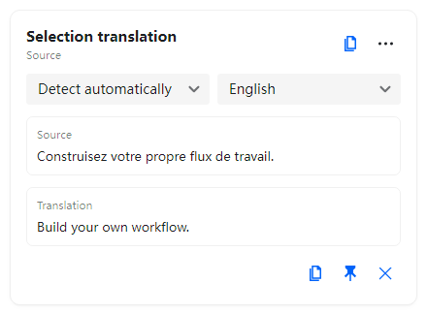
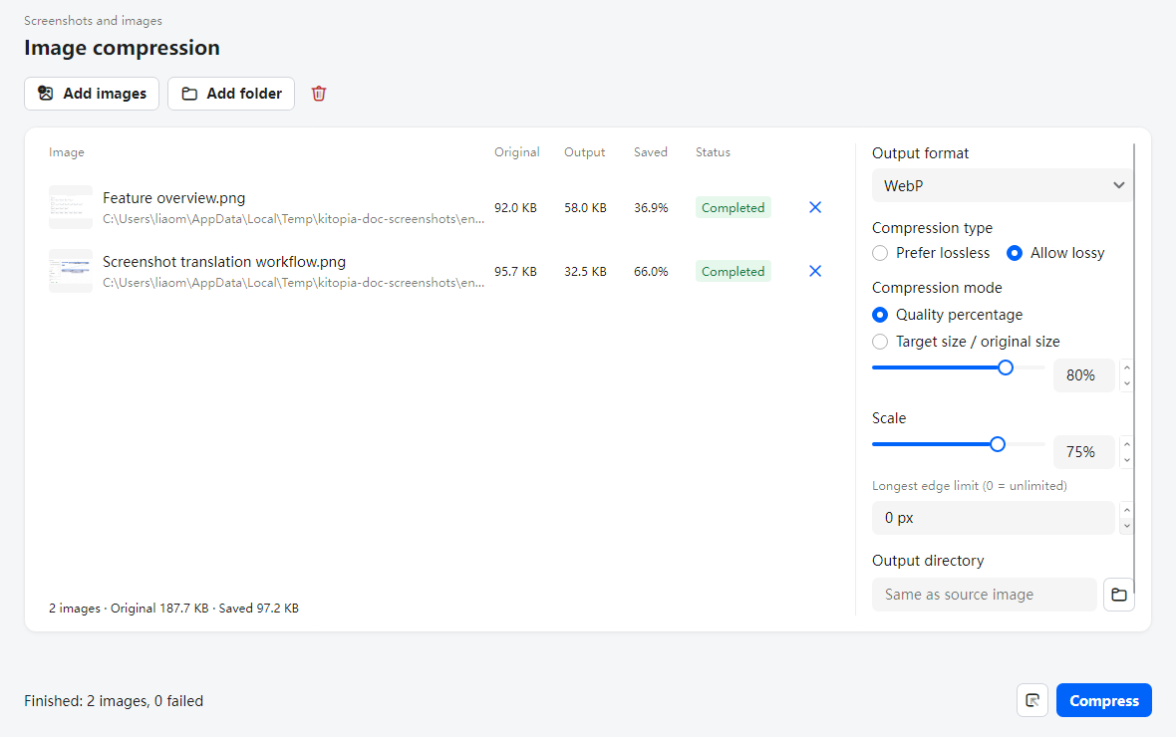
MORE TOOLS
Selection Translation and Image Compression
Selection Translation
Batch Image Compression
Translate selected text with language detection.
Copy results or pin the window while reading.
Export multiple images to WebP and other formats.
Choose quality, lossless mode and resolution.
07 / Kitopia
Notes:
Product screenshots: docs/tools/render. Image material: https://toaru-project.com/railgun_t/chara/mikoto.html

Slide 8
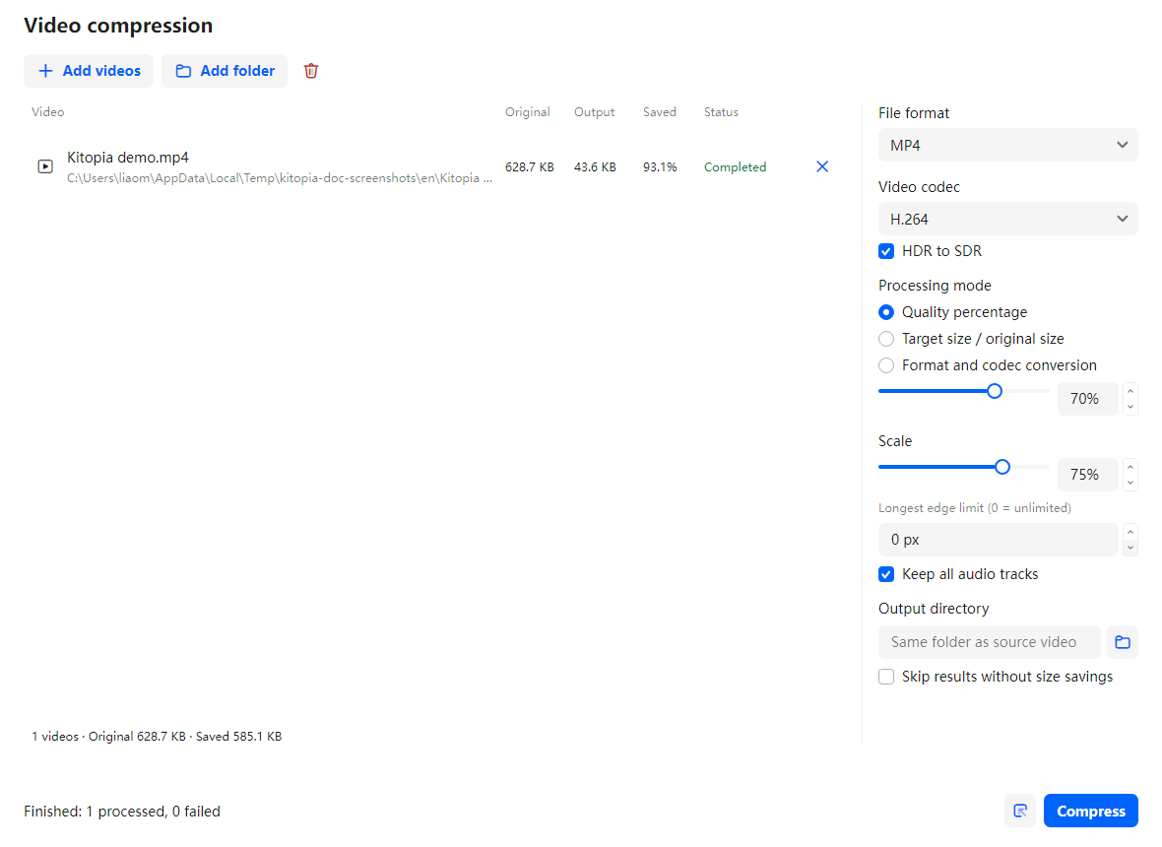
VIDEO COMPRESSION · KitopiaEx
Batch Video Compression and Conversion
Batch Processing
Add videos or folders. View output sizes and status
Formats and Codecs
MP4 / WebM / MKV / MOV, H.264 / HEVC / VP9 / AV1
Quality and Target Size
Compress by quality or a target size ratio
Resolution and Audio
Resize, limit dimensions and retain audio tracks
HDR and Conversion
Convert HDR to SDR or change the container
08 / Kitopia
Notes:
Product screenshots: docs/tools/render. Image material: https://toaru-project.com/railgun_t/chara/mikoto.html

Slide 9
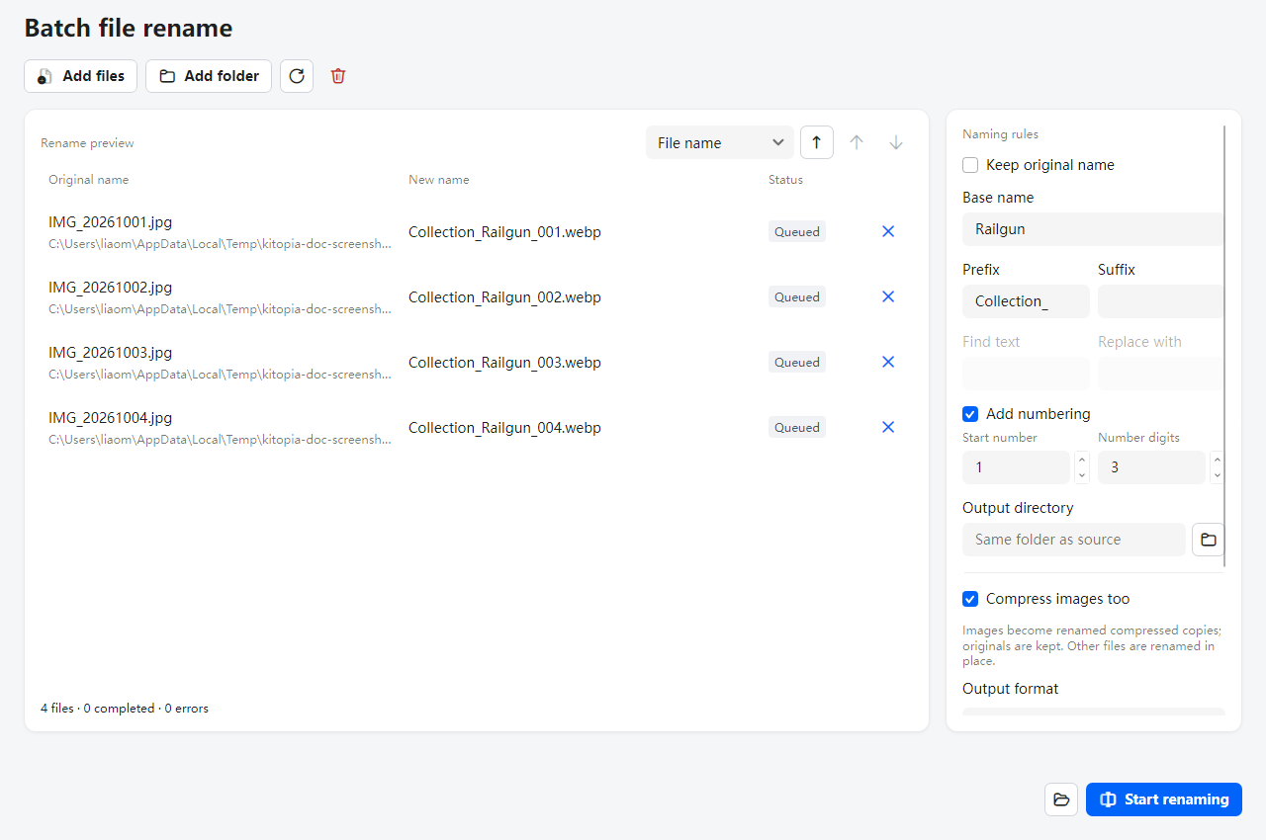
BATCH RENAME · KitopiaEx
Batch File Renaming with a Live Preview
Naming Rules
Set a base name, add a prefix or suffix, or replace text
Sorting and Numbering
Sort files and choose the first number and digit count
Conflict Preview
Compare old and new names. Check conflicts before running
Compressed Image Copies
Export renamed WebP, JPEG or PNG copies. Keep originals
Explorer Integration
Add files or folders, or open from the context menu
09 / Kitopia
Notes:
Feature source: plugins/KitopiaEx/BatchRename/BatchRenameViewModel.cs and BatchRenameWindow.axaml. Screenshots rendered by docs/tools/render using Avalonia Headless and Skia. Compression creates renamed image copies and preserves original images. Other files are renamed or moved.
Product screenshots: docs/tools/render. Image material: https://toaru-project.com/railgun_t/chara/mikoto.html

Slide 10
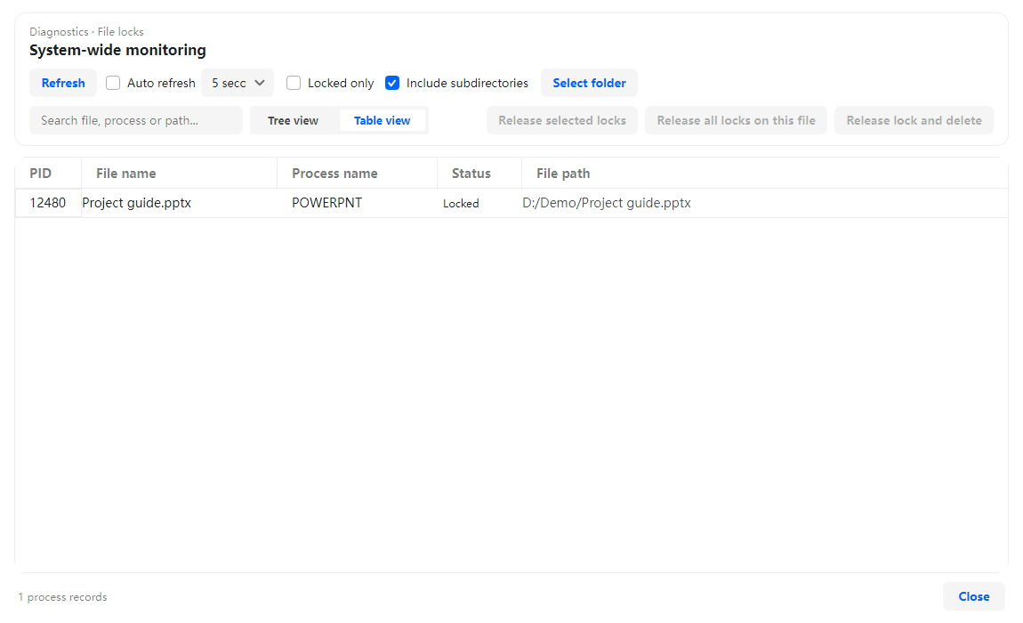
WINDOWS INTEGRATION
Windows File Locks and Always on Top
File Lock Detection
Find processes holding a file, or monitor all locks
Unlock Files
Release selected handles or all handles for a file
End a Process
End a locking process when you need to move a file
Always on Top
Ctrl + Alt + T toggles the active window on top
Explorer Context Menu
Open LAN sharing, compression, renaming and indexing
10 / Kitopia
Notes:
Product screenshots: docs/tools/render. Image material: https://toaru-project.com/railgun_t/chara/mikoto.html

Slide 11
QUICK LOOK
Quick Look: Select a File and Preview It
Explorer Preview
Select a file and press Space to open its preview
In-Search Preview
Preview files next to Alt + Space search results
PDF Reading Tools
Zoom, navigate pages, rotate and search PDFs
Open in the Default App
Choose "Open file" to continue in the default app
Full Screen and File Details
View full screen and check file size and modified time
11 / Kitopia
Notes:
Product screenshots: docs/tools/render. Image material: https://toaru-project.com/railgun_t/chara/mikoto.html

Slide 12
ECOSYSTEM
Plugins and Local AI
P
AI
Local AI
R
Explorer Menu
ONNX: CPU / GPU / OpenVINO
Access tools from file context menus
Plugin Center
Install and manage plugins in one place
Extend tools with the Plugin SDK
Browse ratings, tags and download progress
Notifications
Updates
N
U
View notifications and clear them all
Silent install. Opt into prereleases
C
Themes
EN
Languages
Contribute code or build a plugin
Use system colors or customize
Chinese and English localization
12 / Kitopia

Slide 13
DEVELOPER GUIDE
Plugin Development in Six Steps
</>
1
Create a Library
2
Reference the SDK
Create a .NET class library and configure its project
Use host services for capture, clipboard and notifications
How Plugins Run
Each plugin loads in its own AssemblyLoadContext for isolation and unloading.
The host manages Init, Load and Enable stages.
Plugins can depend on other plugins. See KitopiaEx for an example.
Write manifest.json
Implement IPlugin
3
4
Declare Id, Name, Main and Dependencies
Handle OnEnabled and OnDisabled
5
Register Services
6
Publish a Plugin
Plugin SDK: Kitopia.Desktop.PluginSdk
Expose scenario methods through ServiceCollection
Upload a release for users to install
13 / Kitopia

Slide 14
GET STARTED
Kitopia 1.0.0 Is Available
0.3.7
0.3.8
0.4.0
0.4.1
1.0.0
Plugin and scenario markets
Languages and theme colors
Translation and image compression
Notifications and file transfers
Stable release
1,300+
x64 / ARM64
Avalonia
Download
Commits and ongoing development
Windows installers
Cross-platform .NET UI
GitHub Releases
github.com/Maklith/Kitopia
Star the project, report issues or contribute a PR

