Slide 1
Title: Tanzanian Water Wells Status Prediction Subtitle: Data Analysis & Machine Learning Approach (OKECH MAX)

Slide 2
Introduction
Context: Water access issues in Tanzania and the impact of faulty water pumps • Objective: Diagnose pump status, classify into categories, and inform stakeholders • Importance: Improving public health through proactive maintenance

Slide 3
PROBLEM
Breakdowns
Frequent malfunctions of water pumps lead to severe water access issues
Classification
Classification challenge: – Functional (Fully Operational) – Functional Needs Repair (Partially Functional) – Non Functional (Faulty)
ACTION POINTS
Transforming data into actionable insights

Slide 4
Challenges
Class Imbalance: Fewer malfunctioning pumps relative to fully functional ones • Data Quality: Noisy sensor data and incomplete maintenance logs • Changing Conditions: Environmental factors affecting pump performance over time

Slide 5
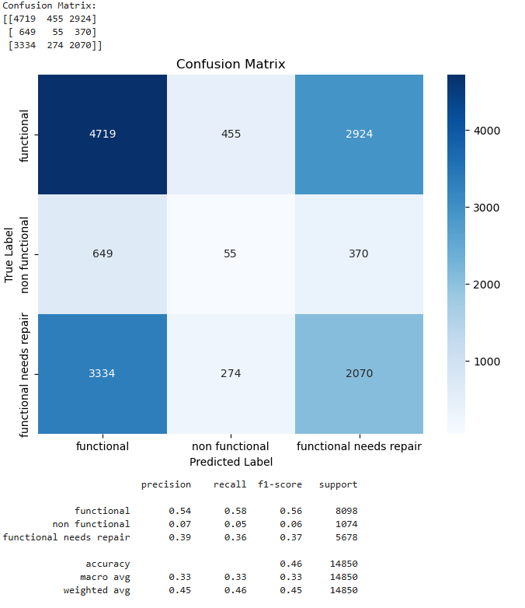

Slide 6
SUMMARY
Our model could predict 54% of the occurences in the functional class, and 39% of the functional needs repair class. It, however, could only predict 7% of the non-functional class.For the functional and functional-needs-repair classes f1-scores of 0.58 and 0.37 reflects a poor performance by the model. For the non-functional class ,moreover, a f1-score of 0.06 indicates that both precision and recall are low for this class. The actual number of occurences "support" for the non-functional class is very small compared to the other classes. The model generally had a poor score only being able to predict less than 10% of the non-functional class and barely 60% for the functional class which was the best performing class. A low number of samples is most likely the reason for the poor precision, recall and f1 score

