Slide 1
CS 230 Game Implementation Techniques
Week 6 Lecture
Instructor
Doug Schilling
dschilling@digipen.edu
x5066
Office Hours
Mon 12:00pm – 1:00pm, Wed 10:30am – 11:20am, or by appointment at digipen.as.me/dschilling
Project 4 – Spaceship
Spaceship Behavior

Slide 2
Project 4 - Spaceship
Implementation Suggestions

Slide 3
What are the four objectives?
Implement an Entity “container”
Implement a simple mesh “library”
Implement cloning of Entities
Implement two unique behaviors

Slide 4
Implementation: EntityContainer
Module to manage lists of Entities
Active Entities
Updates Animation, Behavior, and Physics components
The order of these operations does matter
Hint: The order shown above is correct
Renders Sprite components
Archetype Entities
Used for cloning new Entities
Bullets in Project 4
Asteroids in Project 5

Slide 5
Implementation: MeshLibrary
Module to manage a list of Meshes
Initialization
Set all variables to 0 (Hint: consider using memset)
Build
Build a mesh using data read from a file (AKA “deserialization”)
Add
Consider adding meshes to the list using a private function
“Give one entity one cohesive responsibility”
FreeAll
Free all meshes
Remember: Fire-and-forget!

Slide 6
Implementation: Cloning
New functions:
AnimationClone()
BehaviorClone() – new component
PhysicsClone()
SpriteClone()
TransformClone()
EntityClone()

Slide 7
Implementation: Cloning
The ‘Clone’ functions follow the same pattern:
If the “other” pointer is valid
Allocate memory for the clone structure (hint: use calloc)
If memory allocation was successful,
Perform shallow- or deep-copy, as appropriate
Return the resultant pointer (may be NULL)
Warnings!
EntityClone() requires a deep-copy
Use the EntityAdd functions to add cloned components to the cloned Entity
Animation and Behavior must have the correct parent Entity

Slide 8
Implementation: Cloning
Shallow Copy
How to copy the contents of one structure to another?
typedef struct
{
int x;
int y;
} MyStruct;
MyStruct a = { 1, 2 };
MyStruct b = { 0 };
// Copy the contents of A into B?
// Method A?
b.x = a.x;
b.y = a.y;
// Method B?
b = a;

Slide 9
Implementation: Cloning
Shallow Copy
Which method is better?
typedef struct
{
int x;
int y;
} MyStruct;
MyStruct a = { 1, 2 };
MyStruct b = { 0 };
// Copy the contents of A into B?
// Method A?
b.x = a.x;
b.y = a.y;
// Method B?
b = a;

Slide 10
Implementation: Cloning
Shallow Copy
Now, which method is better?
typedef struct
{
int x;
int y;
int z;
} MyStruct;
MyStruct a = { 1, 2, 3 };
MyStruct b = { 0 };
// Copy the contents of A into B?
// Method A?
b.x = a.x;
b.y = a.y;
// Method B?
b = a;

Slide 11
Implementation: Behaviors
Two unique behaviors:
Spaceship
Acceleration
Turning
Firing (spawn bullets)
Bullets
Life timer

Slide 12
Implementation: Behaviors
Refer to the Week 6 (Behaviors) lecture slides
However, inheritance will not be used in Project 4
Pro: Reduces complexity and risk
Con: Behaviors cannot have unique variables
Instead, the two behaviors will share a single variable:
// Generic timer - may be used as a life timer or a weapon cooldown timer.
// (Default = 0, means infinite amount of time remaining or weapon can be fired.)
float timer;

Slide 13
Questions?

Slide 14
Spaceship Behavior

Slide 15
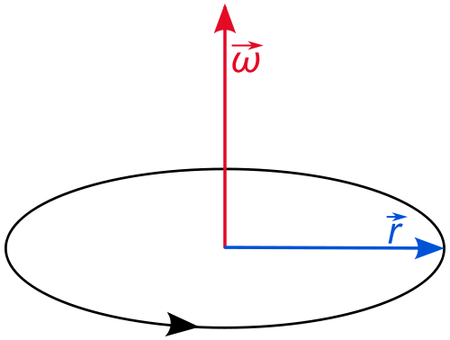
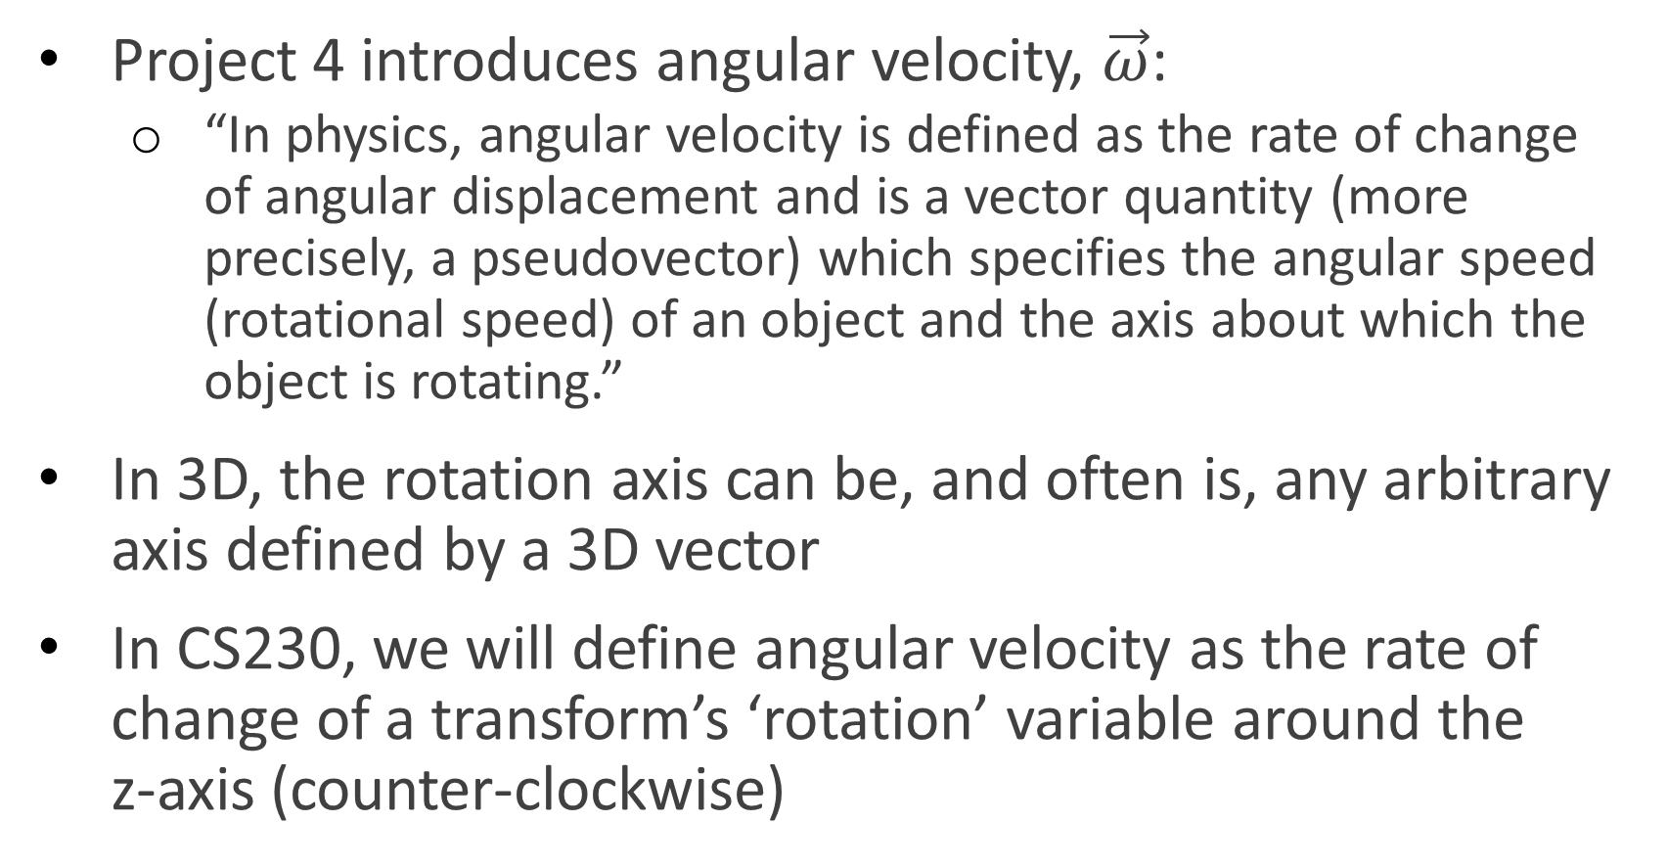
Ship’s Rotation
Project 4 introduces angular velocity, $\vec{ω}$:
“In physics, angular velocity is defined as the rate of change of angular displacement and is a vector quantity (more precisely, a pseudovector) which specifies the angular speed (rotational speed) of an object and the axis about which the object is rotating.”
In 3D, the rotation axis can be, and often is, any arbitrary axis defined by a 3D vector
In CS230, we will define angular velocity as the rate of change of a transform’s ‘rotation’ variable around the z-axis (counter-clockwise)

Slide 16
Ship’s Rotation
If the ‘left’ button is pressed,
Rotational velocity is set to spaceshipTurnRateMax
Else if the ‘right’ button is pressed,
Rotational velocity is set to -spaceshipTurnRateMax
Else
Rotational velocity is set to 0

Slide 17
Ship’s Acceleration/Deceleration
Bullets and asteroids have fixed velocities
Velocities are set at creation time
The ship has a variable velocity
Forward and reverse thruster controlled by user input

Slide 18
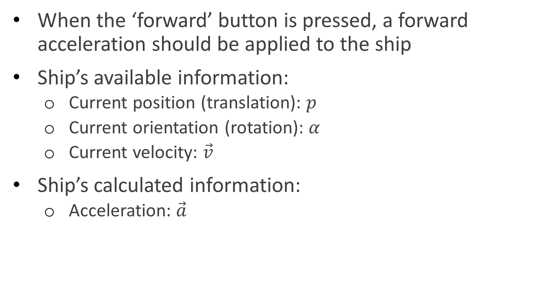
Ship’s Acceleration
When the ‘forward’ button is pressed, a forward acceleration should be applied to the ship
Ship’s available information:
Current position (translation): $p$
Current orientation (rotation): $α$
Current velocity: $\vec{v}$
Ship’s calculated information:
Acceleration: $\vec{a}$

Slide 19
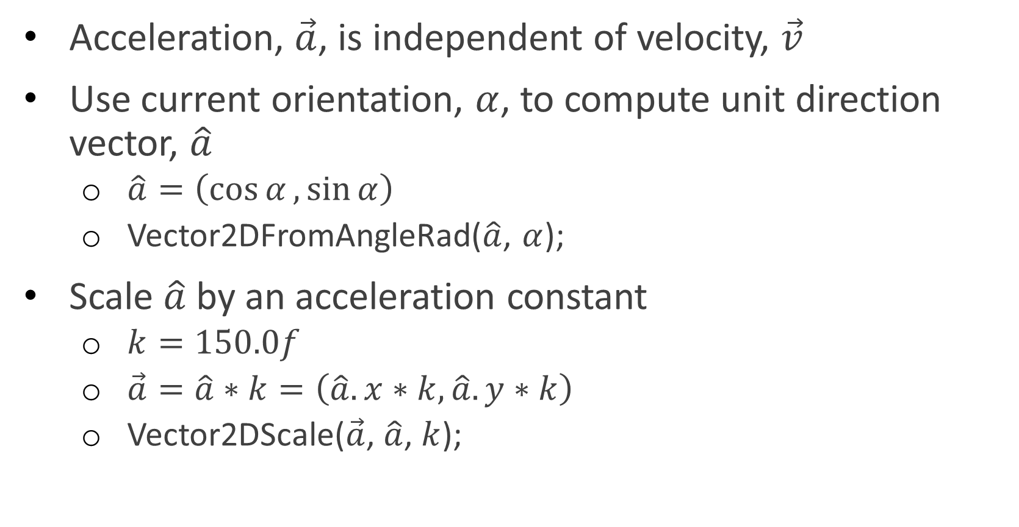
Ship’s Acceleration
Acceleration, $\vec{a}$, is independent of velocity, $\vec{v}$
Use current orientation, $α$, to compute unit direction vector, $\hat{a}$
$\hat{a}=\left(\cos{α},\sin{α}\right)$
Vector2DFromAngleRad($\hat{a}$, $α$);
Scale $\hat{a}$ by an acceleration constant
$k=150.0f$
$\vec{a}=\hat{a}∗k=\left(\hat{a}.x∗k,\hat{a}.y∗k\right)$
Vector2DScale($\vec{a}$, $\hat{a}$, $k$);

Slide 20
Ship’s Acceleration
Assuming the ship is initially not moving

Slide 21
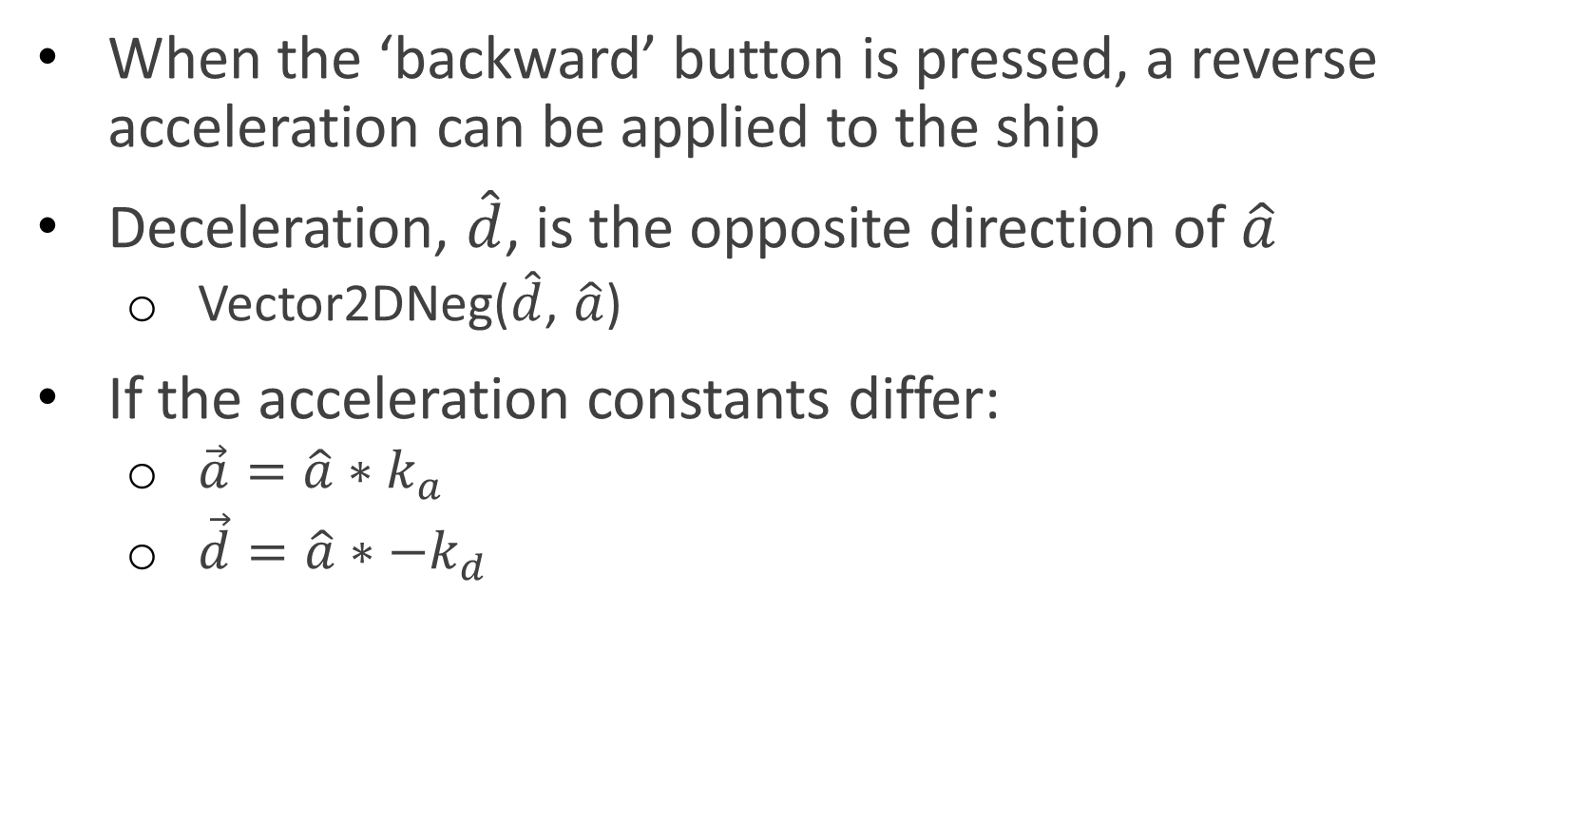
Ship’s Deceleration
When the ‘backward’ button is pressed, a reverse acceleration can be applied to the ship
Deceleration, $\hat{d}$, is the opposite direction of $\hat{a}$
Vector2DNeg($\hat{d}$, $\hat{a}$)
If the acceleration constants differ:
$\vec{a}=\hat{a}∗k_{a}$
$\vec{d}=\hat{a}∗−k_{d}$

Slide 22
Ship’s Velocity Cap
Project 4 introduces one method for limiting velocity
Set a maximum velocity magnitude
Every time a new velocity is computed, compare its magnitude to the maximum
Greater? Set it to the maximum
This works but feels unrealistic
Maximum velocity is reached quickly
Maximum velocity is not reached smoothly

Slide 23
Ship’s Velocity Cap
Fixed velocity cap

Slide 24
Ship’s Velocity Cap
In reality, maximum velocity is reached due to friction
Friction is a force
Accelerations are derived from forces
Velocities are derived from accelerations
Conclusion: Velocities are affected by friction!
Friction allows objects to smoothly reach their maximum velocities

Slide 25
Ship’s Velocity Cap
Velocity Cap Using Friction

Slide 26
Ship’s Velocity Cap
In CS230, we are not using forces
Accelerations and velocities are assigned directly
This means that we can’t apply friction
However, friction can be emulated
Project 5 introduces an optional method for limiting velocity

Slide 27
Ship’s Velocity Cap
Recall “PhysicsUpdate” from Week 2 (Dynamics) lecture
void PhysicsUpdate(Physics* physics, Transform* transform, float dt)
{
// Validate the pointers.
// Get translation from the transform component
// Set oldTranslation = translation
// Set velocity += acceleration * dt
// Set translation += velocity * dt
// Set translation on the transform component
}

Slide 28
Ship’s Velocity Cap
New Step:
Isn’t that just reducing the velocity by 1%?
void PhysicsUpdate(Physics* physics, Transform* transform, float dt)
{
// Validate the pointers.
// Get translation from the transform component
// Set oldTranslation = translation
// Set velocity += acceleration * dt
// Set velocity = velocity * 0.99f
// Set translation += velocity * dt
// Set translation on the transform component
}

Slide 29
Ship’s Velocity Cap
dt = 1 | Frame 1 |  |  | Frame 2 |  |  | Frame 3
 | Original | *0.99 |  | Original | *0.99 |  | Original | *0.99
Given: currPos | (0;0) | (0;0) |  | (2;3) | (1.98;2.97) |  | (6;9) | (5.92;8.88)
Given: currVel | (0;0) | (0;0) |  | (2;3) | (1.98;2.97) |  | (4;6) | (3.94;5.91)
Given: a | (2;3) | (2;3) |  | (2;3) | (2;3) |  | (2;3) | (2;3)
Computed: newVel | (2;3) | (1.98;2.97) |  | (4;6) | (3.94;5.91) |  | (6;9) | (5.88;8.82)
Computed: newPos | (2;3) | (1.98;2.97) 99% of the original value |  | (6;9) | (5.92;8.88) 98.6% of the original value |  | (12;18) | (11.8; 17.7) 98.3% of the original value

Slide 30
Ship’s Velocity Cap
Every frame, the velocity is reduced by a greater %
Feels realistic
Maximum velocity is reached smoothly

Slide 31
Questions?

Slide 32
Creating Bullets
For simplicity, bullets will be created at the same location of the ship
Which means the ship’s current position is needed
Bullets are not accelerated
They have a constant velocity
That velocity has a predefined magnitude
Similar to the ship’s predefined acceleration magnitude
Problem: Computing the direction of the bullet’s velocity

Slide 33
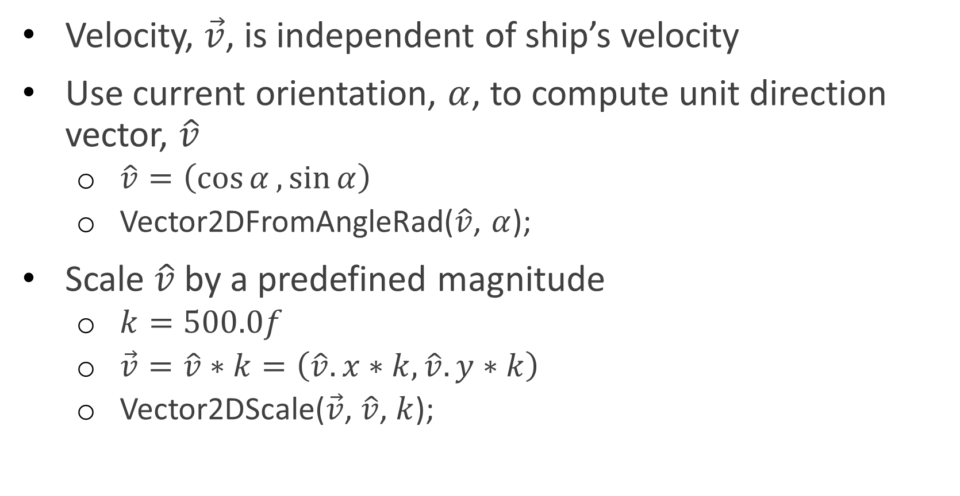
Creating Bullets
Velocity, $\vec{v}$, is independent of ship’s velocity
Use current orientation, $α$, to compute unit direction vector, $\hat{v}$
$\hat{v}=\left(\cos{α},\sin{α}\right)$
Vector2DFromAngleRad($\hat{v}$, $α$);
Scale $\hat{v}$ by a predefined magnitude
$k=500.0f$
$\vec{v}=\hat{v}∗k=\left(\hat{v}.x∗k,\hat{v}.y∗k\right)$
Vector2DScale($\vec{v}$, $\hat{v}$, $k$);

Slide 34
Spawning Bullets
// Get a cloned bullet from the Entity Factory.
Entity* bullet = EntityFactoryBuild("Bullet");
// Check for a valid archetype pointer.
if (bullet)
{
// Get the spaceship's position and rotation.
// Set the bullet's position and rotation.
// Set the bullet's velocity.
// Add the cloned entity to the active scene.
SceneAddEntity(clone);
}

Slide 35
EntityFactoryBuild
There are 3 distinct steps!
// Search for the specified entity in the archetype list.
// If the archetype does not yet exist.
// Construct the file pathname (“Data/%s.txt”) using the entity name.
// Open the file for streaming.
// If the file was opened successfully.
// Read the first token
// If the first token is “Entity”
// Create a new Entity.
// Read the contents of the entity from the data file.
// Add the new entity to the archetype list.
// Close the stream.
// If the archetype exists (either already existing or newly created).
// Clone the archetype.
// Return the pointer to the cloned entity.

Slide 36
Questions?

Slide 37
References
Angular Velocity
https://en.wikipedia.org/wiki/Angular_velocity
Psuedovector
https://en.wikipedia.org/wiki/Pseudovector

