Slide 1
CS 230 Game Implementation Techniques
Week 2 Lecture
Instructor
Doug Schilling
dschilling@digipen.edu
x5066
Office Hours
Mon 12:00pm – 1:00pm, Wed 10:30am – 11:20am, or by appointment at digipen.as.me/dschilling
Project 2

Slide 2
Project 2
Implementation Suggestions

Slide 3

Step 0
Unzip the Project 2 materials into a clean folder
Copy “Source” (.c and .h) files from Project 1
Do not overwrite any Project 2 files
Add and commit the files to version control
SVN or GIT recommended
Do this before opening the project in Visual Studio

Slide 4
Step 1
Integrate code from Project 1 into Project 2
Create new .c modules and add stub functions
Include comments from the header file or you may miss important requirements (see “NOTES” and “HINTS”)
Add temporary return values and unreferenced parameter macros as necessary to compile the code
Writing new code while you are unable to compile and test can be very unproductive
Add and commit the files to version control
Hint: Right-click on “Source” and click “TortoiseSVN/Add”

Slide 5
Step 2
Mesh.c
Implement MeshCreate
Test to make sure the memory is allocated correctly
Implement MeshFree
Test to make sure the memory is freed correctly
Implement MeshBuildQuad
Use a sample from DemoScene.c as a starting point
Implement MeshRender
Test to see if a colored mesh is displayed correctly on screen
You will need to add test code to Level1SceneUpdate
NOTE: Implement MeshCreateSpaceship during Step 11

Slide 6
Step 3
Transform.c
Implement the Create function
Test to make sure that the object is constructed properly
Implement the Free function
Test to make sure that the object is freed properly
Test to make sure that the original pointer is set to NULL
Implement the Get and Set functions
Test to make sure that values are written and read properly

Slide 7
Step 4
Sprite.c
Implement the Create function
Test to make sure that the object is constructed properly
Implement the Free function
Test to make sure that the object is freed properly
Test to make sure that the original pointer is set to NULL
Implement the SetMesh function
Implement the Render function to draw a colored mesh
Use the MeshRender function for this purpose
Modify the test code in Level 1 to call SpriteRender
Verify that a colored mesh is displayed

Slide 8
Step 5
SpriteSource.c
Implement the Create, Free, LoadTexture, SetTexture, and SetTextureOffset functions
Test to make sure the object is constructed and freed properly
Add function calls to Level 1 and Sprite.c
Sprite.c
Modify the Render function to also handle textures
Verify that a textured mesh is displayed
Temporarily disable the SetSpriteSource function call and verify that colored meshes are still displayed properly

Slide 9
Step 6
SpriteSource.c
Implement the GetFrameCount and GetUV functions
Sprite.c
Implement the SetFrame function
Make sure to write the trace message
Temporarily add a SetFrame function call to Level 1
Currently, the only valid value for frameIndex should be 0
Try testing with values of 1 and -1 to see what will happen
Verify that this new trace message is written to the log file
This trace message will become more useful in Project 3

Slide 10
Step 7
Physics.c
Implement the Create function
Test to make sure that the object is constructed properly
Implement the Free function
Test to make sure that the object is freed properly
Test to make sure that the original pointer is set to NULL
Implement the Get and Set functions
Test to make sure that values are written and read properly
Implement the Update function
Update the test code to move an object using velocity

Slide 11
Step 8
Entity.c
Implement the Create function
Test to make sure that the entity is constructed properly
Implement the Add and Get functions
Test to make sure that components are added and returned properly
Implement the Free function
Test to make sure that every attached component is freed properly
Test to make sure that the entity is freed properly
Test to make sure that the original pointer is set to NULL
Implement the Update and Render functions

Slide 12
Step 9
EntityFactory.c
Implement the Build function
Stream.c
Implement the new Read functions
Entity.c, Transform.c, Sprite.c, Physics.c
Implement the Read functions
Hint: Implement them in the order they appear in the data file
Using the debugger, step through each Read function, making sure that each object is created and assigned data correctly

Slide 13
Step 10
Level1Scene.c
Follow the detailed instructions
Verify that the planet moves and lands correctly
Verify that the game advances to Level2 when the planet “lands” for the third time
Verify that the ‘1’ key restarts Level1
Verify that the ‘2’ key advances to Level2
Verify that the ‘9’ key advances to Sandbox
Verify that the ‘0’ key advances to Demo
Verify that <ESCAPE> exits the game

Slide 14
Step 11
Level2Scene.c
Follow the detailed instructions
Verify that the spaceship moves and orients correctly
Verify that the spaceship alpha changes correctly
Verify that the ‘1’ key advances to Level1
Verify that the ‘2’ key restarts Level2
Verify that the ‘9’ key advances to Sandbox
Verify that the ‘0’ key advances to Demo
Verify that <ESCAPE> exits the game

Slide 15
Step 12
DemoScene.c
Follow the detailed instructions
Verify that the input controls work correctly
Verify that the ‘1’ key advances to Level1
Verify that the ‘2’ key advances to Level2
Verify that the ‘9’ key advances to Sandbox
Verify that the ‘0’ key restarts Demo
Verify that <ESCAPE> exits the game

Slide 16

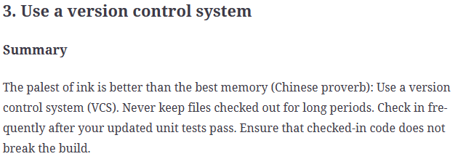
Step 13
Commit all changes to version control
This goes without saying but, unfortunately, still needs to be said…
…Seriously, use version control!

Slide 17
Step 14
Reread all the instructions
Check off every step that has been completed and verified
Missed steps are a common source of errors
Check your submission using the recommended steps
An extra 3 minutes can help avoid a -25% penalty

Slide 18
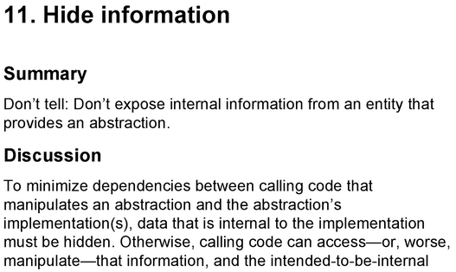
One last point…
Project 2 requirements state:
“The contents of the <module name> structure may not be accessed directly anywhere outside of <module name.c>. The public interface provides everything necessary for this project.”

Slide 19
Questions?

